Slide 1

GBrowse: Generic Genome Browser
May 2005 Update
Lincoln Stein, CSHL

Slide 2
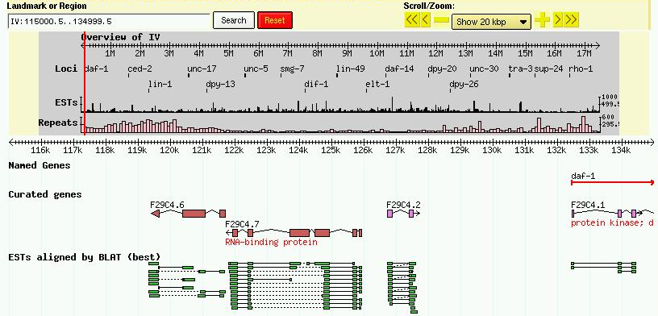
GBrowse

Slide 3
Recent Improvements
Order of sections reorganized
Group tracks by category
Expand/contract categories
Place plugins in menubar
Internal changes
  Libraries refactored; easier to manage plugins, upload tracks, DAS tracks, improved Chado interface, GFF3 loading

Slide 4
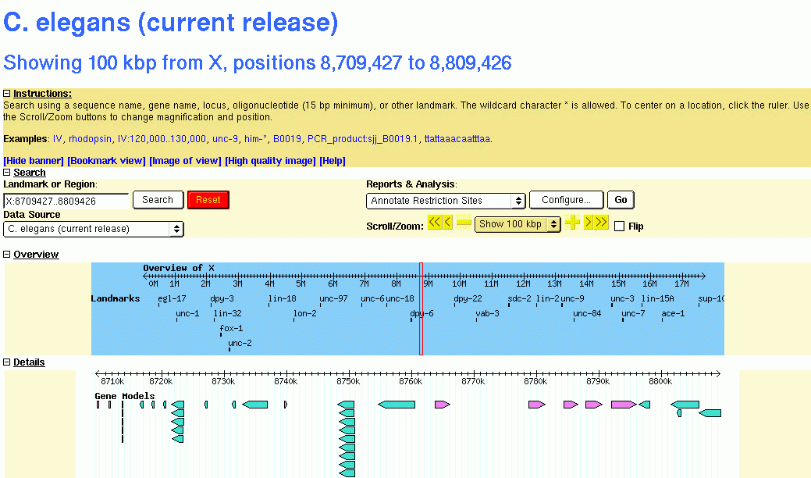
Collapsible Sections

Slide 5
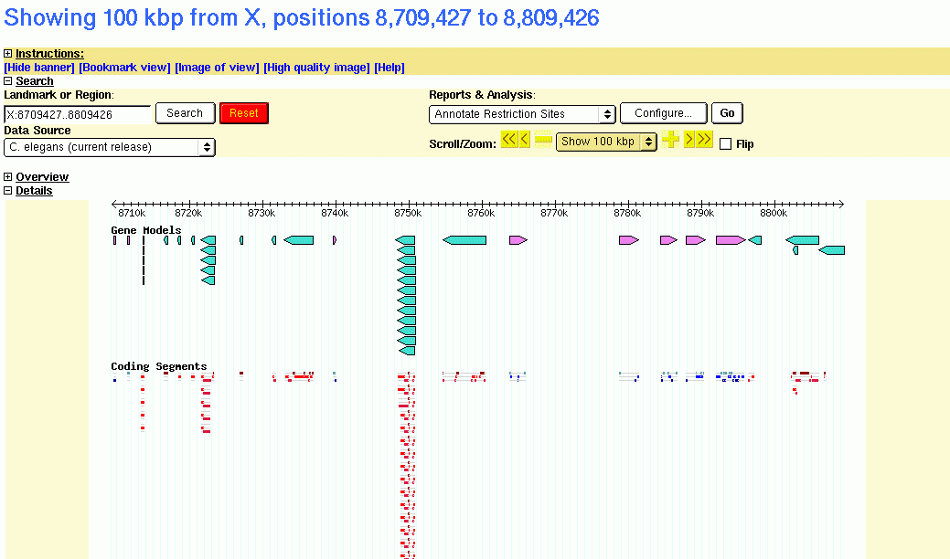
Collapsible Sections

Slide 6
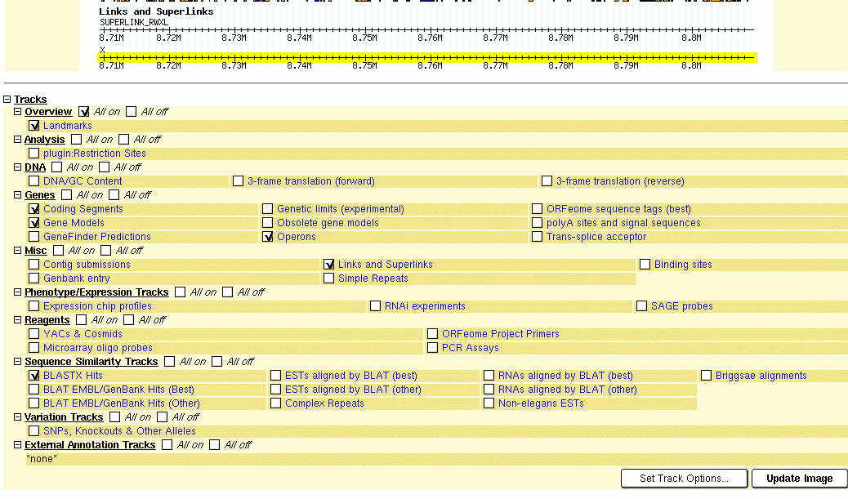
Groupable Tracks

Slide 7

Groupable Tracks

Slide 8
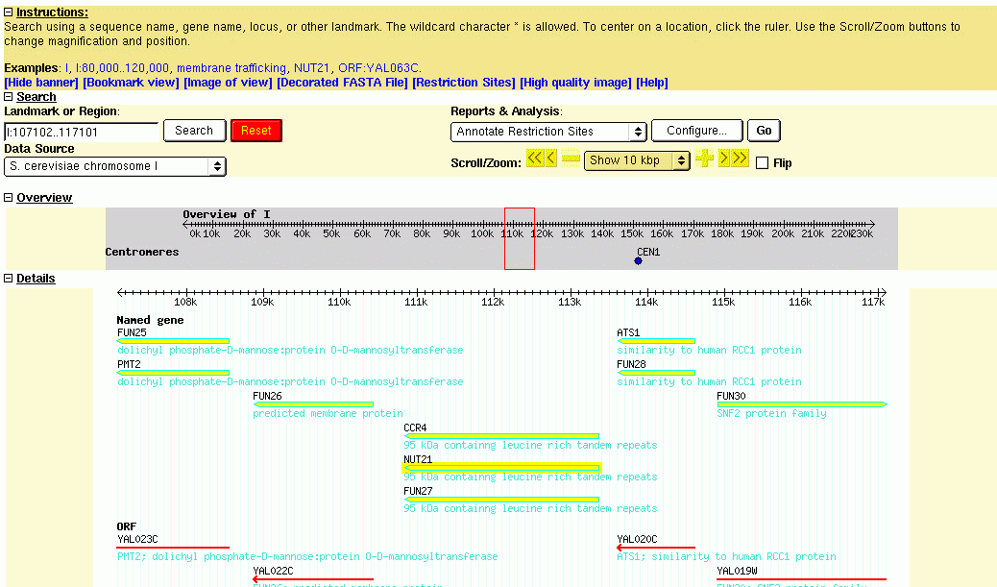
Menuable Plugins

Slide 9
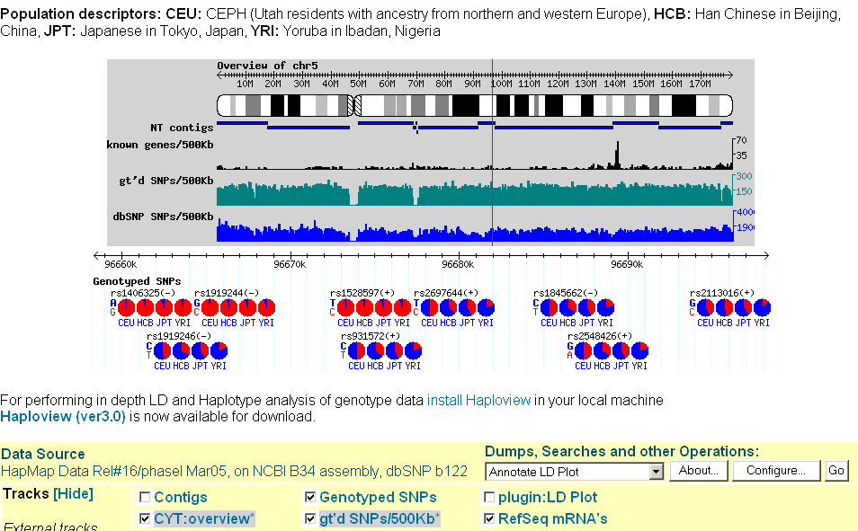
More Glyphs

Slide 10
Coming soon
BerkeleyDB backend
Allen Day’s template system
Unit tests

Slide 11
CVS Issues
Template version on CVS HEAD
  Basic functionality working
  Many advanced features not working
Bug fixes on 1.62-bugfixes branch
  Recommended for end users
  Will become 1.63 RSN

Slide 12

Credits
CSHL
Scott Cain
Simon Ilyuschenko
Lalitha Krishnan
Elsewhere
Marc Colisimo
Marc Logghe
UCLA
Allen Day
http://www.gmod.org

