Slide 1

Comparative Genome Annotation of Drosophila pseudoobscura and Its Implementation in chado

Slide 2
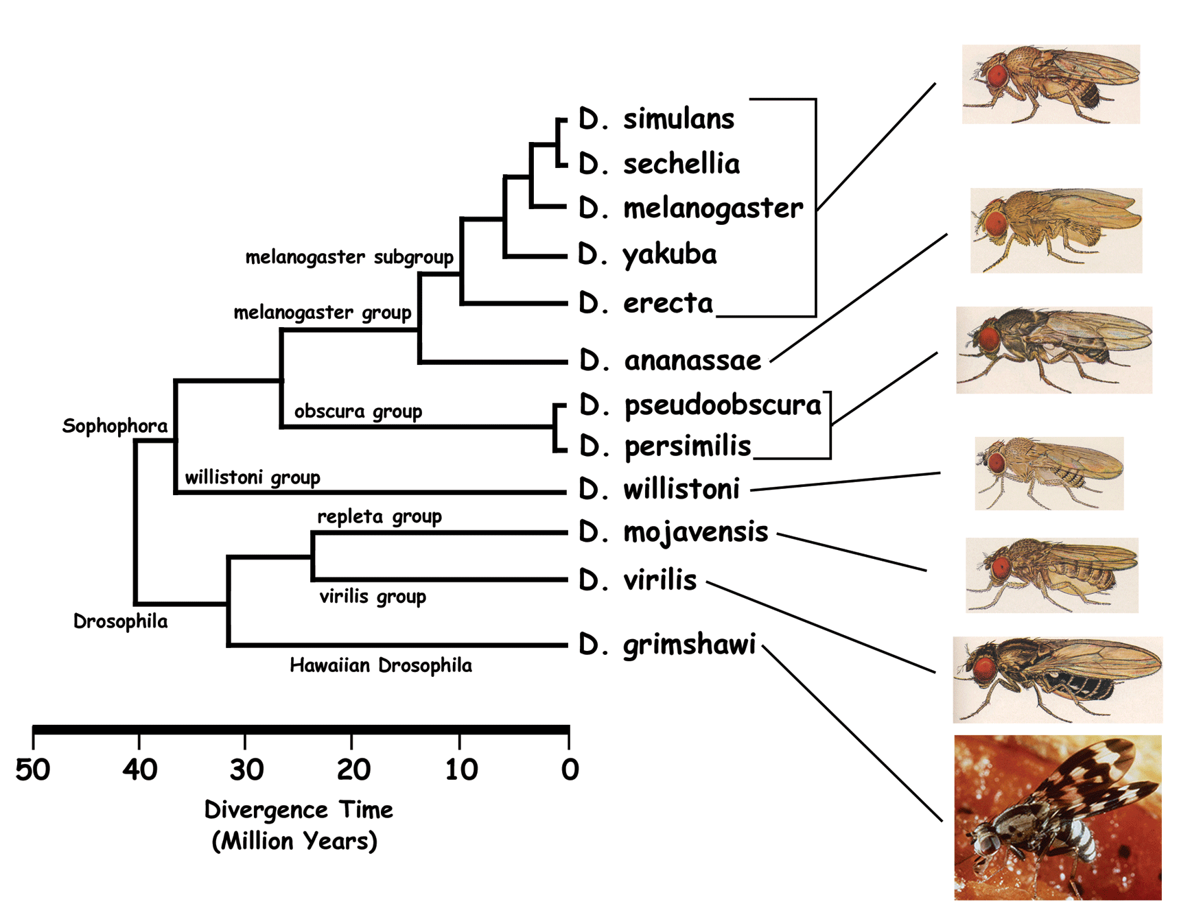
Drosophila phylogeny:

Slide 3
Annotation Methodology:
Driven by orthology to Drosophila melanogaster (Dmel) genome (over 13000 annotated genes with 19000 protein isoforms)
Focused on protein-coding genes
TBLASTN: query: 13659 Dmel proteins subject: 8242 D. pseudoobscura (Dpse) WGS contigs
Synteny, arm-ness conservation of fly genes
obtained genomic locations of 12179 putative orthologs to Dmel genes.

Slide 4
Annotation Methodology (continued):
Gene predictions: Genscan, Twinscan, Genewise (totally 53691 predictions)
Gene predictions filtering: reciprocal best blastp hits (10515 predictions selected)
Looking for overlap between predictions and TBLASTN ortholog calls, 9946 significantly overlapped predictions were promoted to be gene model annotations.

Slide 5
Annotation Methodology (continued):
Mapping of Dpse genes FlyBase Curated from literature:
~500 FlyBase curated Dpse genes
134 one most representative GenBank accession
122 unambiguous hits against Dpse WGS contigs
96 merged with TBLASTN ortholog calls
18 imported into Dpse annotation set as genetic loci on the genome.

Slide 6
Evidence data for Dpse annotation:
BLASTZ HSPs between Dmel and Dpse: 34,576
Gene predictions
Dpse EST alignments: 34,611 ESTs

Slide 7
Implementation of Comparative Data in Chado:
Data objects:
Orthologous Regions
Genes
Gene Models
Syntenic Regions
BLASTZ HSPs

Slide 8
Orthology Relationship
putative_ortholog_of
Dpse
Dmel
partof
producedby
Gene
RNA
Protein
feature_relationship (subj->obj)

Slide 9
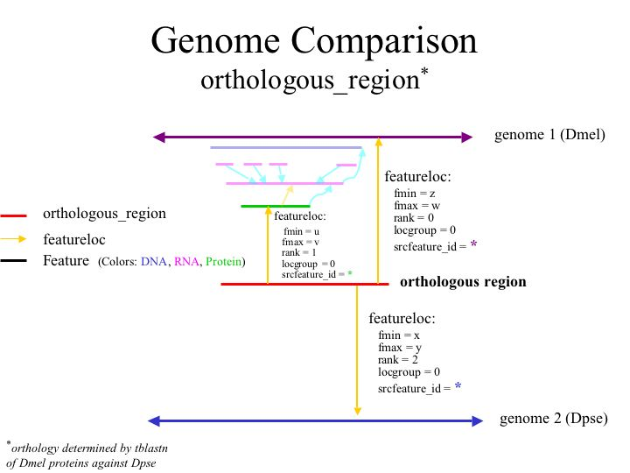

Slide 10
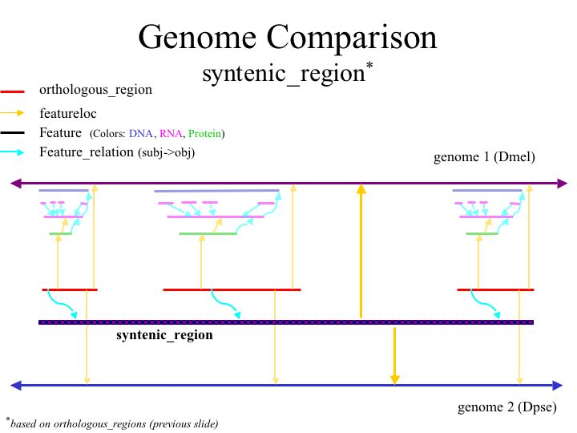

Slide 11
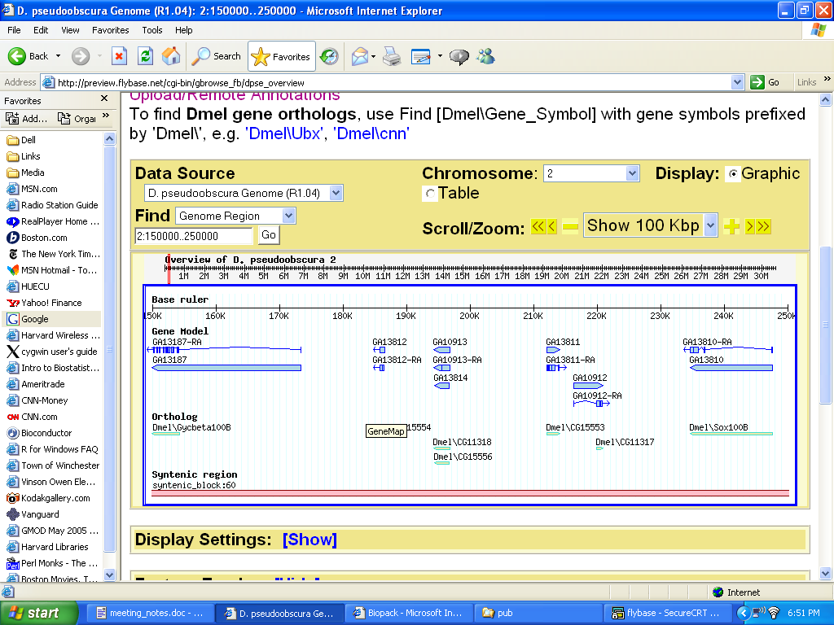

Slide 12
Acknowledgement
FlyBase Baylor College of Medicine
Bill Gelbart Stephen Richards
Brian Bettencourt Yue Liu
Pavel Hradecky Kim Worley
Stan Letovsky Rui Chen
David Emmert George Weinstock
Everyone at FlyBase Richard Gibbs

