Slide 1

Functional genomics data collection, integration, visualization project
Collects functional genomics (microarray, interaction, localization, etc) data
Integrates the data
Provides access to the original data collected and the integrated data via user friendly web tools and convenient bulk download

Slide 2
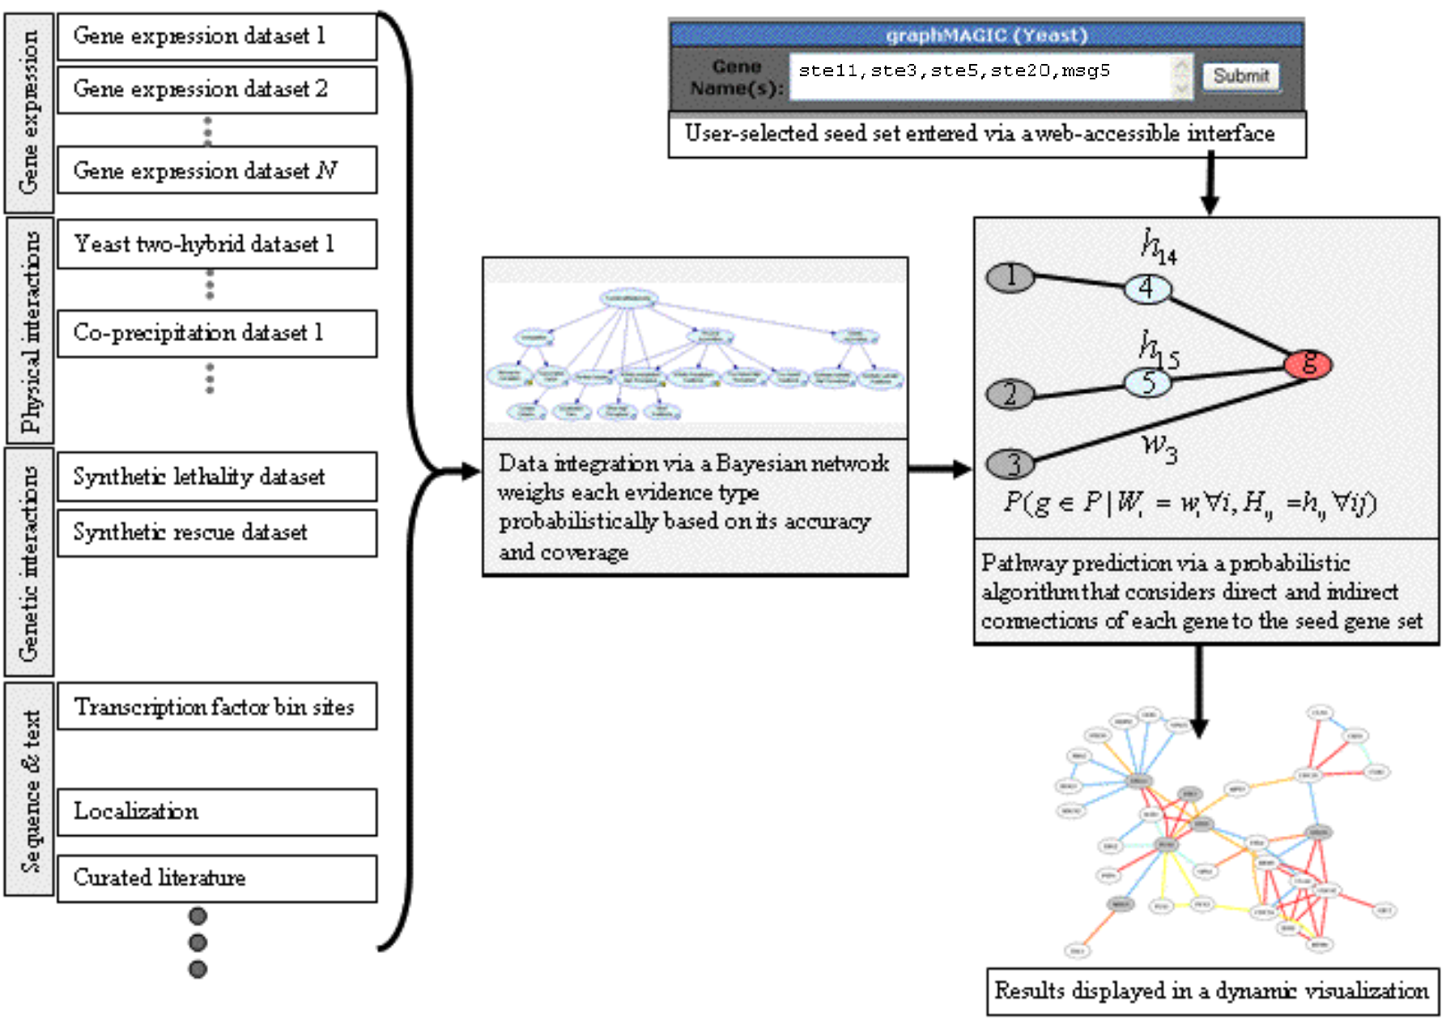
A data integration and network discovery system
Olga Troyanskaya’s lab:
Chad Meyers, Adam Wible, Drew Robson

Slide 3
Demo http://function.princeton.edu/magic/

Slide 4
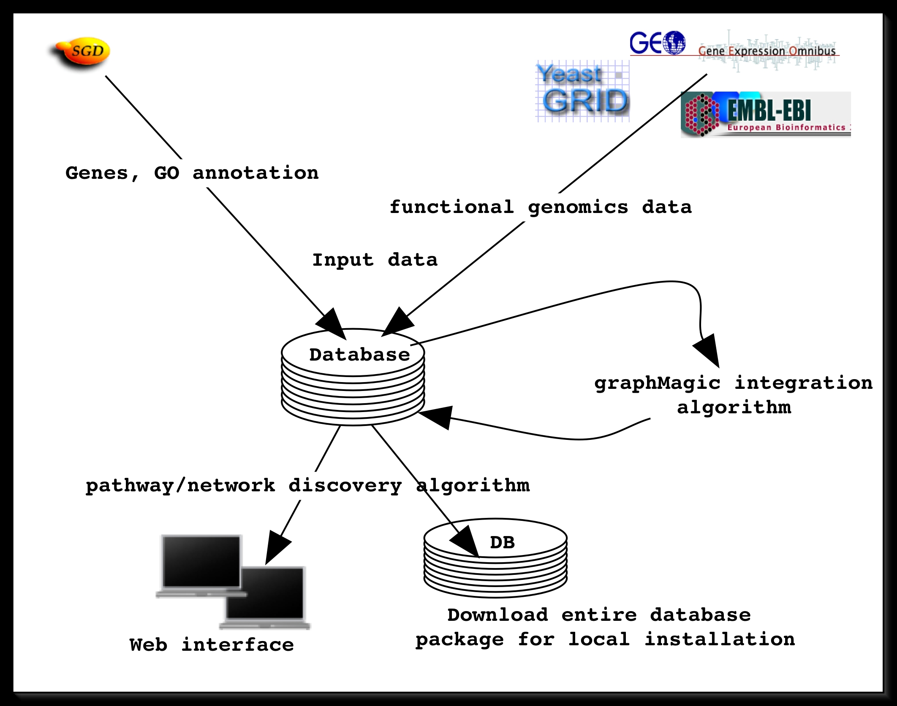

System components

Slide 5
Building the system around the GMOD database package
Write code to load functional genomics data and associated info
  Have curator tool (perl CGI, makes use of MAGE-stk and chado modules) that loads experimental design information (but not actual data yet)
Design a new schema module to store new types of data
  Have working draft
Design and implement software for our specific web tools
  Have php version working off the database

Slide 6
Next steps
Load actual genomics data, via command line and curator tool
Clean up draft schema module, better integrate it with rest of database, send it around to gmod-schema
Go over code for web interface

Slide 7
SGD @ Princeton:
Reazur Rahman
Rose Oughtred
Fan Kang
John Wiggins
Mark Schroeder
Kara Dolinski
David Botstein
Troyanskaya lab:
Adam Wible
Drew Robson
Chad Meyers
Olga Troyanskaya

