Slide 1
Ontology-oriented databases: Chado and OBD
Chris Mungall
Lawrence Berkeley Labs

Slide 2
Outline
Chado
  GMOD & Model Organism Databases
  Genomics data in Chado using SO
OBD
  NCBO & OBD Requirements
  RDF and the semantic web
  SPARQL endpoints

Slide 3
Chado: what is it?
A relational database schema for biological data
Part of the Generic Model Organism Database (GMOD) project
  http://www.gmod.org
  Interoperable tools for Model Organism Databases
Chado was originally built for MODs

Slide 4
A brief introduction to MODs
Some Model Organism Databases:
  FlyBase (D melanogaster)
  WormBase (C elegans)
  MGD (M musculus)
  …
What does a MOD organisation do?
  Curate and integrate data on a specific species or taxon
  Provide a web portal for the community
What are the database requirements for a MOD?

Slide 5
Must store representations of genes and genomic entities
  Sequence data
  Exon-intron structure
  Noncoding genes
  Curated and computed features
  Entities with unusual transcriptional properties
  And more…

Slide 6
Must store other data types pertinent to that organism
Including, but not limited to:
  Expression
  Interaction
  Genetic and phenotypic
Priorities amongst MODs differ
  Different MOs have different biological and experimental characteristics
  E.g. D melanogaster and genetics

Slide 7
Must house rich annotation data using ontologies
GO (Gene Ontology); Anatomical Ontologies; Phenotype Ontologies

Slide 8
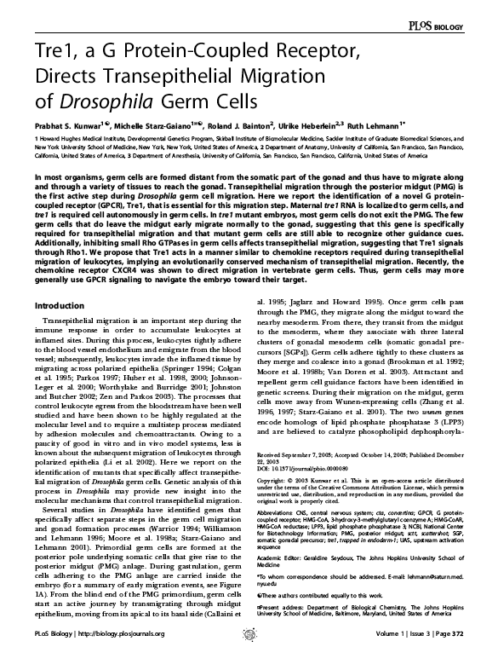
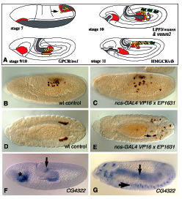
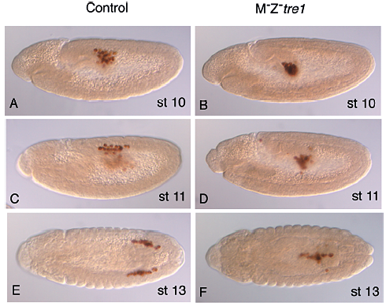
Must track provenance and evidence for data
MOD data is often curated from the literature
Other sources
  Computes
  High throughput data
  Imaging

Slide 9
Must be an integrated source of data
Must drive Web Portal
  http://www.flybase.org
  http://www.wormbase.org
  http://www.yeastgenome.org
Links out to external resources
  GO, Ensembl, UniProt, …
  Substantial amount of records managed locally in single integrated database

Slide 10
Origins of Chado
Chado was originally developed for FlyBase
  Integration of GadFly (Berkeley) and previous FlyBase database
Chado later adopted by GMOD and other some individual MODs
  Popular amongst ‘newer’ MODs; eg Paramecium
Also used outside MOD community
  TIGR
  Jenalia Farm Research Campus

Slide 11
Chado key concepts
Tightly Integrated
  foreign key relations between entities
  Contrast with federated model
Module System
  New modules can be ‘slotted in’
  Some modules are mandatory
Generic and extensible
  uses ontologies and terminologies for typing
  Highly normalised
Community & open source

Slide 12
Chado modules
Core
  general (dbxrefs)
  cv (ontologies)
  pub (bibliographic)
  audit
Domains
  sequence (genomics)
  phenotype
  expression
  RAD
  map
  genetic
  phylogeny
  organism
  event

Slide 13
Identifiers: dbxrefs
All public records identified using bipartite scheme
  Not just external cross-references
  DB Authority must be specified
    Distinct table
      Can be associated with URIs
    (db, accession, version[optional])
Records can also get secondary dbxrefs
Examples:
  GO:0000001, FlyBase:FBgn0000001

Slide 14
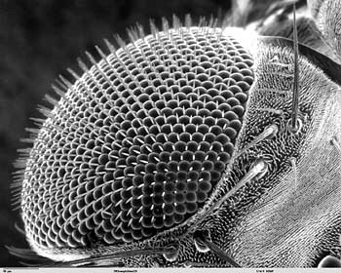
Ontologies and terminologies are central to Chado
Ontology - A formal representation of some portion of biological reality
sense organ
  what kinds of things exist?
eye
disc
is_a
  what are the relationships between these things?
develops
from
eye
part_of
ommatidium

Slide 15
Ontologies: cv module
Based on GO DB Schema and OBO format spec
key concepts
  cvterm (a term, or class in an ontology)
  cvterm_relationship
    DAGs
    Subject-predicate-object
  Cv (an ontology or terminology)

Slide 16
Subject | Type | Object
exon | Is_a | Transcript region
Transcript region | Part_of | transcript
Subset of
Sequence
Ontology

Slide 17
Genomics: Sequence module
some key concepts (a subset):
  Feature
    A genomic entity (gene, intron, SNP, chromosome, ..)
  Featureloc
    A relative location in sequence coordinates
  feature_relationship
    A pairwise relation between two features
      e.g. exon to transcript
  Featureprop
    Tag-value data for a feature
  feature_cvterm
    Ontology-based annotation

Slide 18
Feature table
Features have sequences
  Sequence are not independent entities
  Embedded in feature table
All features reside in same table
  Genes, exons, chromosomes, SNPs, ..
  Typed using Sequence Ontology (SO)
    Optional extra: Automatically generated SQL view layer

Slide 19
Feature Graphs: the feature_relationship table
Feature graphs (FGs)
  Subject-predicate-object
  Predicates (types) are cvterms

Slide 20
Example: alternately spliced gene
7 features:
  1 gene
  2 transcripts
  4 exons
Subject | Predicate | Object
A (transcript) | Part_of | G (gene)
B (transcript) | Part_of | G (gene)
1 (exon) | Part_of | A (transcript)
2 (exon) | Part_of | B (transcript)
3 (exon) | Part_of | A (transcript)
3 (exon) | Part_of | B (transcript)
4 (exon) | Part_of | A (transcript)
Not shown:
  polypeptide

Slide 21
Feature graph configurations are constrained by SO
SO determines ontological relations between features
Eg: Exon part_of transcript
Standard rules for is_a
  E.g.
    X is_a Y, Y part_of Z => X part_of Z
  See OBO Relation ontology
    http://www.obofoundry.org/ro
Rules must be encoded outside standard relational schema

Slide 22
Declarative programming: SQL Functions
Powerful, but optional
  PostgreSQL only
    Can be ported
    Separation of interface from implementation
  Sequence operations
    Transcription, translation
  Feature Graph operations
    Deduction of implicit features (eg introns)
  Location Graph operations
    Projection, mereological relations
Related:
Tata S, Patel JM, Friedman JS, and Swaroop A
Declarative querying for biological sequence databases
Proc of the 22nd International Conference on Data Engineering (ICDE),
April 3-7, Atlanta, GA, 2006.

Slide 23
Chado: ongoing work
Chado for phenotype (EQ) data
  With FlyBase, ZFIN, DictyBase
Chado for evolutionary science
  In collaboration with NESCENT
Documentation!
  Helpdesk (NESCENT)
More GMOD integration
  Unified Architecture for GMOD?
Latest Obo format features
  Allow for post-composition of complex terms

Slide 24
NCBO: OBO and OBD
OBO: Open Bio Ontologies
  Http://obo.sourceforge.net
  http://www.obofoundry.org
NCBO BioPortal; access to:
  OBO ontologies
  OBD annotations
Current DBPs
  Fly & fish mutant phenotype annotation
    Linking to disease
  HIV Clinical trial analysis

Slide 25
OBD: Storing biomedical annotations
Requirements different from Chado
Domain scope
  All of biology and biomedicine
Ontologies used for annotation
  Not just OBO
Data integration
  Index minimum amount of data
  Link to external data where appropriate
  Provide and use data services
Requirements partially met by semantic web technology

Slide 26
The Semantic Web Datamodel
Based on RDF triples
  Subject-predicate-object
    Each element is a URI
Various serialisations:
  RDF/XML
  N3, N-Triples
Multiple APIs, QLs and storage options
RDF Graphs constrained by ontologies
  Expressed in RDF Schema, OWL

Slide 27
OBD ‘Schema’: formal ontology of annotation
Within OBO Foundry
Framework
- uses OBO upper ontology

Slide 28
Implementing OBD using SemWeb technology
OBD-Sesame
  3rd party triplestore
  Relational or in-memory
  Lacks native OWL support
  Performance issues
OBD-SQL
  Developed at Berkeley
  Reuse Chado methodology, code
  ‘Triplestore’ with extras
    Reduces triple overhead with common patterns

Slide 29
Wrapping databases as SPARQL endpoints
A lot of data in existing relational databases like Chado
  Goal: make available as distributed resource in OBD compliant way
  Solution: d2rq declarative mappings and SPARQL
Progress:
  GO Database SPARQL endpoint:
    http://yuri.lbl.gov:9000/
  Chado and OBD mappings coming soon
Application:
  Integration of annotations through genome dashboard

Slide 30
Usage scenario: AJAX Gbrowse (http://genome.biowiki.org)
Annotation
info
sparql
sparql
DAS/2
sparql
D2rq
Sesame
DAS
D2rq
OBD
Disease/pheno
annotations
GO
annotations
MOD
Genome server

Slide 31
Conclusions
Flexible hypernormalized schemas
  Performance penalties
  Too much freedom expression?
    Ontologies + reasoners provide some constraints; eg SO
    Open world assumption
Federation vs tight integration
  Tight integration is required for MODs
  As more data types become available dynamic integration will be key
    RDF and SPARQL is one solution

Slide 32
Thanks
LBL
  Shengqiang Shu
  Mark Gibson
  Nicole Washington
  Seth Carbon
  John Day Richter
  Chris Smith
  Karen Eilbeck
  Sima Misra
  Suzanna Lewis
FlyBase
  Dave Emmert
  Pinglei Zhou
  Peili Zhang
  Aubrey de Grey
  Paul Leyland
  William Gelbart
HHMI
  Gerry Rubin
GMOD, Nescent
  Scott Cain
  Sohel Merchant
  Eric Just
  Sierra Moxon
  Andrew Uzilov
  Brian Osborne
  Ian Holmes
  Lincoln Stein

Slide 34
end

Slide 35
Feature localisation
Interbase
  Simplifies code
All localisations relative
  Location Graph (LG)
  Recursive/nested locations allowed

Slide 36
Recursive location graphs
Locations can be nested
  Finished genomes typically flat; depth(LG)=1
  Unfinished genomes, heterochromatin may require 2 (rarely more) levels
    features located relative to contigs
    Contigs related relative to chrmosomes
  May be a requirement to change coordinates at each level independently

Slide 37
Nested LGs
Feature | Loc | Srcfeature | group
exon1 | 100..200[+] | contig1 | 0
contig1 | 12000..13000[+] | chrom1 | 0
exon1 | 12100..13100[+] | chrom1 | 1
Redundant localisations can be used to ‘flatten’ LG
Group>0 indicates denormalised/flattened LG
- must be recalculated if group=0 coordinates change

Slide 38
Relational featurelocs
A relation between two or more locations
  Matches, sequence variants
  Indicated using rank column
Use case: SNPs
  Simple way to query for variants introducing premature termination of translation
  Combine relational featurelocs and redundant featurelocs
    3+ featureloc pairs:
      Sequence of SNP on reference and variant genome (+ location on reference)
      Same on transcripts
      Same on polypeptides

Slide 39
OWL entailment genomics use case
SO defines ‘TE gene’ as:
  A SO:gene which is part_of a SO:TE
  In OWL:
    Class(TE_Gene complete Gene part_of(TE))
Result:
  Queries for ‘SO:TE_gene’ return features not explicitly annotated as such
Compare: Chado
  Equivalent rules to be added
    PostgreSQL functions?
    Oboedit reasoner adapter?

