Slide 1

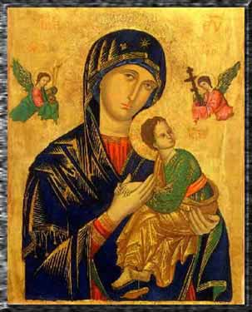
GMOD Help Desk
Dave Clements
Notes:
Our lady of perpetual help

Slide 2
GMOD Help Desk
What I've been doing
What I'm planning on doing
What should I be doing?
How am I doing?

Slide 3
What I've been doing
Web site
  Tags/Categories
    Tagged every page
    Made it easy to tag pages, lookup pages by tag
  Pages for new users
    Glossary, GMOD and Databases, …
  Community Portal
    News, Calendar, Recent Changes
    Need your help

Slide 4
What I've been doing
Outreach
  Posters:
    Genome Informatics, IGERT EvoDevo, Arthropod Genomics, Genetics of Behavior, ISMB
  Representation
    Lepidoptera and ArthropodBase; U Oregon
  Promotion
Education
  Chado Workshop with Scott @ Arthropod Genomics
    ~35 people
  GMOD Summer School with Scott, Ed, Ben,
    25 students for 2 1/2 days
Components
  MAKER, Phenote

Slide 5



@ ISMB & BOSC 2008
http://gmod.org
Intermine - Open source Data Warehouse and Query Interface Richard Smith, Fri 11:10-11:35 Ergatis: A Web-based Bioinformatics Pipeline Management and Collaborative Development System Joshua Orvis, Sat 9:30-9:55 Apollo: a Sequence Annotation Editor Ed Lee, Sat 11:50-12:10 EMBRACE - BioMart Developments and Future Syed Haider, Sat 1:50-2:10 |  | EMBRACE - Enabling Data Integration Syed Haider, Sun 2:15-2:40 Intermine - Open source Data Warehouse and Query Interface Richard Smith, Mon 12:15-12:40 Pathway Tools Software: Regulatory Networks and Recent Developments Peter Karp, Mon 3:15-3:40 Galaxy Workflows: Enabling Complex Compu-tational Analysis For Experimental Biologists James Taylor, Tue 3:15-3:40 New GALAXY Tools Anton Nekrutenko, Tue 3:45-4:10
Sun 5:45-8:30pm A Genome Grid for Finding new Bug Genes A Complete System for Community Genome Annotation GMOD: Managing genomic data from emerging model organisms Galaxy workflows for reproducible analyses of next-generation sequencing data, Anton Nekrutenko Mon 5:45-8:30pm Metagenomic Analysis with Galaxy: Windshield Genomics and Beyond EMBRACE – Enabling Data Integration |  | Sun 5:45-8:30pm Multidimensional annotation of the Escherichia coli K-12 genome Towards Data Analysis of Genome Wide Influenza RNAi Screen Bioinformatics to support the sequencing of Brassica rapa chromosomes A2 and A10 Mon 5:45-8:30pm Regional co-variation among rates of different types of mutations Solutions for database interoperability: a report from the CASIMIR consortium
BOSC Talks
ISMB Talks
Posters about GMOD
Posters using GMOD

Slide 6
What I'm planning
GMOD User Directory
  How
    UseTableEdit
    Each user has a page
    Each component lists users of that component
    Comprehensive user list.
    All driven by data on each user page.
  Why
    Community portal
    Give new users an idea of who is doing something similar
    I'll be in the neighborhood
Notes:
Neighborhood: I'll be working with TableEdit anyway, and
I'll be churning through e-mails from mailing lists for next bit of work.

Slide 7
Experience Logs
Can't possibly describe or maintain HOWTOs for all OS/software combos.
Create organization for including, encouraging and tagging user experience logs
  A few already on the web site.
  No maintenance involved with this.
  Just catalog as we try them.

Slide 8
Documentation
Chado doc reorganization
  Including Chado Cookbook / Best Practices
  Mine gmod-schema mailing list
  Start user directory
GBrowse Doc
  GBrowse Glyphs
  GBrowse Cookbook?
Community Annotation Server Doc

Slide 9
Documentation 2
Tutorials
  Screencasts for sophisticated user interfaces
  GBrowse, Apollo, CMAP
Web site
  Mediawiki upgrade
  TableEdit
  Better searching
  New skin?

Slide 10
Components
Galaxy, InterMine, BioMart
  Seek tighter integration with rest of GMOD
TableEdit
  Documentation
  Testing - will integrate with GMOD web site
  Could be key to (non-sequence) community annotation
Natural Diversity Chado Module
  Get it integrated, documented and used
Google 2009 Summer of Code?
GMOD Logo Service?
Notes:
Galaxy InterMine, BioMart
All well funded, well-run and popular projects.
Do our users a service by getting better integration
Also increase appeal, visibility of GMOD

Slide 11
Education & Outreach
2009 Summer School
GMOD Course in Europe?
Conferences
  Tutorial at Plant and Animal Genomics?
  Arthropod Genomics
  IPlant?
  More posters
Particularly promote
  Comparative Genomics
  Community Annotation

Slide 12
Grants, Reviews & Funding
I now offer to review grants that propose using GMOD
Encourage grant writers to include funding for GMOD
  Fund general project or specific components
  Could increase stability of GMOD

Slide 13
What should I be doing?
?

Slide 14
How am I doing?
Don Gilbert is doing a review of my first year in August and September.
Please contact him if you any feedback.

Slide 15


Thank You!
Dave Clements
GMOD Help Desk
315 Pacific Hall
National Evolutionary Synthesis Center
clements@nescent.org
help@gmod.org
http://gmod.org/GMOD_Help_Desk
http://nescent.org

Slide 16
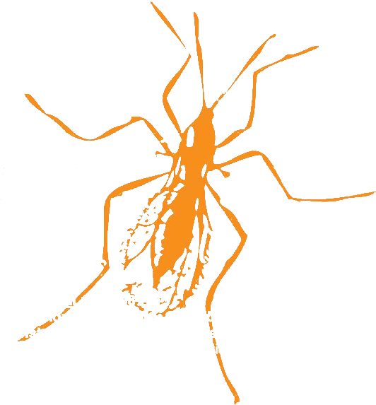
GMOD @ Arthropod Genomics Symposium
GMOD Users
wFleaBase
BeetleBase
FlyBase
AphidBase
ButterflyBase
VectorBase
BeeBase
HeliconiusBase
GnpAnnot-Lep
+ hundreds more
GMOD Tools
Chado
Apollo
GBrowse
CMap
Table Editor
GMODWeb
Ergatis
Textpresso
Sybil
BioMart
LuceGene
SynBrowse
Galaxy
InterMine
…
Thursday 7-9pm
Community Contributions to Genome Annotation
Christine Elsik, Christopher Childers, Darren Hagen
Workshops
Friday 7:30-9:30pm
Chado Databases and Integration with GMOD Tools
Scott Cain, Dave Clements
Friday 11:25-11:45am
Unlocated arthropod genes and ways to find them
Don Gilbert
Talks
Friday 5-6:30pm
A comparative annotation of Drosophilid dicistronic genes
Saturday 10-11:30am
A Complete System For Community Genome Annotation
GMOD: Database Resources for Emerging Model Organisms
Comparative genomics and database construction for Lepidoptera
Unlocated Arthropod genes, and ways to find them
VectorBase: A genome resource for arthropod vectors of human pathogens
The VectorBase Manual and Community Annotation Submission pipeline
ButterflyBase: A framework for comparative genomics in butterflies and moths
Posters
http://gmod.org
Got data?

