Slide 1


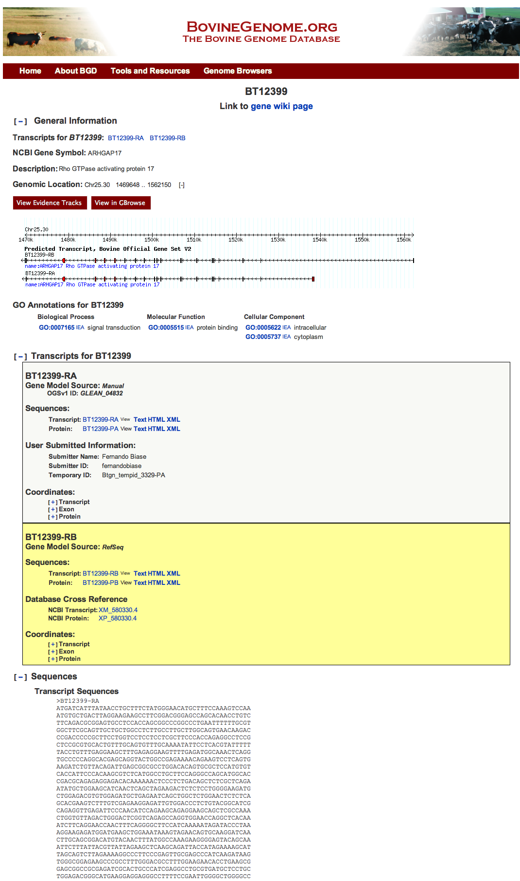
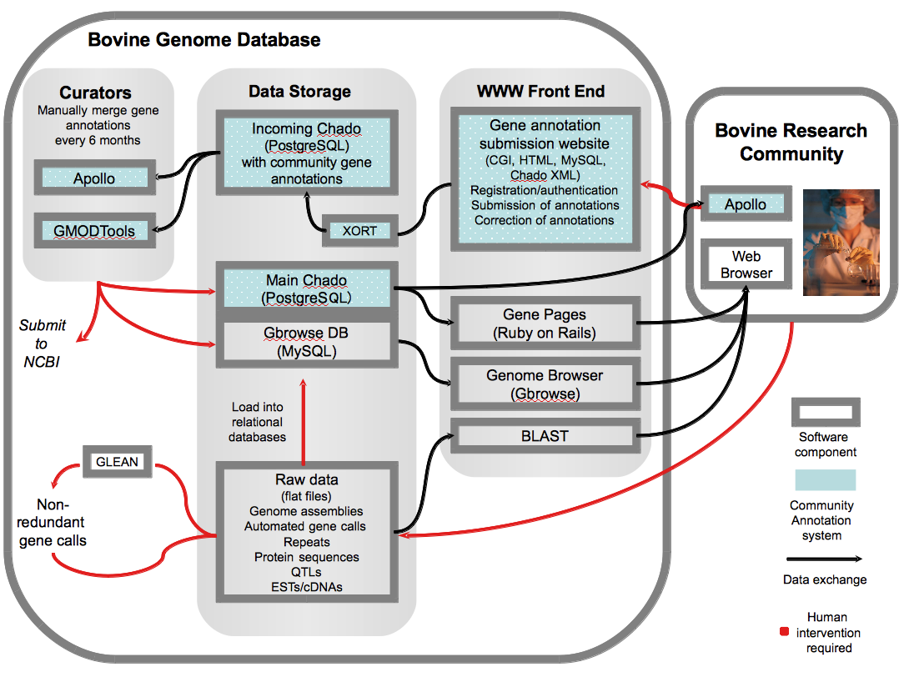
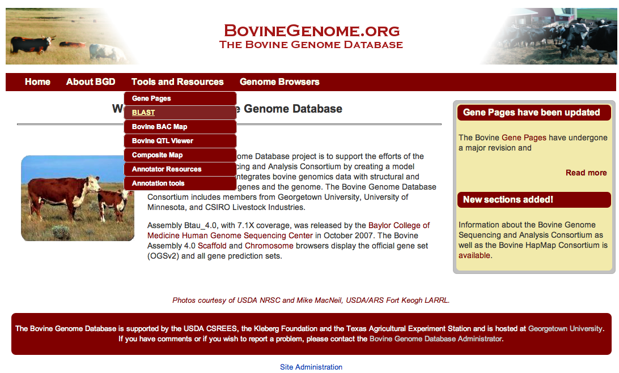
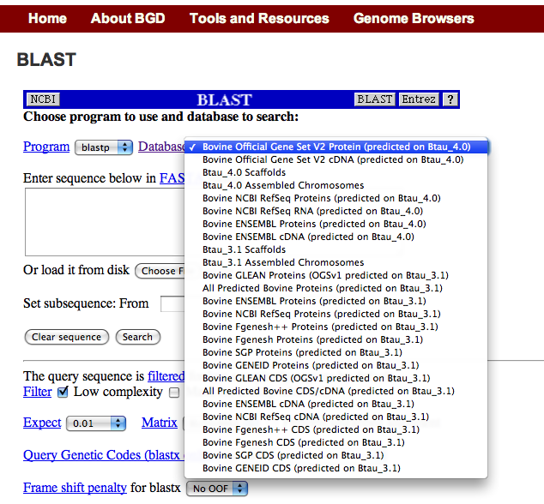
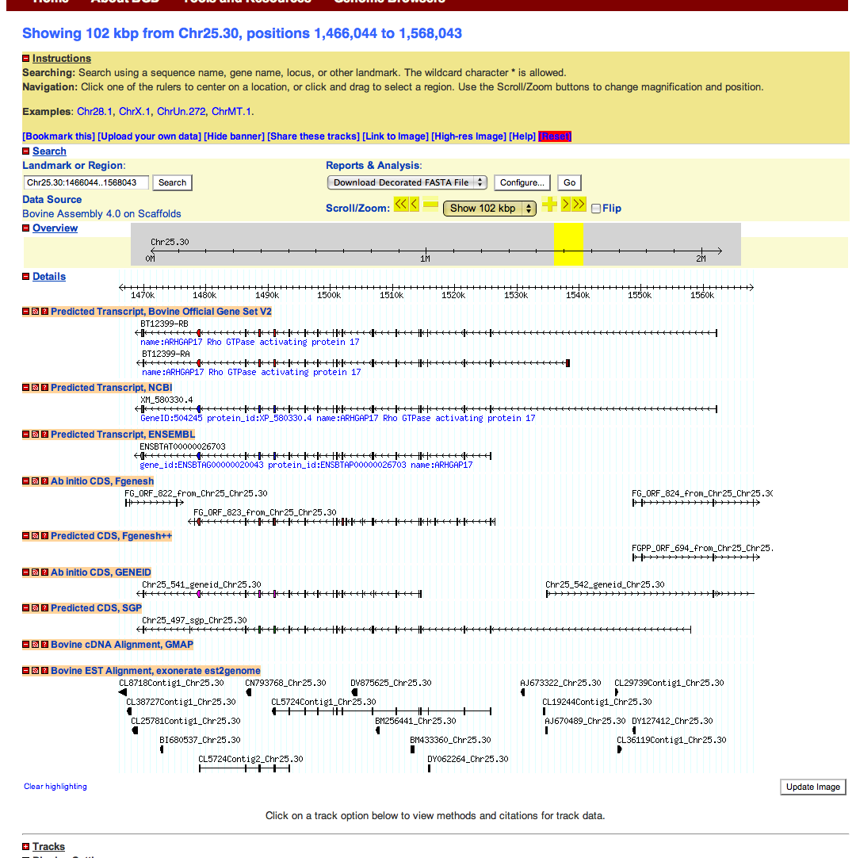
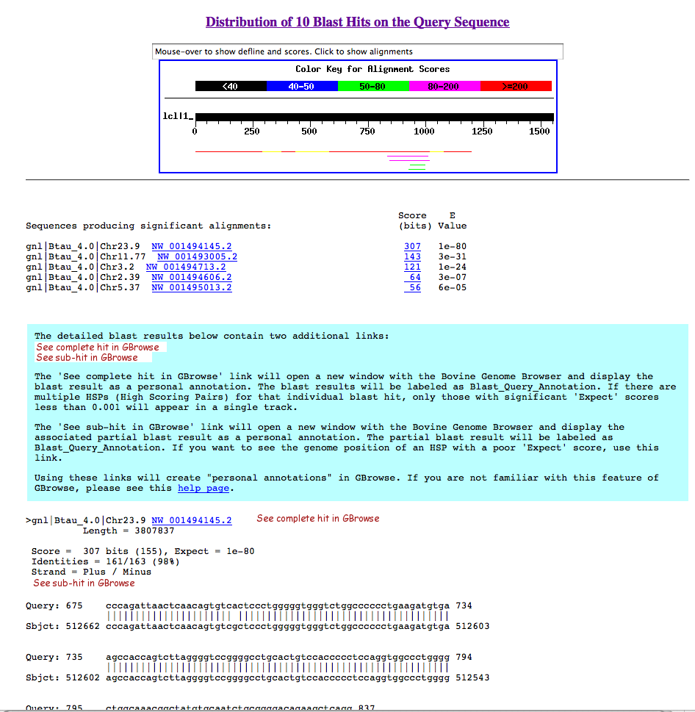
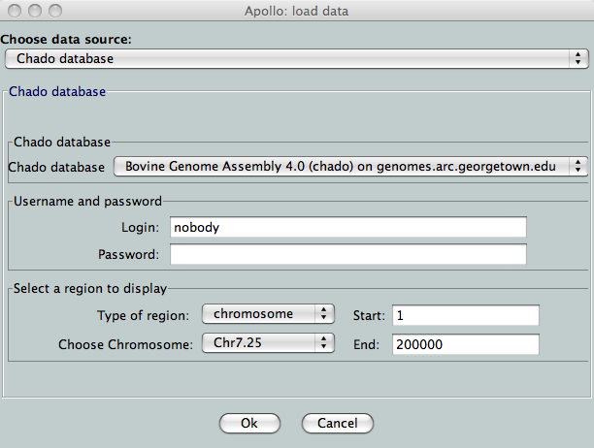
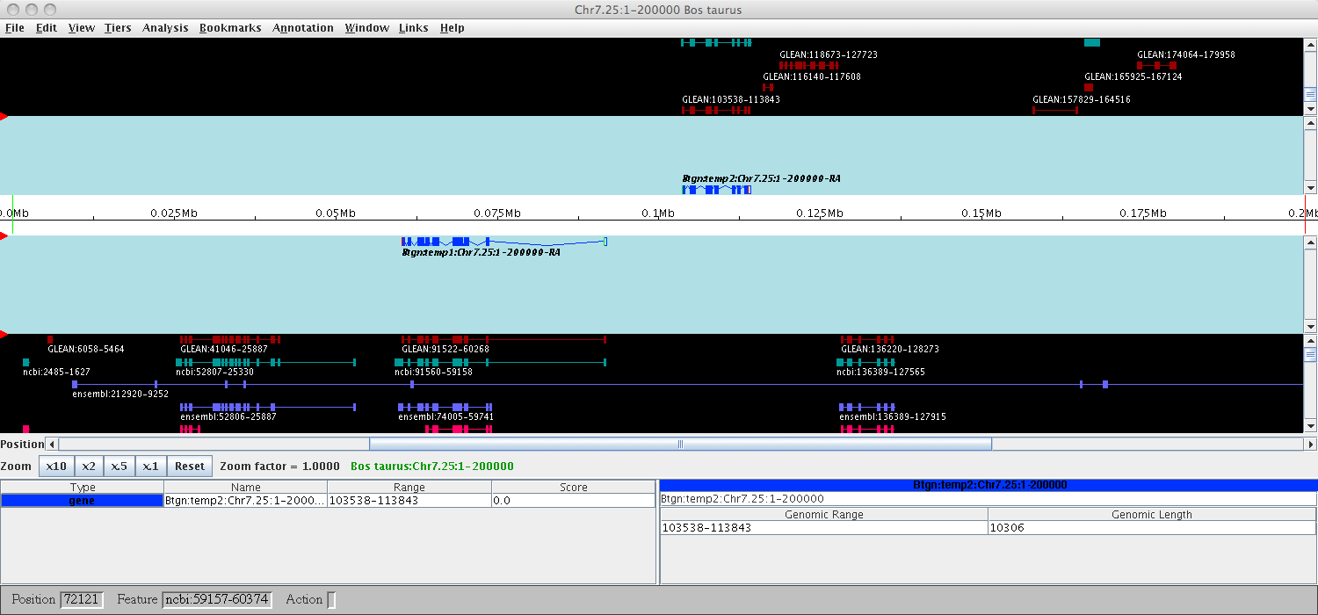
The Bovine Genome Database
United States Department of Agriculture
National Institute of Food and Agriculture
Christopher P. Childers, Justin T. Reese, Jaideep P. Sundaram, Donald C. Vile, Darren E. Hagen, Anna K. Bennett, Christine G. Elsik
Department of Biology, Georgetown University, Washington, DC 20057, USA
Abstract
Gene Pages
The Bovine Genome Database (BGD, http://bovinegenome.org) facilitates the integration of bovine genomic data. BGD is based on an implementation of the Chado schema, a component of GMOD. BGD includes GBrowse genome browsers, the Apollo Annotation Editor, BLAST databases and gene pages. Genome browsers, available for both scaffold and chromosome coordinate systems, display the bovine Official Gene Set (OGS), NCBI and Ensembl gene predictions, non-coding RNA, repeats, pseudogenes, SNPs, markers, QTL and alignments to cDNAs, ESTs, and protein homologs. The Apollo Annotation Editor connects directly to the BGD Chado database to provide researchers with remote access to gene evidence in a graphical interface that allows editing and creating new gene models. Researchers may upload their gene model annotations to the BGD server for review and integration into the subsequent release of the OGS. Gene pages were created using Ruby on Rails and integrated with Chado. They display information for individual OGS gene models, including gene structure, transcript variants, functional descriptions, gene symbols, gene ontology, annotator comments and references to external databases. Users may search by gene symbol, annotator, GO term or BGD identifier. Each gene page is linked to a wiki page to allow input from the research community.
Data model
Overview of resources at BGD:
There are two main interfaces between the database and the research community. The web based interface is located at www.bovinegenome.org, and provides access to all the data sets and gene models. The annotation interface is accessed via the Apollo annotation editor, and allows researchers to annotate gene models and submit them back to BGD through the annotator section of the web interface.
Within the BGD, data is initially stored in flat files which are then loaded into relational databases, and passed through manual and automated curation pipelines. These data sets are used to create the Chado database utilized by the Apollo Annotation editor. Manual annotations are submitted back to BGD, then incorporated into the Official Gene Set. This information is available through the gene pages, and also as flat files and BLAST databases.
BGD Web Interface
Gene Pages:
The Gene Pages at BGD are based on an implementation of Ruby on Rails which interfaces directly with the Chado database (Chado on Rails). The gene pages are written following the MVC convention, which separates the logic that describes the database schema (Model), the methods and subroutines (Controller) and the templates that display the data in the web browser (View). The gene pages display the Official Gene Set v2, and include electronically derived GO annotations with IEA codes, information derived from manual annotations, and overlap information with NCBI and Ensembl genes when available. Genes that include multiple gene models are supported, and coordinates are available for the different levels of detail (gene, transcript and protein). Sequence information is available for each gene model at the transcript and protein level.
Apollo
BGD uses Apollo as the primary annotation editor:
The annotation data generated by the bovine annotation community has been loaded into a Chado database and made available to annotators via Apollo. The Apollo annotation interface allows users to view all available evidence in a single window, greatly facilitating the annotation process. Completed annotations are saved as Chado-XML before uploading to the BGD server.
BGD has been substantially redesigned:
The main site has been redeployed under the Drupal content management system. The existing sections and tools have been retained or extended to support the OGSv2 and genome assembly 4.0. BLAST alignments to OGSv2 gene models now include links to assembly 4.0 GBrowse and direct links to gene pages.
Acknowledgements
BGD is supported by grants 2007-35616-17882 and 2010-65205-20407 from the USDA National Institute of Food and Agriculture.

