Slide 1
CMap Version 0.16
Ben Faga

Slide 2
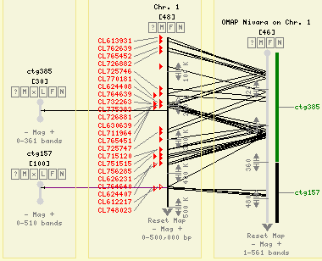
CMap

Slide 3
CMap Version 0.16
Bug fixes and code optimizations
More intuitive menu system
Asynchronous loading of comparative map menus
Initial Page Caching
Chado synchronization
Script to stack relational maps into one map
Support for multiple installations

Slide 4
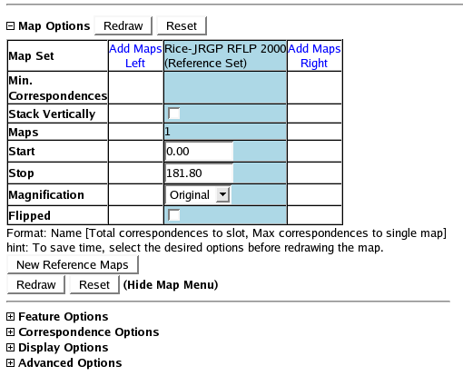
Menu System

Slide 5
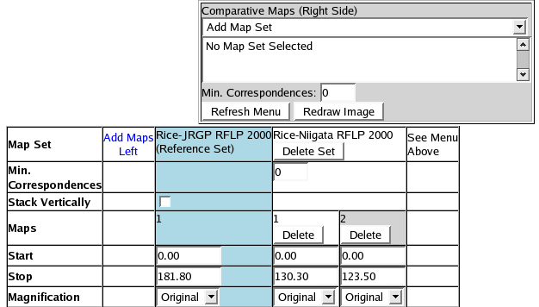
Asynchronous
Comparative Maps Menu

Slide 6
Initial Page Caching
Goal: Speed up the initial view of CMap
Cache commonly accessed views
  Whole page cache of first view of a map
  Cache “Saved Links”

Slide 7
Chado Synchronization
Populate CMap with data from Chado
Create triggers in Chado to keep data synchronized
More discussion later today

Slide 8
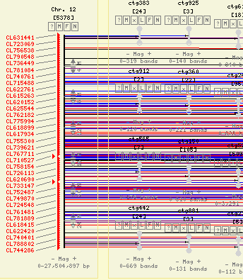
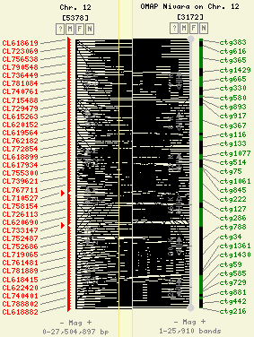
Stacking Relational Maps

Slide 9
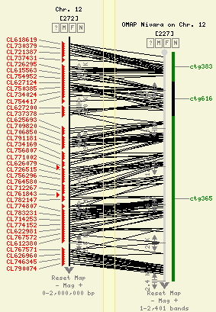
Stacking Relational Maps

Slide 10
Support Multiple Installations
Allow multiple CMaps on the same machine that use the same Perl Modules.
This allows some CMaps installs to be password protected or be hosted by separate web servers.
During installation, alternate configuration directories can be provided.

Slide 11
Thank You

Slide 12
Chado-CMap Synchronization
Configure CMap
Create and populate some specialized tables in Chado (featureset, feature_featureset)
Run script to copy data from Chado to CMap
Install triggers into Chado to update CMap when Chado is changed

Slide 13
Configure CMap
Add map and feature types to the CMap configuration file that correspond to the cvterm name for Chado features.
Failure to do so, will stop the process.

Slide 14
Chado Database Modifications
Add tables, “featureset” and “feature_featureset” to mimic the CMap concept of a “map set”.
Populate featureset tables.
Add tables “featureset_dbxref” and “featureloc_dbxref” for linking to CMap.

Slide 15
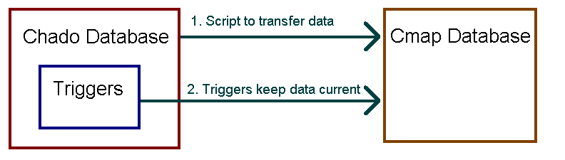
A script is used to transfer the prepared data into CMap and create the dbxrefs in Chado.
Triggers in Chado will update CMap after every insert, update or deletion.

Slide 16
Cross Communication
Each Chado feature that has been exported to CMap will have a dbxref with the ID of the corresponding CMap object.
Currently, CMap itself doesn't have a simple way to get back to the chado data but:
  The config file has a place to insert Perl code that could access the Chado db.
  A attribute could be added to the CMap objects.

Slide 17
Thank You

