Slide 1
Genome reannotation:
Dealing with the atypical, the ambiguous, and the contrary

Slide 2
Release 3.2 contributors
Kathy Campbell
Lynn Crosby
Beverley Matthews
Andy Schroeder
Brian Bettencourt
Yanmei Huang
Leyla Bayraktaroglu
Pavel Hradecky
Gillian Millburn
Sima Misra
Chris Smith
Eleanor Whitfield
Peili Zhang
Pinglei Zhou

Slide 3
Bottom lines
Annotate generously
  Criteria should not be too stringent
Label the ambiguous and atypical
  Define a “problematic” category
  Use a CV to describe
Devise a confidence-rating system or an evidence tally system

Slide 4
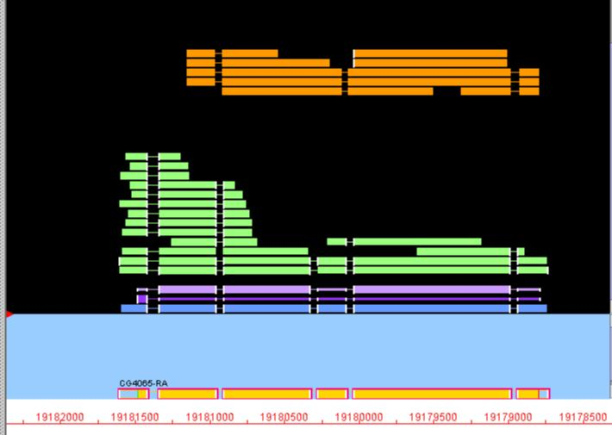

Slide 5
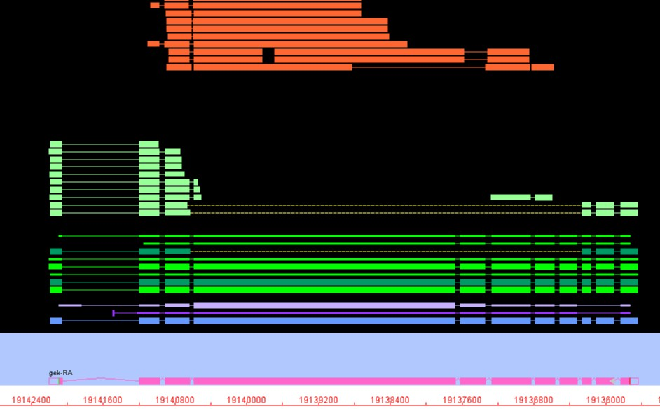

Slide 6
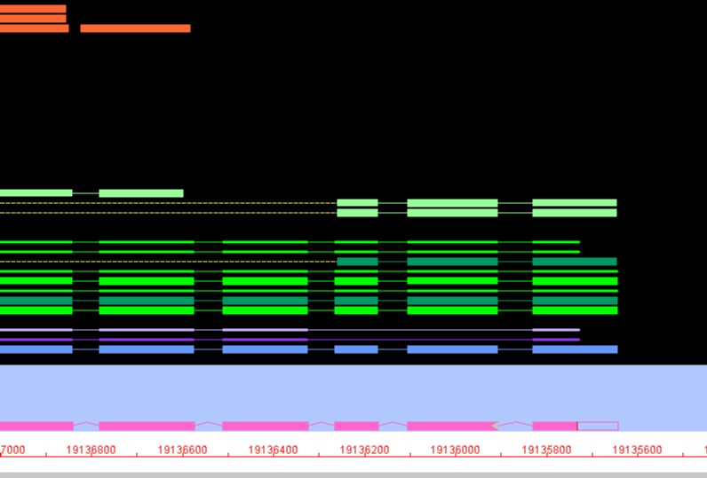

Slide 7
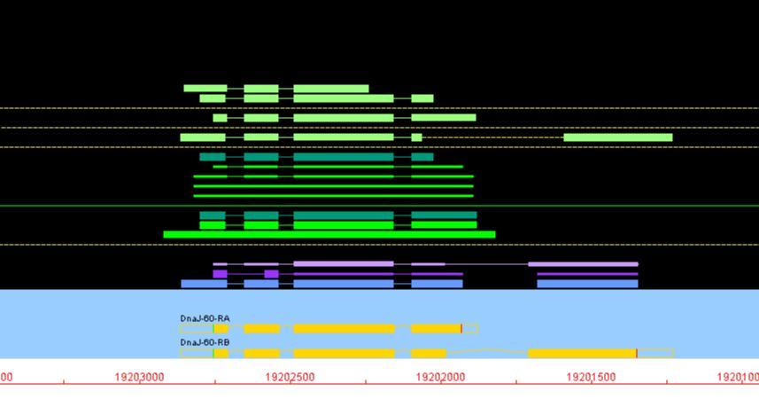

Slide 8
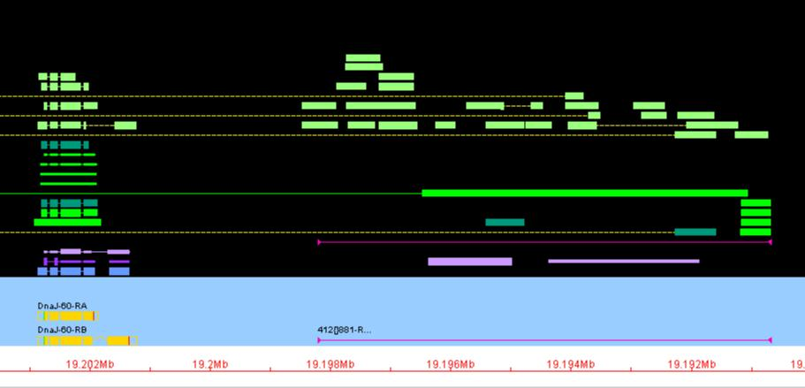

Slide 9
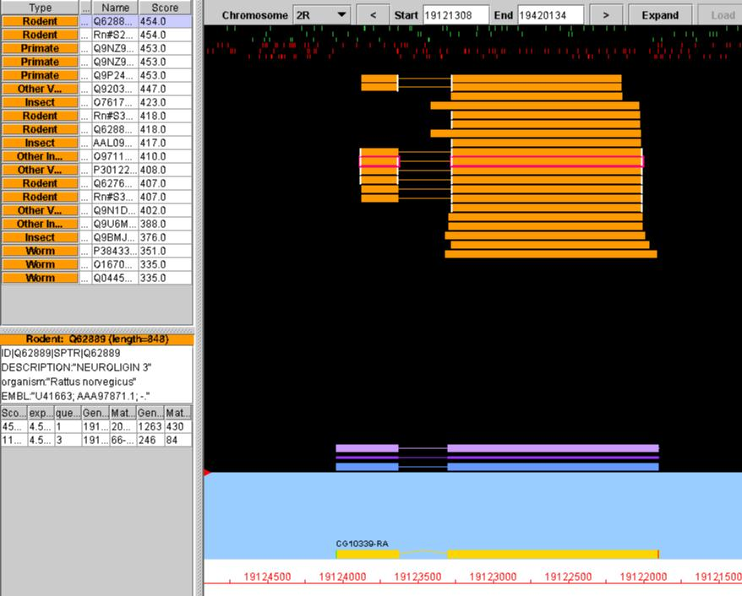

Slide 10
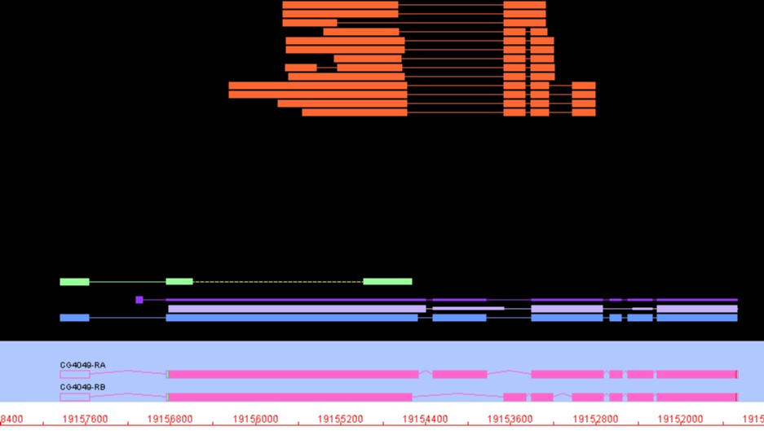

Slide 11
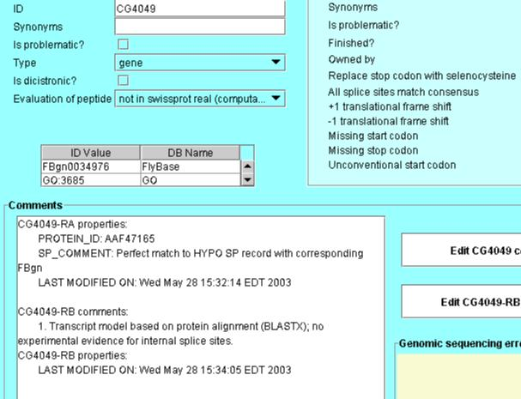

Slide 12
Comments for validation flags
Unusual splice
Short CDS
Short intron
Overlaps transposon
Unconventional translation start
Multiphase exon
CDS overlap
Dicistronic

Slide 13
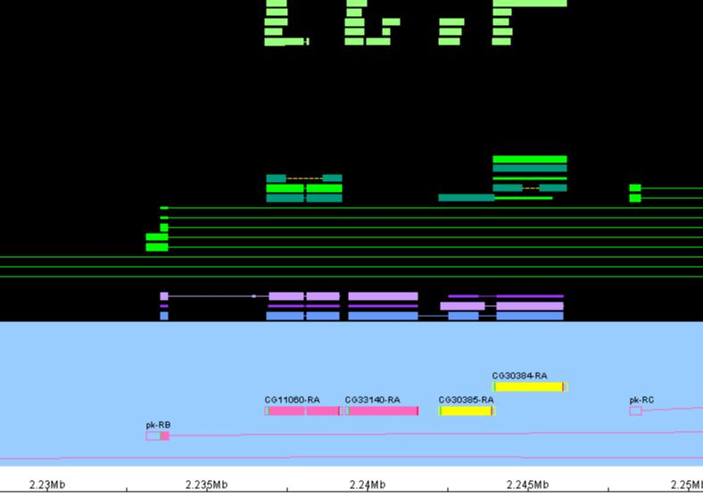

Slide 14
The dubious annotation
Categorized as problematic/provisional
Described using controlled comments
  “Short CDS”
  “Gene prediction only”
  “Possible gene fragment”
Allows capture of the ORF without condoning the gene model

Slide 15
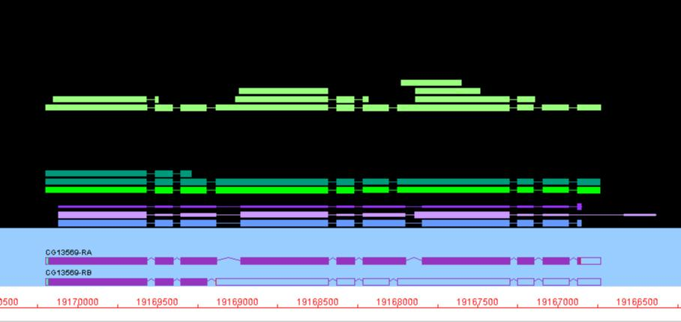

Slide 16
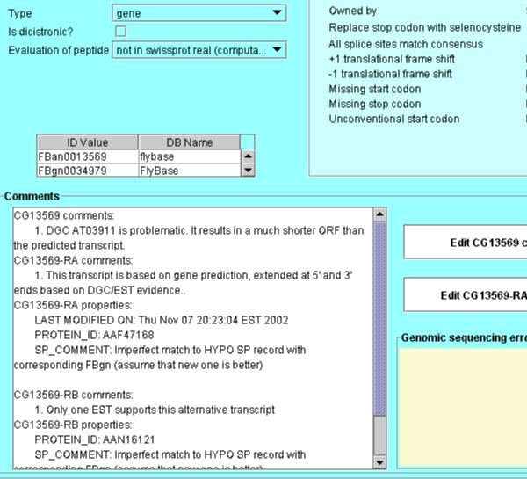

Slide 17
The dubious transcript
Problematic transcript
  “Truncated ORF”
  “Supported by single cDNA”
Controlled comments; distinguish between:
  Truncated ORF
  Short CDS relative to cDNA length (stops throughout; no long ORF)
  Short CDS (previous case)

Slide 18
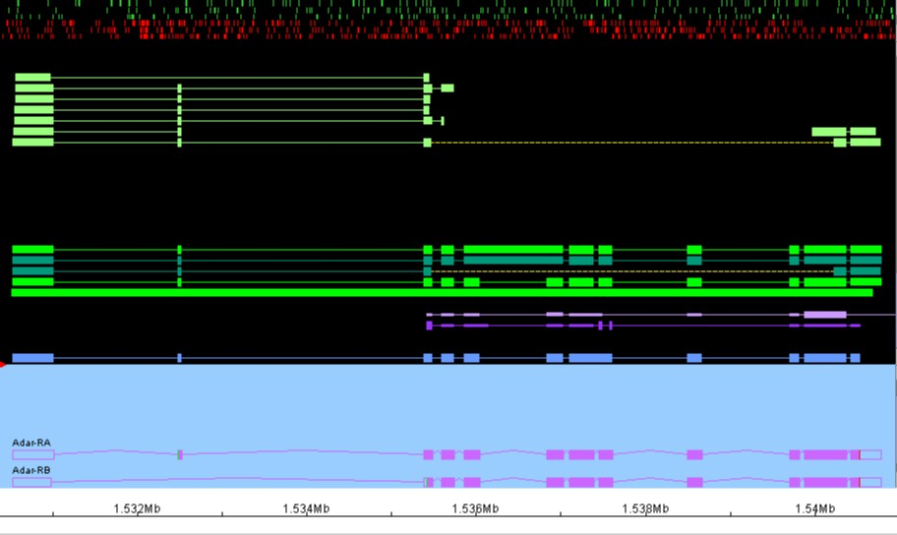

Slide 19
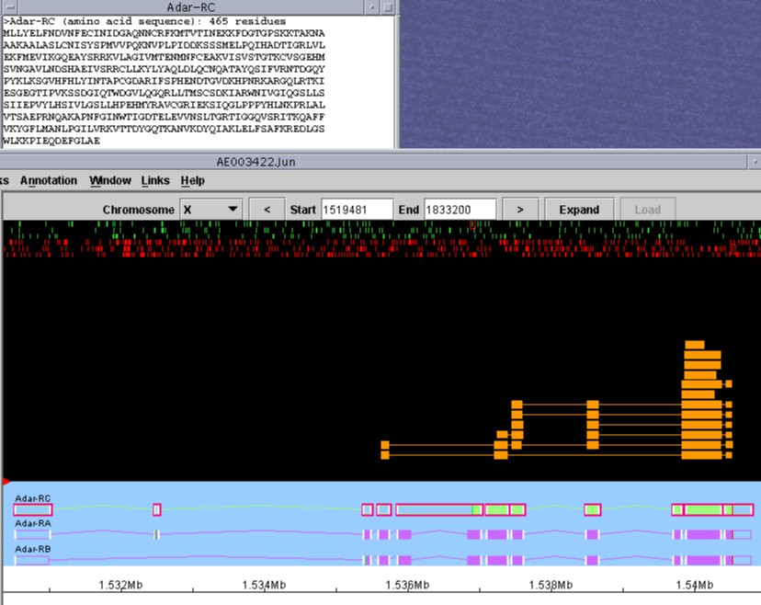

Slide 20
Annotated, but…
Third transcript classified as problematic
  Can be excluded
  Clearly flagged
Controlled comments
  “Truncated ORF”
  “Supported by single cDNA”
  “Suspect cDNA: possible unspliced intron”

Slide 21
Transcript confidence ratings: data types
cDNA data (complete/partial)
Protein homology/protein domain(s)
Gene prediction
Flagged as problematic

Slide 22
Evidence tally system
Yes/no indication for each different level of supporting data
Flexible and open-ended
Can be dense and nuanced
Users can easily set different combinations of criteria for bulk data sets

Slide 23
Evidence tally: cDNA and EST data
Transcript structure supported
  UTRs supported
  CDS supported (full-length)
  CDS supported (partial)
Transcript overlaps cDNA(s) or EST(s)

Slide 24
Evidence tally: supporting protein data
Homologous proteins
  High scoring of similar length
  Less similar
  Indication of taxonomic range?
Complete protein domain(s) identified

Slide 25
Evidence tally: cont.
Gene prediction(s)
Problematic: [CV]
  Short CDS; possible gene fragment
  Truncated CDS
  Possible pseudogene
  CDS overlap
  etc.

Slide 26
Evidence tally: open -ended
Experimental determination of 5’ end
Northern data
ORFeome data
Microarray expression data
In situ expression data
Protein expression data

Slide 27
Dealing with the messy ones
Allow provisional/problematic annotations
  Minimize biases of current knowledge
  Can exclude from rigorous data sets
Describe and categorize using controlled comments
Fold into a transcript rating system
  Evidence tallying system

