Slide 1
BioPivot: Applying Microsoft Live Labs’ Pivot to Problems in Bioinformatics
Stephen Taylor, CBRG
GMOD Europe 2010

Slide 2
Introduction
Visualization of large numbers of genome regions
Querying and filtering properties of genome regions
Pivot and BioPivot tools
Open discussion of other applications of technology

Slide 3
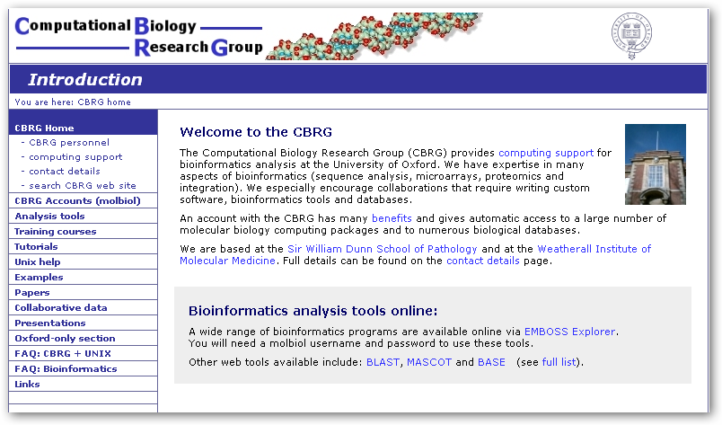
CBRG

Slide 4
Over 50 different GBrowse databases
Many labs started wanting GBrowse
Human
Mouse
Bacterial
Time series
Arrays
ChIP-Seq
RNA-Seq

Slide 5
Next Generation Sequencing
Histone modification Data
ChIP-Seq
Interaction cis/trans data
PCR amplified regions
RNA-Seq
Exome Sequencing/SNP detection

Slide 6
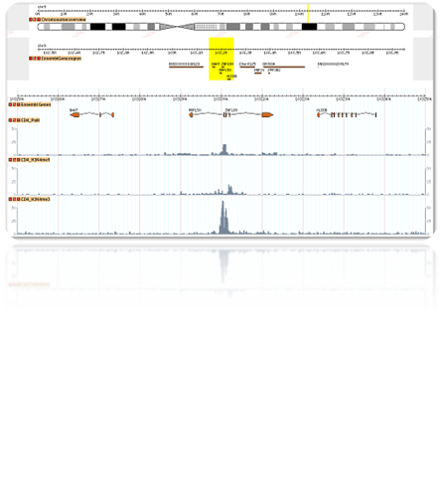
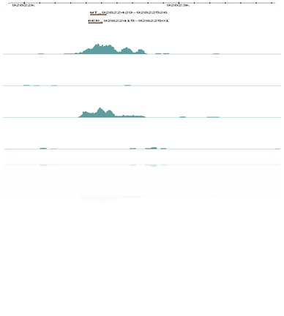
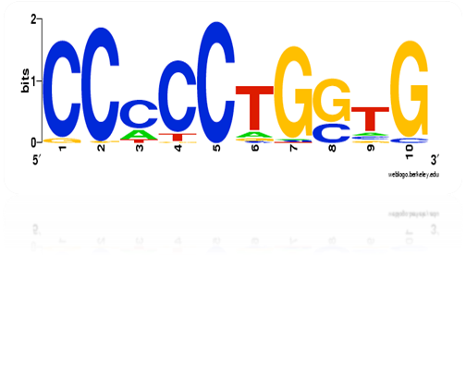
ChIP-Seq example
Map
NGS
reads
Peak pick
Extract sequences from features
Motif extract
Weblogo

Slide 7
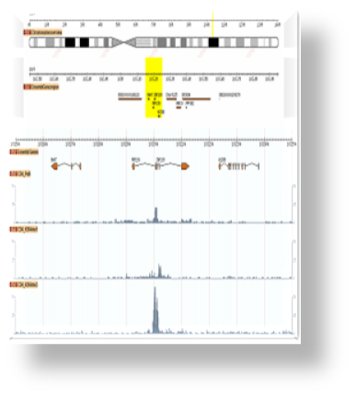
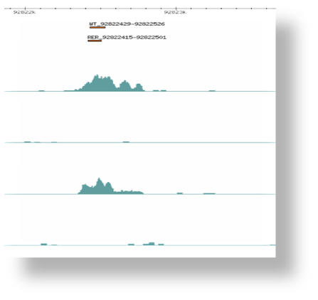



ChIP-Seq
NGS
reads
Map
Peakfind

Slide 8
Problems
Experimental conditions
Antibody
Peak finders give false positives
  Lots of parameters
  Must choose a suitable cut-off
  Eyeballing lots of peaks

Slide 9
Further Analysis
Which of my peaks overlap with:
Genes
Exons
Promoters
CpG Islands
Areas of conservation
etc

Slide 10

Traditionally
Make spreadsheet of data with links to Gbrowse/UCSC regions of interest
Click/Filter various parameters
Add data to spreadsheet each new analysis

Slide 11
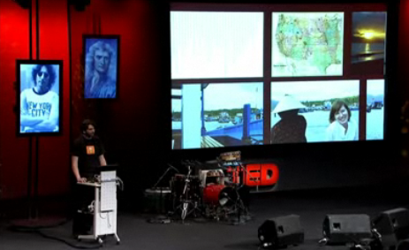
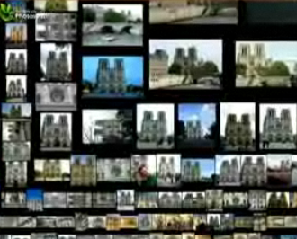
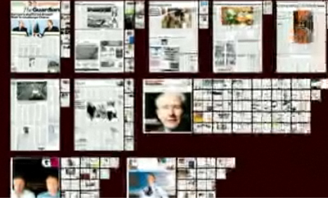
Deep Zoom Tech
Blaise Aguera y Arcas (TED 2007)
Seadragon/Photosynth
  http://www.seadragon.com/showcase/
Microsoft Live Labs’ Pivot
  http://www.getpivot.com/

Slide 12
Wouldn’t it be cool...
To use this in bioinformatics...?
Take thousands of regions of interest of genome
View and Filter seamlessly on metadata

Slide 13
BioPivot Tools
GFF3 of ROI
Ninth column contains ‘facets’
Choose your GBrowse or UCSC Browser View
Run the command:
gff32pivot my.gff3 –dzi –generateimages –conf mytypes.cfg -o my.cxml –browser gbrowse2

Slide 14
BioPivot Tools
Parsers for peakfinders
Annotate a GFF3 file
  nearest gene
  exons, introns, intergenic, intragenic
  TSS/TES up and down stream regions
Overlaps of GFF3/BED features

Slide 15
Open Source
Zoomable User Interfaces (ZUIs)
OpenZoom
  http://openzoom.org/
SDK for Flash, Flex & AIR
APIs

Slide 16
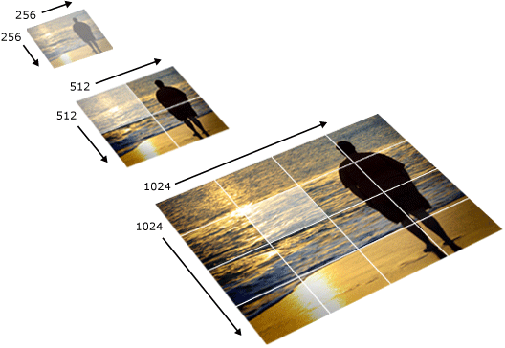
Deep Zoom Image

Slide 17
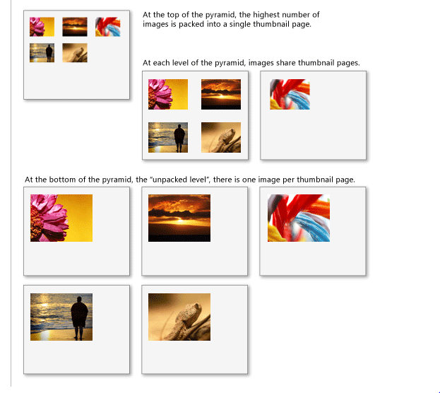
Deep Zoom Collection
Groups of tiled images

Slide 18
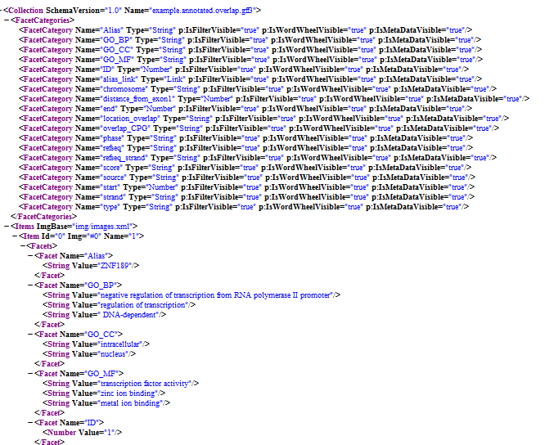
CXML File

Slide 19
To Do
Installation scripts
Deploy in a web browser using Silverlight
RNA-Seq parsers e.g. cufflinks, DESeq
Get feedback from the community
What else can we do with this tech?
http://www.cbrg.ox.ac.uk/data/biopivot

Slide 20
Acknowledgements - Code
OpenZoom
  http://openzoom.org/
Cisgenome
  http://www.biostat.jhsph.edu/~hji/cisgenome/
BEDtools
  http://code.google.com/p/bedtools/

Slide 21
Acknowledgements - People
Jim Hughes
CBRG Team
GMOD Team

