Slide 1
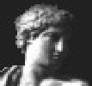
Apollo Progress Report
Nomi Harris (nomi@fruitfly.org), Mark Gibson, Suzanna Lewis
Berkeley Drosophila Genome Project
Stephen Searle, Michele Clamp, Vivek Iyer
Ensembl Project, Sanger Institute
GMOD Meeting, Cold Spring Harbor
May 5, 2003

Slide 2


What is Apollo?
Open source tool for viewing and making annotations on genomic sequence
GMOD’s annotation editing tool
Apollo lets human experts (biologists) view analysis results and create and refine annotations
Developed by groups at FlyBase-BDGP and the Sanger Institute
Notes:
Go through this one very quickly—it’s just in case anyone in the audience doesn’t know what Apollo is

Slide 3
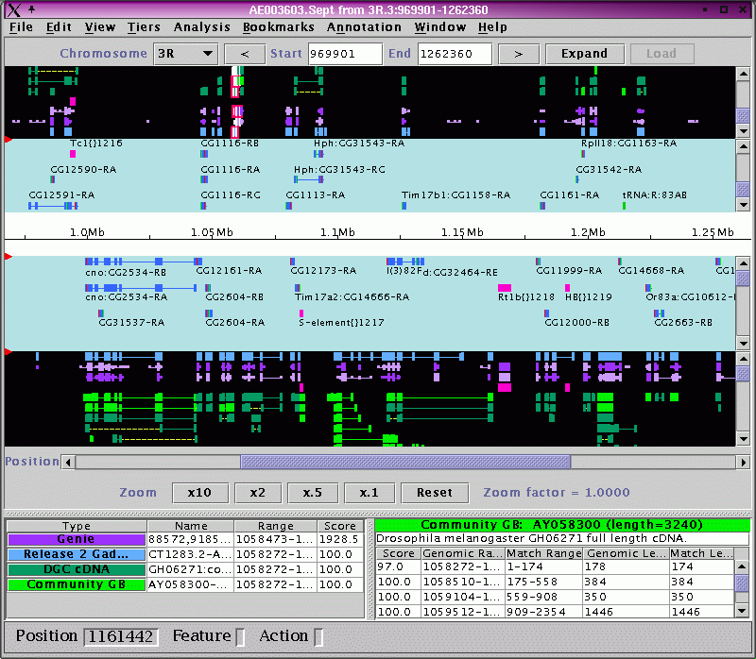
Main display
Notes:
I show this one for about five seconds, saying something like, “I’m sure most of you already know what Apollo looks like. This is the main display, showing analysis results and curated annotations on both strands.”

Slide 4
To Do (February 2003 list)
MOSTLY DONE: Fix all editing capability (esp. Exon Detail Editor)
IN PROGRESS: Alignment viewer
IN PROGRESS: Interoperability: better parsing of more data formats
IN PROGRESS: Community annotation (layering, combining evidence)
MOSTLY DONE: View comparative data (synteny viewer)
Undo/Redo
See splice sites and use to edit annotations
Lazy loading of sequence
IN PROGRESS: Extending feature types
Dynamic analysis launch
Notes:
This is the list from Feb 2003, annotated with what we’ve finished and what we’re working on. No need to say anything extra—just basically read all the items (not verbatim—form complete sentences, use different words, etc. You know the drill).

Slide 5
Debugging
Fixed some memory leaks (some still unresolved)
Editing/curation functionality pretty much fixed
  Deletion now working
  Exon Detail Editor behaving much better
  Annotation text info editor fixed
  Better handling of overlapping and dicistronic genes
Improved handling of selections
Most of the remaining bugs involve new features (alignment viewer, non-gene annotations, etc.)

Slide 6
Extending annotation types
Generalize ability to create annotations—not just genes
  tRNAs, transposons, P insertions, pseudogenes, etc.
Show non-gene annotations as different glyphs
Currently implementation is temporary solution--some things don’t work
Notes:
This could perhaps use a screenshot—unfortunately, there’s some weird problem that prevents me from making screenshots at home. If you want, you could add a cropped portion o f annot-types.xml showing the different annotation types.

Slide 7
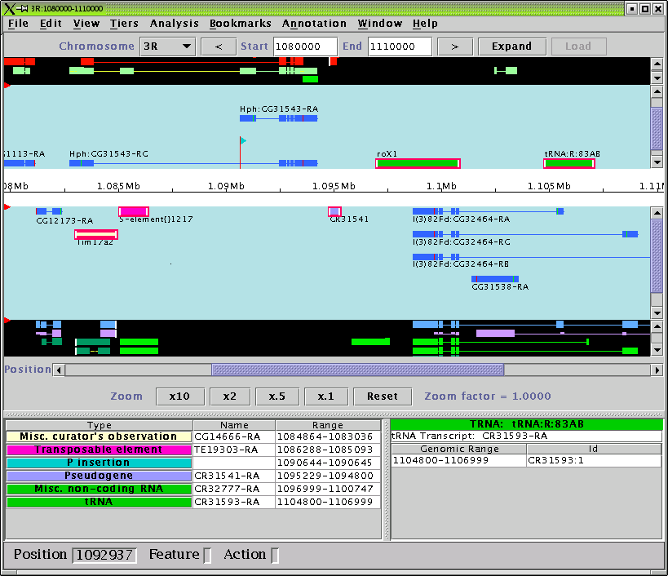

Slide 8
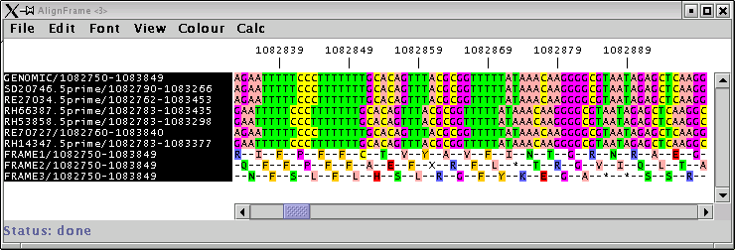
Alignment viewer
Adapted version of Jalview (Michele Clamp)
View multiple alignment of selected features
  Residues color-coded for easy recognition of mismatches
  Shows selected sequences plus genomic sequence + three-frame translation
  Can view DNA and/or protein sequences
Notes:
Quickly go over some of the main features. Next slide has screenshots.

Slide 9
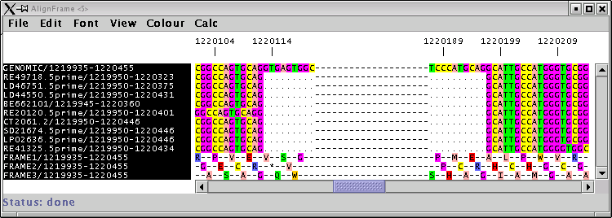
Jalview, cont.
Can show or hide introns

Slide 10
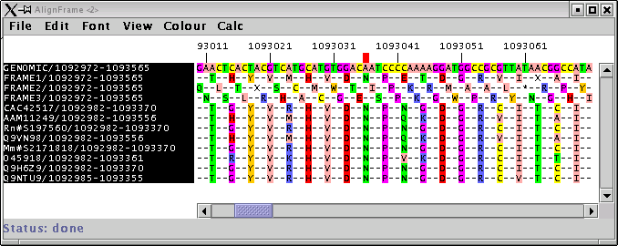
Jalview, cont.
Can align selected feature(s) or all nearby features of selected type(s)
Can remove sequences you don’t want to see
Can change fonts, colors
Notes:
Point out very briefly the genomic, three-frame translation, matches vs. mismatches.

Slide 11
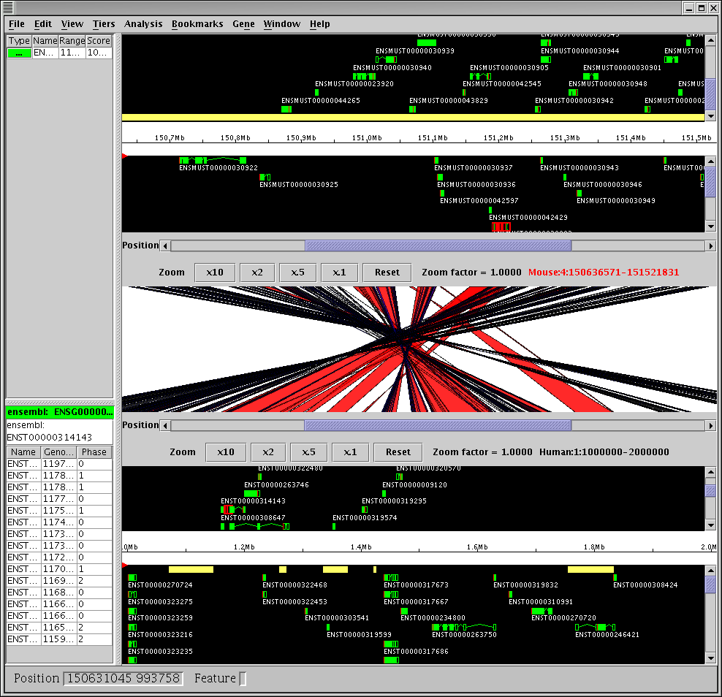
Synteny viewer (Ensembl)
View (soon edit) comparisons between two genomes
Notes:
No need to say much. Synteny viewer shows two Apollo panels, one for each species, plus a graphic showing regions of homology between the two genomes.

Slide 12
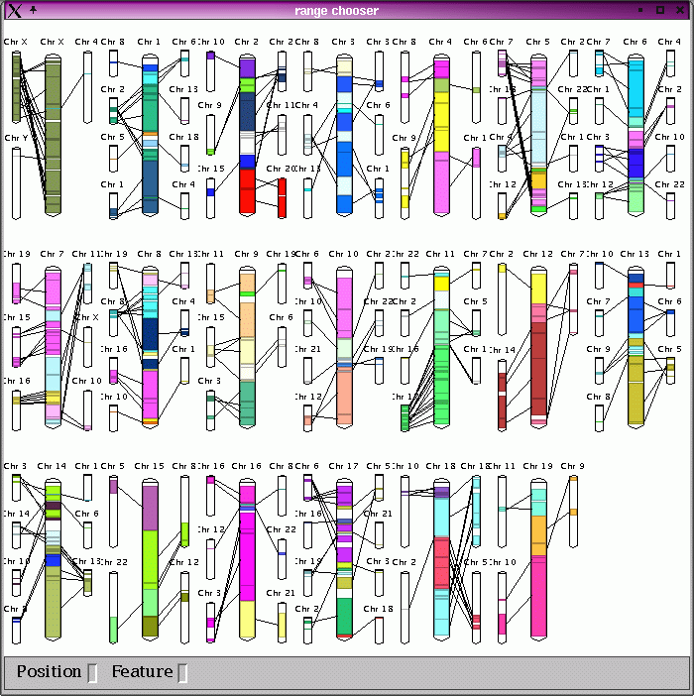
Human/mouse synteny region chooser
Notes:
Pretty chromosome picture that provides a graphical way to choose a region of homology to look at.

Slide 13
Coming soon
Upgrade to JDK 1.4
Handle non-gene annotations better
Improve Jalview
  Match/mismatch coloring scheme
  Get alignment sequences for Ensembl data
  Improve memory usage
Improve synteny view
Layer raw BLAST results over current region
Notes:
Can mention that Suzi is working on that last item.

Slide 14
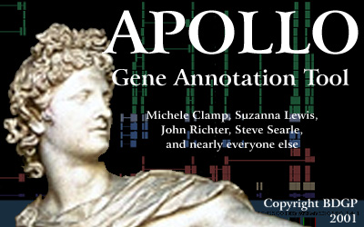
Code available at SourceForge: http://sourceforge.net/projects/gmod/
Installer available at http://ww.fruitfly.org/annot/apollo/install.html
Notes:
Leave this slide up while you answer any questions (or until next speaker starts his/her talk) so people can copy down the URLs.

