Slide 1

EAnnot: A genome annotation tool using experimental evidence
Aniko Sabo & Li Ding
Genome Sequencing Center
Washington University, St. Louis

Slide 2
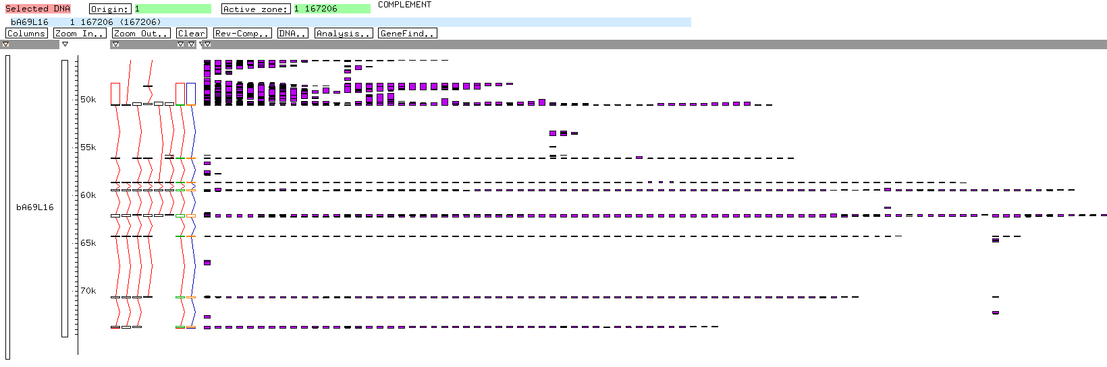
Challenge….
Manual annotation of human chromosomes 2 and 4
Overwhelming amount of expression sequence data for annotators to review

Slide 3
Why was EAnnot created?
EAnnot = Electronic Annotation
Created to aid manual annotation by removing the most time consuming and repetitive tasks:
  Initial creation of gene models
  Evidence attachment
  Evaluating CDS translation
  Locus information addition

Slide 4
How does EAnnot work?
INPUT: mRNA, EST,
protein alignments
INPUT: Genomic sequence
(clones, contigs, chromosomes)
STEP 1: Gene boundaries created based on
strand assignment, sequence overlap, clone linking
STEP 2: mRNAs and ESTs clustered, gene models created,
Exon/intron boundaries fine tuned using splice table
STEP 3: gene models evaluated, corrected based on protein data
STEP 4 OUTPUT: annotated gene models

Slide 5
STEP 1: Gene boundaries created based on
strand assignment, sequence overlap, clone linking
Gene boundaries
Clone linking
Same strand, sequences overlap
ESTs do not overlap
Paired end reads

Slide 6
STEP 2: mRNA and EST clustering, gene models created
Multiple EST and mRNA alignments
gene models

Slide 7
STEP 3: gene models evaluated, corrected based on protein data
DNA Translation DNA Translation
Frame
shift
Gene model translation is compared with matching protein from GenBank.
If there is discrepancy EAnnot tries to adjust gene model to resolve frame shifts, insertions and deletions.
*
STOP
3’

Slide 8
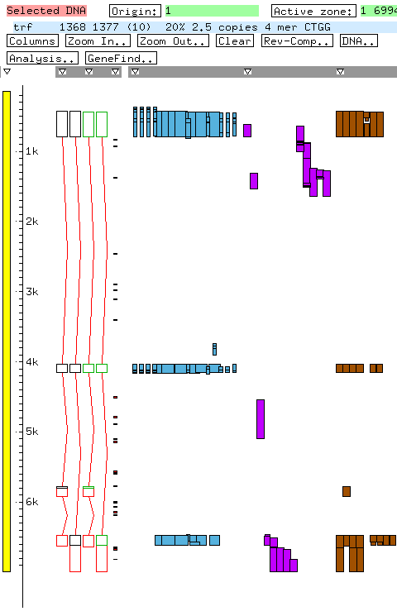
STEP 4: OUTPUT: gene models
Expression sequence data
Gene models

Slide 9
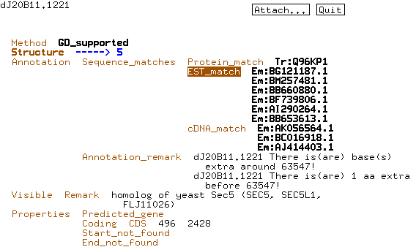
STEP 4: gene models annotated
Supporting evidence
Protein
EST
mRNA
Locus information

Slide 10
Unresolved problems with CDS are placed in remark field for the annotators

Slide 11
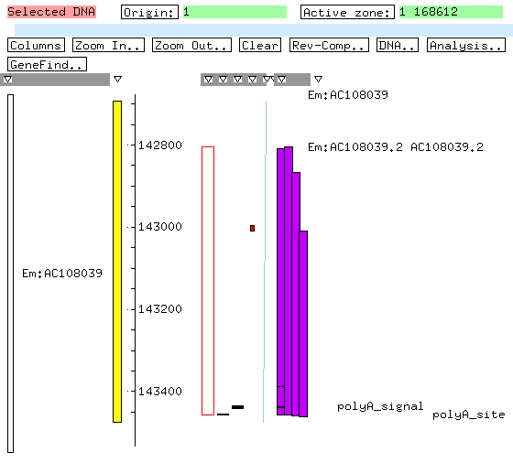
PolyA signal and site annotation
spliced and non-spliced ESTs and mRNAs with PolyA tail
The presence of a polyA site/signal
in non-spliced ESTs is additional evidence
for putative genes
PolyA signal
PolyA site

Slide 12
EAnnot performance evaluation
Human chromosome 6 annotation (Sanger)
  Manual annotation: 1557 genes, 3271 transcripts
  EAnnot annotation: 1724 genes, 5266 transcripts
Gene level:
87% manually annotated genes overlap EAnnot genes
20% EAnnot don’t overlap manual
Splice site level:
  sensitivity 86%, specificity 86%
EAnnot can be a good stand alone annotation tool

Slide 13
Comparison with chr6 manual annotation
Eannot gene models the same
as manually annotated

Slide 14
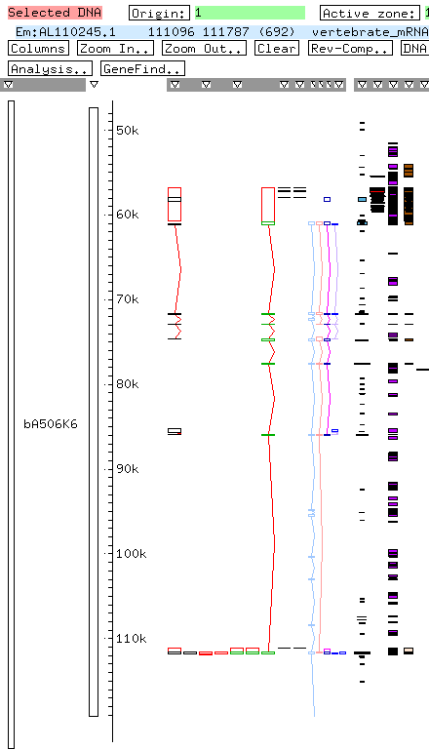
Comparison with chr6 manual annotation
Manual annotation used rat mRNA
Rat mRNA did not pass threshold
Eannot split gene model

Slide 15
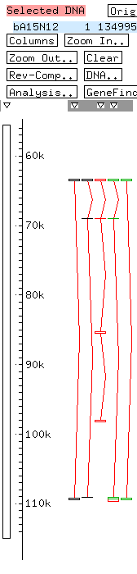
Comparison with chr6 manual annotation
Eannot missed
supporting EST did not pass threshold

Slide 16
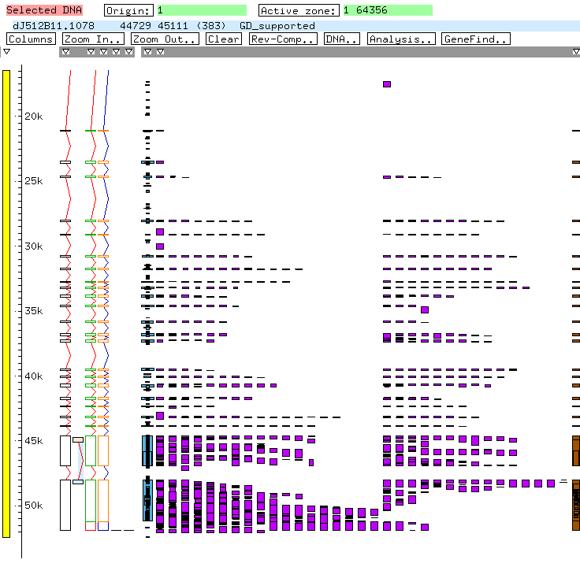
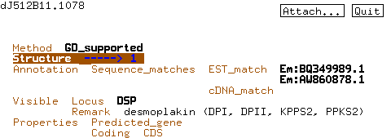
Comparison with chr6 manual annotation
Eannot created additional splice form

Slide 17
Using EAnnot in annotation of non-human genomes:
Example Histoplasma capsulatum
Issues Strategies
Organism specific expression data not abundant in GenBank
Use all available data
Gene stitching, merging data
Average homology low
Lower identity and gap thresholds
Genes different than vertebrate genes; large exons, small introns
Lower gene and intron size parameter
Splice consensus preference
Organism specific splice table
Splice variants
Splice variants based on organism specific expression data

Slide 18
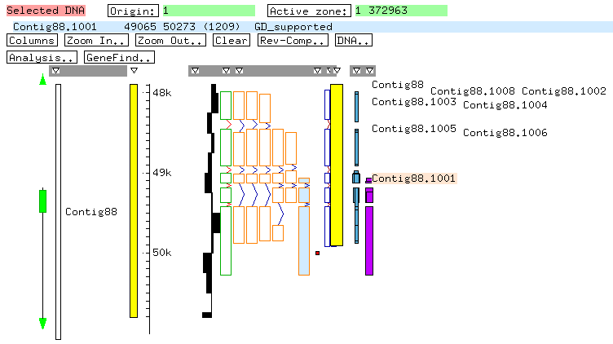
Merging depends on the type and quality of the underlying data
Histoplasma EST based model
Protein based models
Merged model

Slide 19
Manual annotation:
EAnnot saves time by creating gene models and attaching information (supporting evidence, CDS evaluation, locus)
Increases accuracy and consistency
EAnnot can be used as stand alone gene prediction tool
Future: other formats in addition to AceDB

Slide 20
GSC annotation group:
Aniko Sabo
Li Ding
Rekha Meyer
Tamberlyn Bieri
Phil Ozersky
Nicolas Berkowicz
LaDeana Hillier
Kym Pepin
John Spieth

Slide 22
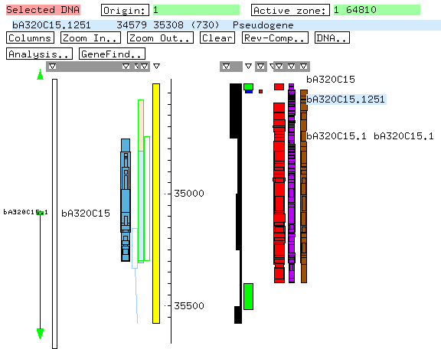
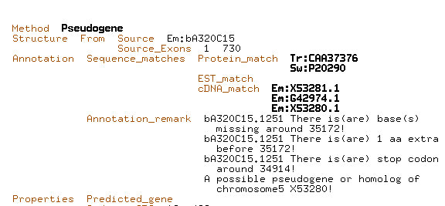
Annotates pseudogenes based on RefSeq locus link information and fish banding patterns

