Slide 1



The State of GMOD
Scott Cain
GMOD Project Coordinator
Ontario Institute for Cancer Research (OICR)
scott@scottcain.net
March 2011 GMOD Meeting
US National Evolutionary Synthesis Center (NESCent)
5 March 2011
Sponsored by

Slide 2
GMOD is …
A set of interoperable open-source software components for visualizing, annotating, and managing biological data.
An active community of developers and users asking diverse questions, and facing common challenges, with their biological data.

Slide 3
Software Releases
GBrowse 2.00-2.26
JBrowse 1.2
Chado 1.1-1.11
Tripal 0.21
Galaxy
InterMine 0.96
Notes:
Components that have a publicly hosted site:
Galaxy, MAKER Web Annotation Service, WebGBrowse
Flip side to not being monolithic:
Sometimes integration is not smooth.

Slide 4
Software New to GMOD
WebGBrowse
  Web interface for creating GBrowse instances
IGSA
  “Biologist-friendly” interface for Ergatis
Notes:
Anything else?

Slide 5
Google Summer of Code
Hopefully!
http://gmod.org/GSoC
Cooperative application between Reactome, WormBase, and GMOD
9 suggested ideas with 8 possible mentors (and many more should the need arise)
Notes:
Anything else?

Slide 6
PAG 2011
San Diego/January
  GBrowse tutorial
    Used a Ubuntu VMware instance
    Attended by about 50 people
  GMOD Workshop
    Presentations on GBrowse_syn, Galaxy, MAKER, Tripal
    Attended by about 80 people
  At least 25 workshops, tutorials and posters involving GMOD projects
Notes:
Anything else?

Slide 7
GMOD.org Migration
Moved from CSHL to OICR
A year in the making
Updated the News entry interface—way easier to add items:
  Create a page
  Add a template at the bottom:
    “{{NewsItem|2011/03/05}}”
Notes:
Anything else?

Slide 8
GMOD issue in Database journal
“Virtual” issue
Theory, tutorial or community papers
Notes:
Anything else?

Slide 9
Upcoming GMOD Meetings
October 2011: Toronto, Canada,
April 2012: Washington, DC (in conjunction with the Biocurator meeting)
Notes:
Anything else?

Slide 10
GBrowse 2 Update
2.0 release:
  Distributed databases and rendering
  User accounts/track sharing
  Wig, BigWig and BAM support
  AJAX track rendering
  Automatic summary tracks
2.2 release:
  User accounts improved
  Details multiplier
  iPad compatibility
  Ruler
Notes:
Anything else?

Slide 11
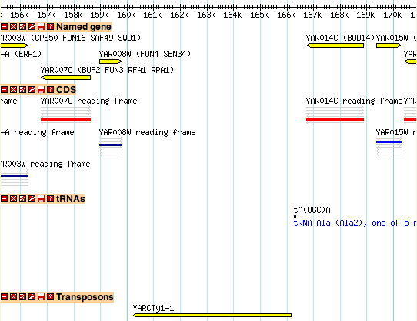
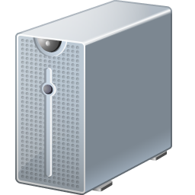
GBrowse 2 Update
MySQL/
GFF
Chado
BAM
Pg/SFS
Notes:
Anything else?

Slide 12
Local Demo
http://localhost/cgi-bin/gb2/gbrowse/yeast_mysql/
Notes:
Anything else?

Slide 13

Acknowledgements
GBrowse
Lincoln Stein
Anthony deCatanzaro
Christopher Vandevelde
Peter Ruzanov
Ian Davies
GMOD
More people than I could possibly name, and you!
NESCent
Todd Vision
Hilmar Lapp
Danielle Wilson
Barbara Mitchell
Duke
Jim Hodges

