Slide 1
GMOD Meeting
Stan Dong
Saccharomyces Genome Database

Slide 2
Textpresso
New build with 43,426 papers, 44,690 abstracts and 3.2 million key words.
New machines.
Plan to port textpresso to a DBMS (mysql 5.0)

Slide 3
blastGraphic
Version 0.02 released
Support BLAT search
Bug fixing

Slide 4
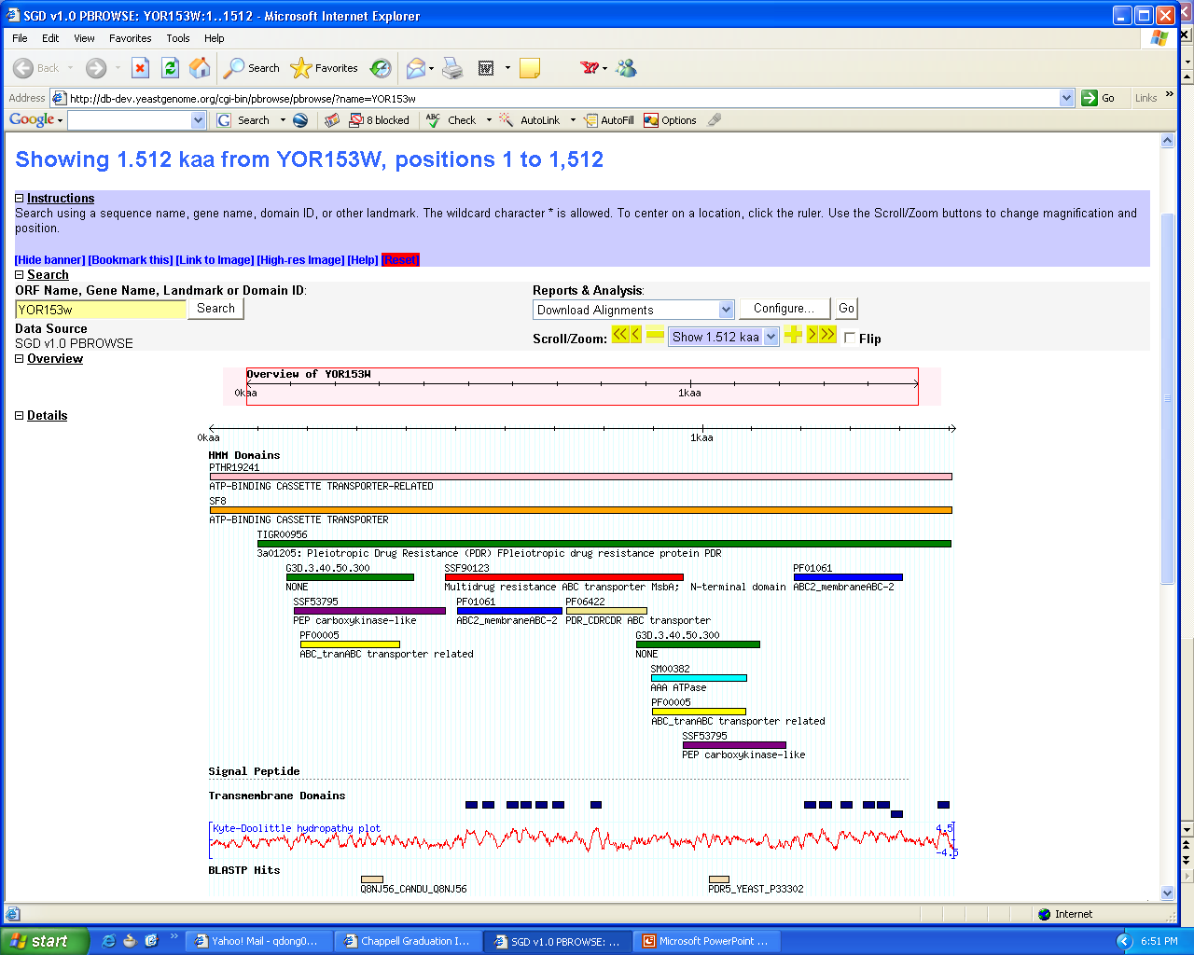
Protein data in GBrowse

