Slide 1



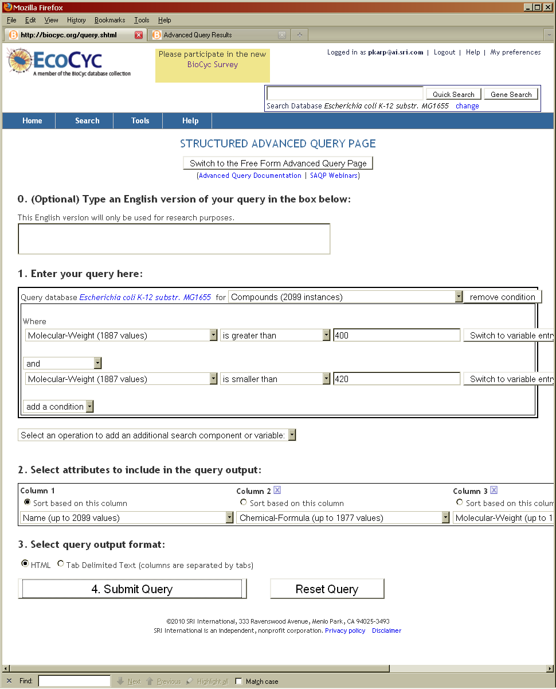
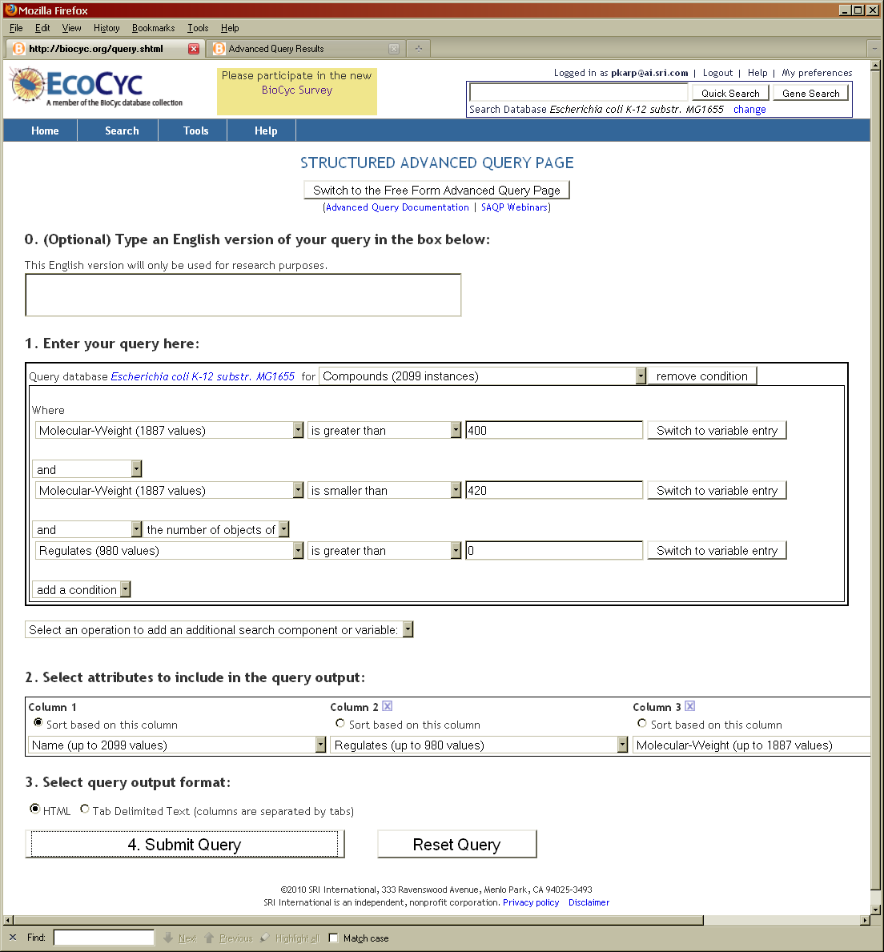
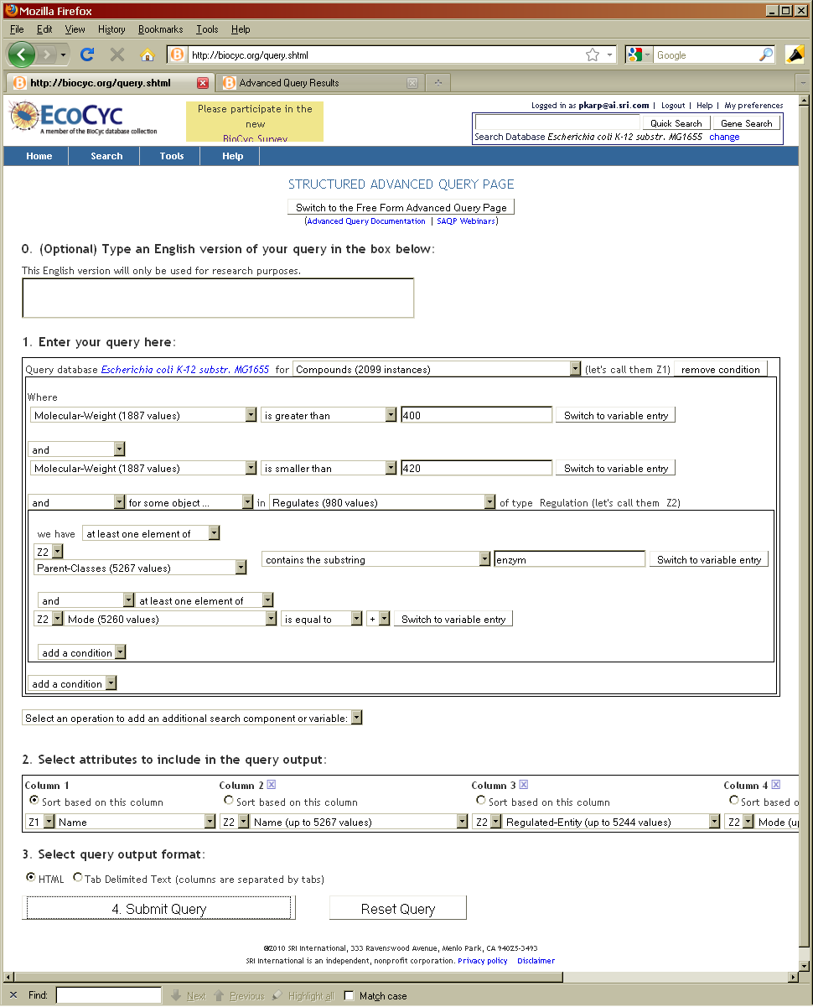
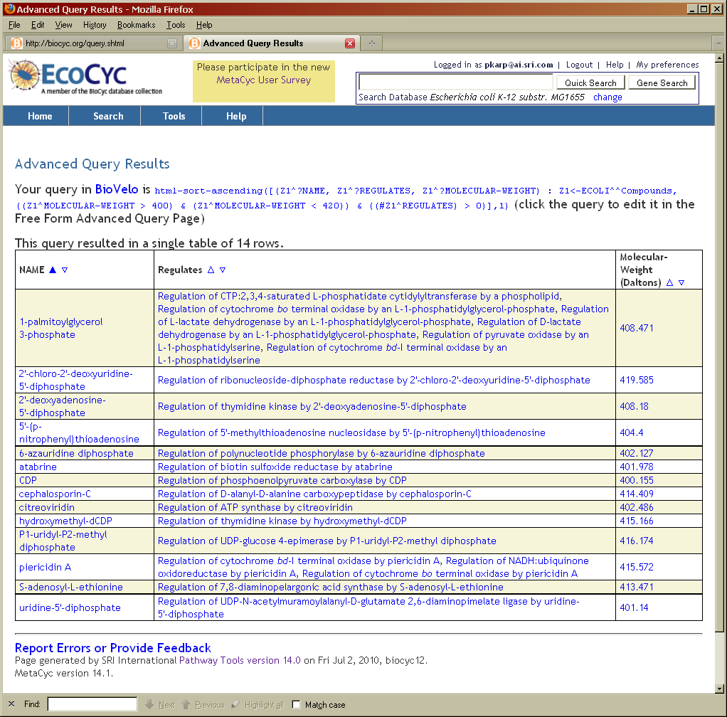
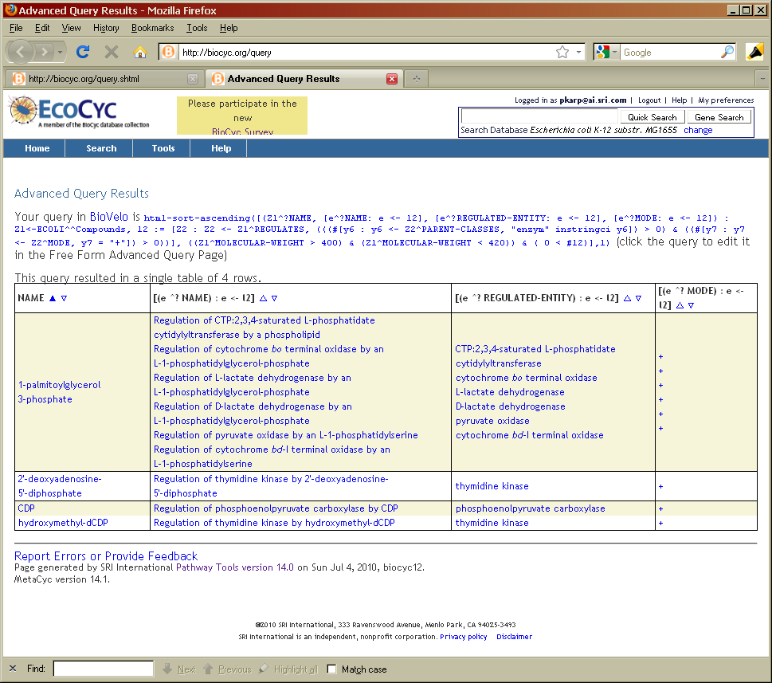
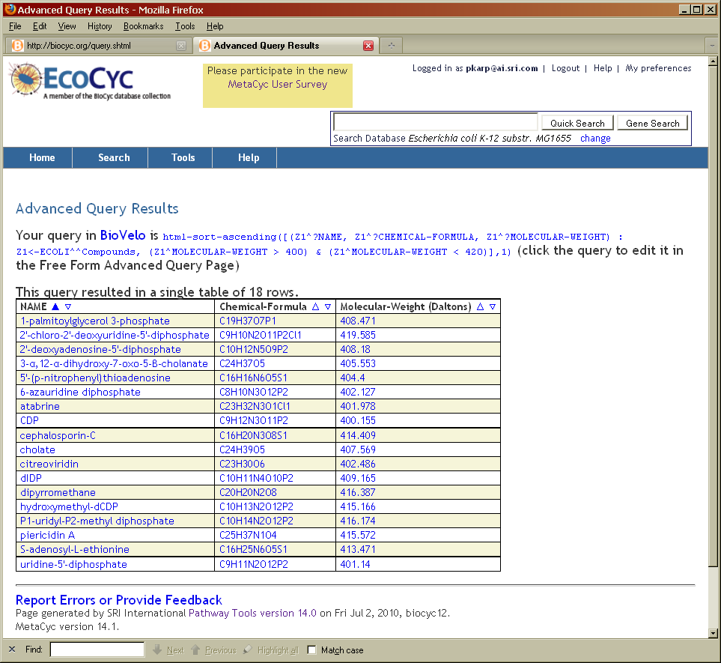
Poster E02
An Advanced Web Query Interface for Biological Databases
Peter Karp
SRI International
333 Ravenswood Ave, Menlo Park CA 94025
650-859-4358
Peter D. Karp, Mario Latendresse
Bioinformatics Research Group, SRI International, Menlo Park CA USA
bioinformatics.ai.sri.com/ptools/ BioCyc.org
1. Introduction
2. Structured Advanced Query Form
4. Pathway/Genome Databases on the Internet
The Pathway Tools software [1] is used to create, query, curate, and analyze Pathway/Genome Databases (PGDBs). A PGDB integrates information about genomes, metabolic pathways, and regulatory networks.
Pathway Tools operations include:
  Query and update genome and pathway annotation
  Prediction of metabolic network from genome sequence
  Visual analysis of omics datasets
  Comparative analysis
  Network analysis and debugging
A large number of PGDBs are accessible on the Internet from Pathway Tools based Web sites that provide the exploration capabilities described here.
Pathway Tools Availability
  Freely available to academics and non-profits. Licensed by 2,100 groups.
  Runs on PC/Linux, PC/Windows, Macintosh
References:
[1] Karp, P.D. et al, Briefings in Bioinformatics 2010 11:40-79.
[2] Latendresse, M. and Karp, P.D., Database 2010.
Supported by grants GM75742 and GM080746 from the National Institutes of Health.
Writing precise and complicated queries against biological databases (DBs) usually requires programming skill
Most Web-based DB query forms are quite restricted in power of queries they can support
Pathway Tools Structured Advanced Query Form (SAQP) [2]:
  User friendly
  Supports precise and complicated queries
  Supports multiple conditions and connectives
  Supports connections between object types
  Schema driven
  Interactive documentation on DB schema
Where to find the SAQP on the Web:
  http://biocyc.org/query.shtml
  Search -> Advanced at any Pathway Tools driven Web site
Available PGDBs include the following. Web links to all available from http://BioCyc.org/otherpgdbs.shtml or find them using Google
Microbial
BioCyc – 670 microbial PGDBs including EcoCyc (E. coli K-12)
BeoCyc – 33 Bioenergy organisms
ScoCyc – Streptomyces coelicolor
TBCyc – Mycobacterium tuberculosis
PseudoCyc – Pseudomonas aeruginosa
PATRIC – Bacterial pathogens
ApiCyc – 8 apicomplexan PGDBs
Fungal
YeastCyc – Saccharomyces cerevisiae
CalbiCyc – Candida albicans
Plant
SolCyc – 7 Solanacea PGDBs
ChlamyCyc – Chlamydomonas reinhardtii
AraCyc – Arabidopsis thaliana
RiceCyc – Oryza sativa
PlantCyc – General plant PGDB
Mammalian
MouseCyc, HumanCyc, CattleCyc
3. Example Queries and Their Results
Add additional condition to previous query:
The multivalued slot Regulates, which lists regulation interactions that the compound regulates, must have more than 0 values
Add two additional conditions to previous query:
The regulation interaction must have a parent class whose name includes the string “enzym”, indicating that it involves regulation of enzyme activity
The mode of regulation must be positive (activation)
Simple initial query:
Find Compounds whose molecular weight is between 400 and 420
Show a result table that includes the compound name, chemical formula, and molecular weight

