Slide 1
DAS Current Situation and Future Developments
Jonathan Warren
DAS coordinator for the Sanger Institute
www.biodas.org
www.dasregistry.org
Notes:
I’m senior developer and das coordinator at the sanger, previously I was a bioinformatics consultant and used DAS many years ago as an “user”.

Slide 2
Contents:
What is DAS?
What is the history and current situation?
What are we doing at the moment and where are we going?

Slide 3
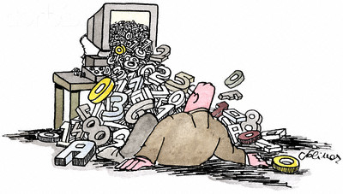
Notes:
DAS Stops us from suffering under too much data to manage.
Allows us to download annotations for regions of interest rather than for whole genomes or databases.
Allows data providers to be in control of their annotations displayed to the world and can keep them up to date for users.

Slide 4
What is DAS?
Distributed Annotation System
Based on HTTP and XML
User perspective
  Client
  Choose coordinate system
  Connects to one registry for DAS server list
  Request a region of interest from the reference and many annotations from the DAS servers.
Notes:
Distributed Annotation System, allows data providers to provide their data over the web in a common format.
A set of possible http requests and standard xml responses.
Ensembl, Apollo, Gbrowse, Spice for proteins.
Coordinate system can be a genome build such ncbi_36 or uniprot protein sequences for alignments.
The client can then get a list of das sources that are available for each coordinate system which the user chooses ones of interest
The client/user then chooses a region of interest e.g. human chromosome 1 bases 1 million 1.1 million.
The client then shows the annotations on this region from local sources as well as remote das sources.

Slide 5
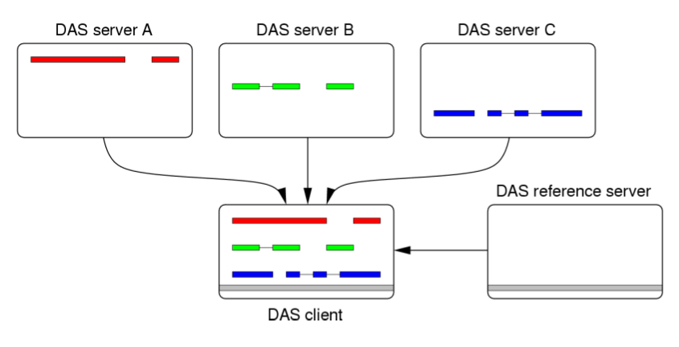
What is DAS?

Slide 6
What is DAS?
Clients are “intelligent”
Servers should be spec compliant
  Common request format
  Common xml format returned

Slide 7
History
2001 The Distributed Annotation System
Robin D Dowell, Rodney M Jokerst, Allen Day, Sean R Eddy and Lincoln Stein
DAS1.53E + DAS2 running in parallel.
At workshop in March this year DAS1.6E is expected to provide the functionality that DAS2 users desired => DAS2 is dead?
1.6 spec has new features and is a consolidation of the way DAS is being used.
1.6E has extensions being developed.
Notes:
DAS1 in early 2000
DAS1.53E later with support for proteins added and the registry
Majority of users see no great advantage of moving to DAS2
100s or DAS1 servers compared to a handful of DAS2 servers.

Slide 8
Some DAS 1.5/1.6 Commands:
Sources
Features
Sequence
types
Stylesheet
Structure
Alignment
Interaction

Slide 9
Current Situation- addressing issues:
Represent features with more than two levels 1.6
Reliably relate feature types to a more structured ontology 1.6

Slide 10
Addressing issues cont:
Easily identify when two DAS servers are using the same coordinate system (doable with help of Sanger DAS registry)
Have a standard way to create and edit DAS features 1.6E

Slide 11
Addressing issues cont:
Verify whether a DAS server is compliant with the specification.
  Critical for improving interoperability between clients and servers developed by different groups. The Registry

Slide 12
What are we doing?
Increasing validation capability of the registry for 1.53E and upcoming 1.6E spec
RelaxNG
  http://www.dasregistry.org/validation/sources.rng

Slide 13
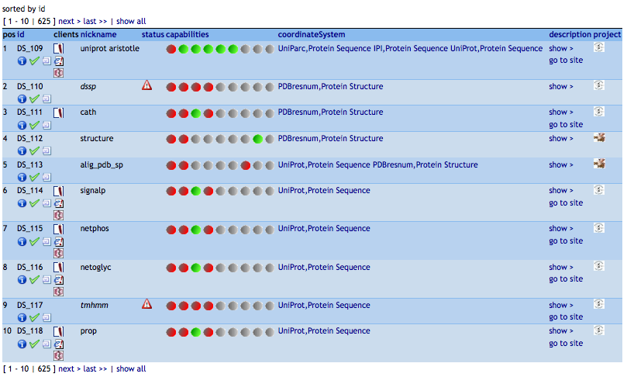

Slide 14
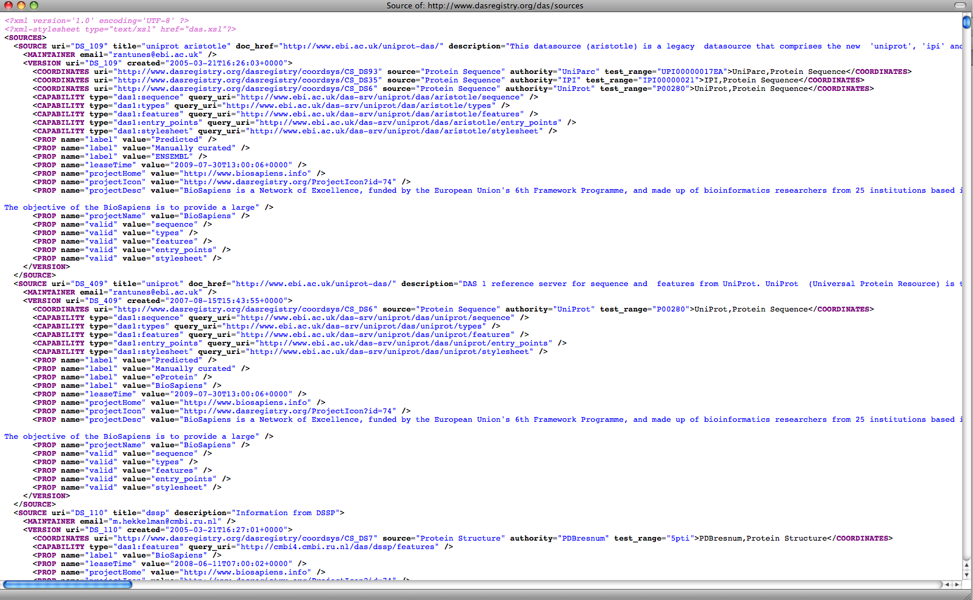
http://www.dasregistry.org/das/sources
http://www.dasregistry.org/services/das:das_directory?wsdl

Slide 15
Currently?
More validation (headers and feature by id).
Capability of bulk uploading/mirroring DAS sources to Registry (sources cmd).
  Adding all of ensembl genomes (bacteria and viruses) as DAS sources and to the registry.
Completing the 1.6 spec - hierarchies, nextFeature.
Updating client libraries and servers to work with both 1.53 and 1.6 spec

Slide 16
Future continued:
New user interface to the registry for faster searching using Lucene - also limited version available from Sanger and EBI sites.
Greater supprt for ontologies-give me all das sources that provide genes?

Slide 17
Libraries:
PERL
  Proserver, LDAS - servers
  Bio::Das::Lite - client library
Java
  Dazzle, MyDAS - servers
  Dasobert - client library

Slide 18
Some DAS providers:
* Affymetrix
* BioSapiens servers
* Ensembl server
* KEGG DAS
* Sanger DAS server
* EBI Genomic DAS server
* EBI Protein DAS server
* Uniprot DAS server
* TIGR's listing of servers
* UCSC server

Slide 19
Some clients:
* Ensembl
* Spice
* Dasty
* Pfam
* STRAP
* DASher

Slide 20
Useful links:
www.biodas.org
www.dasregistry.org

Slide 21
Acknowledgments:
Andy Jenkinson (EBI)
James Smith
Andreas Prlic
Gregg Helt
Lincoln Stein
Tim Hubbard
The DAS community

