Slide 1

An Information Retrieval and Extraction System
for C. elegans Literature
www.textpresso.org

Slide 2


Slide 3
Is full text important???
Case Studies:
35% protein-protein interactions not mentioned in abstract
Blaschke and Valencia (2001)
7 out of 19 unique interactions were present in the abstract
Friedman et al (2001)
Full text contains redundancies!

Slide 4
System Specifications
Queries:
article classification keyword searches
semi-semantic queries batch retrieval of facts
Return:
citation abstract full text paper sections
Target Users:
researchers curators bioinformaticians/NLP

Slide 5
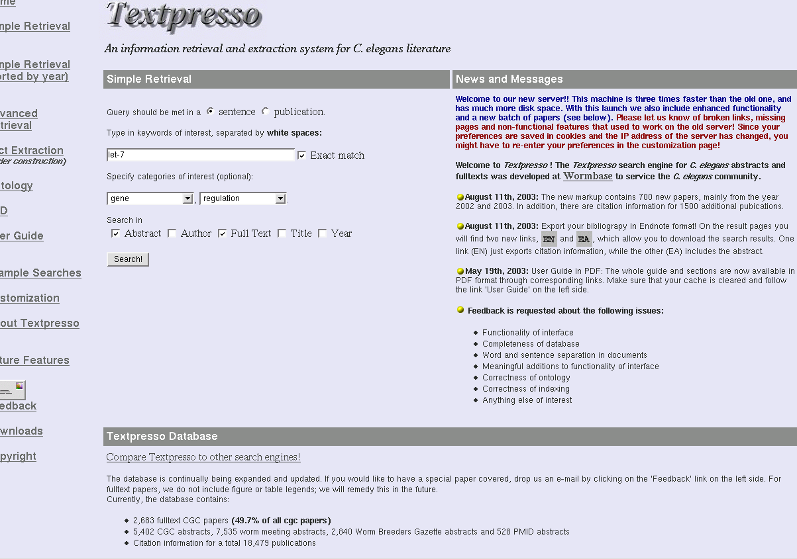

Slide 6
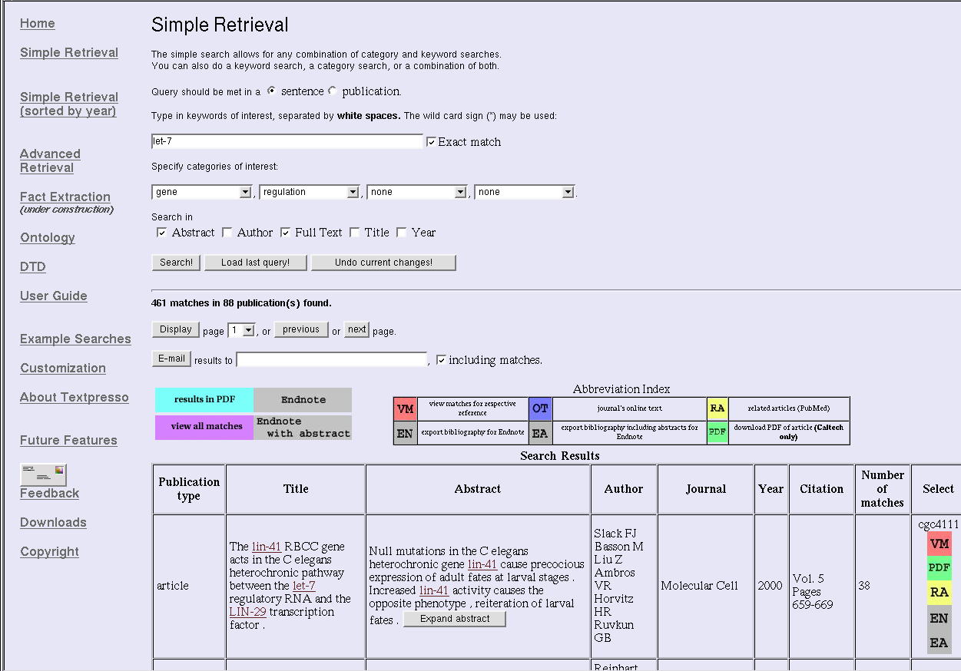

Slide 7
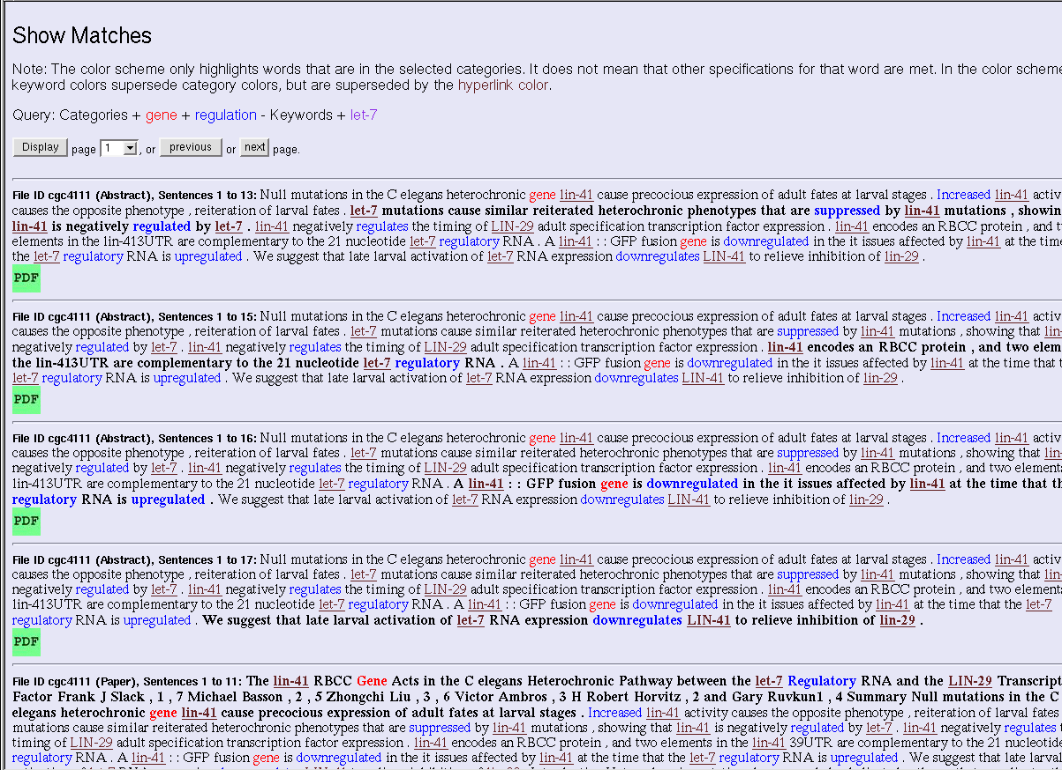

Slide 8
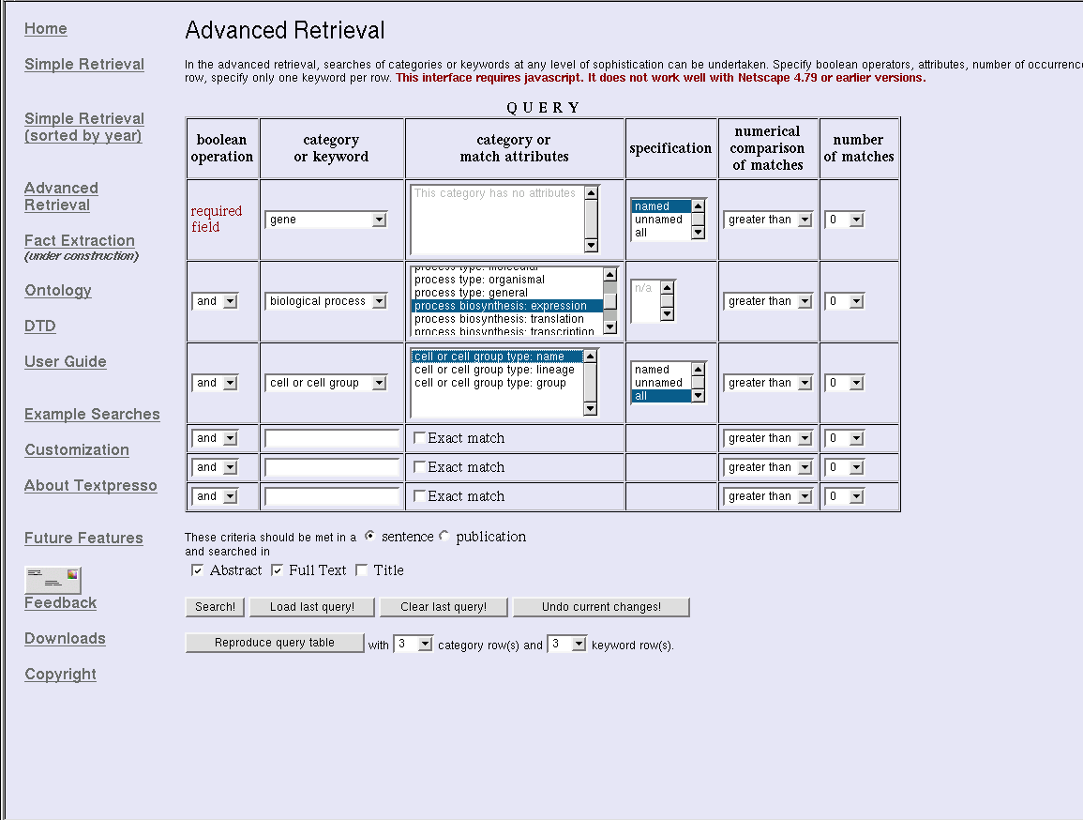

Slide 9
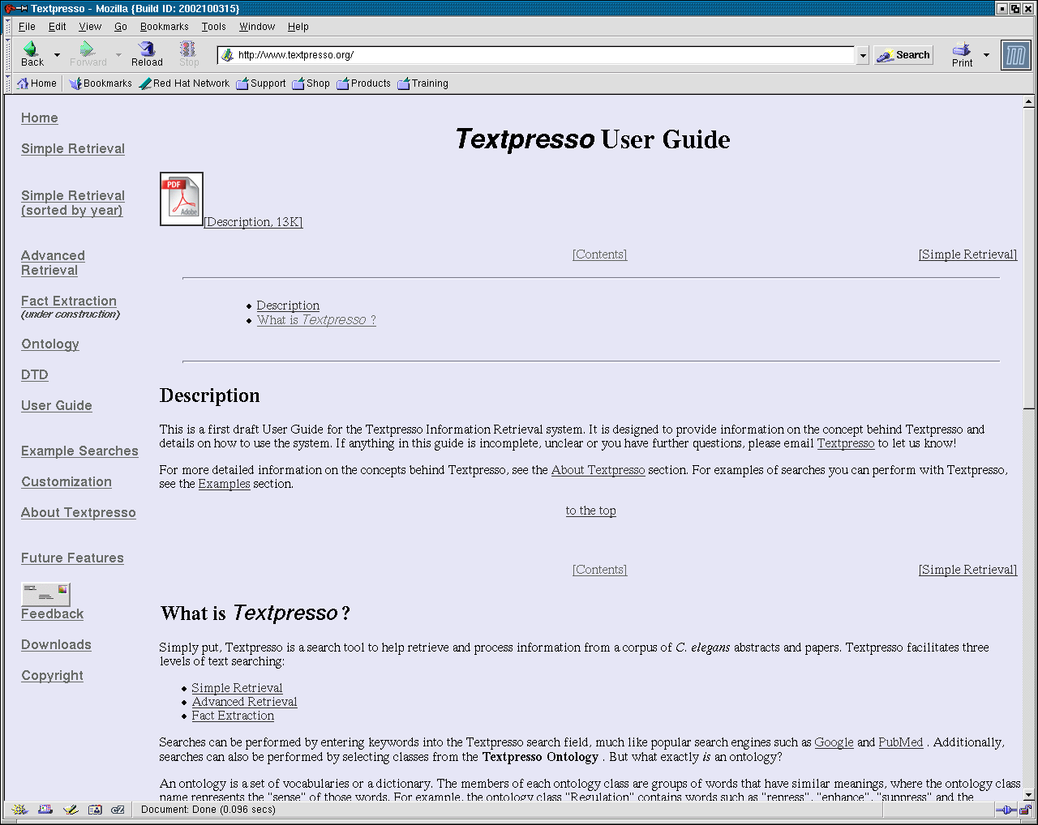

Slide 10
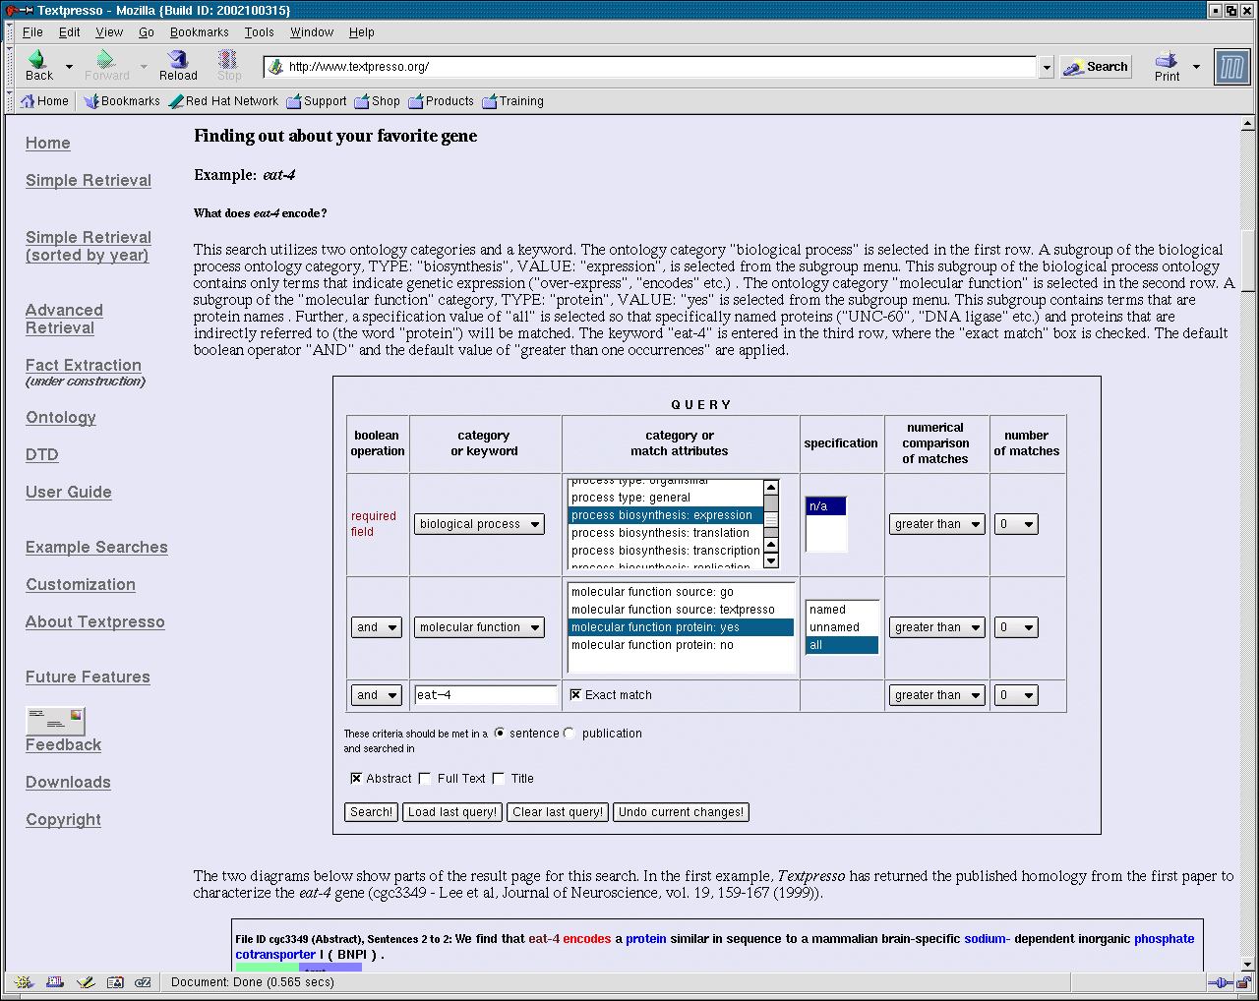

Slide 11
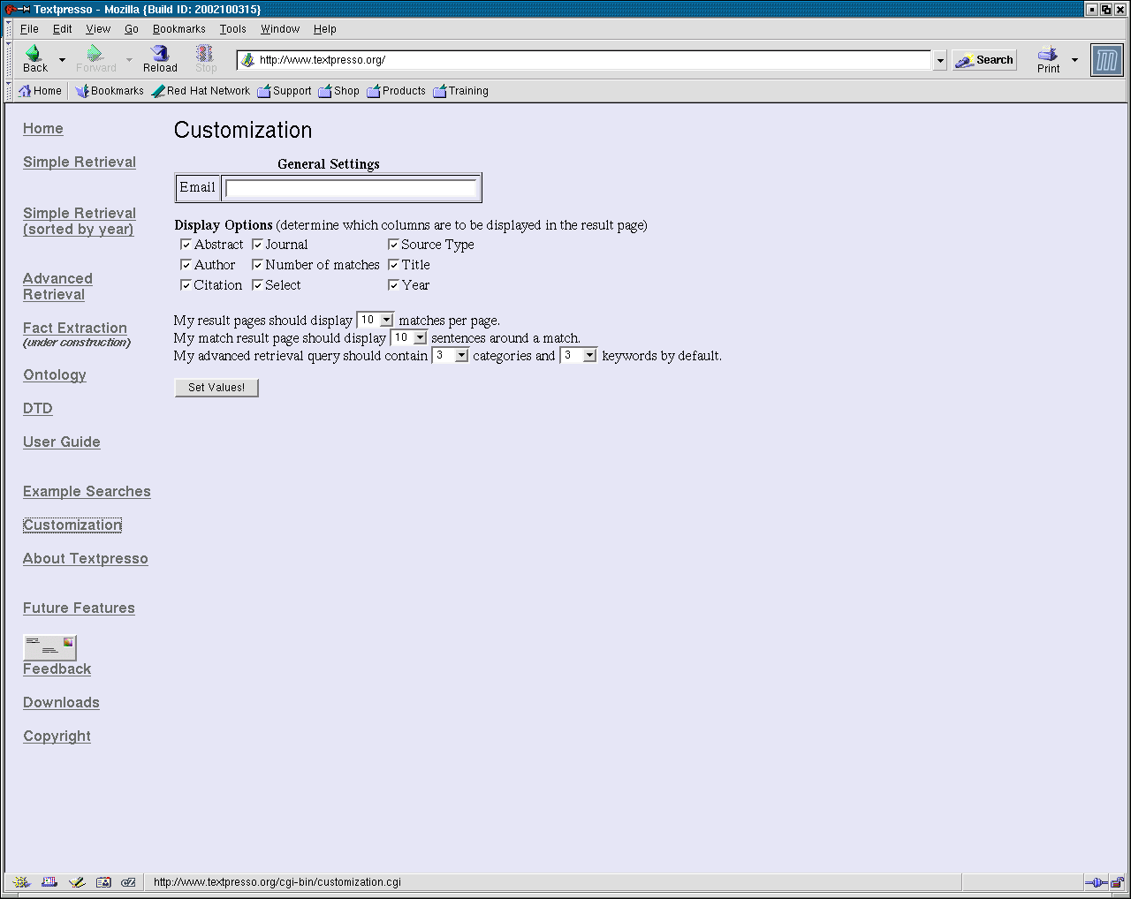

Slide 12
gene
transgene
allele
nuclei acid
organism
clone
strain
sex
entity feature
life stage
phenotype
drugs and small molecules
molecular function
cell and cell group
cellular component
mutant
Biological Entities
“Plugin Dictionaries”
Specific
Actions, Facts or
Circumstances that
Relate Two Entities
method
consort
effect
purpose
pathway
regulation
action
physical association
comparison
spatial/time relation
localization
involvement
characterization
biological process
descriptor
“Common Sense”
Partially Generic
Semantic
bracket
determiner
conjunction
auxiliary
conjecture
negation
pronoun
preposition
punctuation
Generic

Slide 13
Gene
Regulation
Regulation
Biological
Process
Biological
Process
Molecular
Function
Gene
….. activation of let-7 RNA expression downregulates LIN-4 to relieve inhibition of lin-29.
<?xml version="1.0" encoding="ISO-8859-1" standalone="no" ?>
<!DOCTYPE article SYSTEM "/var/www/html/textpresso.dtd">
<article> //
<sentence id='s7'> //
<process grammar ='NN' source='textpresso' type='general' biosynthesis='no'> activation</process>
<pposition grammar ='IN' type='of'> of </pposition>
<gene grammar ='JJ' reference='direct'> let-7 </gene>
<text>RNA</text>
<process grammar ='NN' source='textpresso' type='molecular' biosynthesis='expression'> expression</process>
<regulation grammar ='NNS' type='negative'> down regulates</regulation>
<function grammar ='NNP' reference='direct' source='textpresso' protein='yes'> LIN-41 </function>
<pposition grammar ='TO' type='to'>to </pposition>
<text>relieve</text>
<regulation grammar ='NNS' type='negative'> inhibition </regulation>
<pposition grammar ='IN' type='of'> of</pposition>
<gene grammar ='NNP' reference='direct'> lin-29 </gene>
<text>. </text>
</sentence> //
</article>

Slide 14
What genes does let-7 regulate?
Keyword: “let-7”
Category: “Regulation”
Category: “Gene”

Slide 15
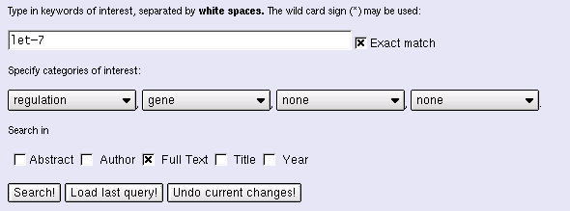
www.textpresso.org
Keyword
Categories
Facts returned from Journal articles!

Slide 16
Electronic
PDF
Abstracts
Titles
Citations
PDF2text
Wormbase Database
Text
preprocessor
Link Maker
Formatted
Text
Journal
web-site
text2XML
Textpresso
Ontology
PubMed
Annotated
Text
Citation:
Year
Author
Keywords
Textpresso Database
Index Maker

Slide 17
Progress since April…..
Installed Textpresso on a new server
Expanded Textpresso corpus (~2,700 full text)
Preparing PDF2text for release

Slide 18
PDF2text
Software to convert electronic journal article PDF’s
to correctly flowing ASCII text
Written in Perl and Python by Robert Li @ Caltech
Relies on Journal specific templates (Daniel Wang)
Utilizes .pos output of generic pdf2text (xpdf)

Slide 19
Two column PDF Journal format:
//
Null mutations in the C. elegans heterochronic gene
lin-41 cause precocious expression of adult fate at
21 nucleotide regulatory RNA. A lin-41::GFP fusion
gene is downregulated in tissues affected in late lar-
//
Typical conversion to ASCII text:
//
Null mutations in the C. elegans heterochronic gene 21 nucleotide regulatory RNA. A lin-41::GFP fusion
lin-41 cause precocious expression of adult fate at gene is downregulated in tissues affected in late lar-
//
pdf2text output:
//
Null mutations in the C. elegans heterochronic gene lin-41 cause precocious expression of adult fate at
//
21 nucleotide regulatory RNA. A lin-41::GFP fusion gene is downregulated in tissues affected in late lar-
//

Slide 20
Limitations
Doesn’t work so well on older PDF’s
Relies on uniformity of article format within Journal
Requires the development of templates

Slide 21
Progress since April…..
Installed Textpresso on a new server
Expanded Textpresso corpus (~2,750 full text)
Preparing PDF2text for release
Textpresso paper …. in progress
Begun Fact Extraction using Textpresso …

Slide 22
Extract C. elegans alleles from full text
eg vba-1(e2)

Slide 23
Text extraction pattern:
<gene><bracket><allele><bracket>
Template:
Result:
Gene
age-1
dpy-5
daf-16
lon-2
unc-32
osm-3
lin-29
unc-5
daf-2
Allele
hx546
e61
mg51a
e678
e189
p802
n333
e53
e1370
Evidence
cgc3008
cgc666
cgc5034
wbg14.1
wm97ab55
cgc2033
pmid31222
euwm2000
cgc3012
Sentence
...age-1(hx546)...
...expressed in....
.
.
.
.
.
.
.
osm-3(p802) was
found to be......
.
.
.
.
Accept
y/n?
y/n?
y/n?
y/n?
y/n?
y/n?
y/n?
y/n?
y/n?
Locus: $1
Allele: $3
Evidence: $paperref

Slide 24
Allele : te21
Gene oma-1
Reference [cgc5198]
Allele : s1733
Gene let-653
Reference [wbg11.1p21]
Allele : s1733
Gene let-653
Reference [cgc3721]
Allele : te51
Gene oma-2
Reference [cgc5198]
Allele : s1748
Gene let-655
Reference [cgc3120]
Allele : tm291
Gene pip-1
Reference [wm2001p213]
Allele : gm85
Gene fam-1
Reference [cgc2795]
Allele : gm85
Gene fam-1
Reference [cgc2978]

Slide 25
Total papers: ~ 2,000
gene ⬄ allele ⬄ reference: ~14,000
gene ⬄ allele: ~ 3,200 (~1,100)
allele ⬄ reference: ~ 3,200 (~1,500)
gene ⬄ reference: ~ 1,400
FILTER
~99%
uploaded to Wormbase
~14,000
~300
required manual resolution
- ~ 80 synonyms
- typo’s e.g. rol-2(e678) 160 hits
bli-2(e768) 17 hits
rol-2(e768) 2 hits

Slide 26
Lots of work to do…..
Increasing recall
  Anaphora resolution (5%-8%)
  Synonym recognition
Develop Textpresso Ontology
  Integrating open source ontologies (MeSH, UMLS)
  Pilot study of other MOD’s
Package and release software
Develop Fact Extraction

