Slide 1
WEB-BASED BIOINFORMATICS PIPELINES FOR BIOLOGISTS
Integrative Services for Genomic Analysis (ISGA)
Chris Hemmerich
Center for Genomics and Bioformatics
CONTACT: biohelp@cgb.indiana.edu

Slide 2
JUSTIFICATION AND HISTORY

Slide 3
ISGA BACKGROUND
Provide a high-throughput microbial annotation service to local biologists
  Reliable and pipelined execution
  Efficient maintenance
  Provide privacy and security for data
High-quality (automated) annotation
  Biologists able to customize parameters
  Able to incorporate new programs and pipelines

Slide 4
ERGATIS (ERGATIS.SOURCEFORGE.NET)
Web-based analysis pipeline tool
Wraps tools and utilities in “components”
Ability to add new components
Build new and customize existing pipelines
In-depth monitoring of pipelines
Underlying Workflow package supports SGE
XML/BSML common data exchange format
Includes prokaryotic annotation pipeline

Slide 5
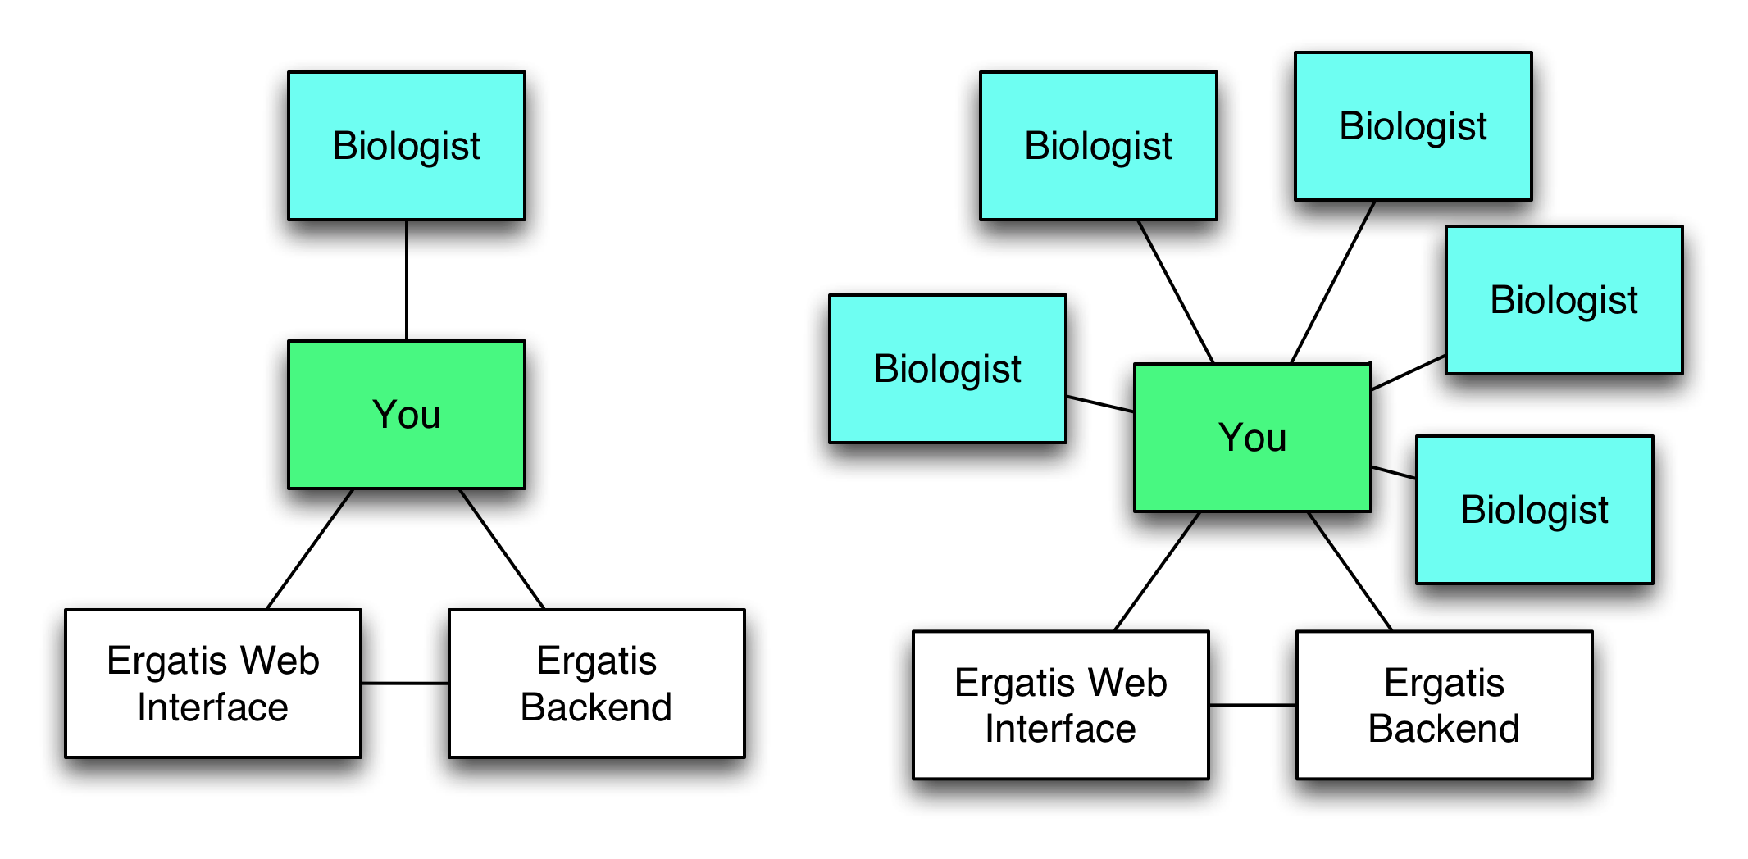
ERGATIS WORKFLOW

Slide 6
A SLIGHT CORRECTION

Slide 7
WHY NOT EXPOSE ERGATIS?
Insufficient accounts and permissions
Shared interface for building and customizing pipelines
Users must submit and retrieve results through filesystem
Pipeline monitoring interface is slow and complex.
Information of use to biologists is lost in “noise”
  High umber of components in a pipeline
  Complexity of configuration interface

Slide 8
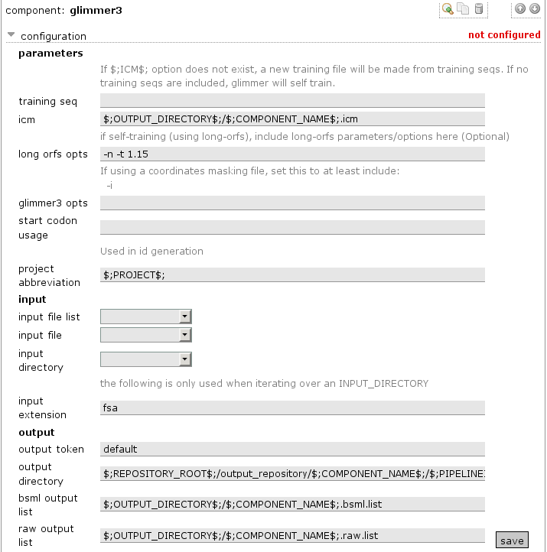

Slide 9
OUR SOLUTION
Develop an alternative interface for biologists that uses the Ergatis backend
  Administrators also use Ergatis
New interface features
  Accounts and permission system
  File management
  Simplify pipelines and component management by reducing functionality
  Provide form validation, documentation and other features to improve usability

Slide 10
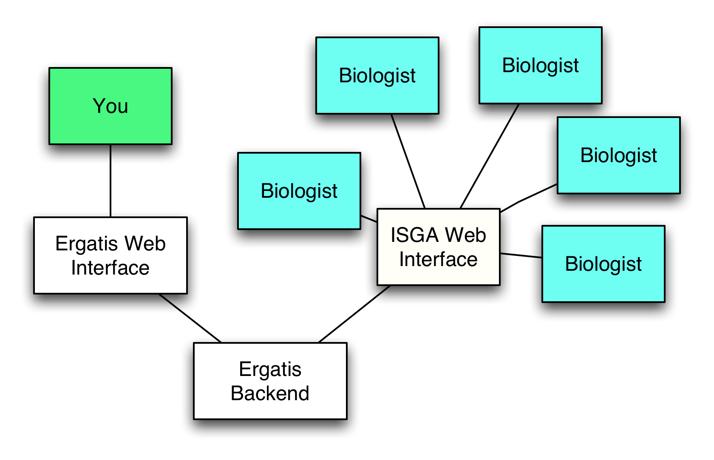
THE GOAL

Slide 11
ISGA: WHIRLWIND TOUR

Slide 12
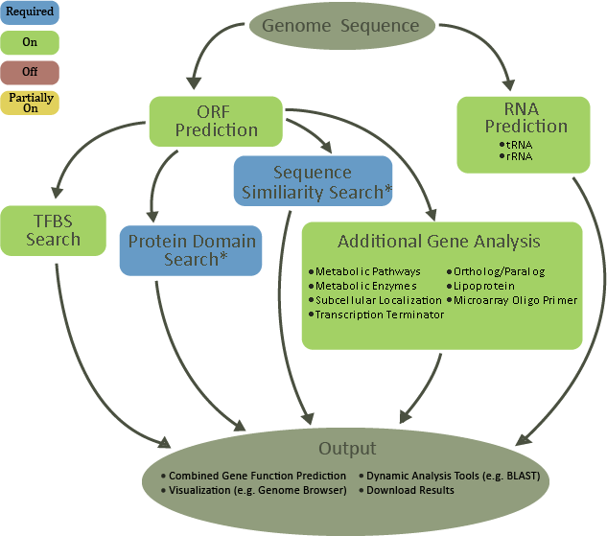

Slide 13
PIPELINE CUSTOMIZATION
Ability to toggle some clusters on/off.
Some clusters contain parallel programs that can be independently toggled.
Ability to edit component parameters
Ability to save customizations to use with later data sets

Slide 14
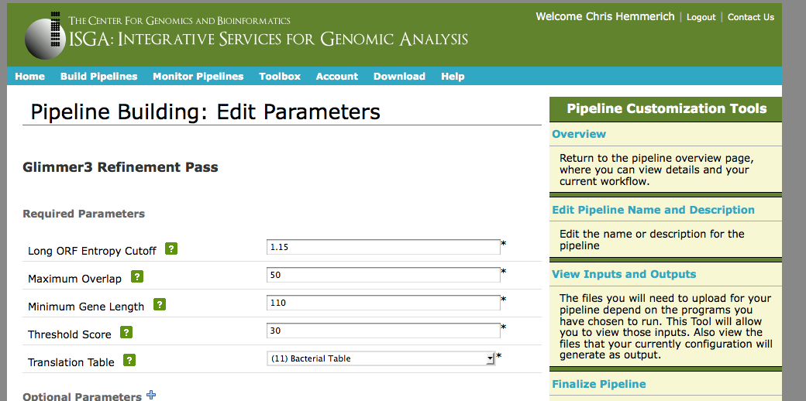
PIPELINE BUILDER

Slide 15
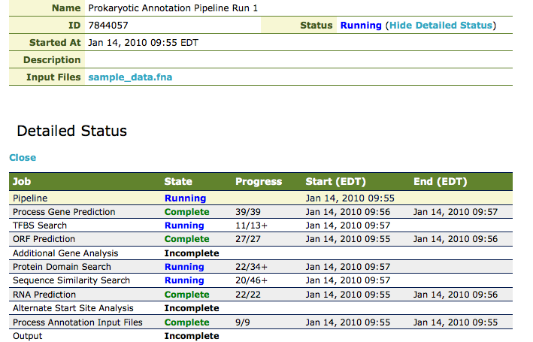
RUN STATUS

Slide 16
ISGA PIPELINE EXECUTION
ISGA writes configuration and pipeline definition files to the Ergatis installation
ISGA then triggers execution through Ergatis and receives the pipeline id in return
Status is updated directly from Ergatis XML files
Selected output is copied to ISGA, and the rest is available for download if needed

Slide 17
ISGA TOOLBOX
Includes a GBrowse instance for visualizing annotation results
BLAST support for pipeline results as query or database
Text search against annotation results
Tools can be executed over SGE and monitored

Slide 18
ADMINISTRATIVE TOOLS
Lightly monitor status in ISGA w/ link to Ergatis page
Notification when pipeline fails, ISGA will pick up a resumed pipeline
Ability to redirect ISGA to a cloned Ergatis pipeline or cancel (w/ user notification)
Disable new job submissions

Slide 19
UNDER THE HOOD
ISGA Web Interface
pipeline builder
genome browser
monitor pipelines
download results
blast search
PostgreSQL Database
pipeline specification
user account
annotation results
Ergatis
XML configuration
workflow engine
Shared Storage
Sun Grid Engine
bioinformatics tools
input and results
computation nodes
job scheduler
ISGA Backend

Slide 20
UNDER THE HOOD (CONTINUED)
Perl & jQuery
Persistence = PostgreSQL & YAML & XML
Mason
MasonX::WebApp
Hacked up HTML::FormEngine

Slide 21
ADDING AN ERGATIS PIPELINE TO ISGA

Slide 22
64 Ergatis Components

Slide 23
FIRST: UNDERSTAND THE PIPELINE
ISGA takes a description of an Ergatis pipeline
  YAML
  Database Schema
  Ergatis component .config files
Document input and output of all components
Which components are optional?
  The user can upload previously generated data in their stead?
  Alternative data from the pipeline can be used?
  The pipeline is still useful without this functionality

Slide 24
SIMPLIFICATION
Our microbial annotation pipeline is composed of 64 Ergatis components
  Impossible to diagram for you on a slide or for a biologist on our web page
Many of these components are file format conversions, program iterations, database preparation, etc…
  They are not relevant to a high level view of the pipeline and offer no useful parameters for a biologist to customize

Slide 25
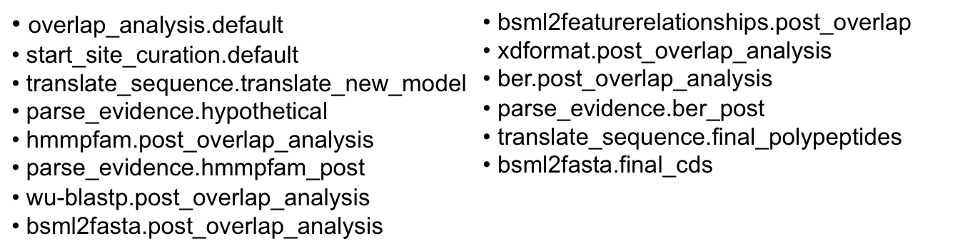
CLUSTERS OF ERGATIS COMPONENTS
Break the pipeline into biologically meaningful clusters of one or more components
  This is as much art as science, may depend on your audience
  Example: ‘Alternative Start Site Analysis’

Slide 26
COMPONENT CUSTOMIZATION
Scripts and XML files are unchanged
ISGA stores the configuration template for each component
Components with editable parameters have a YAML definition that is used to build the web form
These values are incorporated into the configuration template

Slide 27
COMPONENT TEMPLATE
--- !perl/ISGA::ComponentBuilder
Name: RNAmmer
Description: ‘RNAmmerpredicts 5s/8s, 16s/18s, and …’
Params:
- { templ: 'select', NAME: 'molecules', TITLE: 'rRNA Molecules', REQUIRED: 1, OPTION: ['ssu (5/8s rRNA)', 'lsu (16 /18s rRNA)', 'tsu (23/28s rRNA)', 'ssu and lsu', …], OPT_VAL: ['ssu' , 'lsu', 'tsu', 'ssu,lsu’, …], VALUE: 'ssu,lsu,tsu', DESCRIPTION: 'Declare what rRNA molecule types to search for.', CONFIGLINE: '___molecule___’ }
RunBuilderParams:
- { templ: 'hidden', NAME: 'project_id_root', TITLE: 'Project Id Root', REQUIRED: 1, DESCRIPTION: 'The Id root used in bsml id generation', CONFIGLINE: '___project_id_root___' }

Slide 28
FUTURE ISGA WORK
Incorporate additional pipelines
  Small prokaryotic assembly pipeline
  Comparative genomics
  Functional genomics
Add additional features
  Make pipelines modular components of ISGA
  Implement pipeline versioning
  Pipeline and data sharing
Ergatis Cloud Support?

Slide 29





ISGA
Aaron Buechlein
Kashi Revanna
Qunfeng Dong
Chris Hemmerich
Ram Podicheti

