Slide 1
The Pathway Tools Software and
BioCyc Database Collection
Peter D. Karp, Ph.D.
Bioinformatics Research Group
SRI International
pkarp@ai.sri.com
http://www.ai.sri.com/pkarp/talks/
BioCyc.org
EcoCyc.org, MetaCyc.org, HumanCyc.org

Slide 2
Use Cases for Pathway Tools and BioCyc
Development of organism-specific DBs (model-organism DBs) that span many biological datatypes
Web publishing of those DBs with a powerful set of query and visualization tools
Computational inferences of metabolic pathways, pathway hole fillers, operons, transport reactions
Visual tools for analysis of omics data
Tools for analysis of biological networks
Comparative analysis tools
Metabolic engineering
BioCyc is a Web portal for genome and pathway information

Slide 3
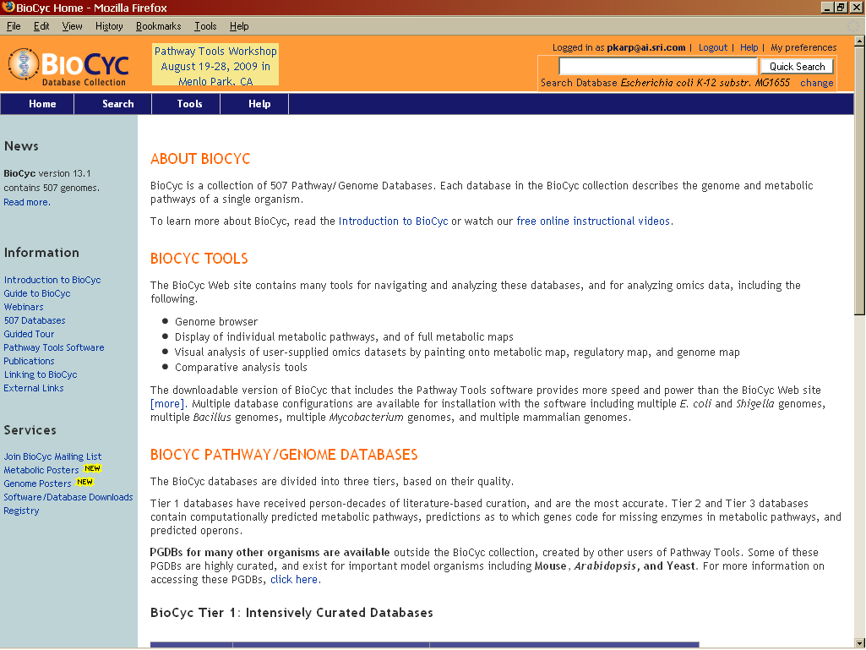
BioCyc Collection of 673 Pathway/Genome Databases
Pathway/Genome Database (PGDB) – combines information about
  Pathways, reactions, substrates
  Enzymes, transporters
  Genes, replicons
  Transcription factors/sites, promoters, operons
Tier 1: Literature-Derived PGDBs
  MetaCyc
  EcoCyc -- Escherichia coli K-12
Tier 2: Computationally-derived DBs, Some Curation -- 28 PGDBs
  HumanCyc
  Mycobacterium tuberculosis
Tier 3: Computationally-derived DBs, No Curation -- 643 DBs

Slide 4
Pathway Tools Software
PathoLogic
  Predicts operons, metabolic network, pathway hole fillers, from genome
  Computational creation of new Pathway/Genome Databases
Pathway/Genome Editors
  Distributed curation of PGDBs
  Distributed object database system, interactive editing tools
Pathway/Genome Navigator
  WWW publishing of PGDBs
  Querying, visualization of pathways, chromosomes, operons
  Analysis operations
    Pathway visualization of gene-expression data
    Global comparisons of metabolic networks
Briefings in Bioinformatics 11:40-79 2010

Slide 5
Obtaining a PGDB for Organism of Interest
Find existing curated PGDB
Find existing PGDB in BioCyc
Create your own
Curated pathway DBs now exist for most biomedical model organisms

Slide 6
Pathway Tools Software:
PGDBs Created Outside SRI
2,100+ licensees: 180 groups applying software to 1,600 organisms
Saccharomyces cerevisiae, SGD project, Stanford University
  135 pathways / 565 publications
Candida albicans, CGD project, Stanford University
dictyBase, Northwestern University
Mouse, MGD, Jackson Laboratory
Drosophila, FlyBase, Harvard University
Under development:
  C. elegans, WormBase
Arabidopsis thaliana, TAIR, Carnegie Institution of Washington
  288 pathways / 2282 publications
PlantCyc, Carnegie Institution of Washington
Six Solanaceae species, Cornell University
GrameneDB, Cold Spring Harbor Laboratory
Medicago truncatula, Samuel Roberts Noble Foundation

Slide 7
MetaCyc: Metabolic Encyclopedia
Describe a representative sample of every experimentally determined metabolic pathway
Describe properties of metabolic enzymes
Literature-based DB with extensive references and commentary
MetaCyc now assigns more than twice as many reactions to pathways as does KEGG
Nucleic Acids Research 2010

Slide 8
MetaCyc Data -- Version 14.0
Pathways | 1,471
Reactions | 8,409
Enzymes | 6,198
Small Molecules | 8,572
Organisms | 1,861
Citations | 22,459

Slide 9
Taxonomic Distribution of
MetaCyc Pathways – version 13.1
Bacteria | 883
Green Plants | 607
Fungi | 199
Mammals | 159
Archaea | 112

Slide 10
Pathway Tools Survey Publication
Karp et al, Briefings in Bioinformatics 2010 11:40-79.

Slide 11
Signaling Pathway Editor
Signaling pathways use different visual conventions than metabolic pathways
Look and feel based of our tool based on CellDesigner, SBGN
Manual layout
  Can’t yet be included in Cellular Overview Diagram

Slide 12
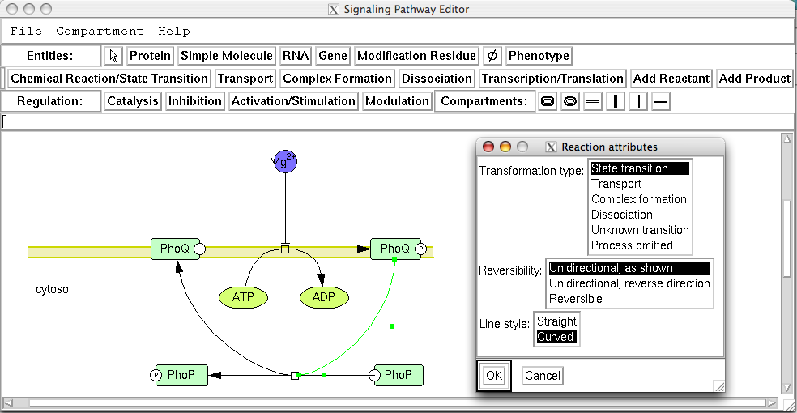

Slide 13
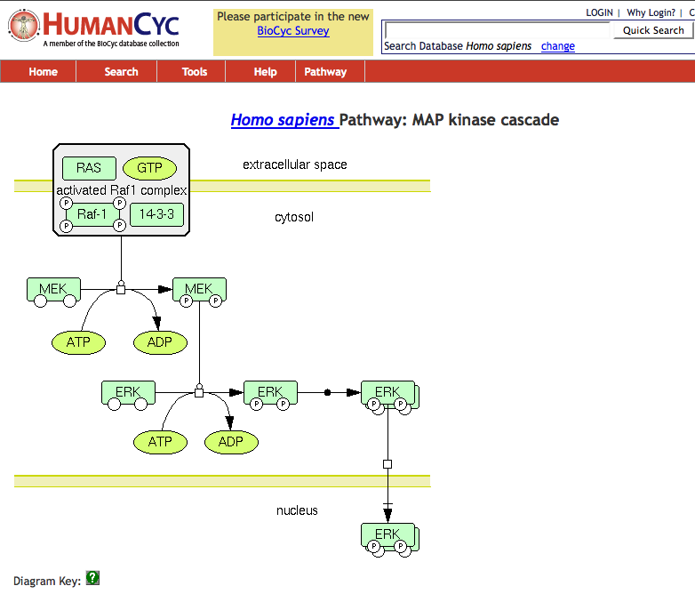

Slide 14
Improved Web Overviews
Implemented using OpenLayers
Zoomable, draggable, searchable, paintable
Cellular Overview
  Highlight compounds, reactions, enzymes, genes by name, substring, with autocomplete
  Highlight genes from file
  Superimpose omics data
Regulatory Overview
  Draw connections between a gene and its regulators, regulatees
  Show full diagram or only highlighted genes

Slide 15
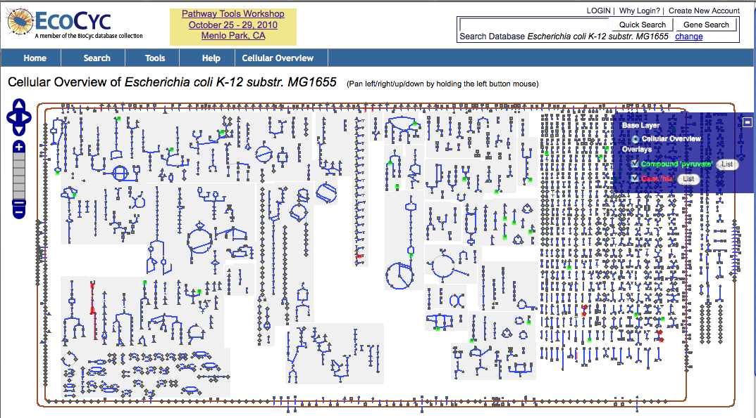
Cellular Overview

Slide 16
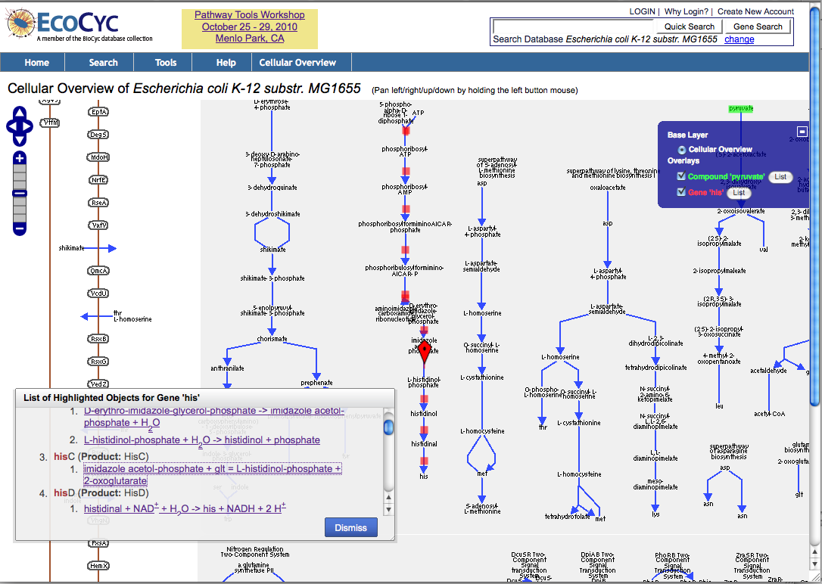
Cellular Overview, zoomed-in view

Slide 17
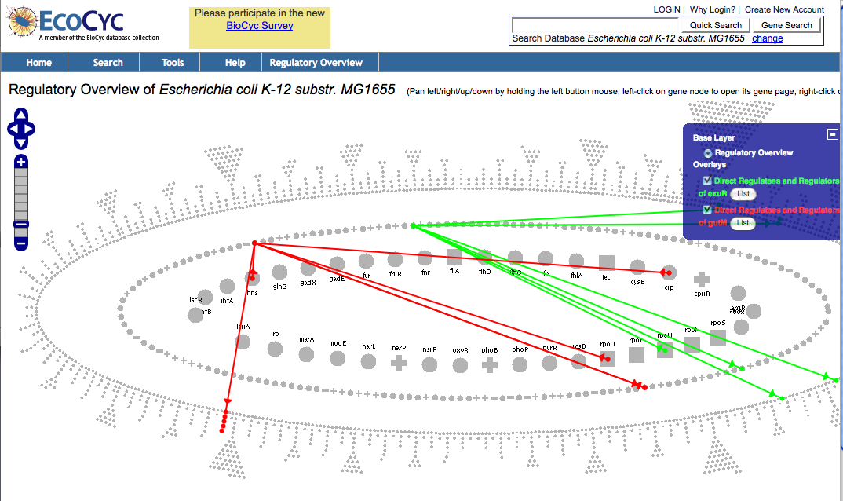
Regulatory Overview

Slide 18
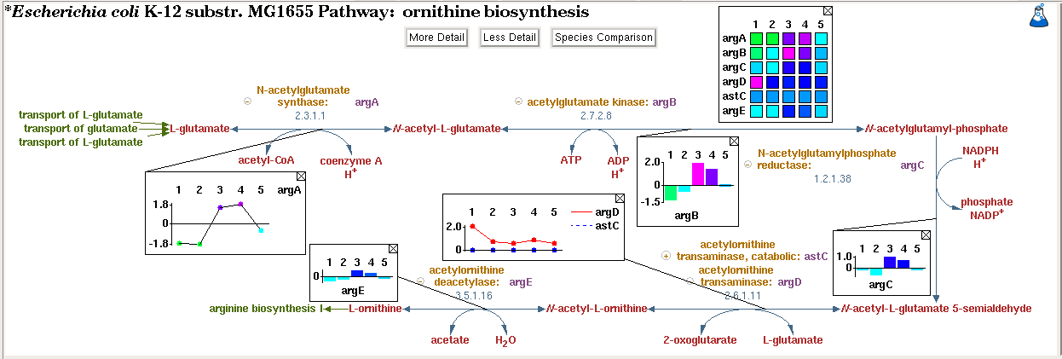
Omics Popups
Desktop Pathway Tools only
Can show omics popups for a gene, reaction, pathway
Use also in Cellular Overview
Choose from 3 styles: heatmap, bar graph, plot

Slide 19
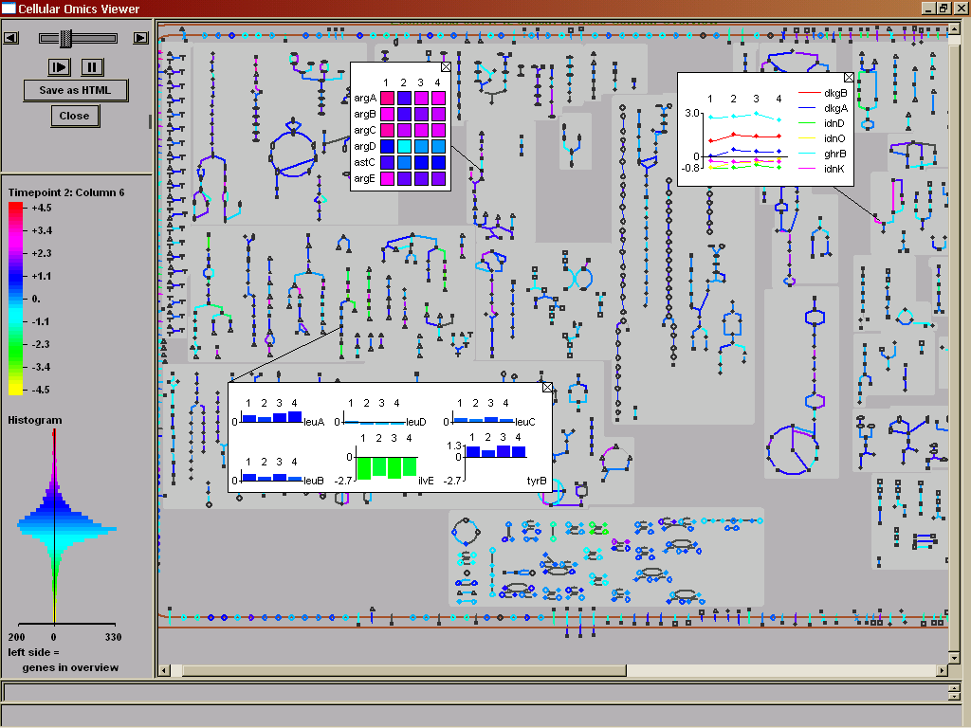
Omics Data Graphing

Slide 20
Pathway Tools Captures All Bacterial Regulation Mechanisms
Regulation of transcription
  By transcription factors
  By attenuation
Regulation of translation
  By proteins and small RNAs
Regulation of protein activity
  By covalent modification (e.g., phosphorylation)
  By non-covalent modification (e.g., allosteric inhibitors)
Support: Schema, editing tools, display tools

Slide 21
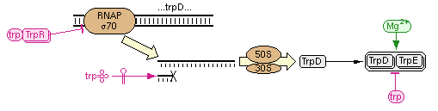
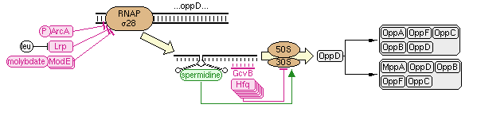
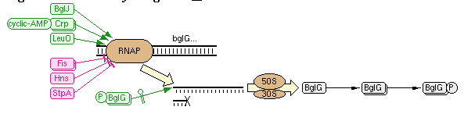
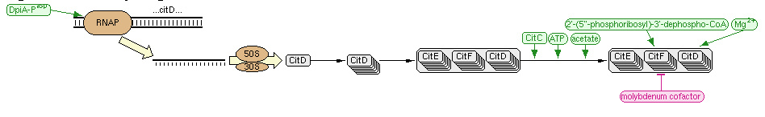
Regulatory Summary Diagrams

Slide 22
Other Recent Enhancements
Phases I and II of upgrade to Pathway Tools Web mode
  Phase III still to come
Ability to customize pathway displays via Web site
  Pathway → Customize

Slide 23
Reachability Analysis of Metabolic Networks
Given:
  A PGDB for an organism
  A set of initial metabolites
Infer:
  What set of products can be synthesized by the small-molecule metabolism of the organism
Motivations:
  Quality control for PGDBs
    Verify that a known growth medium yields known essential compounds
  Experiment with other growth media
  Experiment with reaction knock-outs
Limitations
  Cannot properly handle compounds required for their own synthesis
  Nutrients needed for reachability may be a superset of those required for growth
Romero and Karp, Pacific Symposium on Biocomputing, 2001

Slide 24
Algorithm: Forward Propagation
Through Production System
Each reaction becomes a production rule
Each of the 21 metabolites in the nutrient set becomes an axiom
Nutrient
set
Products
Transport
PGDB
reaction
set
Metabolite
pool
“Fire”
reactions
A + B → C
Reactants

Slide 25
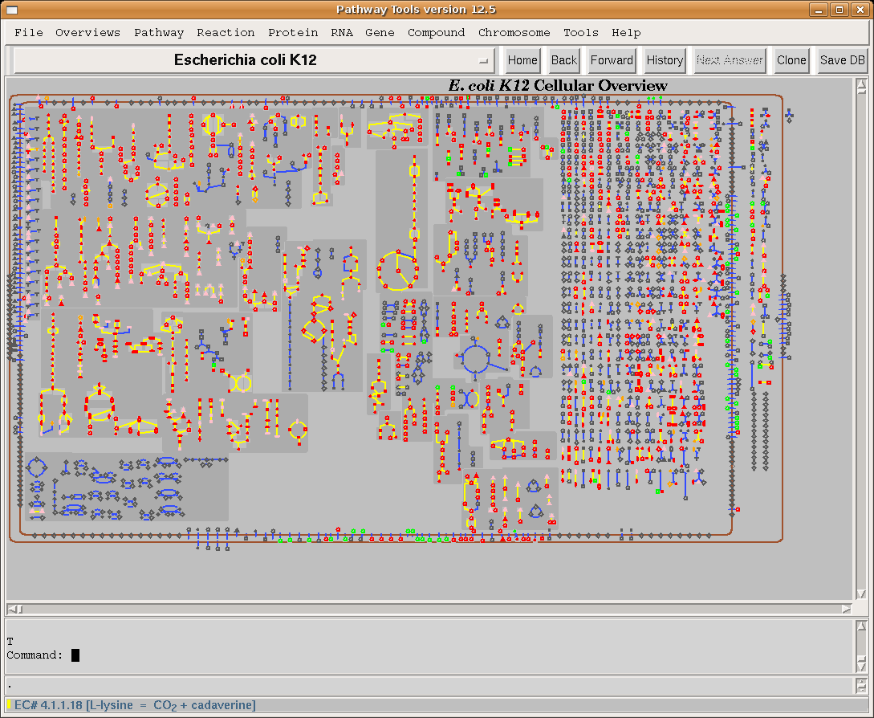

Slide 26
Coming Soon
BioCyc / EcoCyc / HumanCyc will support Web services for data retrieval
iPhone app for BioCyc / EcoCyc / HumanCyc and other PGDBs

Slide 27
Acknowledgements
SRI
  Suzanne Paley, Ron Caspi, Ingrid Keseler, Carol Fulcher, Markus Krummenacker, Alex Shearer, Tomer Altman, Joe Dale, Fred Gilham, Pallavi Kaipa
EcoCyc Collaborators
  Julio Collado-Vides, Robert Gunsalus, Ian Paulsen
MetaCyc Collaborators
  Sue Rhee, Peifen Zhang, Kate Dreher
  Lukas Mueller, Anuradha Pujar
Funding sources:
  NIH National Institute of General Medical Sciences
  NIH National Center for Research Resources
BioCyc.org
Learn more from BioCyc webinars: biocyc.org/webinar.shtml

