Slide 1
Toward a Unified Gene Page
GMOD Meeting, April 2004
Don Gilbert, gilbertd@indiana.edu

Slide 2
Extraneous announcements
Bionet news (www.bio.net) needs new home
  Used by celegans, yeast, chlamydomonas, drosophila, zebrafish, maize, urodeles; genbank, embl, software, others. Letters of Support?
TeraGrid (NSF Shared Cyberinfrastructure) wants to help MOD genome computes
  BLAST for FlyBase and euGenes this fall - others?
See Don Gilbert for details

Slide 3
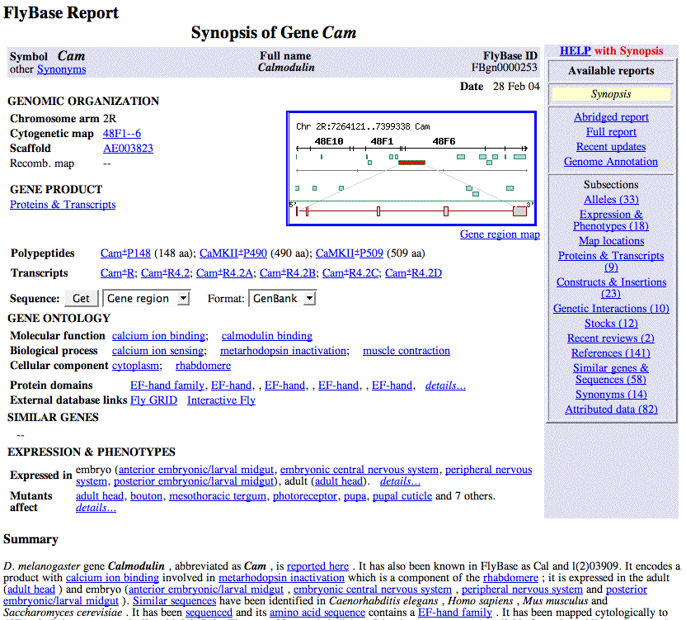

Slide 4
Gene Pages
Common parts of MOD gene pages
What could/should be unified?
  Who will benefit? Costs?
Common Web Reports and XML ?
You: discuss, design common gene page

Slide 5
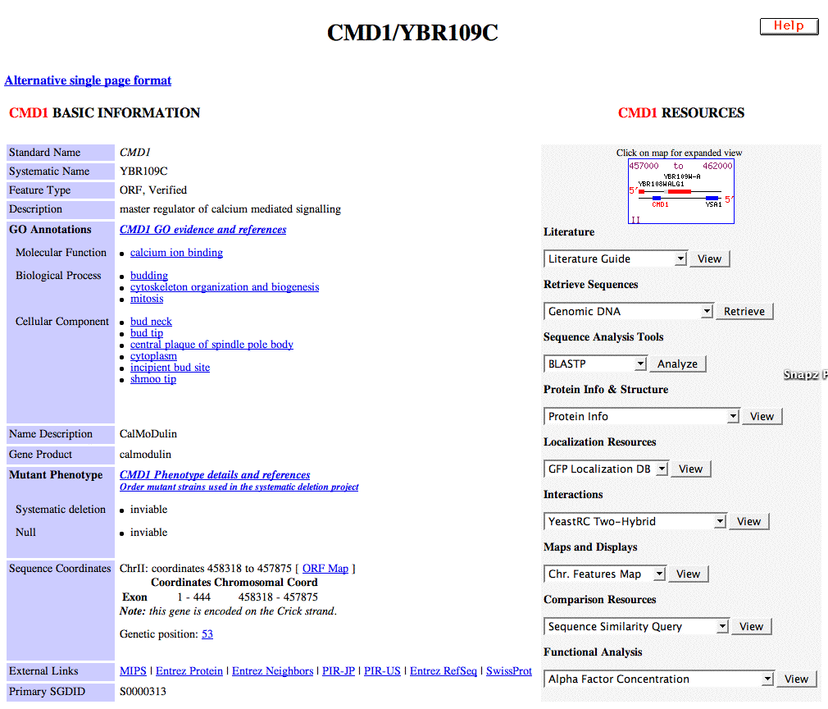

Slide 6
Common gene attributes, pt1
Names, symbols/IDs, synonyms
Map locations
Sequences
Reagents
Gene ontology
Similar Genes
Database cross-refs, External links

Slide 7
Common gene attributes, pt2
Alleles, Transcripts
Expression and Mutant Phenotypes
Proteins, Structure and Domains
Gene Interactions
Literature references
Summary Text
... others...

Slide 8
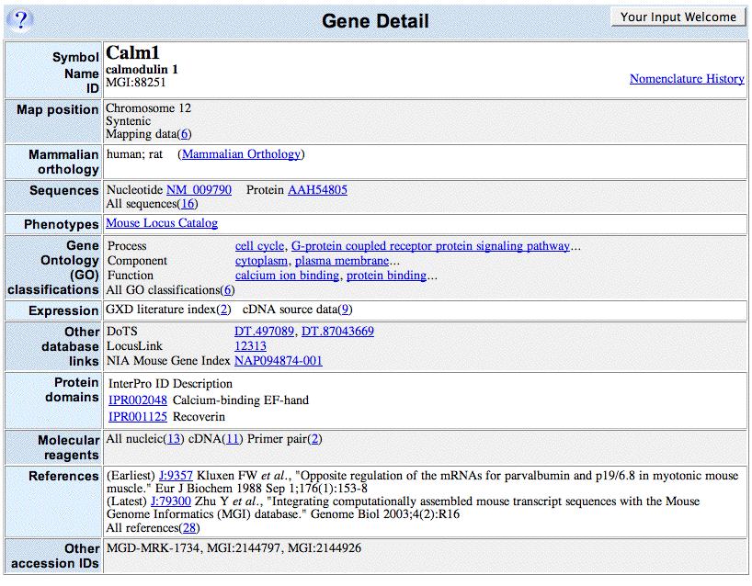

Slide 9
Should these be unified?
Labels - are these same things?
  Gene / locus / orf
  Homolog / ortholog / relationship / similarity
  Citation / publication / reference
Organization of document
  Section headers
  Important at top, common ordering

Slide 10
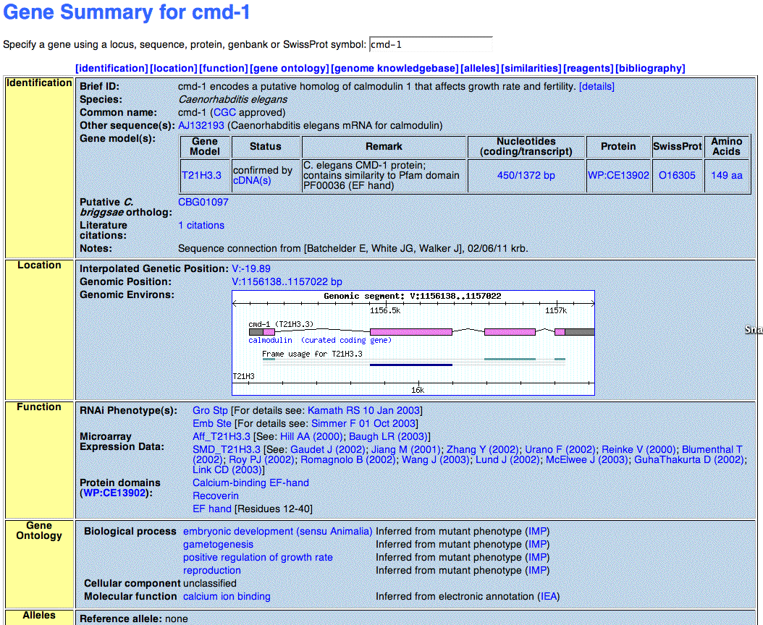

Slide 11
Should these be unified?
Structure and size of default document
  Tabular, text, document-like, …
  One screen or long report
Graphics (maps, icons, ...)
Further Detail options
Layout and Design (colors, formatting, fonts ..)

Slide 12
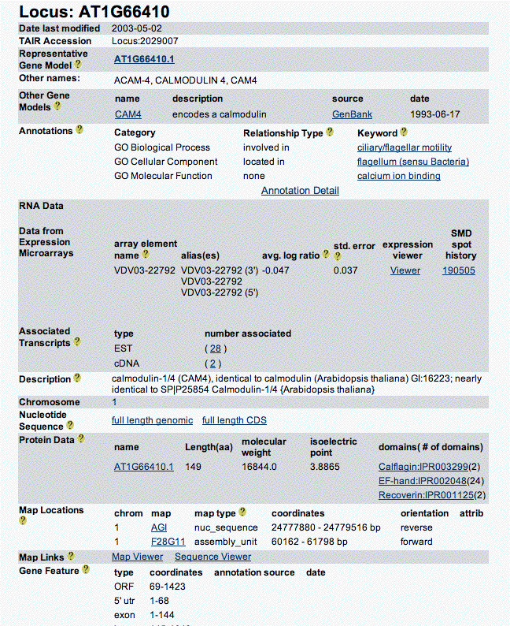

Slide 13
What is customizable?
MOD customizations
  Look and Feel
  Details & Extensions
Customer choices
  Best for organism community (org. standard) or for general reader (general standard)
  Best for beginners or experts (simple,complex)

Slide 14
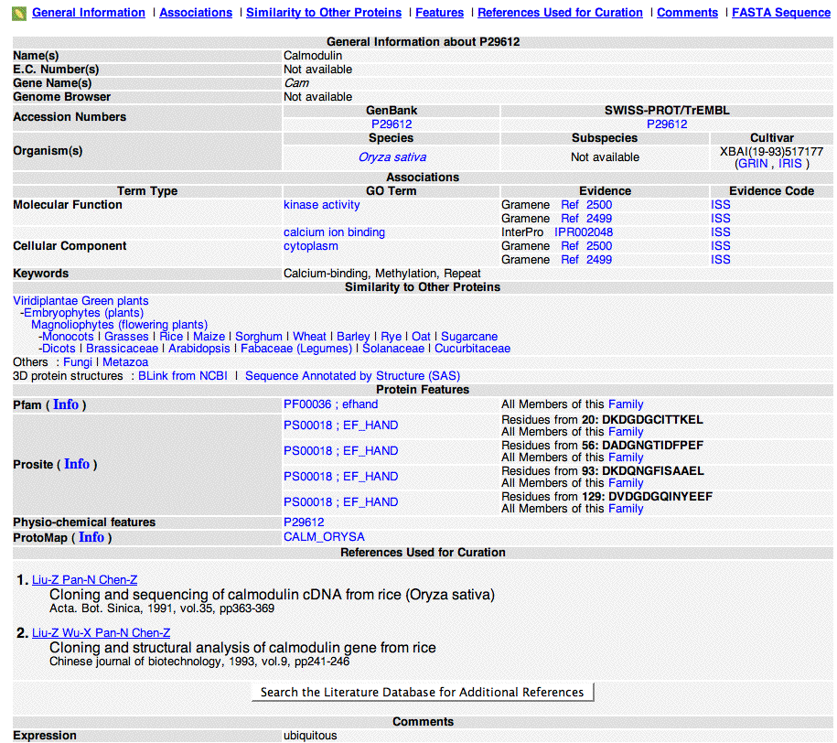

Slide 15
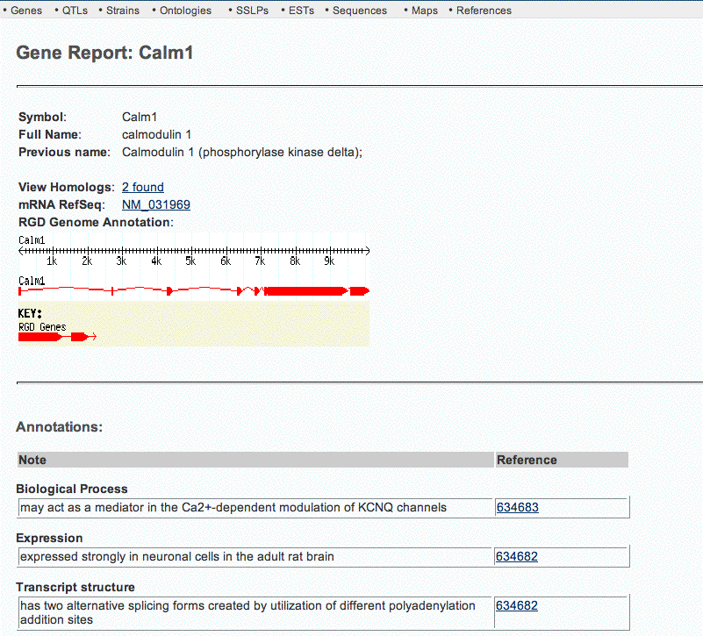

Slide 16
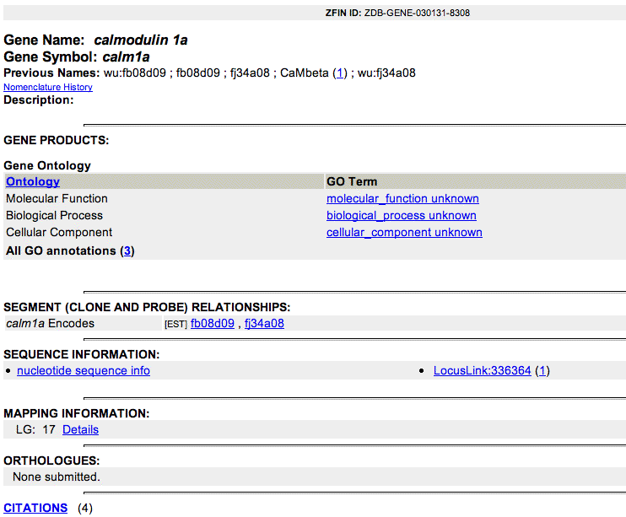

Slide 17
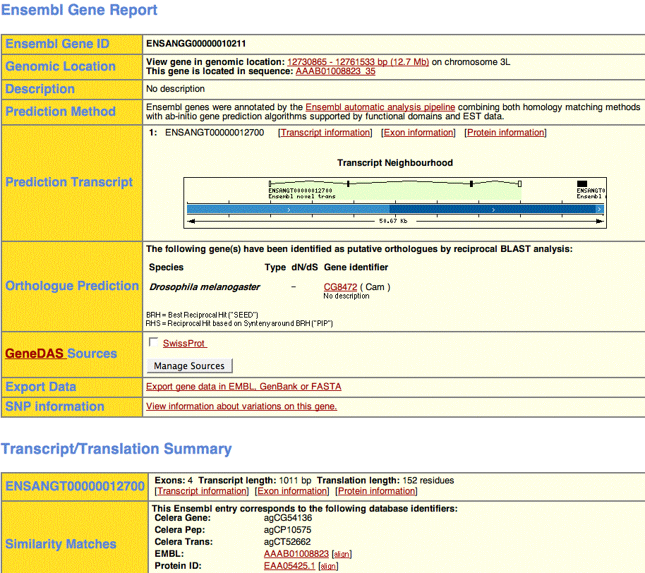

Slide 18
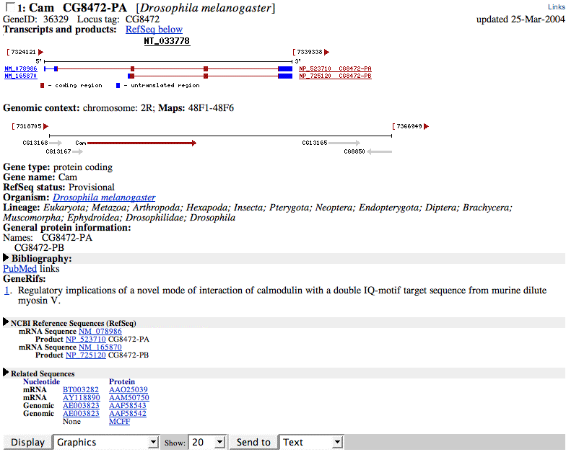

Slide 19
Common Gene XML?
Computable text of gene page ?
  "what you see (web page) is also what your computer can read"
  simple and human-readable, or complex and detailed
XML variants, tabular, other?
  Ace2XML, NCBI XML, others
Samples (Web -> XML)

Slide 20
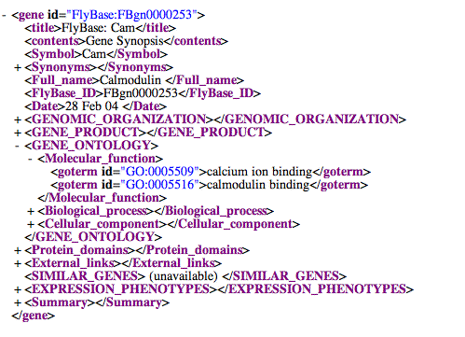
Fly Gene Page as XML

Slide 21
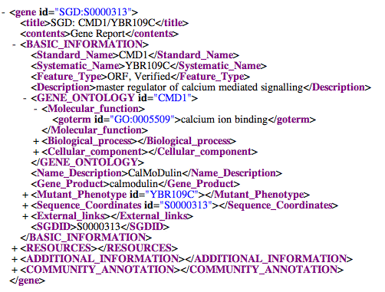
Yeast Gene Page as XML

Slide 22
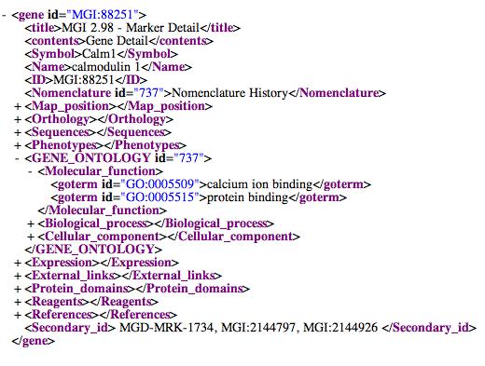
Mouse Gene Page as XML

Slide 23
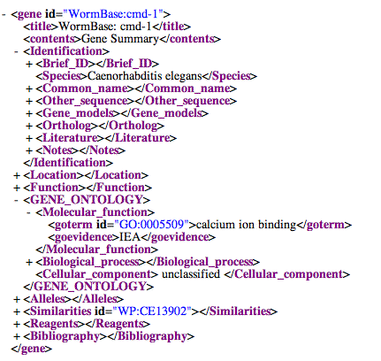
Worm Gene Page as XML

Slide 24
Tasks
Now: Design your common gene page
  Cut/paste sample XML pages into one
  Comment on what should be unified
  Comment on best parts of MOD pages
After: Talk MODs into generating these
http://eugenes.org/all/gene-report-examples/
HTML and XML

