Slide 1


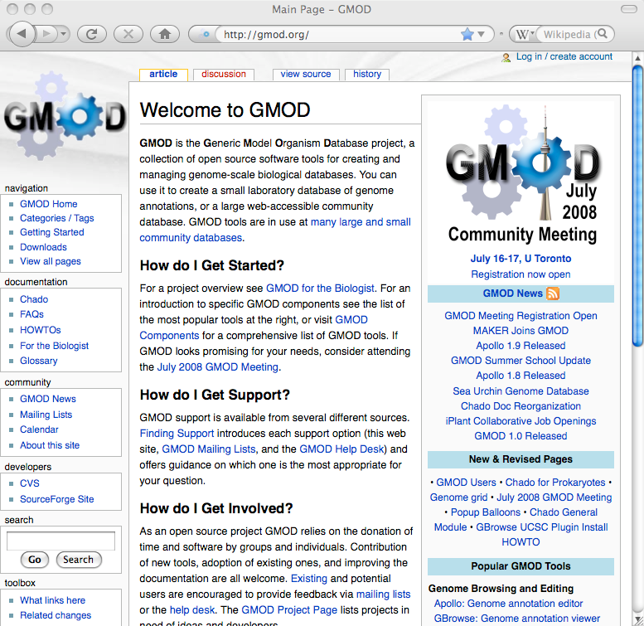
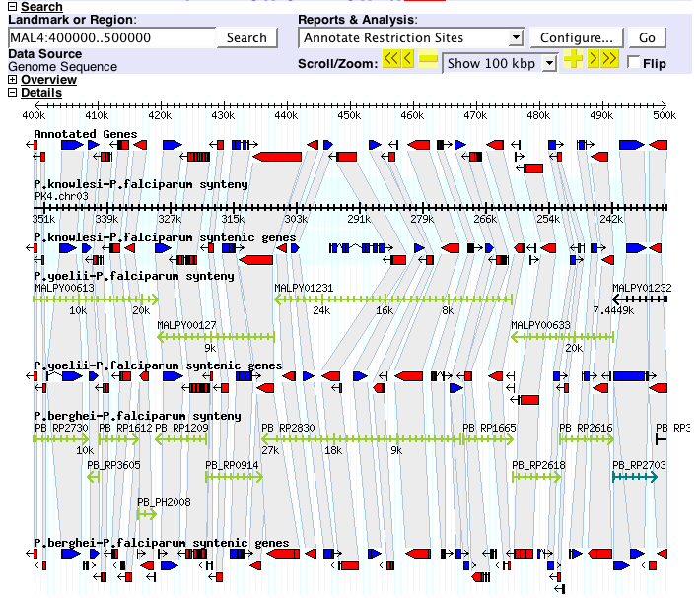
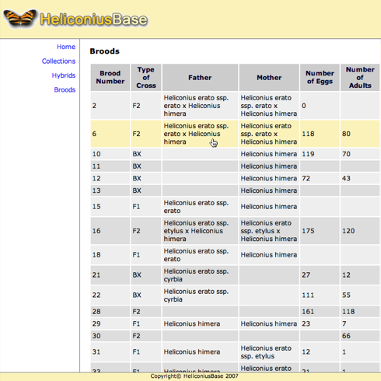
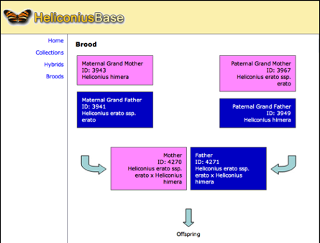


_x0003_
GMOD: Managing Genomic Data from
Emerging Model Organisms
Dave Clements¹, Hilmar Lapp¹, Brian Osborne², Todd J. Vision¹
¹National Evolutionary Synthesis Center, Durham, NC, USA
² BioTeam, Middleton, MA, USA
Abstract
GMOD Community Resources
Comparative Genomics
GMOD is a collection of interoperable open-source software components for managing, visualizing and annotating genomic data. GMOD components are used at hundreds of organizations, ranging from major model organism databases to individual labs. GMOD is well positioned to serve the converging interests of genomic model organism communities and evolutionary biology. In the past year there have been new releases of several core GMOD components, and a new wiki-based project website (http://gmod.org) has been launched.
Start at GMOD.org
GMOD for Biologists
GMOD supports visuali-zing comparative geno-mics data. Sybil shows syntenic regions and whole genome compari-sons. CMap shows com-parative maps of any type (genetic, physical, sequence, …). SynView
Downloads
Project Meetings
FAQs & HOWTOs
Project News
Mailing Lists
Help Desk:
help@gmod.org
Project Calendar
Contribute Doc!
GMOD.org is a wiki
Contribute code!
We're open source
Most popular
GMOD Components
(shown), GBrowse_syn and SynBrowse are GBrowse-based synteny browsers.
http://gmod.org
What can GMOD Do?
What's New in GMOD?
_x0013_
Chado Database Schema
If you have | & you need to | then GMOD can help with
Genomic Sequence | View/search Annotate Organize | GBrowse Apollo, MAKER Chado Sequence Module
Comparative Genomics | View/search Annotate | CMap, SynView, Sybil, GBrowse_syn, SynBrowse Sybil
Phylogenies | Organize | Chado Phylogeny Module
Phenotype, Genotype | Organize Annotate | Chado Genetics Module Phenote
Microarray & Expression | View/search Organize | Java TreeView Chado Mage, Expression
Ontologies | Curate View | Chado CV module GO Term Viewer
Pathways | View, predict, organize | Pathway Tools
Publications | Curate/search Organize | TextPresso, PubSearch Chado Publication Module
Data! | Organize View/Query | Chado, BioMart, InterMine GMODWeb,BioMart,InterMine
New Components
MAKER is an annotation pipeline for eukaryotic genomes that produces GMOD compatible databases. MAKER identifies repeats, aligns ESTs and proteins to a genome and produces ab initio gene predictions.
The Community Annotation System (CAS) is a set of popular GMOD components prepackaged into a single system. It comes with GBrowse, Chado, Apollo, Modware, and MediaWiki with the TableEdit extension installed. CAS is under development.
Phenote is used to annotate biological phenotypes using ontologies, and pairs phenotypes with genotypes. Phenote-Chado integration is coming soon.
GBrowse_syn is a GBrowse-based synteny browser for displaying multiple genomes.
New Features
GBrowse: automatic installation, rubberbanding, popup balloons, draggable and collapsible tracks, and track sharing.
Apollo: undo function, preferences editor, Chado adapter enhancements, and improved graph and GFF3 support.
CMap: ribbon and dot-plot displays, new feature glyphs, embeddable image generation, and directory guessing for easier installation.
Chado: ontology updates, materialized views, stock module, easier GFF loading and delete by GFF.
Chado is the unifying data model for GMOD. It is a modular and extensible database design for biological data. Chado supports sequence, genetic, phenotypic, ontology, gene expression and many other datatypes.
Natural Diversity in GMOD
Chado has recently been extended with the Natural Diversity module, which supports stocks, individuals, pedigrees, crosses, geolocations, and phenotype and genotype experiments. Taxonomy and phylogenetic trees in Chado’s core modules have also been rationalized.
Who Uses GMOD?
AphidBase, ApiDB, ChromDB, CGD, DictyBase, FlyBase, Gramene, ParameciumDB, PlasmoDB, PossumBase, SGN, SmedGD, SpBase, VectorBase, wFleaBase, Xenbase, and hundreds of other large and small communities.
The GMOD Help Desk is hosted by NESCent and is funded by NIH grants to Ian Holmes at UC Berkeley and James Hu at Texas A&M.
http://nescent.org

