Slide 1
Recent Developments in Pathway Tools
GMOD Workshop November ‘07
Suzanne Paley
Bioinformatics Research Group
SRI International
paley@ai.sri.com
BioCyc.org
EcoCyc.org

Slide 2
Pathway Tools Software
PathoLogic
  Predicts operons, metabolic network, pathway hole fillers, from genome
  Computational creation of new Pathway/Genome Databases
Pathway/Genome Editors
  Distributed curation of PGDBs
  Distributed object database system, interactive editing tools
Pathway/Genome Navigator
  WWW publishing of PGDBs
  Querying, visualization of pathways, chromosomes, operons
  Analysis operations
    Pathway visualization of gene-expression data
    Global comparisons of metabolic networks
Bioinformatics 18:S225 2002

Slide 3
Pathway Tools Software: PathoLogic
Computational creation of new Pathway/Genome Databases
Transforms genome into Pathway Tools schema and layers inferred information above the genome
Predicts operons
Predicts metabolic network
Predicts pathway hole fillers
Infers transport reactions
Bioinformatics 18:S225 2002

Slide 4
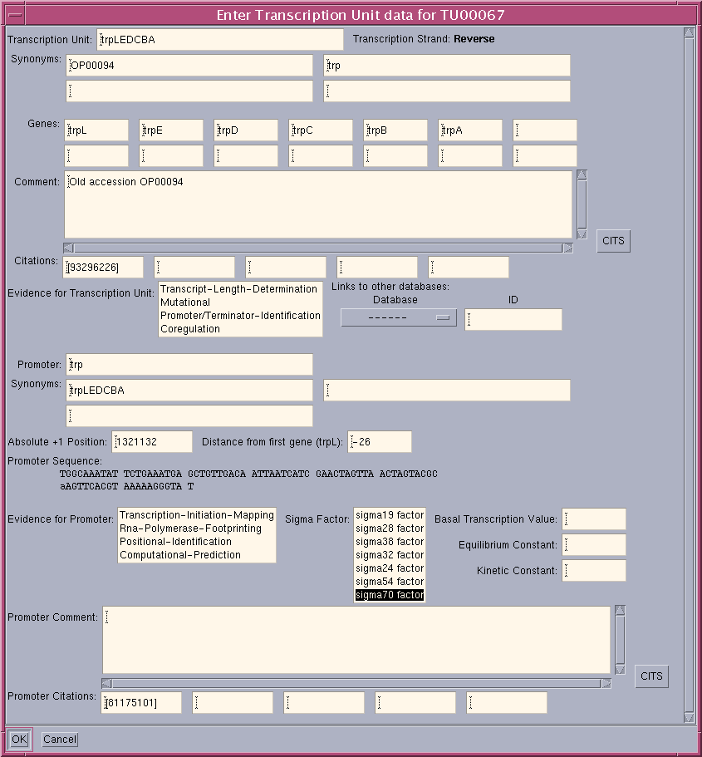
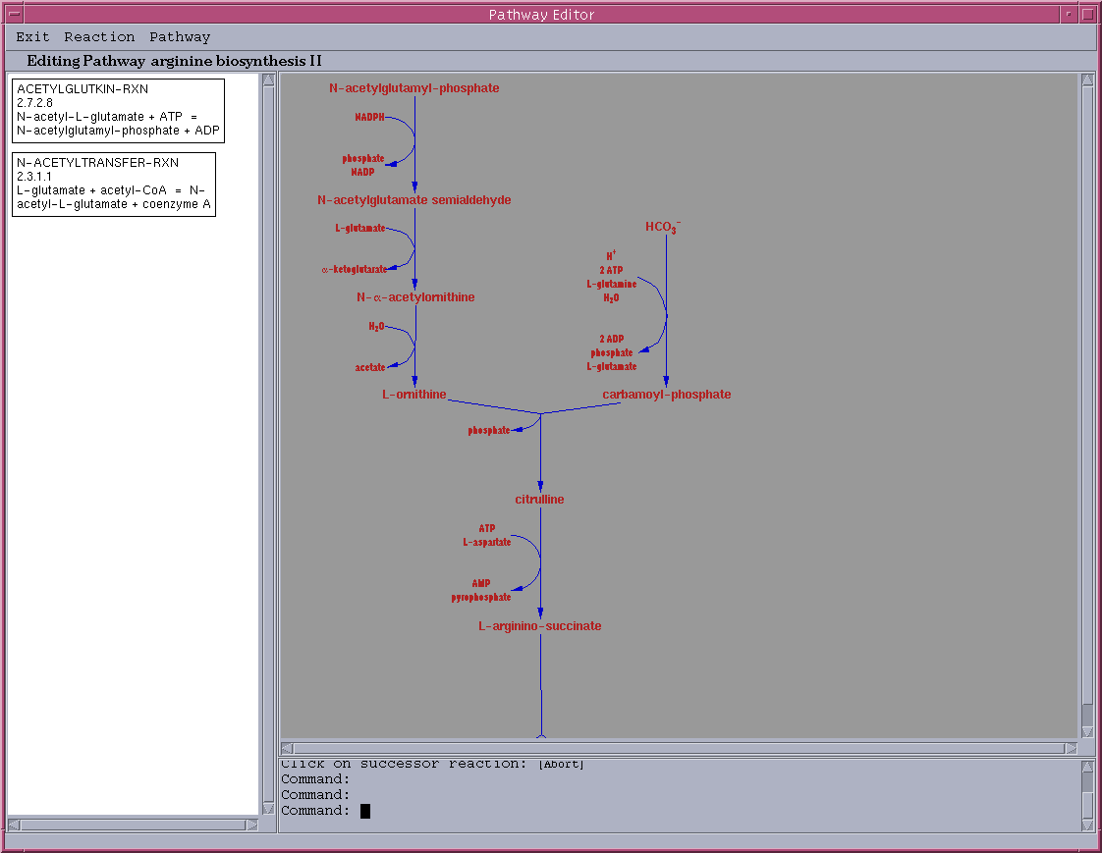
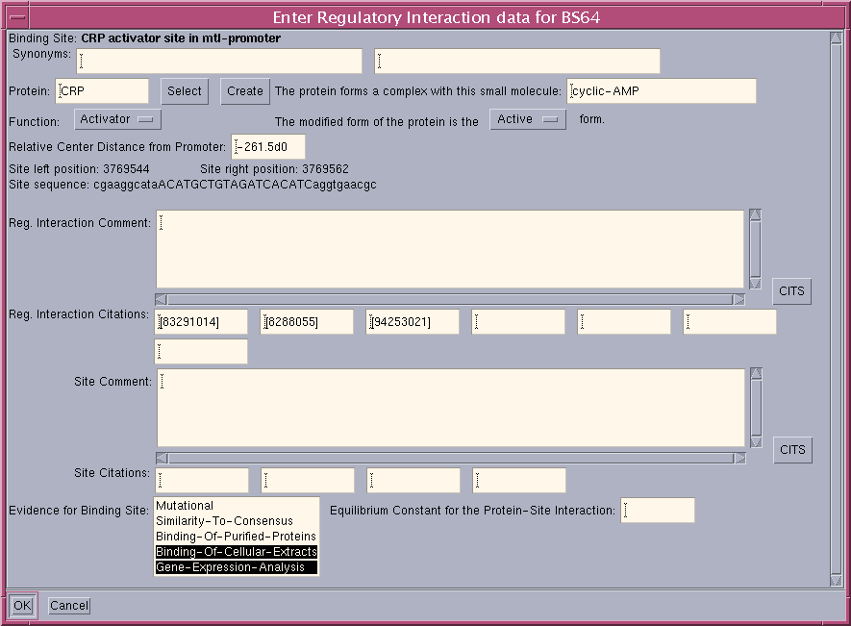
Pathway Tools Software:
Pathway/Genome Editors
Interactively update PGDBs with graphical editors
Support geographically distributed teams of curators with object database system
Gene editor
Protein editor
Reaction editor
Compound editor
Pathway editor
Operon editor
Publication editor

Slide 5
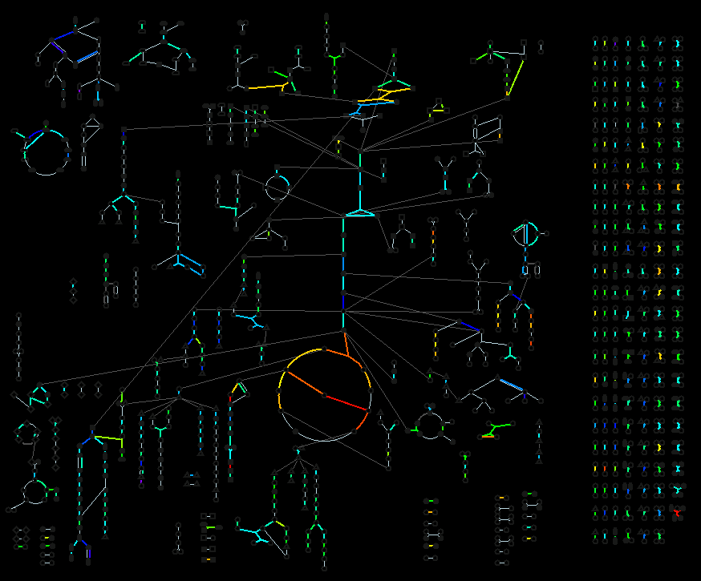
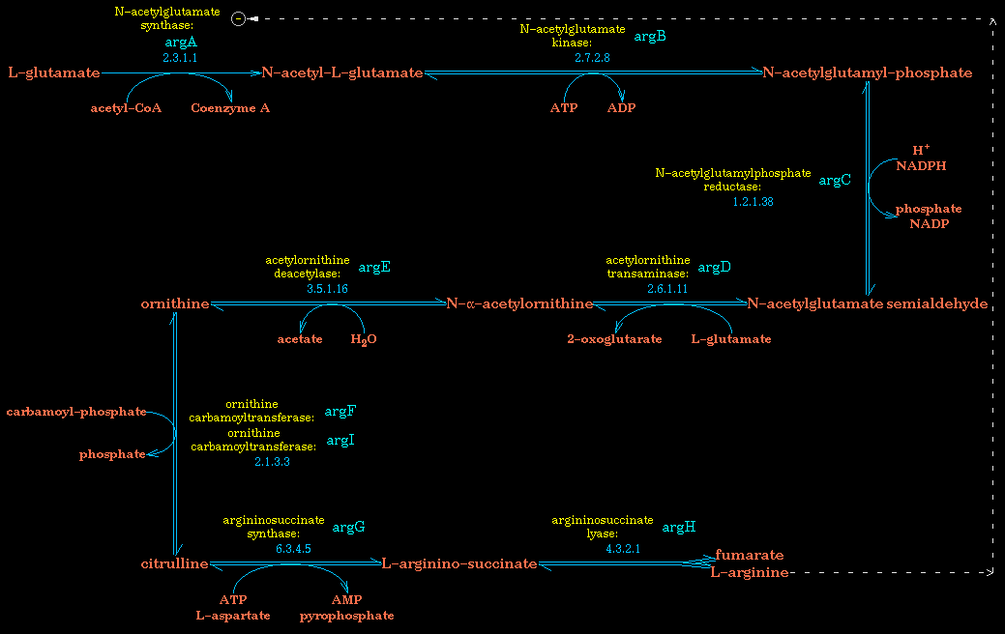
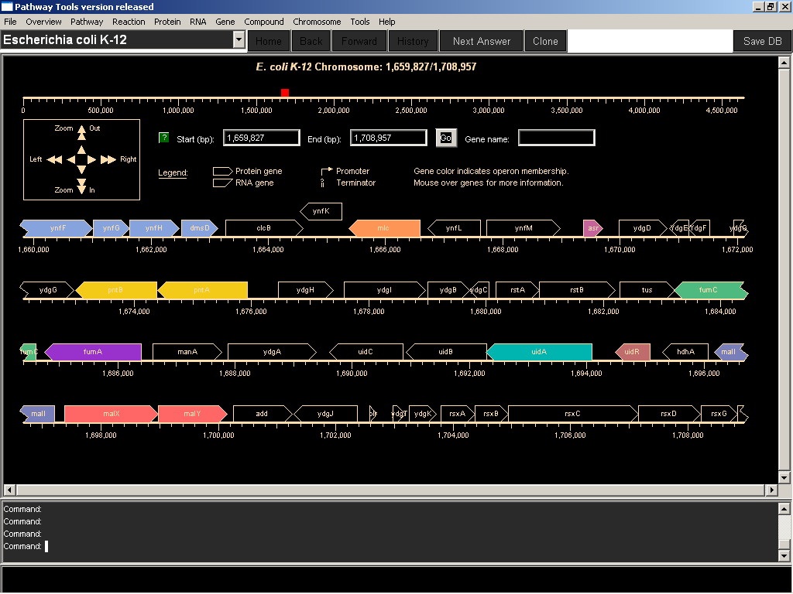
Pathway Tools Software:
Pathway/Genome Navigator
Querying, visualization of pathways, chromosomes, operons
Analysis operations
  Pathway visualization of gene-expression data
  Global comparisons of metabolic networks
  Comparative genomics
WWW publishing of PGDBs
Desktop operation

Slide 6
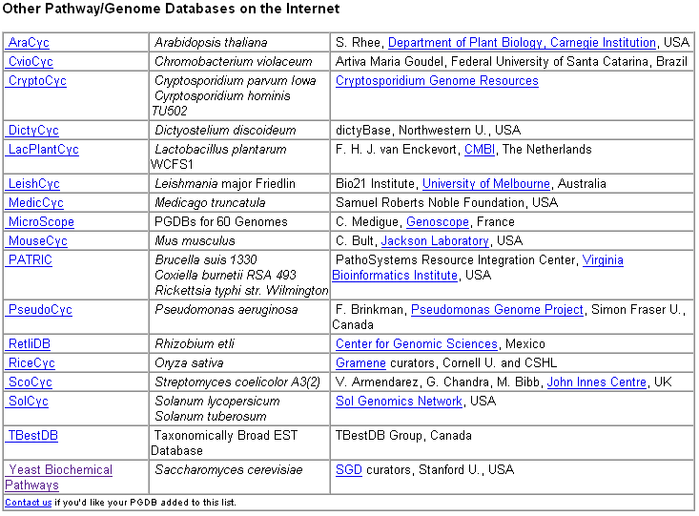
Pathway/Genome Databases on the Web
Pathway Tools can be used either as a standalone curation/publishing platform or as a Pathways Module that lives side by side w/ existing DB using other GMOD applications
BioCyc (http://biocyc.org): a collection of PGDBs for 370 organisms – these are available for adoption by groups that wish to curate them

Slide 7
New Developments
Navigator
  Advanced Query Form and BioVelo
  Omics Viewer now shows data on 3 different overviews
PathoLogic
  Taxonomic pruning reduces false positive pathway predictions
  Incremental PathoLogic allows revised annotation to be imported into existing PGDB
Ontology
  Revised schema for representing regulation
  Added representation of electron transport reactions

Slide 8
Advanced Query Capabilities and BioVelo
Can query across organisms and datatypes
Can either use structured form or more powerful BioVelo query language
Structured form translates query to BioVelo, so you can copy, paste, modify if desired
Notes:
Example Queries:
All pwys w/ experimental evidence in yeastcyc: in database S. cerevisiae, search for Pathways where at least one element of CITATIONS contains the substring EV-EXP. Columns for NAME and CITATIONS

Slide 9
Taxonomic Pruning in PathoLogic
Historically, PathoLogic very conservative, prefers to infer more pathways and let curator strip out false predictions
Growing numbers of pathway variants in MetaCyc mean potentially many false positive pathway predictions
MetaCyc pathways now tagged w/ Taxonomic-Range attribute
Pathways will not be predicted for an organism outside its taxonomic-range unless it has enzymes identified for all or almost all its steps
User can turn off taxonomic pruning if too many pathways being pruned out

Slide 10
Incremental PathoLogic (avail. in v.12.0)
Revised annotations may contain
  new genes
  updated gene properties
  updated functional descriptions
Curators don’t want to rebuild PGDB, don’t want to lose manual curation work
New command reads revised annotation file, compares w/ existing PGDB, presents summary of changes
Curator can:
  Apply a set of changes en masse (e.g. create all new genes)
  Examine each change in a group and decide individually which to apply
  Save progress and return later
  Generate report of changes to import into spreadsheet

Slide 11
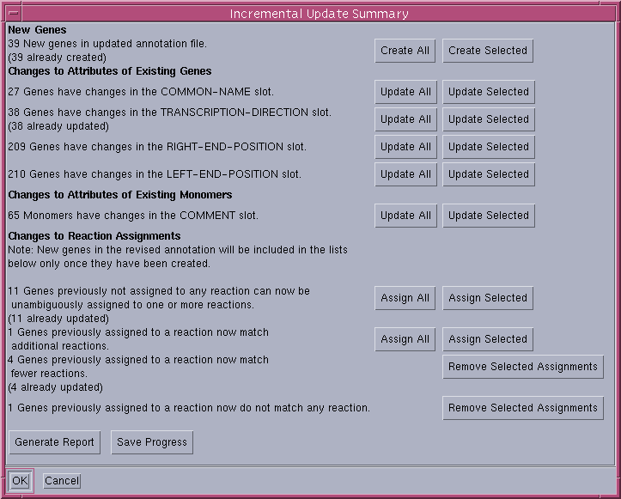
Incremental Update Summary Dialog

Slide 12
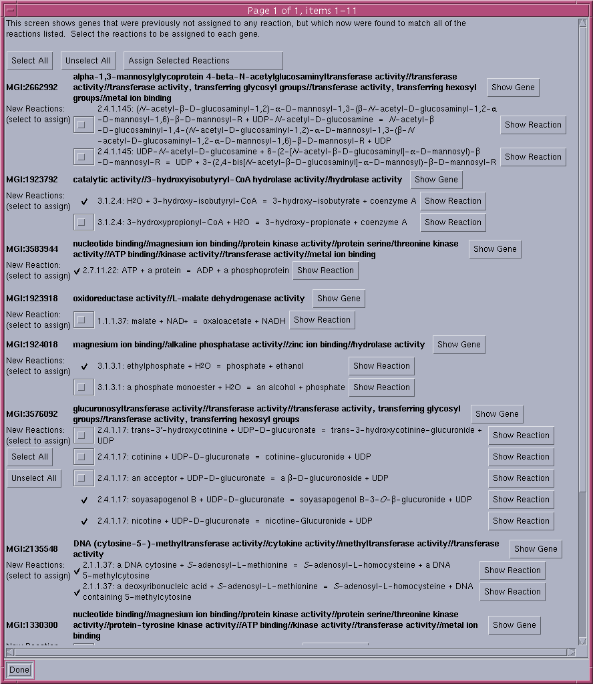
Assign Selected Reactions Dialog

Slide 13
Rescoring Pathways
Rescore Pathways after desired annotation changes have been made
  Software remembers which pathways were inferred last time
  If a pathway has since been deleted, the software only considers it if there is now additional evidence for it
Summary lists:
  Previously deleted pathways now w/ more evidence
  Previously inferred pathways that should now be pruned
  Newly inferred pathways
  Pathways not in MetaCyc
For each list, curator can quickly check off pathways that should be deleted

Slide 14
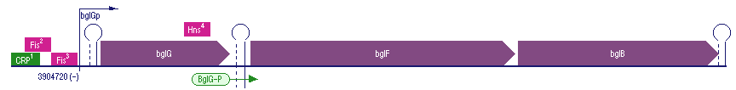
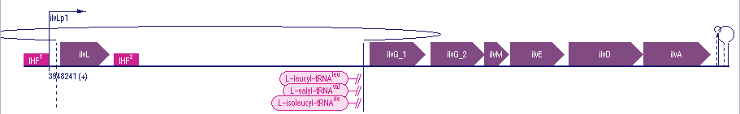
New Representation of Regulation
Previously, regulation represented idiosyncratically:
  One representation for modulation of enzymes
  Completely different representation for regulation of transcription initiation
Now unified under single Regulation class w/ subclasses
This enables us to easily add support for new kinds of regulation, e.g.
  Transcriptional attenuation (done)
  Regulation of translation by small RNAs (in progress)
New tools for display and editing of new Regulation classes

Slide 15
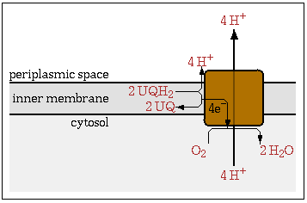
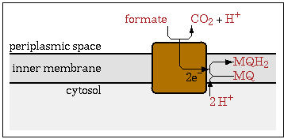
New Representation of Electron Transport Reactions
Electron transport reactions now composite reactions composed of half-reactions
Left and right compounds inferred from constituent half-reactions
Direction of reaction inferred from standard reduction potential of half-reactions
New display and editing tools to support new representation

Slide 16
Acknowledgements
Peter Karp
Markus Krummenacker
Mario Latendresse
Curators
  Ron Caspi
  Ingrid Keseler
  Alex Shearer
  Carol Fulcher
  Peifen Zhang

