Slide 1
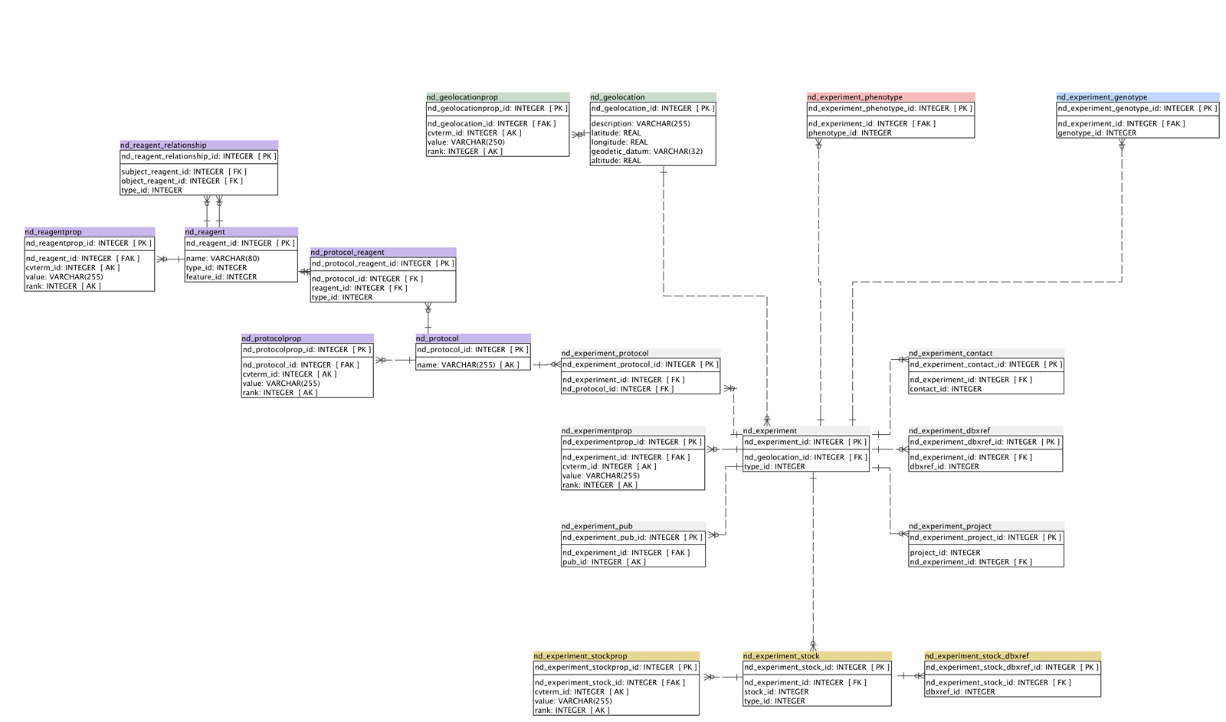
The GMOD Chado Natural Diversity Module
Bob MacCallum
Seth Redmond
Imperial College London
http://vectorbase.org
Notes:
We're not claiming credit for the whole module, we're just its N European representatives...

Slide 2
Motivation
Manage phenotypic and genotypic data for both field collected and captive bred organisms
Store collection site information for growing "next gen"-based variation data
Leverage existing/future Chado modules, GMOD tools and know-how
Notes:
next-gen: our motivation at VectorBase - if we do it properly, it should be possible to do association studies on accumulated community data

Slide 3
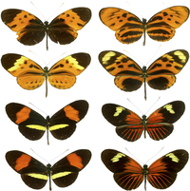
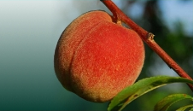
Developmental history
2007
Early version:
HeliconiusDB @ NESCent
(National Evolutionary Synthesis Center)
http://nescent.org
Inspired by:
GDPDM (The Genomic Diversity and Phenotype Data Model)
http://www.maizegenetics.net/gdpdm/
2009-2010
Reincarnation spearheaded by:
Sook Jung @ Washington State University
GDR (Genome Database for Rosaceae)
http://www.rosaceae.org/
GMOD working group formed:
http://gmod.org/wiki/Chado_Natural_Diversity_Module_Working_Group
August 2010
Natural Diversity module merged into Chado svn trunk

Slide 4
Current developers
Name
Affiliation
Dave Clements (organizer)
NESCent, GMOD
Sook Jung
Washington State University, GDR
Dorrie Main
Washington State University, GDR
Stephen Ficklin
CUGI
Meg Staton
CUGI
Scott Cain
OICR / GMOD
Genevieve DeClerk
Cornell / Gramene
Bob MacCallum
VectorBase, Imperial, London
Seth Redmond
VectorBase, Imperial, London
Naama Menda
Sol Genomics Network / SGN
Maren Friesen
Medicago ecological genomics, University of Southern California
Yuri Bendana
Medicago ecological genomics, University of Southern California
Pantelis Topalis
VectorBase, IMBB, Crete
Emmanuel Dialynas
VectorBase, IMBB, Crete
Rob Buels
Sol Genomics Network / SGN
Notes:
Sol = tomato
GDR = apples, peaches

Slide 5
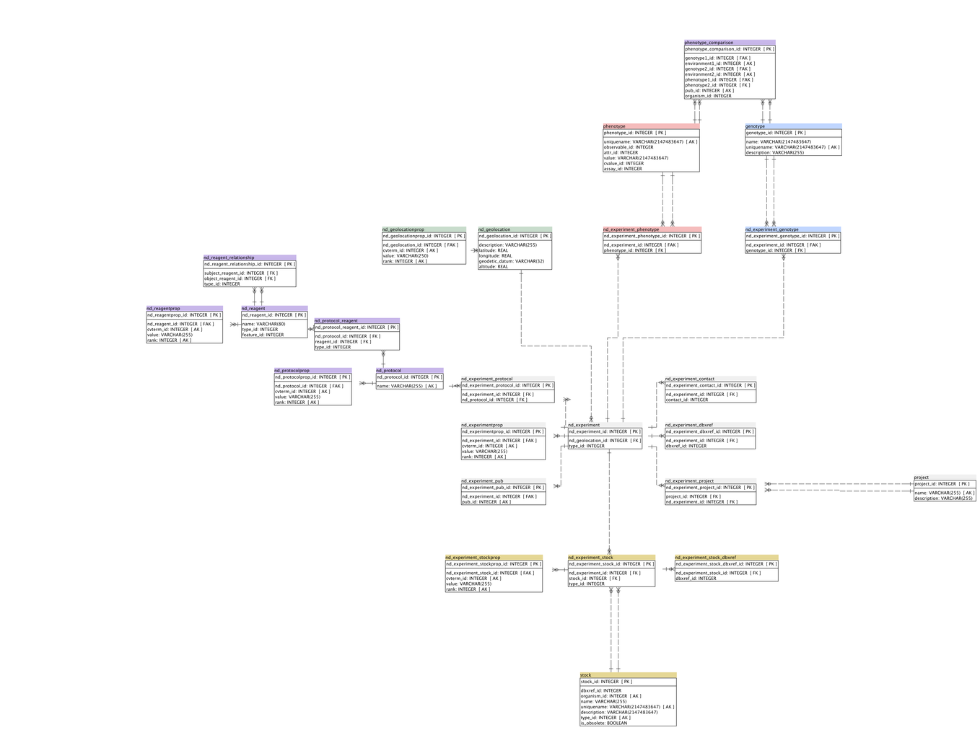
The Schema

Slide 6
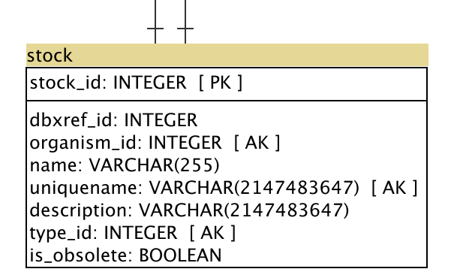
Stock (pre-existing module)
Notes:
not just stocks in the usual sense of the word
individuals
samples
populations
as defined by type
removed the NOT NULL constraint on organism so that mixed or unknown species collections (e.g. soil samples) can be tracked.

Slide 7
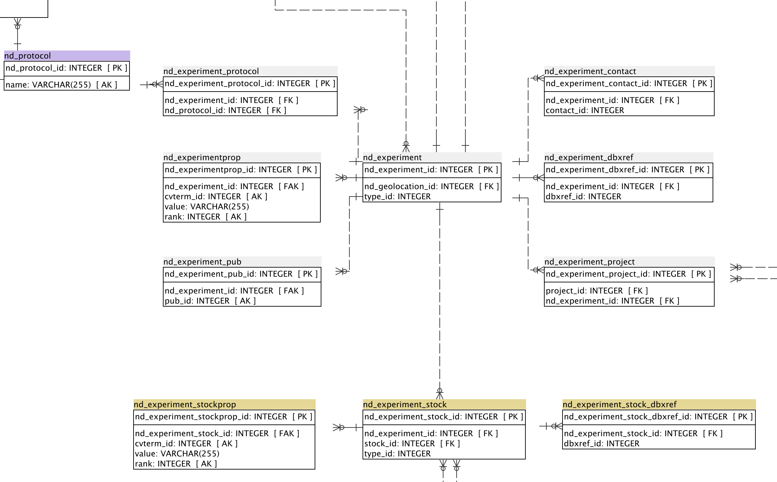
Experiment
Notes:
go quickly now because the examples in a minute will make things clearer
we've currently got a nd_ prefix for all tables in the model but this is still open to debate
experiment.type is important
we currently envisage 4 types but of course
field collection
cross
phenotype assay
genotype assay

Slide 8
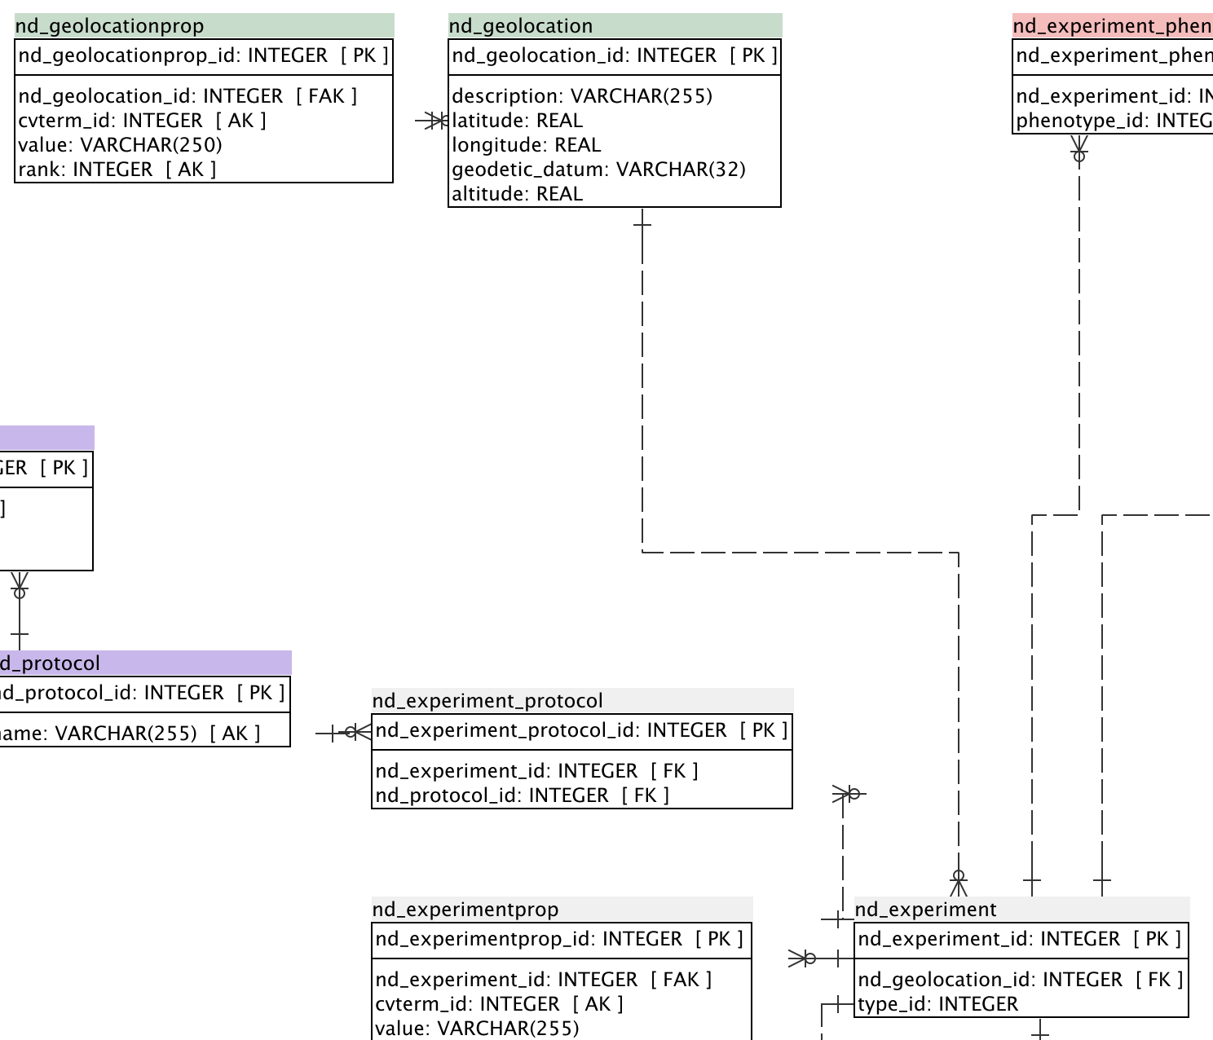
Geolocation

Slide 9
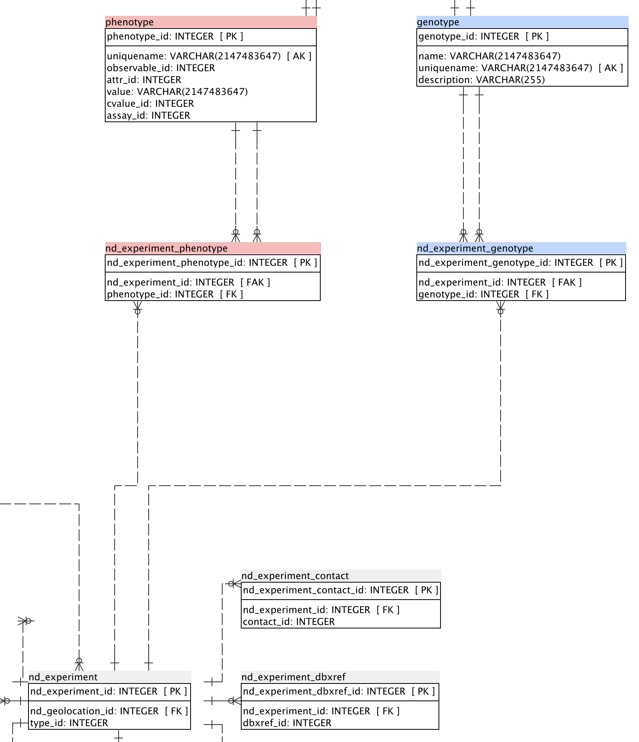
Genotype &
Phenotype

Slide 10

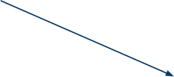
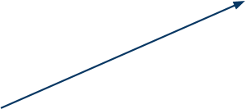







Use case: cross experiment
Notes:
Date, person, and other info in nd_experimentprop and nd_protocol
and if required: nd_geolocation

Slide 11







Use case: field collection

Slide 12






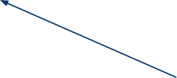


Use case: phenotype assay

Slide 13
CV terms
Schema is very flexible
nd_experiment.type and nd_experiment_stock.type are key
Several ways to do the same thing
Working group is hoping to agree on core CV terms to aid API development

Slide 14
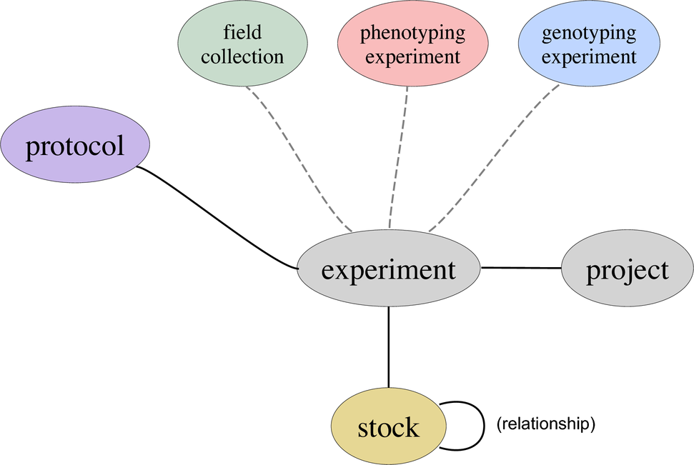
A simplified API

