Slide 1
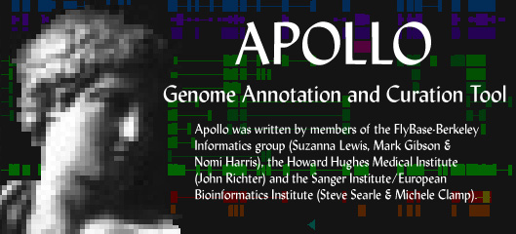
Apollo Future Plans
Nomi Harris, BDGP/FlyBase
GMOD Meeting, Cambridge
April 27, 2004

Slide 2
Undo
Undo/redo individual edits
  Delete transcript, change 3’ end, add comment, etc.
Transaction recording is first step

Slide 3
Analysis adapters
Lower barrier to importing data into Apollo
Let you read raw analysis results (BLAST, sim4, GENSCAN, etc.) and filter appropriately (using integrated BOP)
Finish debugging raw analysis loader; improve user interface; document
Allow genomic to be subject (not just query)
Automatically figure out coordinate offset of analysis results by doing simple alignment

Slide 4
Combining data adapters for concurrent loads
Add the ability to request data from multiple different sources from a single “Open” request
  E.g. read a directory containing various raw analysis results on a sequence
  Apollo should figure out which type of results each file contains and parse/filter them appropriately
  Need to define default filtering parameters for each input type
Layer data from multiple sources
  E.g. read an XML file and then overlay with a GenBank sequence

Slide 5
Chado adapter
Adapting TIGR’s (JDBC)
Make SO-compliant
Lazy/selective loading for improved performance (time & memory)
  Ensembl db adapter does this

Slide 6
Fix memory leaks
Apollo uses a lot of memory
Memory leaks needlessly waste memory
Runs slowly on smaller computers
Can even freeze up your computer

Slide 7
GenBank reader/writer
Test/debug new GenBank reader
Enable Apollo to write human-readable GenBank format (currently only writes feature tables)
  Is there a table2human converter?
Automatically call table2asn (so you can run Sequin)

Slide 8
Annotation of new feature types
Make it possible to annotate non-gene features, e.g. mRNAs, peptides, transposable elements, sequence variations, etc.
Need Apollo to read SO and use hierarchy of features
Support the annotation of sequences other than genomic

Slide 9
Possible new editing interfaces needed
Sequence variation editor to annotate differences between current reference sequence and related sequences
  Annotate SNPs and other allelic differences
Spliced-together gene view
  Reduce size of introns
  Useful for vertebrate genomes
mRNA view

Slide 10
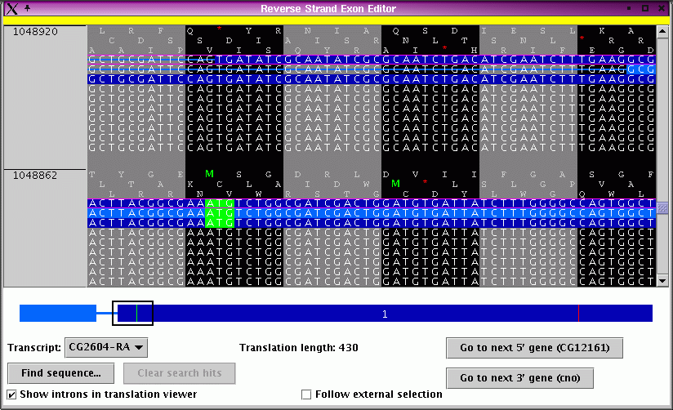
More new views
Peptide view (similar to Exon Detail Editor--would let you annotate cleavage sites, disulfide bonds, etc.)
Other views?
  Tell us!
  Opportunities for collaboration

Slide 11
Support for fragmentary genomes
Many genomes now being sequenced to low coverage
Provide support for viewing partial genomic assemblies

Slide 12
Webstart
Want to be able to click on a Web link (e.g. for a transposable element) and have it launch Apollo on appropriate region
Current webstart progress:
  Launch empty Apollo (platform-independent)
  Launch Apollo on specific region (but only with certain browsers on Linux)
Need platform and browser independence

Slide 13
GAME XML DTD
GAME XML is still the most completely supported format in Apollo
Update GAME XML DTD (be sure to document "magic" properties, e.g. translation exceptions)
Requested by groups trying to convert their data to GAME

Slide 14
Redesign tiers
Visual indication of whether a tier is expanded or collapsed
Tier labels/buttons on separate panel that scrolls along with main panel
  Buttons launch tier/type editor
Transparent tiers that can be dragged around and overlaid
Other kinds of tiers, e.g. graphs (like GC content or gene density)

Slide 15
Synteny goals
Make Synteny view more robust as an editor (has mostly been tested as a browser)
Remove distinction between single-species Apollo and Synteny view
  Right now, Synteny view assumes two species
  We should always be in n-species mode, where sometimes n=1, sometimes n=2, and sometimes n>2
Should be able to read data for different species from different adapters

Slide 16
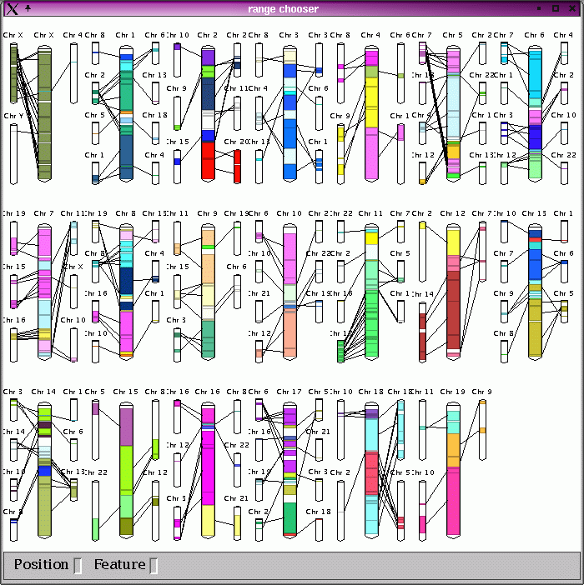
Synteny navigation from whole-chromosome view

Slide 17
More synteny goals
Allow user to navigate between multiple disjoint contigs (e.g. for D. pseudoobscura)
Add similarity graph to show amount of conservation between species
  Dynamic links with response to similarity graph threshold changes
Better ways to present comparative data?

Slide 18
The Apollo Team
FlyBase/Berkeley:
  Suzanna Lewis, Nomi Harris, Mark Gibson, Sima Misra
Past contributors
  Sanger Institute:
    Steve Searle, Michele Clamp, Vivek Iyer
  HHMI:
    John Richter
  FlyBase curators
  JGI:
    David Goodstein (added regexps to Find; read/write JGI relational db)
Chado adapter
  TIGR:
    Jonathan Crabtree

Slide 19
Installer available at http://ww.fruitfly.org/annot/apollo/install.html
Code available at SourceForge: http://sourceforge.net/projects/gmod/
Notes:
Leave this slide up while you answer any questions (or until next speaker starts his/her talk) so people can copy down the URLs.

