Slide 1
Turnkey & GMOD
May 16, 2005
Brian O'Connor

Slide 2
Overview
Overview of “active code generation”
Previous Progress
  customization through skins
  integration with other GMOD tools
Current Progress
  new application features
  new installation features
Next Steps...

Slide 3
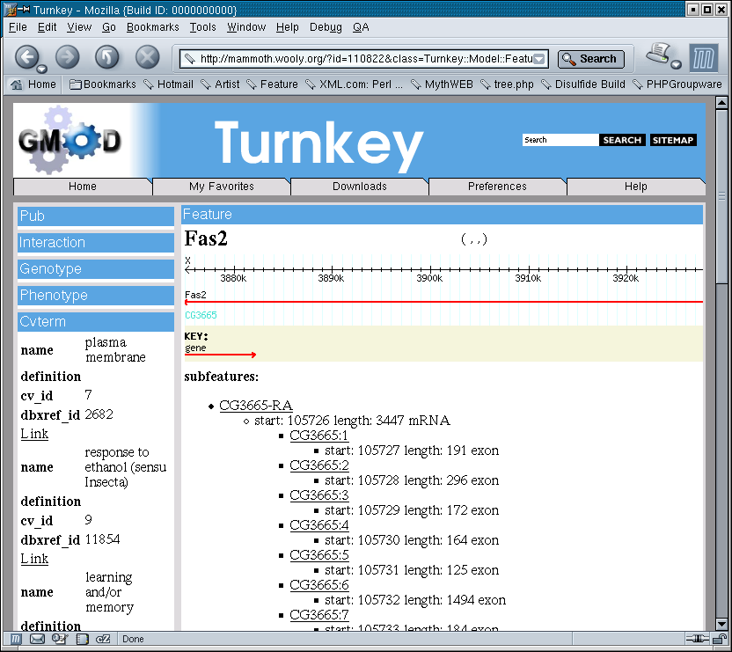
Turnkey is...
A website auto-generator
SQL
Create
table
foo...
2 minutes

Slide 4

Active Code Generation
SQL Schema
SQL::Translator
Directed Graph
SQL
Create
table
foo...
XML Layout
& Templates
Mapping Layer
Data
Objects

Slide 5
Data Flow
XML is used to define a layout and represents the relationships between tables in the database
What about actual data rendering?
Turnkey currently uses a MVC approach
Templates
Mapping Objects
Data
Objects
V
C
M

Slide 6
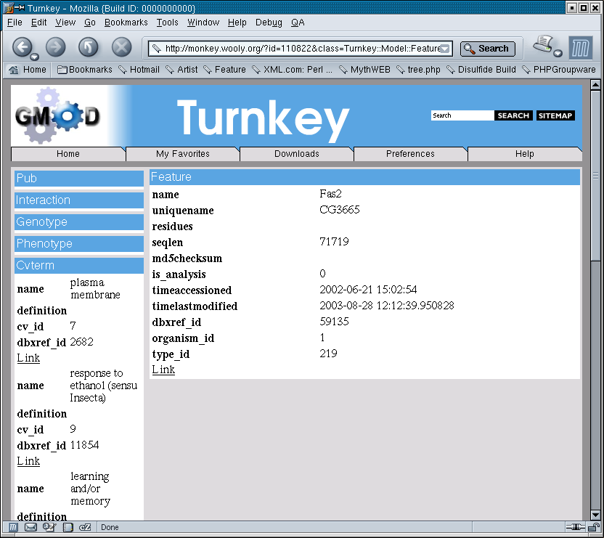
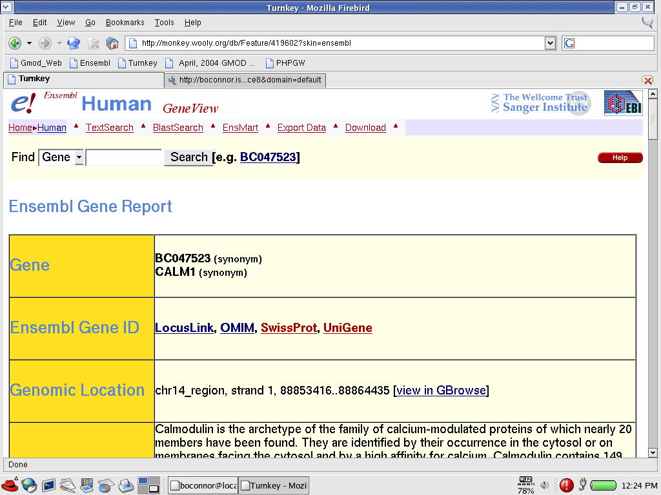
Previous Work: Customization
CSS + Custom Templates = Skins

Slide 8
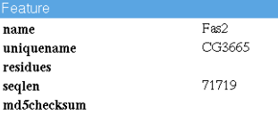
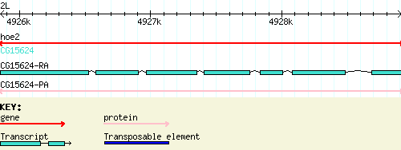
Previous Work:
GBrowse & GMOD-Web
Have
Want

Slide 9
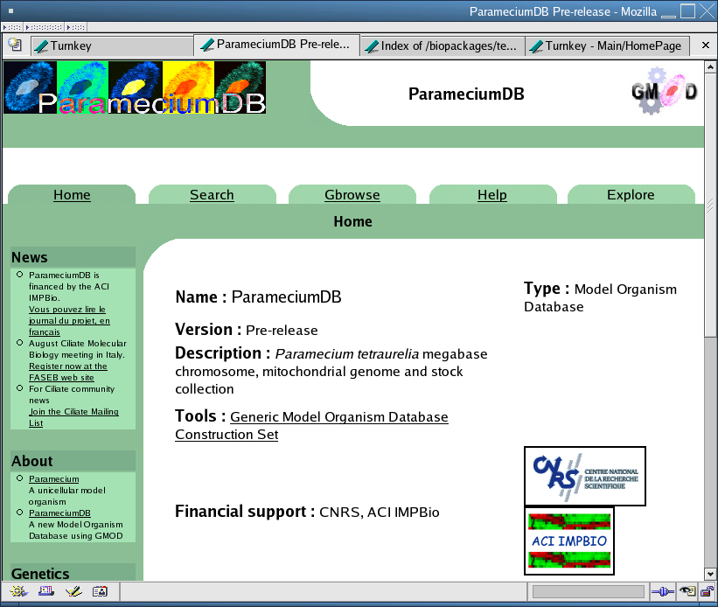
First User!

Slide 10
What's New?
Application Changes
Record Editing
Iterators
Paging support (partial)
Generic search engine

Slide 11
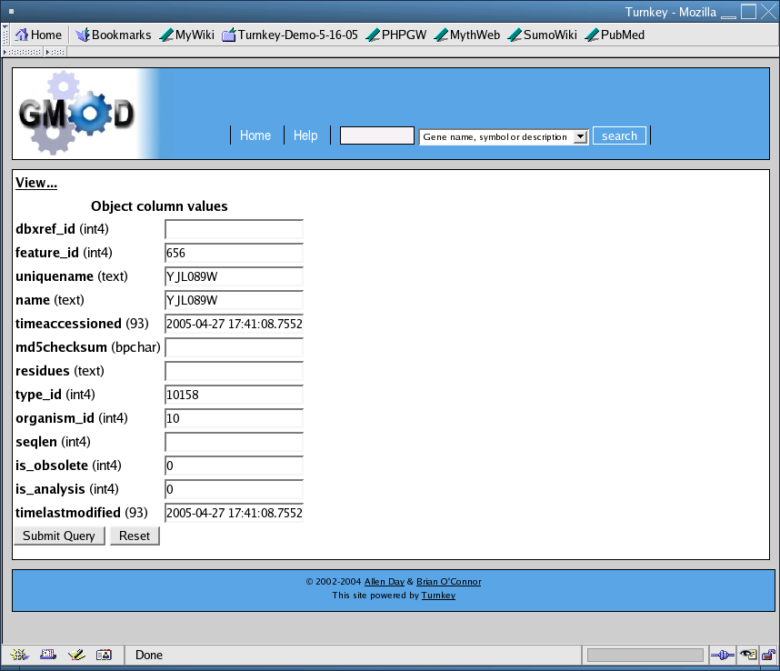
Record Editing

Slide 12
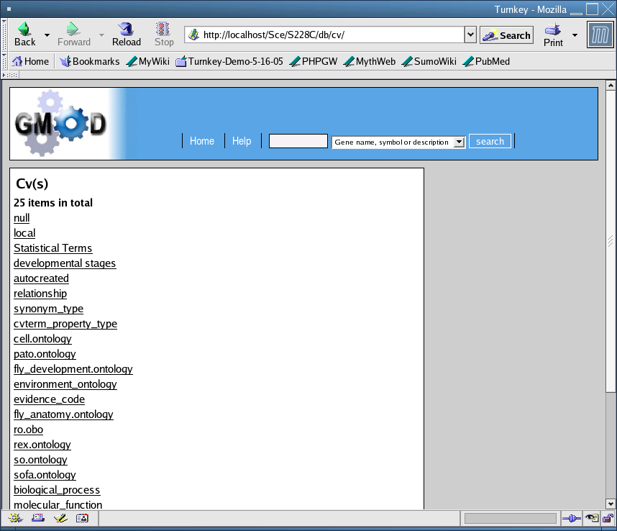
Iterators

Slide 13
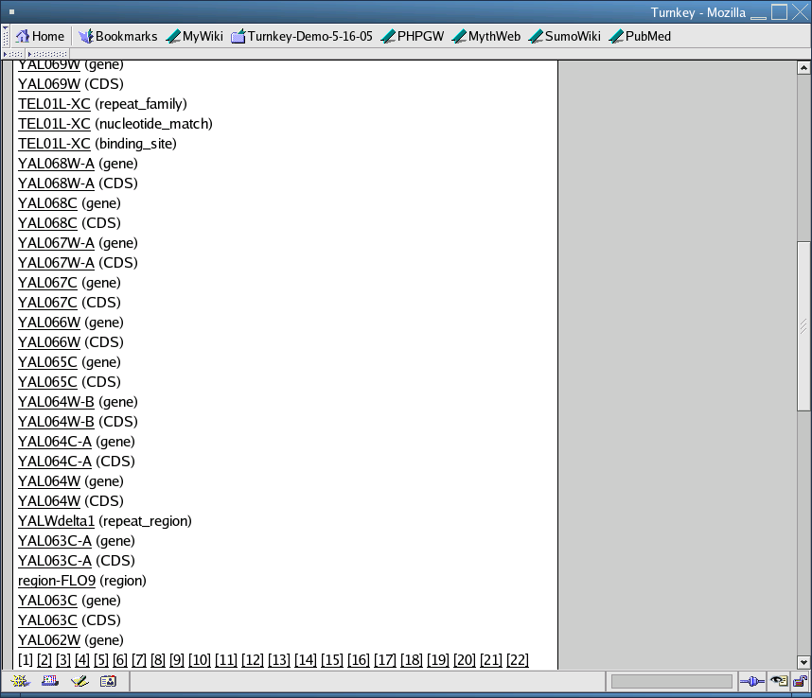
Paging

Slide 14
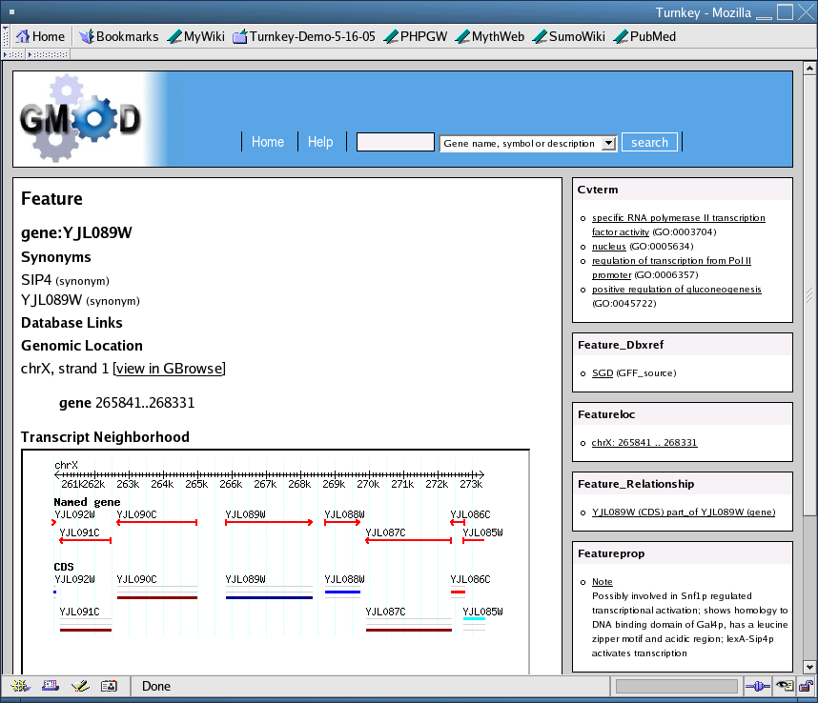
Generic Search Engine

Slide 15
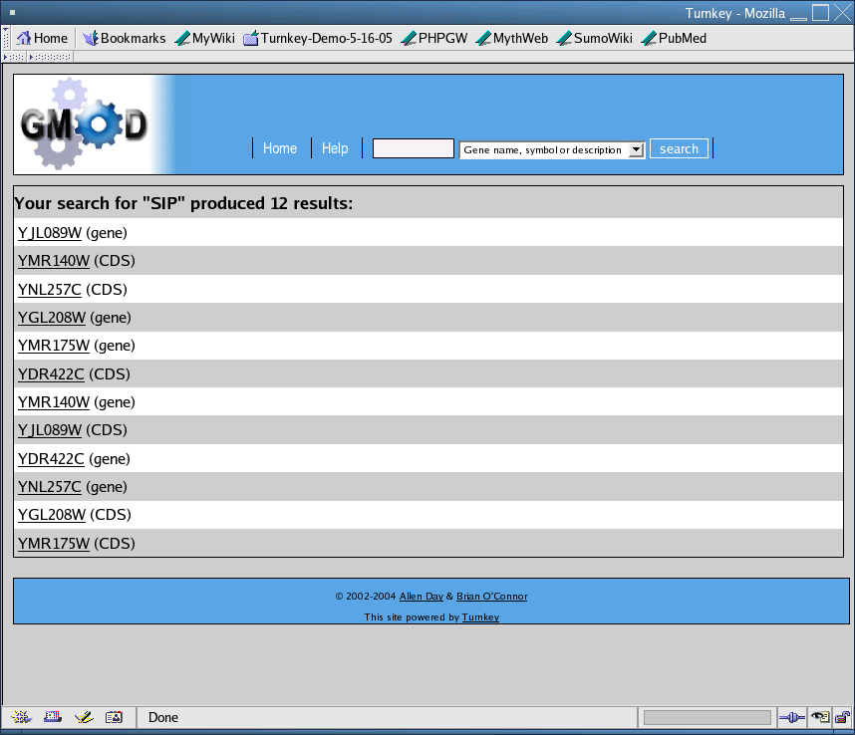
Generic Search Engine

Slide 16
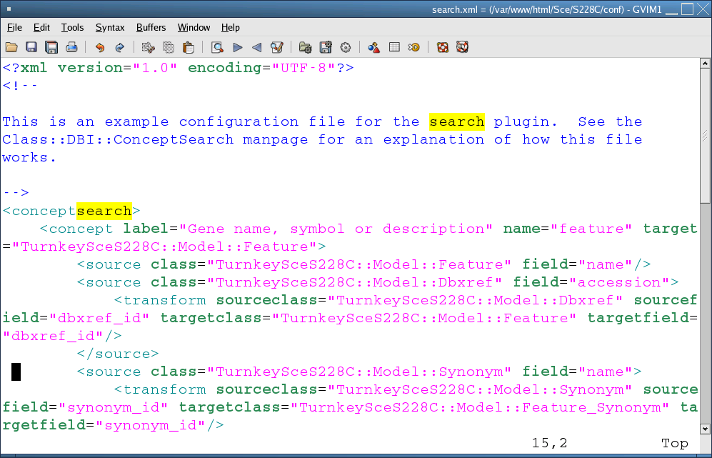
Generic Search Engine

Slide 17
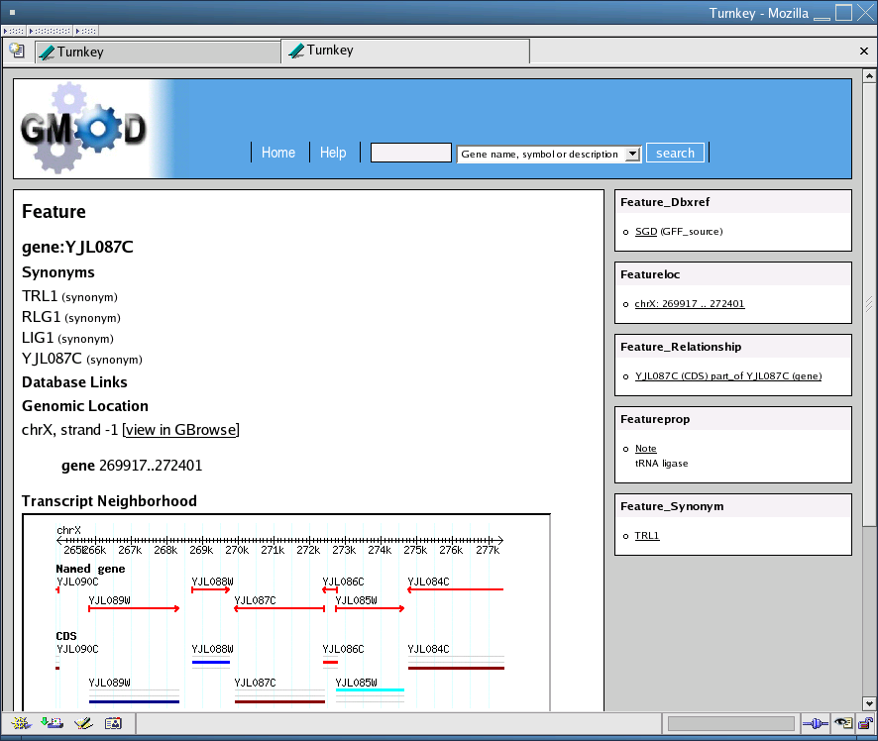
Demo in GMOD-Web-SCE

Slide 18
What's New?
Installation Changes
mod_perl 2 on FC2 for alpha 3
Virtual hosts are not required
Easy multiple installs
Demo applications & build process
  Wine/Wiki
  customized apps in CVS
Documentation at http://turnkey.sf.net
RPM-based install

Slide 19
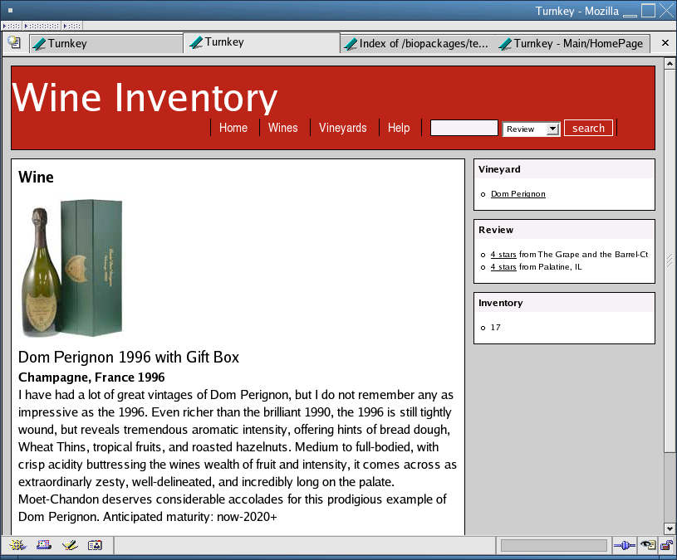
Turnkey Applications
Base
Turnkey
Turnkey-based Apps
GMOD
Web
Turnkey
Demos
* each turnkey application has one or more “skin”

Slide 20
Turnkey Application Development
Add a schema file to <cvsroot>/turnkey/schema (both data and schema files)
Make a dir in <cvsroot>/turnkey/demo for your application
run <cvsroot>/turnkey/scripts/turnkey_generate to build your default application

Slide 21
Turnkey Application Development
Modify the default application
Merge the changes back into the <cvsroot>/turnkey/demo directory
Done... check into cvs
More documentation will follow at http://turnkey.sf.net

Slide 22
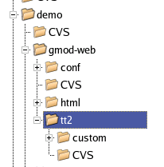
Turnkey Application Development
Customized files for
GMOD-Web Apps
CSS customization lives here
TT2 customization lives here

Slide 23
Turnkey Application Development
Customized files for
GMOD-Web Apps
CSS customization lives here
Dynamic skins live in their
own dir here
URL?skin=foo
TT2 customization lives here

Slide 24
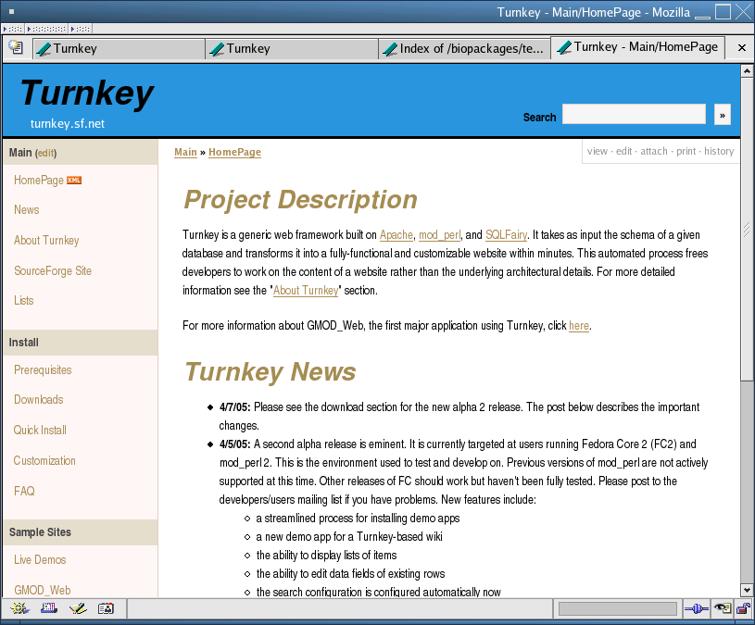
Documentation
http://turnkey.sf.net

Slide 25
Documentation
Install Prerequisites
Installation Process
FAQ
Customization (“skin”) guide
etc.
This gets a lot easier with alpha 3 (RPMs)

Slide 26
Installation Process
This can be done manually or via RPMs
chado DB
Apache/mod_perl
Turnkey/GMOD Web
Perl Modules
SQLFairy

Slide 27
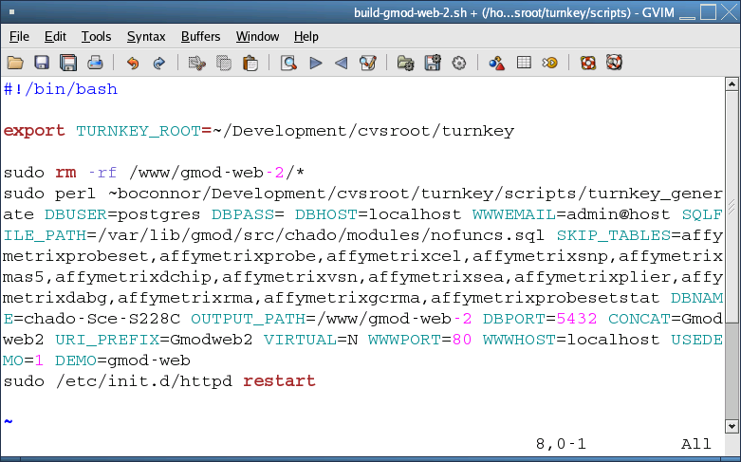
RPM-Based Install
Compared to old style...

Slide 28
RPM-Based Install
Wine demo install from RPM
> yum install gmod-web-Sce

Slide 29
Next Steps
Alpha Phase – New Features
  improved paging
  improvements modeling complex relationships
  Alpha 3 this week
Beta Phase – Stability & Documentation
  expand docs on skinning and turnkey
  application development
  builds for more platforms (?)
Release - soon

Slide 30
http://turnkey.sf.net
Acknowledgments
Allen Day
Scott Cain
Linda Sperling et al.
Stan Nelson
GMOD Group

Slide 31
How a Web Page is Rendered
Template Toolkit Page
Atom Renderer
DB Object
A
C.tt2
Model::C
B
Atom::C
Database
<page>
<element name=”A” renderer=”Atom::A” focus=”minor”/>
<element name=”B” renderer=”Atom::B” focus=”minor”/>
<element name=”C” renderer=”Atom::C” focus=”major”/>
</page>

