Slide 1

Manual Annotation of Human Genome
at Broad Institute
Chinnappa Kodira
April 2004
GMOD 2004, Cambridge, MA

Slide 2
Goals
Accurate and comprehensive catalog of genes and gene products
Robust annotation system for annotation of all sequenced genomes

Slide 3
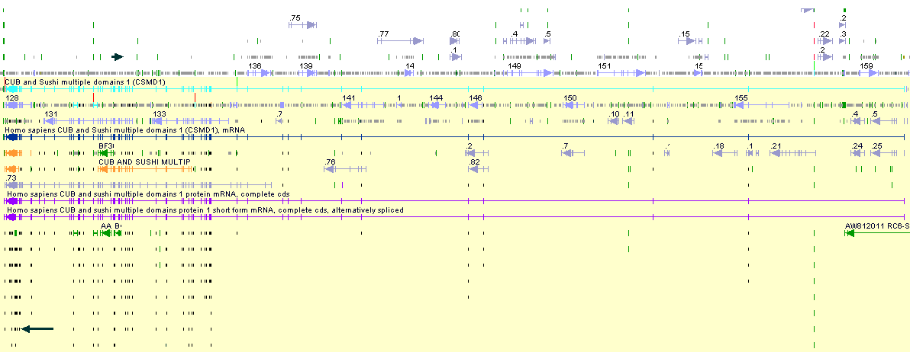
Annotation Strategy: Evidence-based Annotation
CSMD1 gene:
Gene Size: 2065,608 bases
Transcript Length: 11,297 bases
Protein Length: 3565 aa
No of Exons: 68
Average length of Exons : 166 bases
Fgensh 20
Genscan 25
Blat_EST 179
mRNA 3

Slide 4
Rule-based Annotation
FL-mRNA
Species-specific ESTs
Cross-species ESTs
Protein homology
Ecores + GenePredictions
Decreasing order of confidence level

Slide 5
Annotation System
Genome
Evidence
Loader
Alignment
Publication
database
QA
Automated
GeneCaller
Argo Genome Browser
Manual Annotation
Transcript Hunter
Notes:
Evidence includes:
ESTs, GenBank, GenPept, MGC, RefSeq
QA computes metrics but also flags certain genes for manual inspection.
Publication is in GenBank and the Vega DB.

Slide 6
Critical Steps in our Annotation Process
Running Computes
Selection and Filtering Evidence
Intelligent Automated Gene Caller
Genome Browser and Editor
Annotation Rules
Trained Manual Annotators
Annotation QA Process

Slide 7
Computes
Finished Sequence
Repeat Mask
Homology Search
Gene Prediction
Sequence Alignment
Raw Features
Filtering of High Quality Evidence
Identity >95% and >50% QS coverage
Splice Junctions
Rank Order
Repeat filtering
Computed Features
Annotation

Slide 8
TranscriptHunter
Computed Features
TranscriptHunter
Exon-based Clustering
  Define Gene Locus
Intron Edge Clustering
  Identify Variants
Creation of Gene Models
  ORF and UTRs
  Gene Name
  Transcript Classification
  Curation Flags

Slide 9
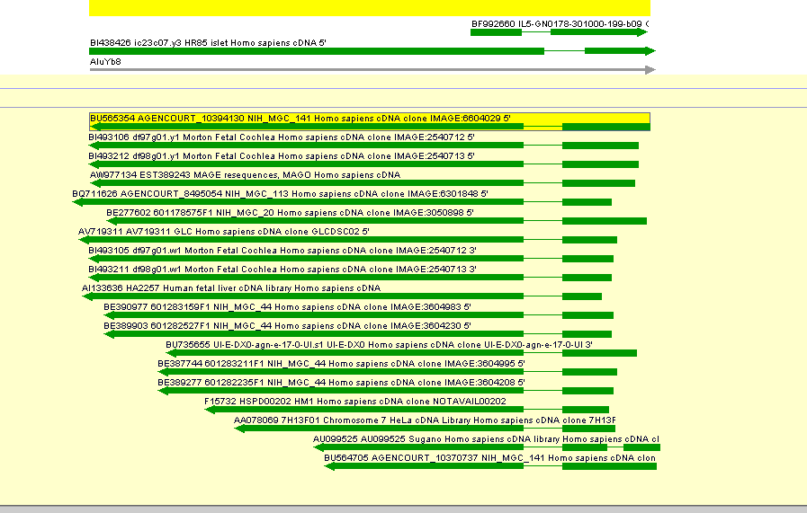
Screening of spliced ESTs contained within repeat elements
AluYb8 Repeat
Spliced ESTs

Slide 10
Manual annotation
TranscriptHunter Gene Models
Refine Gene Boundaries
  Exon/Intron
  3’ and 5’ UTR
Create New Genes
Classify Transcripts
Edit Automated Gene Calls
Identify Pseudogenes
Add Curation Flags
Call/Adjust ORF
Select PolyA Signals
AnnotDB

Slide 11
Features of Argo
Attaching primary and supplemental evidence
Cluster feature display
Filtering and customizing evidence list
Display poly A signals and splice junctions
Alerting discrepancies before updating
Highlighting parent and child features
Real-time interactive analysis
ORF selection options
Tabular dump of selected features
Roll back and save work
Customization of feature display

Slide 12
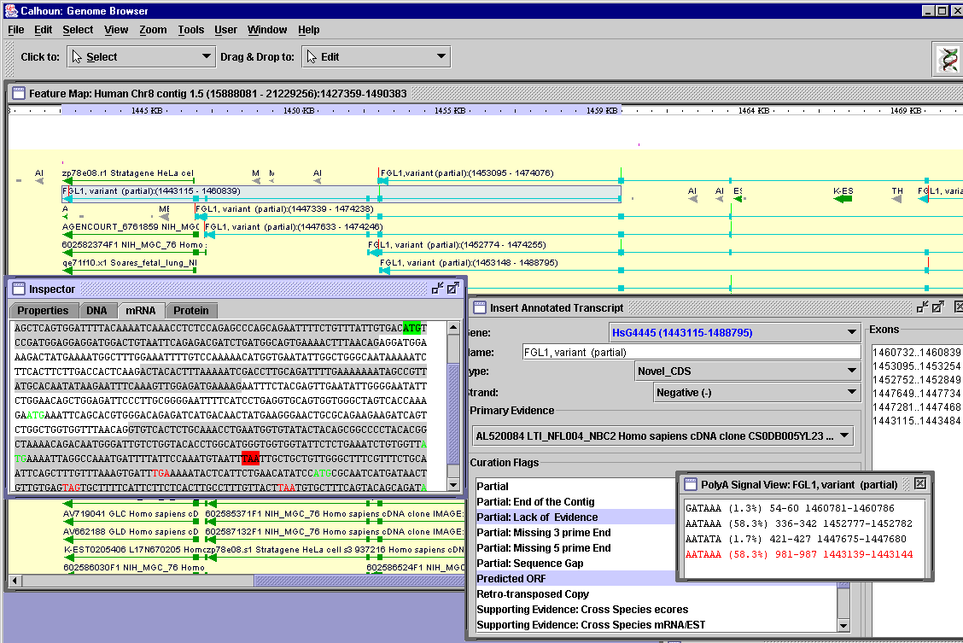
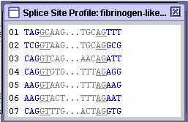
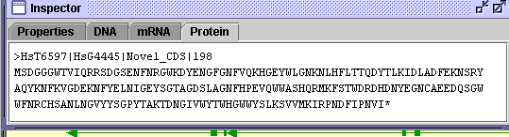
Annotation View

Slide 13
Confidence levels of our gene models
Classification of transcripts –Hawk standards
  Known, Novel_CDS, Novel, Putative, Pseudogene
Association of primary and supplemental evidence with annotated feature
Rank order in selection of supporting evidence
Curation flags
Free text comments

Slide 14
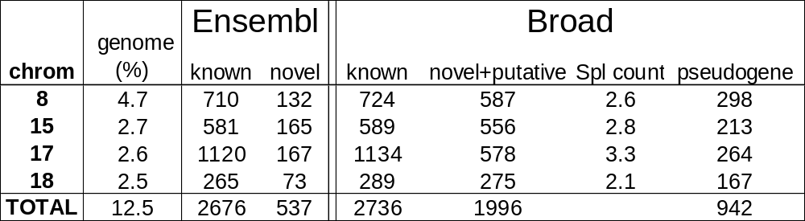
Gene counts for Broad and Ensembl
Notes:
Manual annotation results for Broad.
% of genome = 100(# basepairs/3,000,000,000)
Broad known count scales up to 21,888 genes in the genome
RefSeq:
8 - 663
15 - 576
17 - 1187
18 - 250
TOTAL - 2676
Ensembl found 960 pseudogenes in the entire genome: clearly too low.
Annotated 23,299 genes in the entire genome.

Slide 15
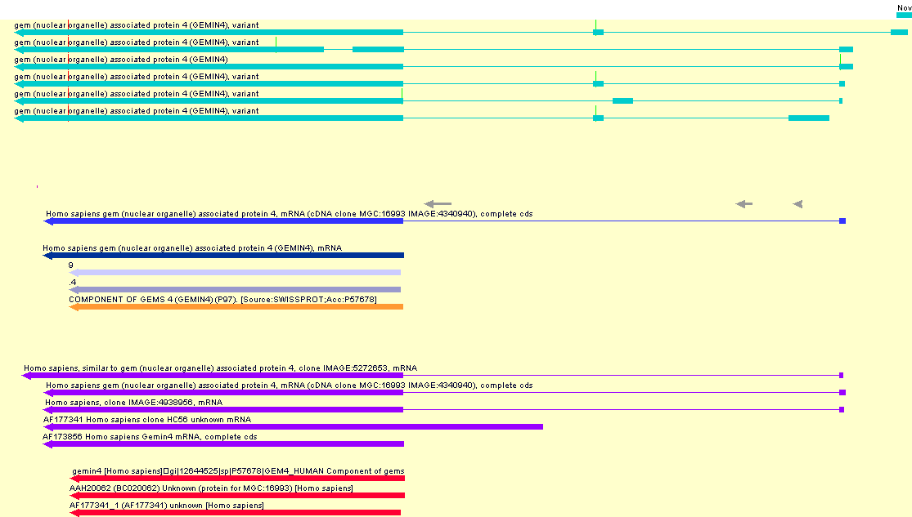
Manually Annotated Gene Models vs. public Gene Models
Broad
MGC
Refseq
ENSEMBL
mRNA
Gene-wise
Notes:
HsT32991

Slide 16
Types of splice variation
Type | % of variants
extra | 31
skip | 18
alt site | 33
run on | 18
CDS altered | 84 %
new stop | 48 %
Notes:
This is ‘most exciting exon’ hierarchy in which extra > skip > alt > run on. Hence lower types on the table may be contained within higher types as well.
Total frequencies, “pure cases” as % of type, and “pure cases” as % of total for each type are:
extra 31 41 13
skip 25 50 9
alt site 46 70 23
run on 30 100 18
total 62
Out of 1229 full length variants aligned to their known counterparts
Similar results are seen for all variants aligned to knowns
33% of variants are full length
New 5’ exons – 7% of all variants
New 3’ exons – 3 % of all variants
new stop stat only applies to cases with inserted sequence (extra exon, alt sites which extend an exon, and run ons)

Slide 17
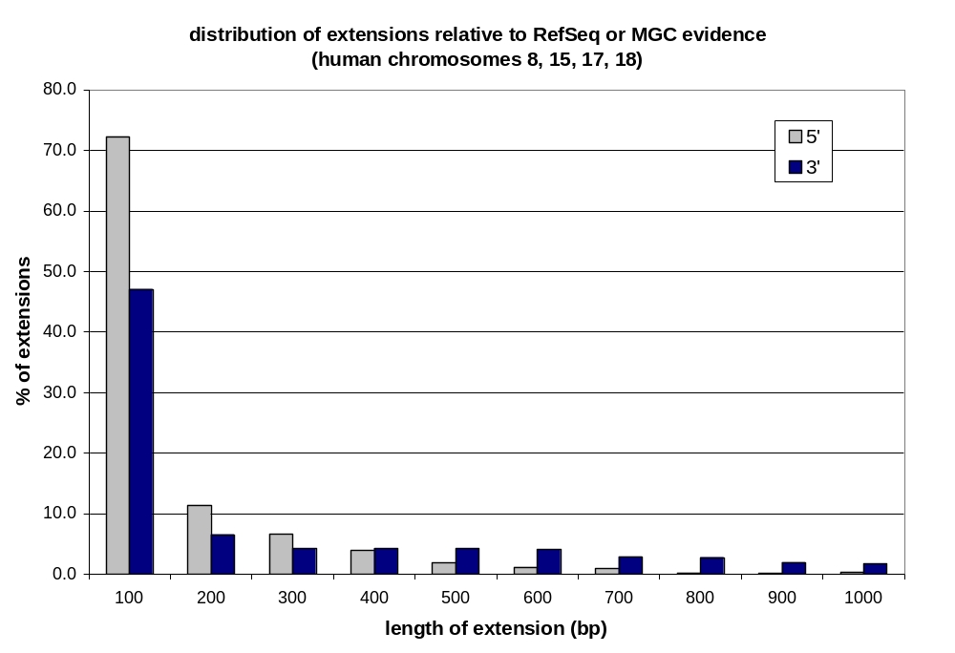
Our data extend most RefSeq/MGC transcripts
38 % positive for 5' extension
71 % positive for 3' extension
30 % positive for both
79 % positive for either
median 5' extension = 46 bases
median 3' extension = 143 bases
Notes:
38 % positive for 5' extension
71 % positive for 3' extension
30 % positive for both
79 % positive for either
median 5' extension = 46 bp
median 3' extension = 143 bp

Slide 18
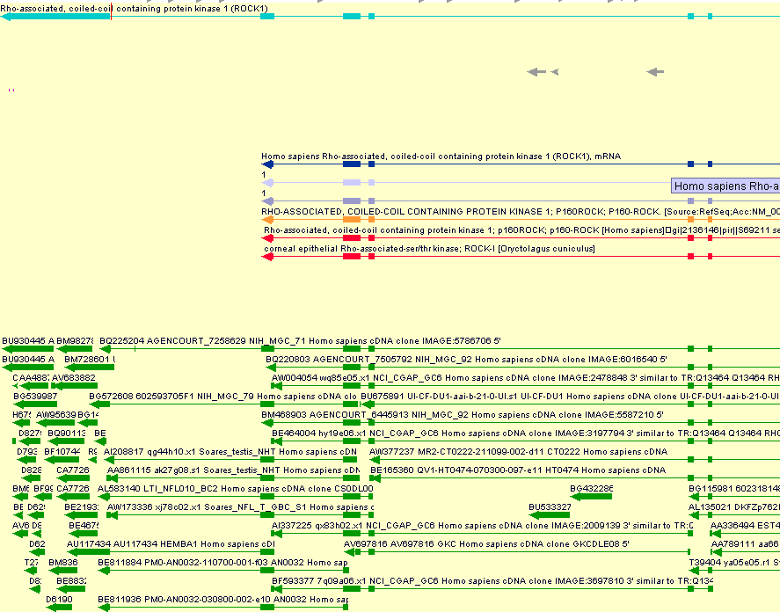
Complete 3 end as compared to Refseq mRNA and ENSEMBL gene
Notes:
HsT2393

Slide 19
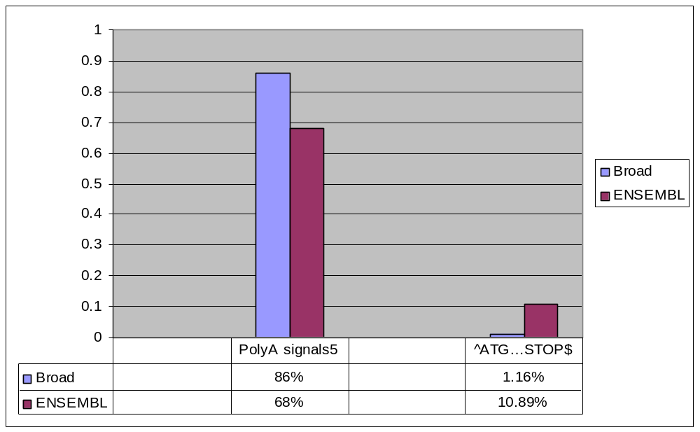
How valid are these 3’ and 5’ extensions ?

Slide 20
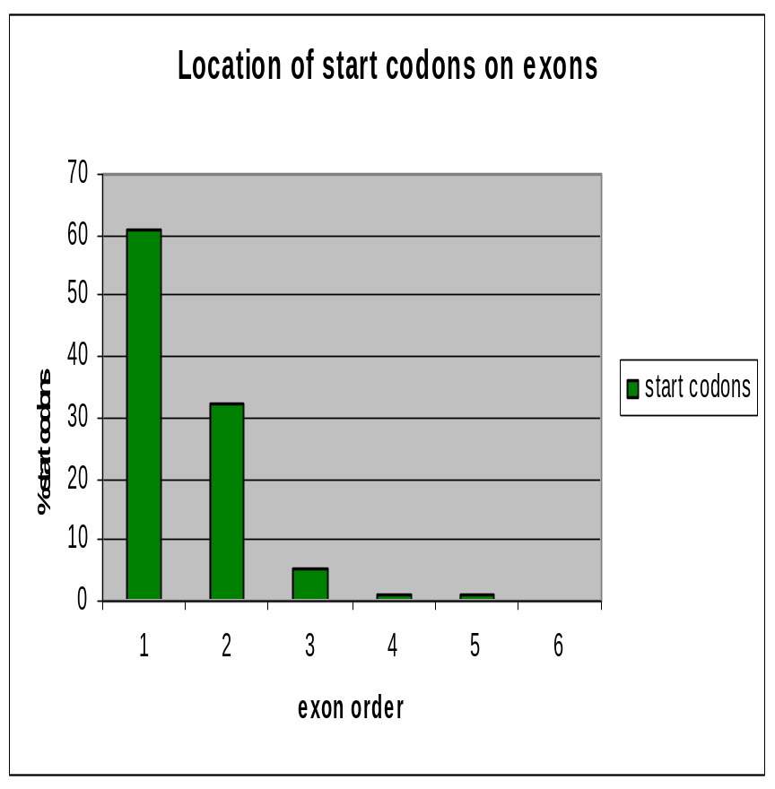
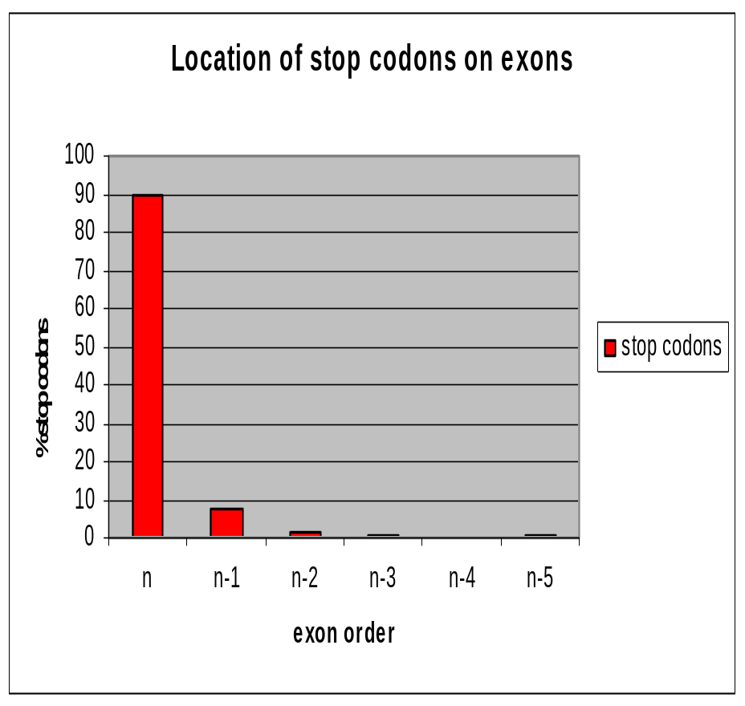
Using Start and Stop Codon Context to Refine Annotation
Pseudogenes
Real Start codons
NMD candidates
Sequence Errors
Non-coding genes
Pseudogenes
Real Stop codons
NMD candidates
Sequence Errors
Non-coding genes
SECIS genes

Slide 21
Issues with Novel and putative transcripts
Concerns
Probable reasons
High number
Low depth EST coverage
Small transcript size
Low no of variants
Poor coding potential
Poor cross-species conservation
Low poly A frequency
Weak CpG context
Spurious transcription
Mostly partial
Temporal genes
Non-coding
Poorly expressed
Lineage specific

Slide 22
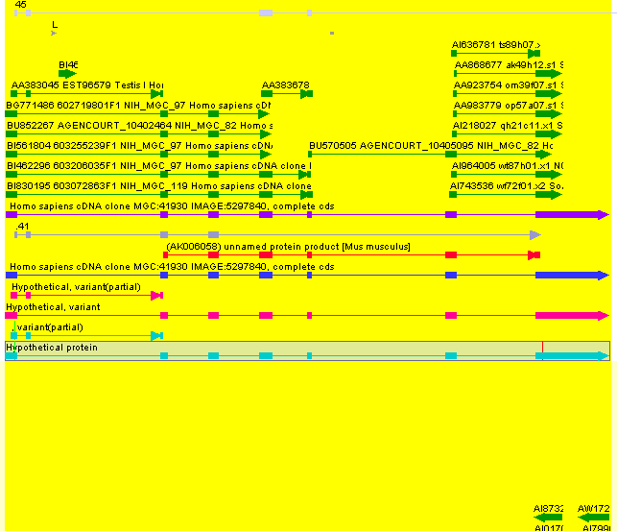
Putative→ Novel→ Known Transcript
Novel
Putative
Known
Notes:
>HsT34389|HsG15518|Novel_CDS|2189

Slide 23
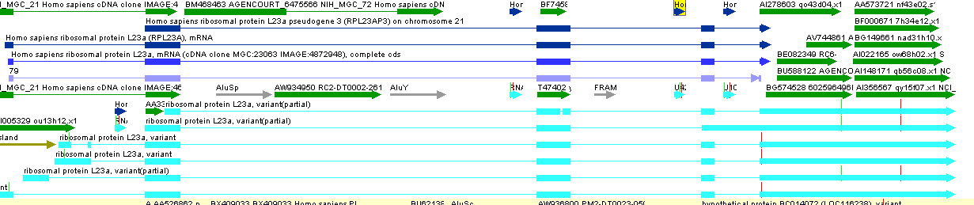
Annotating Non-coding mRNAs is still a challenge !!!
Sno RNAs

Slide 24
Challenges Ahead….
Establishing Common Standards
Validating Novel Transcripts
Single Exon Expressed Sequences
Determination of Accurate ORFs
Annotation of Functionally Relevant Alternative Splice Forms
Finding Sparsely Expressed Genes
Annotation of New Types of Non-coding Functional mRNAs
Incremental Update of Annotation
Capturing Biological Exceptions

Slide 25
Acknowledgements
  Annotation and Analysis
  Charlie Whittaker
  Mark Borowsky
  Sinead O’leary
  James Galagan
  Jill Mesirov
  Eric Lander
  Sequencing, Finishing and Closure Teams
Annotation Pipeline
    Reinhard Engels
    Shunguang Wang
    Seth Purcell
    Tim Elkins
    Yuhong Wu
    Serge Smirnov
    Sarah Calvo
    David Dicaprio

Slide 26
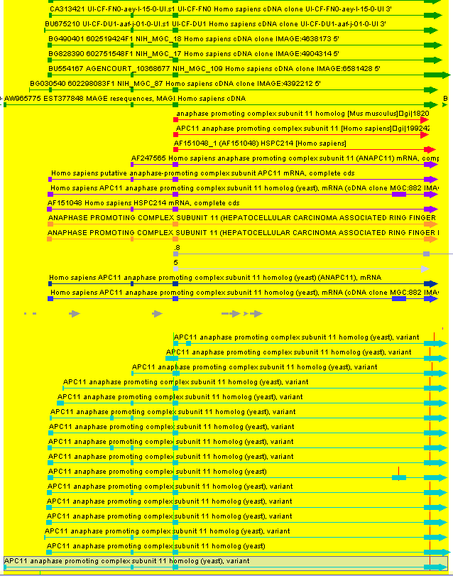
Comparison of alternative splice forms between ENSEMBL and Broad annotation
Manually Annotated Gene Models vs. public Gene Models
dbEST
nrnt-mRNA
ENSEMBL
Refseq
Broad

Slide 27
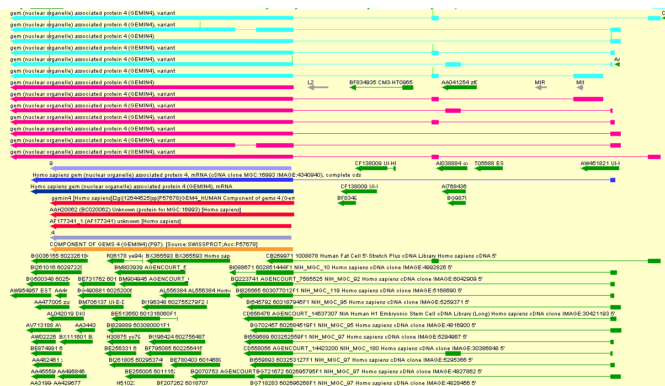
Novel Transcript Variants of Known Genes
PolyA signal
MANUAL
ANNOTATION
Transcript Hunter
REFSEQ
GENEWISE
ENSEMBL
ESTs
Notes:
HsG15104- GEMIN4 gene; several additional alternative splice forms; extra UTR and longer gene space

