Slide 1
javaSean
A Sequence Annotation Tool

Slide 2
javaSean
SEquence ANnotator
Developed to allow literature curation of sequence-level features
Used for creation of ARGS
(annotated reference gene sequence)

Slide 3
Process of ARGS Curation
Select a gene
Create a reference sequence
  Gene-plus region
Create gene models
  From nucleic acid alignments and literature
Add additional sequence-level features
  Include literature citations
  Add supporting information

Slide 4
ARGS Curation with javaSEAN
Gene based
  Curate one gene at a time
  Focus is on well studied genes
Literature driven
  Journal articles
  GenBank accessions
  Personal communications
Feature rich
  Gene models
  Variety of additional sequence-level features

Slide 5
Annotated Features
mutations
aberration breakpoints
transposon insertion sites
regulatory regions
protein-binding sites
rescue fragments

Slide 6
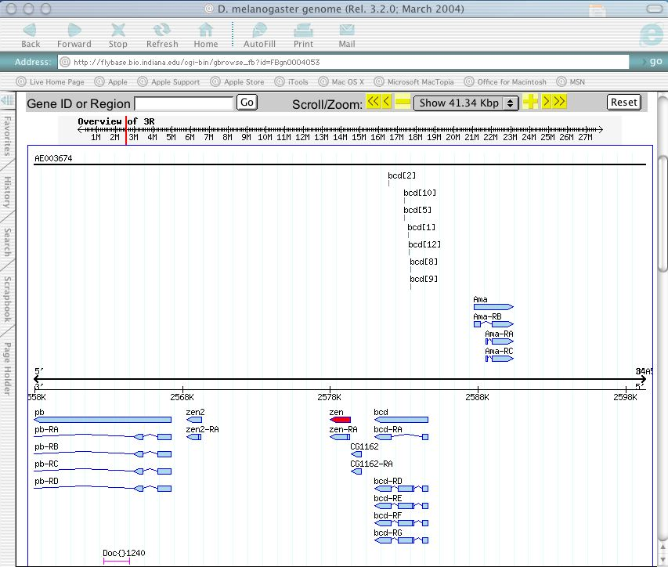

Slide 7
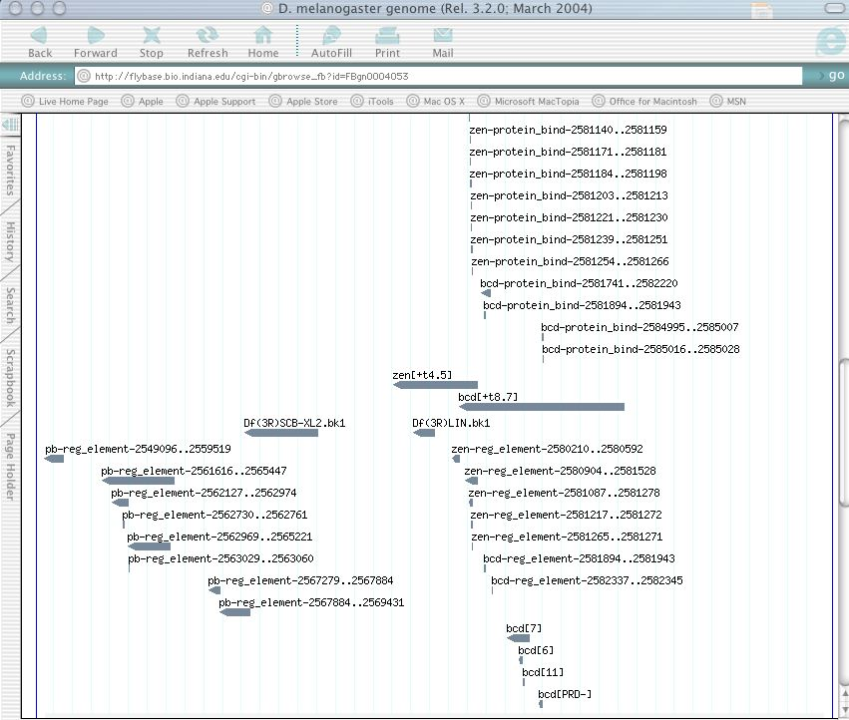

Slide 8
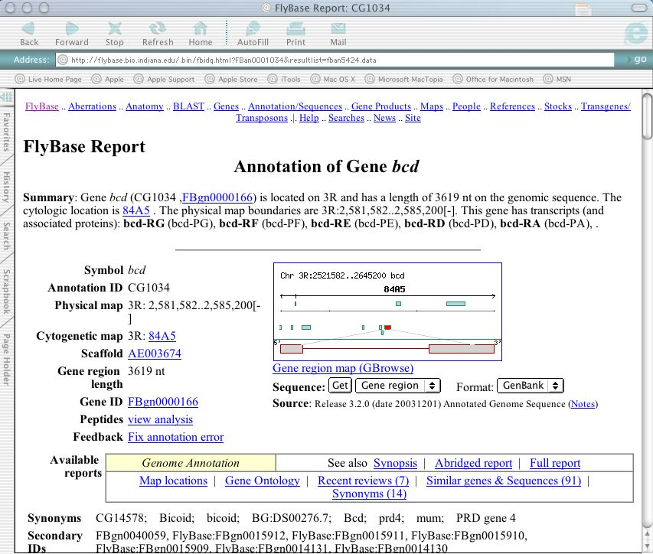

Slide 9
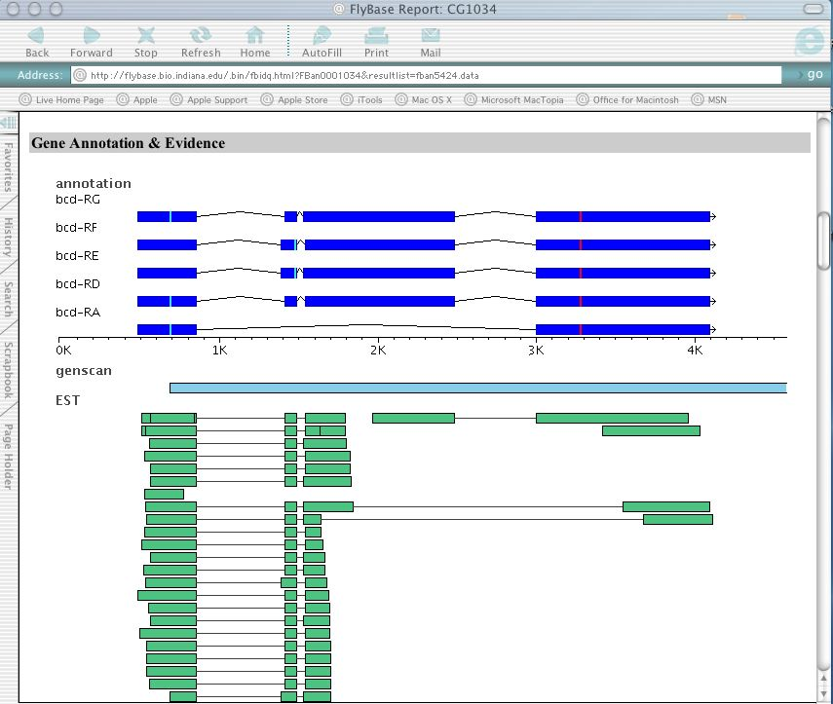

Slide 10
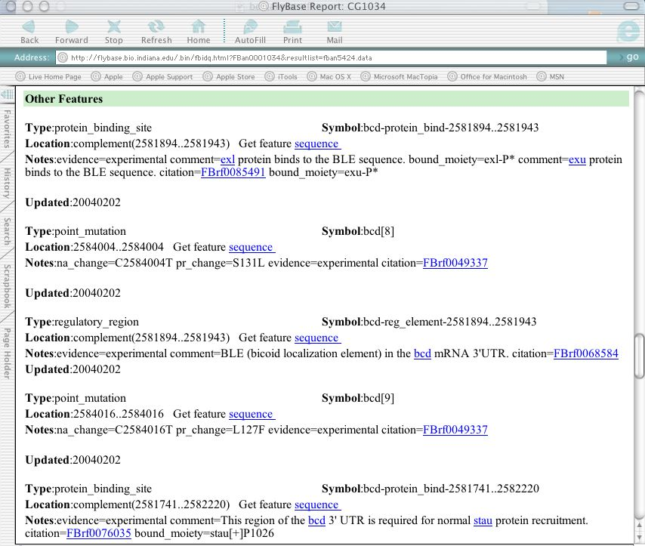

Slide 11
Data Paths
Map File
  from in-house expertise
  from an external source TBD
    Automated generation (EntrezGene?,UniGene?)
    Other organisms
Accession Files
  Automatically updated from NCBI
  Chado XML Adapter in near future
  GAME XML via ChadoXML-GAME bridge

Slide 12
Alignments
Alignments – remote or local
  Spidey – NCBI
  BLAST – NCBI, local at FlyBase
  ClustalW – Stanford

Slide 13
javaSean Software
System Requirements
  Java 1.4.1
  Solaris 8 or Mac OS X
Downloading
  Binary dist in JAVASEAN_PKG.tar from http://www.gmod.org/javaSean

Slide 14
javaSean was developed at
FlyBase-Harvard
Developed by Frank Smutniak
based on Joe Lemaire’s SEAN app.
Curators
Leyla Bayraktaroglu
Beverley Matthews
Andy Schroeder
Bill Gelbart

