Slide 1
Adventures in NOSQL
Brian O'Connor
Postdoc – Nelson Lab
University of California, Los Angeles

Slide 2
Overview
Why I'm giving this talk
My motivation
  Stupendous data growth
  Desire for scalability
What NOSQL means
  What you get
  What you give up
Progress in SeqWare project

Slide 3
My Background
User of relational databases for many years
  GMODWeb & Chado
  Celsius & Chado
  Other schema
Seen relational DBs not scale well when pushed to hundreds of millions of rows, looking for alternatives
I am just a user, not an expert and in the early stages of exploring NOSQL (take everything I say with a grain of salt!)

Slide 4
My Motivation
File size is proxy
for bases sequenced
Based on GA machines
in Nelson lab
Suggests Sequencer Output
Increases by 5-10x Every 2 Years!
Log scale

Slide 5
Pressures of Sequencing
A lot of data (50GB SRF file, 150GB alignment files, 60GB variants for a 20x human genome)
Needs to be processed, annotated, and queryable (variants, coverage, annotations)!
Want to ask simple questions:
  “What SNVs are in 5'UTR of phosphatases?”
  “What frameshift indels affect PTEN?”
  “What genes include homozygous, non-synonymous SNVs?”

Slide 6
Requirements for System
A sequence database must:
  Provide a common “place” for lots of data and annotations
  Support a rich level of annotation
  Support very large variant databases (>300GB)
  Be distributed across a cluster (>100 nodes)
  Be queriable programmatically and/or using a simple RESTful web service
  Support a crazy growth of data scalably

Slide 7
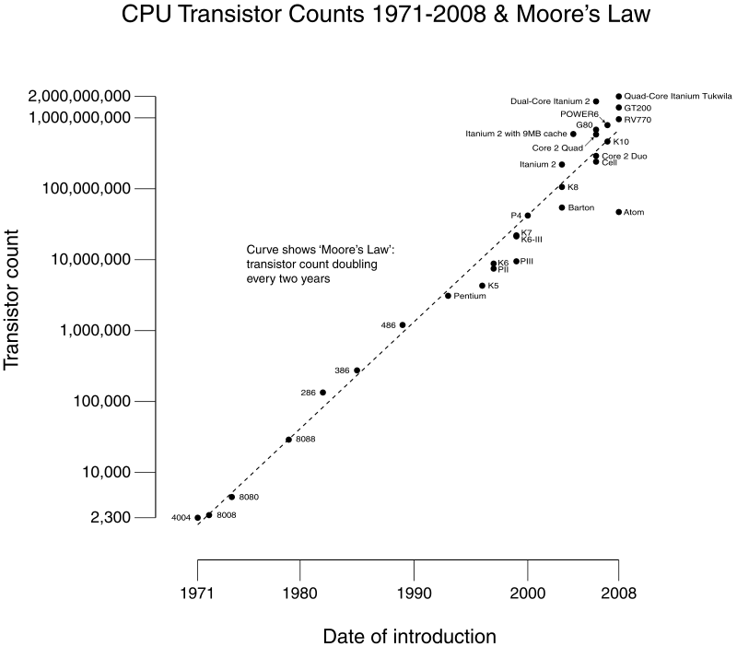
Reality of CPU Growth
Moore's Law:
CPU Power Doubles Every
18 Months - 2 Years

Slide 8
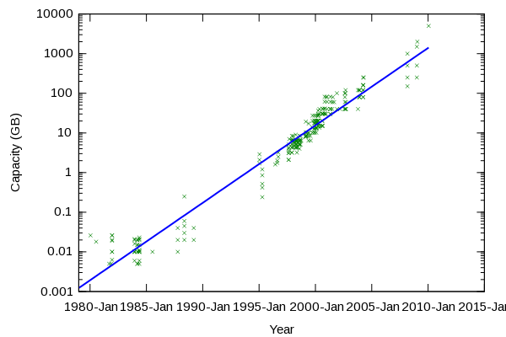
Reality of Storage Growth
Kryder's Law:
Storage Quadruples Every 2 Years
By 2020 1 disk = 14TB @ $40

Slide 9
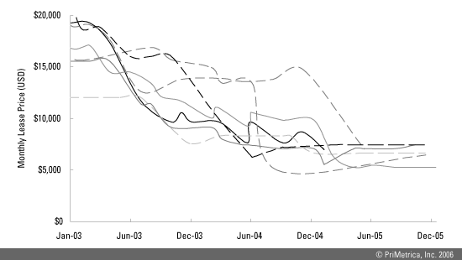
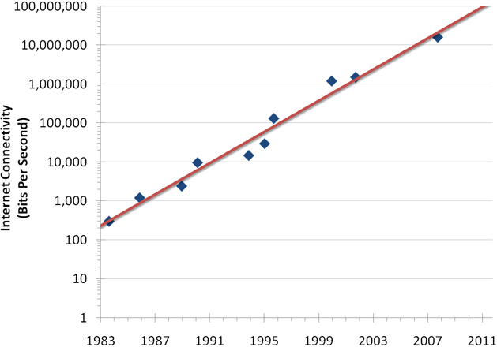
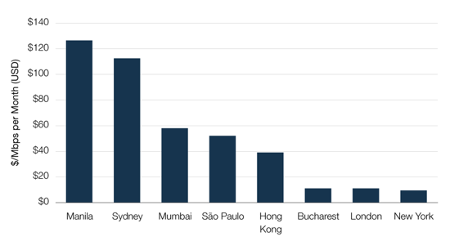
Reality of Bandwidth Growth
Los Angeles-New York OC-3 Lease
Nielsen's Law:
Internet Bandwidth Doubles Every 2 Years
Models home bandwidth (~10Mbps now)
Institutions with GigE connections clearly much more expensive and constrained!
Internet2's backbone is 100Gbit/s
Home Bandwidth Growth
Only 155.52 Mbit/s, price ½ 2 years
GigE IP Transit Price by City, Q2 09
http://www.telegeography.com
~$10K/month
For GigE
http://www.useit.com/alertbox/980405.html

Slide 10
Sequencers vs. Information Technology
Sequencers are increasing output by a factor of 10 every two years!
Hard drives: 4x every 2 years
CPUs: 2x every 2 years
Bandwidth: 2x every 2 years (really?!)
So there's a huge disconnect, can't just throw more hardware at a single database server!
Must look for better ways to scale

Slide 11
Google to the Rescue?
Companies like Google, Amazon, Facebook, etc have had to deal with massive scalability issues over the last 10+ years
Solutions include:
  Frameworks like MapReduce
  Distributed file systems like HDFS
  Distributed databases like HBase
Focus here on HBase

Slide 12
Magically Scalable Databases
Talking about distributed databases, forces a huge shift in what you can and can't do
“NoSQL is an umbrella term for a loosely defined class of non-relational data stores that break with a long history of relational databases and ACID guarantees. Data stores that fall under this term may not require fixed table schemas, and usually avoid join operations. The term was first popularized in early 2009.”
http://en.wikipedia.org/wiki/Nosql

Slide 13
When Would You Use NOSQL?
Horizontal scalability: not something common in database servers which tend to scale vertically
Don't mind having weaker consistency guarantees
Schema is less defined
Data is sparse
Query needs are not quite realtime (maybe)
http://blog.rapleaf.com/dev/?p=26

Slide 14
What Do You Give Up?
SQL queries
Well defined schema, normalized data structure
Relationships manged by DB
Flexible and easy indexing of table columns
Existing tools that query a SQL database must be re-written
Certain ACID aspects
Software maturity, most distributed NOSQL projects are very new

Slide 15
What Do You Gain?
Scalability is the clear win, you can have many processes on many nodes hit the collection of database servers
Ability to look at very large datasets and do complex computations across a cluster
More flexibility in representing information now and in the future
HBase includes data timestamps/versions
Integration with Hadoop

Slide 16
When Would You Not Use It?
When your data fits in a SQL database
If your data is simple, fits well into a relational schema
You data is not sparse
You want to store large amounts of binary data
http://blog.rapleaf.com/dev/?p=26

Slide 17
SeqWare Query Engine
My first NOSQL project
Ask simple questions:
  “What SNVs are in 5'UTR of phosphatases?”
  “What frameshift indels affect PTEN?”
  “What genes include homozygous, non-synonymous SNVs?”
SeqWare Query Engine was designed to:
  Support very large variant databases (>300GB)
  Be distributed across a cluster (>100 nodes)
  Be queriable using a simple RESTful web service (e.g. common programmatic interface)
  Support a rich level of annotation (is_dbSNP, frameshift)

Slide 18
BerkeleyDB SeqWare Query Engine
Lustre Filesystem
clients
backend
webservice
Genome
Database
Analysis/Web Nodes
BED/WIG
Files
XML
Metadata
Genome
Database
RESTful
Web Service
Analysis/Web Nodes
Genome
Database
Annotation
Database
Analysis/Web Nodes
BerkeleyDB
Variant & Coverage
Databases
Web/Analysis
Nodes process
queries
Webservice combines
Variant/Coverage data
with annotations (hg18)

Slide 19
Challenges with BerkeleyDB
BerkeleyDB let me:
  Create a database per genome, independent from a single database daemon
  Provision database to cluster for distributed analysis
  Adapt to key-value database semantics with nice API
Limitations:
  Creation on single node only
  Want to query easily across genomes
  Database are not distributed
  I saw performance issues, high I/O wait

Slide 20
HBase SeqWare Query Engine
Hadoop
Map Reduce
Hadoop HDFS
clients
backend
webservice
Data
Node
ETL Map
Job
Analysis/Web Nodes
BED/WIG
Files
XML
Metadata
Data
Node
RESTful
Web Service
ETL Map
Job
Analysis/Web Nodes
ETL
Reduce Job
Name
Node
Annotation
Database
Analysis/Web Nodes
MapReduce
jobs extract,
transform, &
load in parallel
HBase
Variant & Coverage
Database System
Web/Analysis
Nodes process
queries
Webservice combines
Variant/Coverage data
with annotations (hg18)

Slide 21
What HBase DB Looks Like
A Record in my HBase
A Record in my HBase
family
label
key
variant:genome4
variant:genome7
coverage:genome7
chr15:00000123454
byte[]
byte[]
byte[]
Variant object to byte array
Database on filesystem (HDFS)
key
timestamp
column:variant
chr15:00000123454
t1
genome7
byte[]

Slide 22
Current Prototyping Work
Validate creation of U87 (genome resequencing at 20x) genome database
  SNVs
  Coverage
  Annotations
Test fast querying of record subsets
Test fast processing of whole DB using MapReduce
Test stability, fault-tolerance, auto-balancing, and deployment issues along the way

Slide 23
What About Fast Queries?
I'm fairly convinced I can create a distributed HBase database on a Hadoop cluster
I have a prototype HBase database running on two nodes
But HBase shines when bulk processing DB
Big question is how to make individual lookups fast
Possible solution is Hbase+Katta for indexes (distributed Lucene)

Slide 24
Resources
Hbase & Hadoop: http://hadoop.apache.org
When to use HBase: http://blog.rapleaf.com/dev/?p=26
NOSQL presentations:
http://blog.oskarsson.nu/2009/06/nosql-debrief.html
Other DBs: CouchDB, Hypertable, Cassandra, Project Voldemort, and more...
Data mining tools: Pig and Hive
SeqWare: http://seqware.sourceforge.net

Slide 25
Acknowledgments
Zugen Chen
Michael Clark
Ascia Eskin
Bret Harry
Nils Homer
Stanley Nelson
GMOD!
Hane Lee
Jordan Mendler
Barry Merriman
Dmitriy Skvortsov
Colin Flinders
John Klejnot
Felipe Cervantes
Kevin McKernan (ABI)
SeqWare: http://seqware.sf.net
boconnor@ucla.edu

Slide 26
Extra Slides

Slide 27
File Sizes for 20x Genome
U87
  150GB for SRF file (sequence and quality)
  150GB for BAM (alignment)
  50GB for pileup (variant calls)
  30GB for BekeleyDB (variant calls, coverage, annotation, but no alignments)
  Total = ~400GB per genome
2000 genomes x 400GB/genome = 800TB
2000 genomes x 30GB/genome = 60TB

Slide 28
File Sizes for ?x Genome
HuRef
  ?GB for SRF file (sequence and quality)
  ?GB for BAM (alignment)
  ?GB for pileup (variant calls)
  140GB for BekeleyDB (variant calls, coverage, annotation, but no alignments)
  Total = ~?GB per genome
2000 genomes x ?GB/genome = ?TB
2000 genomes x 140GB/genome = 280TB

Slide 29
Would 2,000 Genomes Kill SQL?
Say each genome has 5M variants (not counting coverage!)
5M variant rows x 2,000 genomes = 10 billion rows
Our DB server running PostgreSQL (2xquad core, 64GB RAM) died with the Celsius (Chado) schema after loading ~1 billion rows
So maybe conservatively we would have issues with 150+ genomes
That threshold is probably 1 year away with public datasets available via SRA, 1000 genomes, TCGA

Slide 30
HBase Under the Hood
Slide from architecture

