Slide 1
Gene Expression Databases:
Where and When
Dave Clements
davidc@hgu.mrc.ac.uk
EuReGene and Mouse Atlas projects
Medical Research Council Human Genetics Unit
Edinburgh
23 April 2007
Notes:
Going to talk about gene expression databases, and the When and Where aspects of gene expression data

Slide 2
Overview
The Fine Print
DB Issues: With a focus on anatomy
  What to record?
  How to present?
  How to query?
Some implemented solutions
Notes:
First going to introduce the issues then talk about some implemented solutions.

Slide 3
The Fine Print
A Discussion
  Talk, ask questions, interrupt!
Describe issues and existing solutions
Not proposing any new solutions
Some interesting gene expression topics I am not going to talk about:
  Microarrays, mutants, Cell/Tissue Type Ontology, curation standards.
I am not a biologist
Notes:
The whole point of this slide is:
TALK! INTERRUPT! ASK QUESTIONS!
Lectures are not nearly as interesting as discussions.

Slide 4
Recording Expression Data
Notes:
Before I dive into the details of gene expression databases, this is a good time to ask: Is this interesting?

Slide 5
Fundamental Data
What: Gene, probe, strain, alleles
When: Usually developmental stage
Where: Usually anatomical terms
How: Assay, environment
Who: Publication, screen
Notes:
These are the absolute minimums.
They tell others how to reproduce your results and allow them to make judgement calls on reliability.
Also lays the groundwork for later querying of the data.

Slide 6
Some Additional Annotations
Pattern
  Homogenous, graded, regional, spotted …
Strength of signal
  Within this assay
  Good for expression gradients
Confidence:
  Experiment: Sample, image, signal, probe quality
  Annotation: How sure am I?
Notes:
Not detected annotations are a challenge.
Always has to be followed with qualifier: “In this assay”.
“Not detected” is not the same thing as the absence of a “detected” annotation.

Slide 7
Not Detected Annotations
Important but confusing
Tempting not just to make them
‘not detected’ does not = not ‘detected’!
  3 value logic
  detected, not detected, and no assertion
Not detected in this assay
  Hard to prove absence of something
  Assertions always subject to limits of current assay

Slide 8
When and Where
When and where are central to gene expression databases
Often the least understood of the basic items
Anatomy Ontologies define
  When
  Where
  Relationships
Notes:
The concepts of when and where are central to any gene expression database.
Without them you can’t answer even the most basic questions

Slide 9
Presenting Expression Data

Slide 10
Trees, DAGs, Lists
Most anatomy ontologies are directed acyclic graphs (DAGs)
Tree
  Terms (except root) have 1 parent
  Terms have 0 or more children
DAGs
  Terms (except root) can have multiple parents
  Terms have 0, 1 or many children
  Allows multiple ways to think about anatomy
  Cycles are not allowed
Notes:
Tree metaphor well established. Directory/folder navigation on PCs. Graphs are not as familiar to people.
Show graphs as tress anyway. Have to communicate to user that what appears as two separate parts of tree are actually the same.
Or draw them as graphs. See Mary Dolan’s work.
Negative annotation propagates downward. Positive information propagates upward.
How do you combine annotations when you have extra information?

Slide 11
Tree: Spatial mouse
mouse
head
torso
tongue
brain
spinal cord
kidney

Slide 12
DAG: Spatial and Functional
mouse
head
CNS
torso
tongue
brain
spinal cord
kidney
Notes:
CNS is a different colour here, but it is not significantly different from the others.
Sometimes even spatial only requires DAG strucutures.

Slide 13
Annotation in Context
Show terms in anatomy tree
  Render DAG as tree
Show context graphically
Show terms in a flat list
  Give user other means to figure out where/what the thick ascending limb is
Presenting assay versus whole data set
Notes:
The last point is significant.
In a single assay, a list may make sense
For summarise the whole dataset a tree may work better.

Slide 14
Details
Propagating annotation up/down
  Detected propagates up
    What about homogenous / ubiquitous patterns?
  Not Detected propagates down
    What about whole mounts?
  Should propagation be shown?
Strength, pattern, confidence
  On annotated component
  Should this be propagated?
Too much information?

Slide 15
Querying Expression Data

Slide 16
Asking Where
Anatomy ontologies can be large
  Mouse TS26 has 2600+ components
Synonyms
Booleans: OR/any, AND/all, NOT
Detected, Not Detected
Propagation
Lineage
Notes:
Typical user is not an expert anatomist. How do you make interfaces flexible enough to help these users out?
How do you display 2600 terms
How complex do you want your queries to be?
NOT raises its ugly head again. Average user will think that these two queries should two distinct sets, that cover every experiment in the database.
“show me all experiments with expression in X”
“show me all experiments without expression in X”
How do you explain 3-valued logic to web users?

Slide 17
Asking When
Most users won’t know what distinguishes stages TS18 and TS19
How to provide flexibility without swamping them in too much anatomy
  Can confuse them by presenting terms that never coexist in a real specimen

Slide 18
Asking What, How, Who, …
Genes / Probes
  Symbol / Name / Synonyms
  GO
  Sequence
Assay and Environment
Who
Patterns, Confidence, etc

Slide 19
Example Expression Databases

Slide 20
Example Implementations
ZFIN
  Well integrated basics (I like to think)
GenePaint
  Limited anatomy, robust pattern and strength
Work by Mary Dolan based on MGI data
  An alternative way to show context
EMAGE
  Something completely different
GUDMAP/EuReGene
  Booleans via collections
Notes:
ZFIN
Has basics
Supports OR searches, AND searches. But can’t combine the two.
Has not expressed annotations, but can’t query them.
Deals with size of ontology with
Auto-completion of terms (AJAX)
Can also query from complete list.
GenePaint
Strength and pattern, and how to propagate that information.
Deals with complex anatomy by reducing it to 100 terms.
Allows them to specify positive and negative annotation for all 100 terms in the set.
MGI/Mary Dolan
Show annotation as a graph, drawn on the screen.
Maximally informative about how the terms are related to each other, but
takes a lot of screen space, and
How long does it take new users to figure this format out?
EMAGE:
Abandons (almost) text annotation. Instead of describing expression with words, describe it with 3-D models of embryonic mice.
Take the gene expression images and map them to models.
NOT expressed generated as part of the process.
Not based on what the author says, but rather than what the images say.
GUDMAP/EuReGene
Deal with complex Boolean expressions by use of sets and set-based operation. AND/OR/NOT all supported using intersection, union, difference.

Slide 21
ZFIN
Model organism database for zebrafish
  http://zfin.org

Slide 22
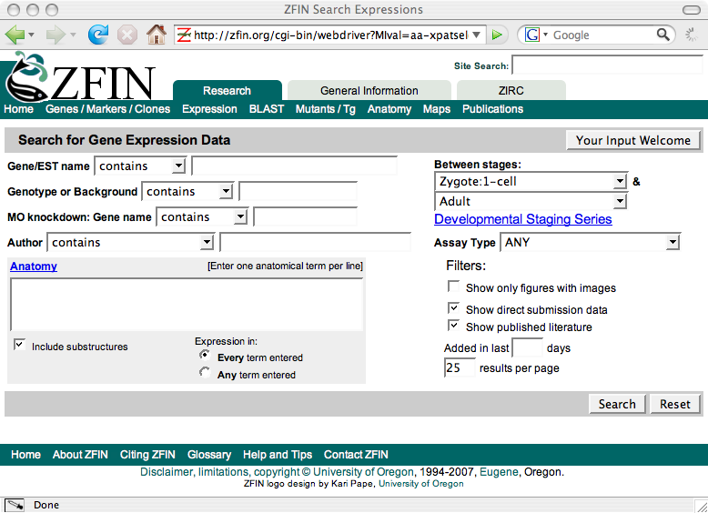
Notes:
Most complicated form at ZFIN.
This is a tax form query form.
Problem is to balance flexibility with ease of use.
Anatomy complexity / size: see later slides
Stage range: Allows for flexible time windows.
Not detected annotations: ZFIN records them, but you can’t query them.
Any/All, propoagation both switchable by user.

Slide 23
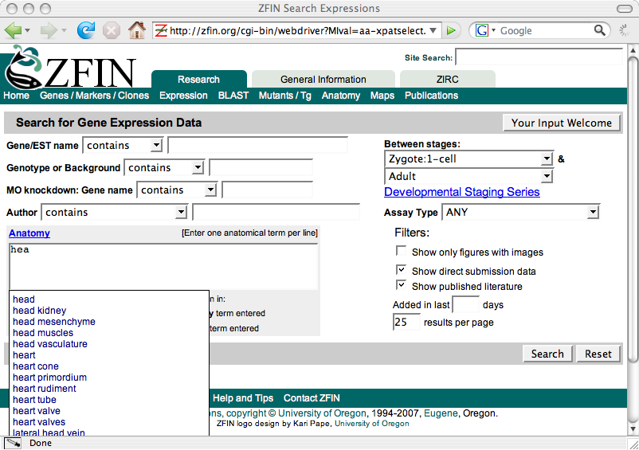
Notes:
Helping the user deal with the complex anatomy
Failed anatomy terms are recorded for later analysis.

Slide 24
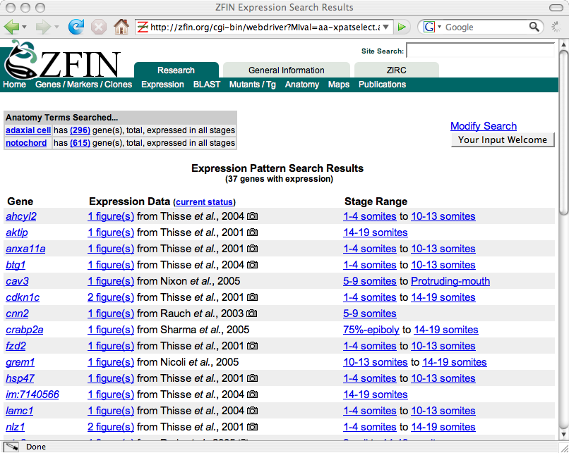
Notes:
Here I looked for adaxial cell and notochord
Assays grouped first by gene.

Slide 25
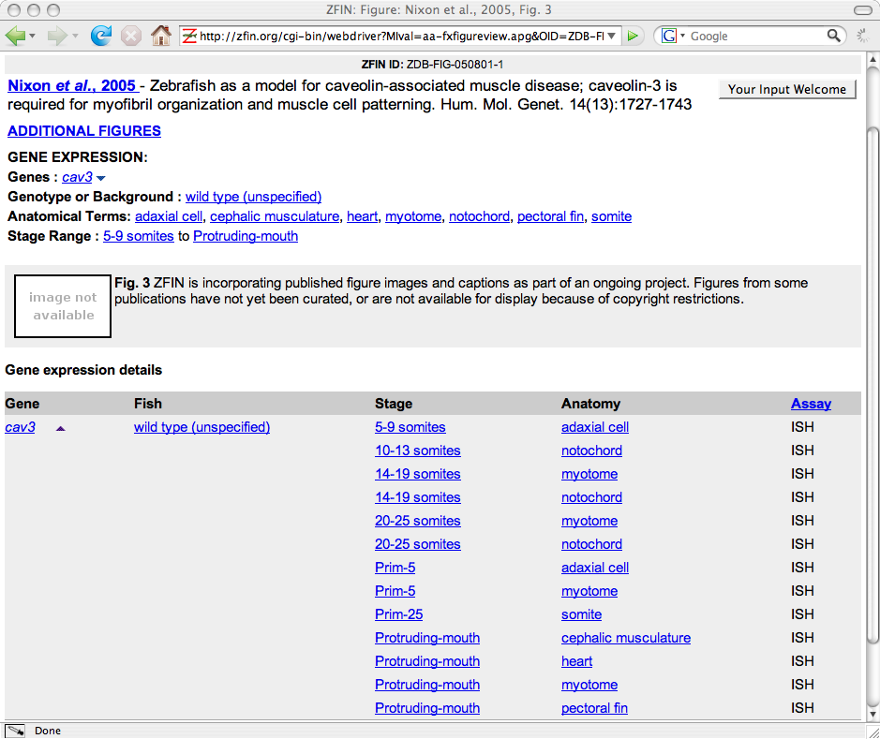
Notes:
Shows one of the entries from the previous page.
This is figure 3 from this paper.
Anatomy annotations presented as a list, ordered by time and then alphabetical.
Note that for many assay types the image is the most important piece of source data. However, ZFIN has decided to annotate publications even where the image is not available.

Slide 26
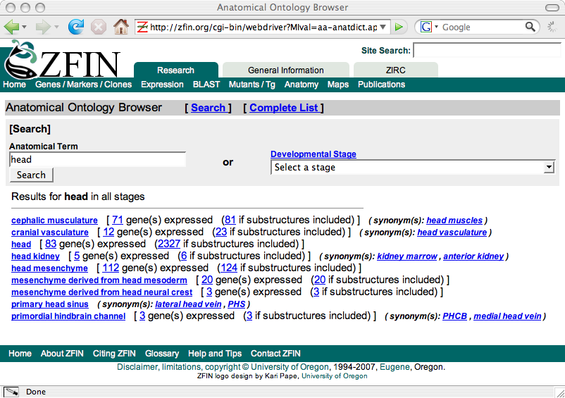
Notes:
Alternative ways to find this information.
The anatomy browser. Can search for terms, uses Ajax again.
Here I searched for head across all stages. Shows me links to gene expression assays that are annotated for each term.

Slide 27
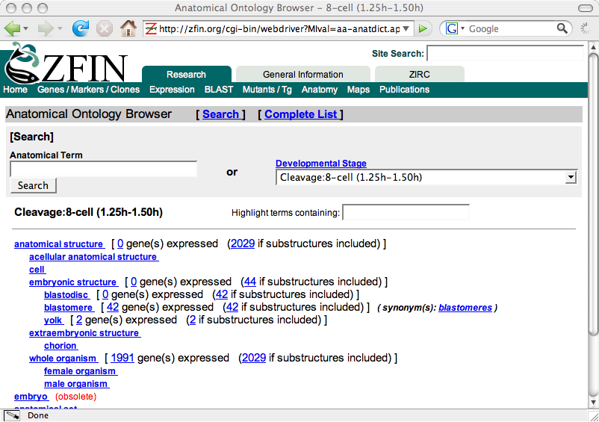
Notes:
Show a particular stage as a tree. The only time you’ll see a tree at ZFIN.
Talked about presenting a single assay vs larger databsets.

Slide 28
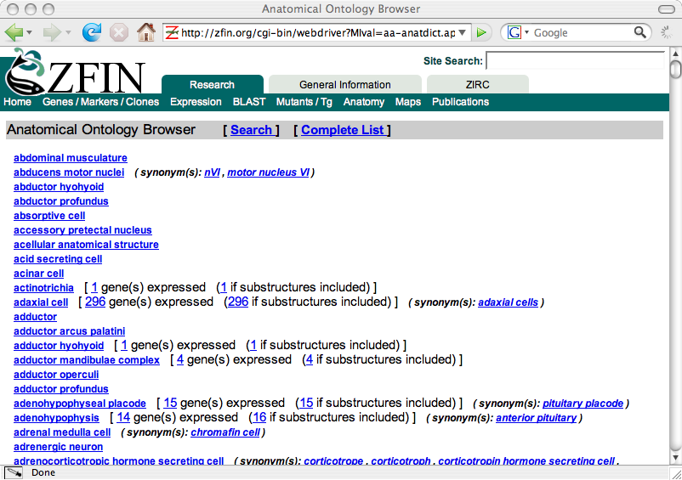
Notes:
Hypothetical fish / Abstract Mouse
Everything is listed.
Let user search for terms using their browser.

Slide 29
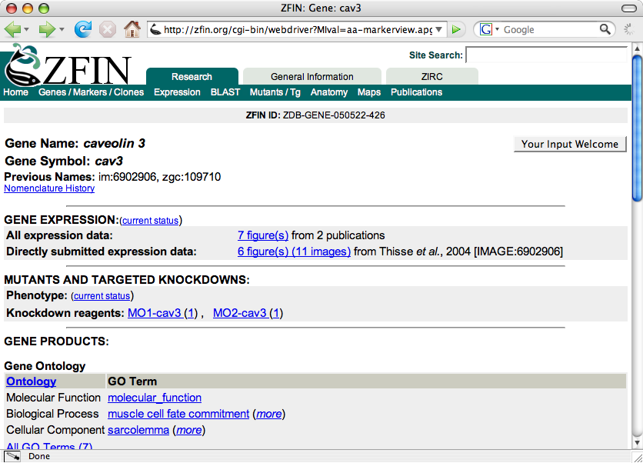
Notes:
Can also get to it from Gene

Slide 30
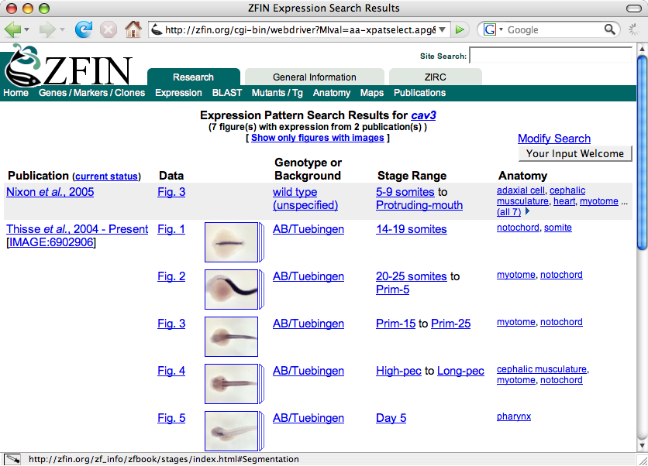
Notes:
This is what you get if you click the link from the cav3 gene page.
ZFIN demonstrates importance of integration. Everything on this page is hot link to something.

Slide 31
GenePaint
Mouse ISH Gene Expresssion
  http://genepaint.org/Frameset.html
  All data uses same set of high-throughput methods

Slide 32
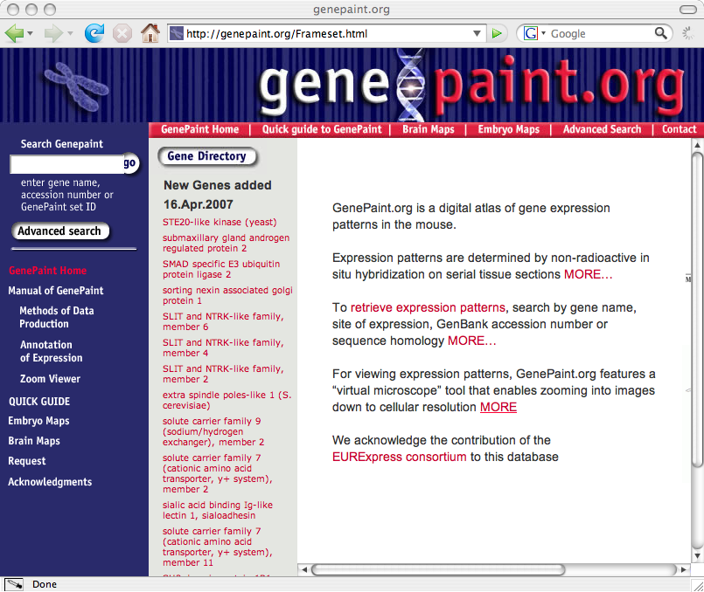
Notes:
GenePaint is Gregor Eichele’s child.
It’s a web site that focuses on mouse ISH experiments on sections all produced by the same automated platform.

Slide 33
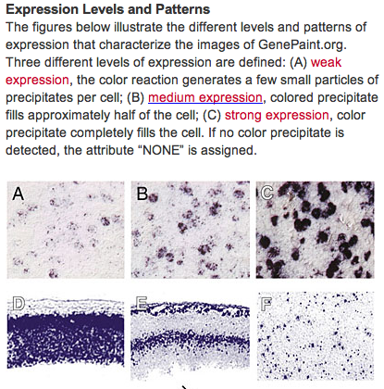
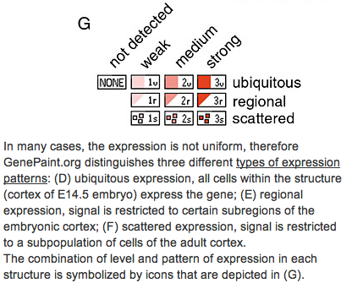
Notes:
GenePaint uses 10 icons to convey different combinations of strength, pattern, and detected / not detected.
This key is pulled from the web site.
The key shows examples of what they mean by each label.
Unfortunately key is not linked to from results pages.

Slide 34
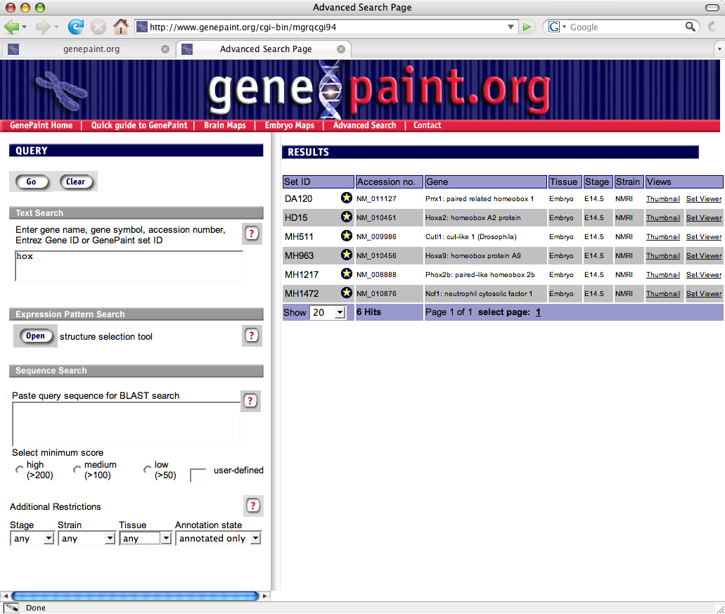
Notes:
The query form showing the results of the given query: hox and annotation only.
Note you can search by sequence.
Tissue is not shown, but there are only 5 or terms in the pull down.
Only 2 strains.

Slide 35
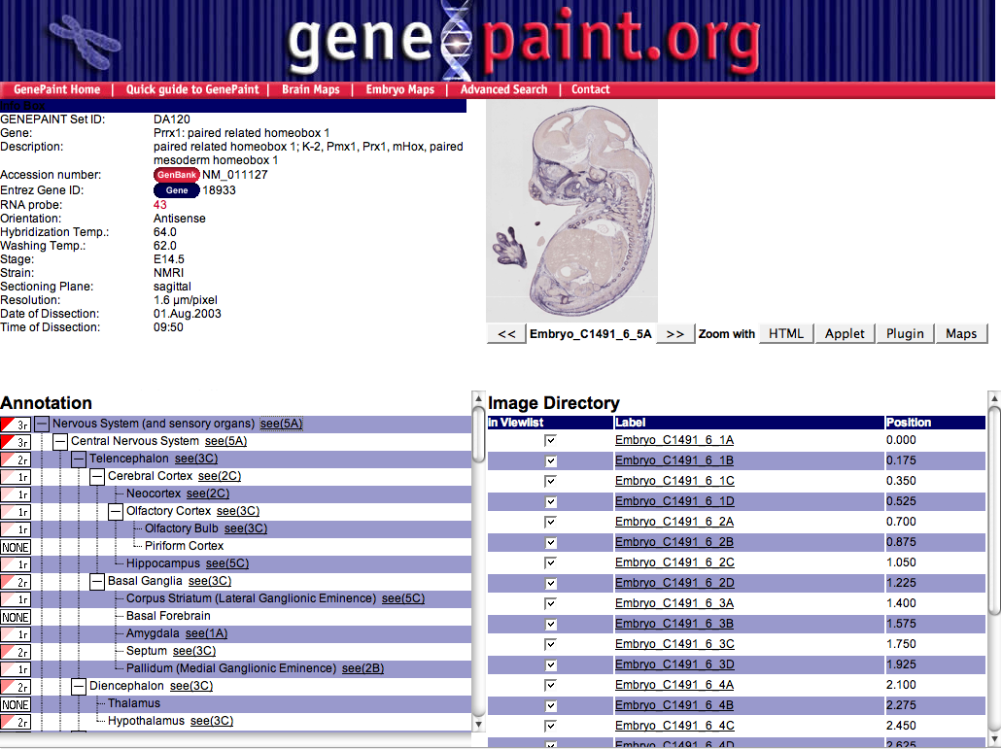
Notes:
Results of clicking on first entry on previous page.
GenePaint deals with anatomical complexity by
only annotating a single stage
reducing the anatomy ontology for that stage down to 100 or so terms
subset is a tree, not a DAG
For every assay they annotate every term.
Show annotation in a collapsible / expandable tree on left.
GenePaint takes 20-24 sections and pictures for each assay, each slicing through a different part of the animal.
Note that each (detected) annotation has a link to an image that supports that annotation. Clicking on the link changes the thumbnail.

Slide 36
Mary Dolan’s work with MGI
Visualizing expression in a DAG
  http://www.spatial.maine.edu/~mdolan/GXD_Graphs/

Slide 37
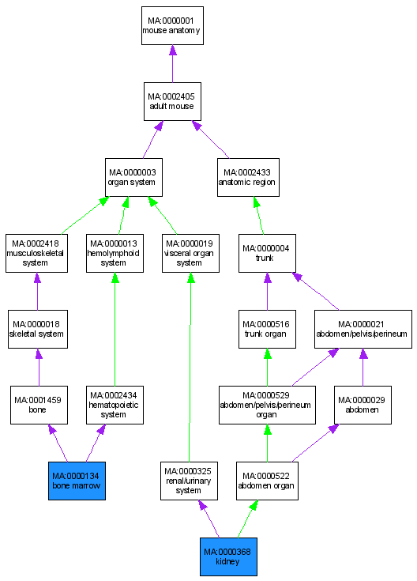

MGI GXD Annotations for Abca13
Green arrows indicate “is_a”
Purple arrows indicate “part_of”

Slide 38
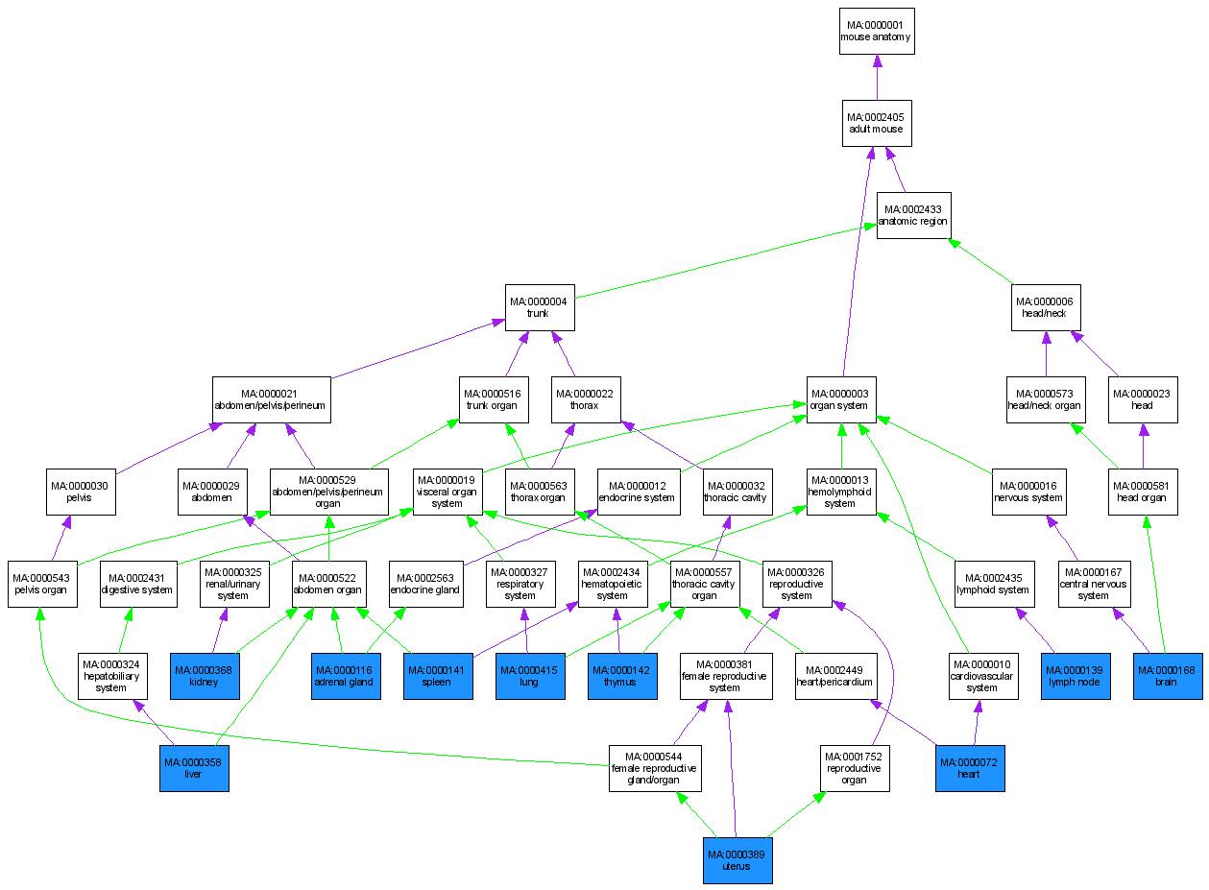
MGI GXD Annotations for Abca7

Slide 39
EMAGE
Edinburgh Mouse Atlas Gene Expression Database
  http://genex.hgu.mrc.ac.uk
Something completely different
Spatial annotation
Example from
  http://genex.hgu.mrc.ac.uk/das/jsp/submission.jsp?id=EMAGE:1033

Slide 40
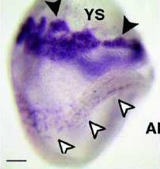
EMAGE: Original Image
Start with original whole mount image
Specimen from TS11

Slide 41
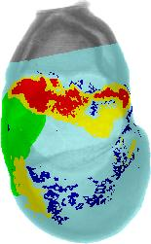
EMAGE:
Map to TS11 Model and threshold expression
➔
Notes:
Through a labour intensive process, the image is mapped onto the model for TS11 using tie points.
Image is then thresholded to reveal different levels of expression.

Slide 42
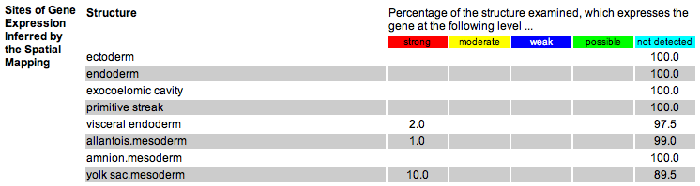
EMAGE
Extract anatomy and
expression levels via
image processing
➔
⬇
Notes:
Through a labour intensive process, the image is mapped onto the model for TS11 using tie points.
Image is then thresholded to reveal different levels of expression.

Slide 43
Thank you

