Slide 1

BeeSpace Navigator v4.0 and Gene Summarizer beespace.uiuc.edu
`
Notes:
Hi, I’m Barry Sanders and this is David Arcoleo. We’re from the Beespace project at the University of Illinois. We’re here to present the latest version of Beespace Navigator and the Gene Summarizer. Please feel free to follow the URL on this page (beespace.uiuc.edu); but I want to let you know that the hotel network is – for reasons unknown – blocking all queries to our Beespace software demo. It’s OK because we have a complete copy of it on our local machine.

Slide 2
The BeeSpace Project
5-year NSF-funded FIBR project
At University of Illinois Urbana-Champaign
Project Goals
  Develop open bioinformatics resources
  Support functional analysis of social behavior
  Initial prototype focused on honey bee research
  Main software product is Beespace Navigator
Notes:
Beespace is funded by the NSF Frontiers in Integrative Biology Research. We’re currently in year 5 of the 5 year project. Beespace Navigator is our flagship product, which we’re demonstrating today. After I get through these slides, David will do a live demo of the new v4.0 beta, which we’re premiering today.

Slide 3
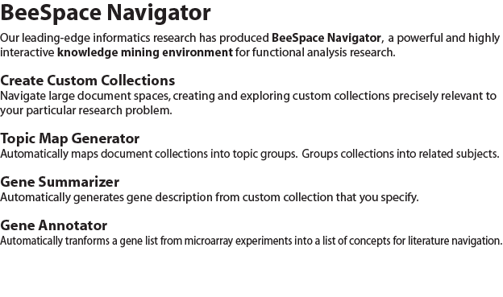
What is BeeSpace Navigator?
Notes:
Beespace Navigator is a highly interactive knowledge mining environment for functional analysis research. With it, researchers can create custom document collections and refine them using various functional modules including topic map generation, gene summarization and annotation. I’ve left some handouts on the back table if you’d like to take one with you.

Slide 4
Navigator v4.0: Technology
New AJAX-based user interface
  Directly consumes web services
New Python + Django backend
  Migrated from Java/JSF codebase
  Directly supports RESTful URL mgmt.
Notes:
Navigator has evolved significantly over the past 4 years. The text mining components have been working well for a while; but the user interface has been the major drawback. It just wasn’t as usable as it should have been. Purpose of collections is to narrow down documents over which Beespace applications operate. Used as a filter to enhance relevance of results.

Slide 5
Navigator v4.0: Features
AJAX discovery environment
Interactive, iterative collection building
Automatic collection version management
Rich collection metadata
Unified UI expresses research workflow
Social collection management
Notes:
Beespace has always been a discovery environment. But now it is a much more usable discovery environment, thanks to a unified AJAX user interface. Biologists engaged in literature discovery in support of hypothesis building employ a cyclic, highly iterative workflow as they find clues within the larger collections. We keep a complete history of those iterations which can be revisited and reused at any time. We’ve exposed more metadata, and added tags, for use in the discovery and collection management process. Currently, collection sharing is our only social feature; but we plan to expand the social features within BeeSpace.

Slide 6
Gene Summarizer
Automated curation
  Extracts gene summaries from literature
  Automatic version of MOD Annotation (FlyBase)
  Results targeted to specific collections
  Extracts gene sentences from custom collections
    eg: across organism or behavior or method
  Automatically categorizes gene sentences
    protein domain, phenotype function, genetic interaction
Notes:
By Automated Curation, we mean that the Gene Summarizer is designed to do what human curators do, completely automatically and adaptively, using machine learning and statistical natural language processing algorithms that have been heavily customized. According to our P.I., the Summarizer is an Automatic version of MOD Annotation in FlyBase. Given gene names as input, the Summarizer finds the most relevant sentences from the federated corpora (currently over 17 million documents, including all of Medline), and automatically categorizes them into useful and relevant categories such as protein domain and phenotype function.

Slide 7
Gene Summarizer Web Service
Plan to publish Beespace tools as web services
Gene Summarizer is first available service
  Simple RESTful URL service API
  Returns JSON data structure (XML to come)
  Summarizer also available as web application
  Easy integration with existing web applications
How easy, you ask?...
Notes:
Why publish the Gene Summarizer as a web service? The indexes are large. The code isn’t easy to manage or use. It requires a great deal of maintenance to keep the Medline and other literature indexes current. One indexing pass might take several days on a 16-core server. Since the Summarizer accepts simple inputs and produces relatively compact output, which is already in XML, it is ideally suited for publishing as a RESTful web service.

Slide 8
Ultra-Simple GBrowse Integration
Starting with a generic install of GBrowse:
Change 1 line of code in file “gbrowse_details”
  From:
    print $CONFIG->header || h1("$head_name Details");
  To:
    print $CONFIG->header || h1("<a href=http://workerbee.igb.uiuc.edu:8080/BeeSpace/SearchServlet?query=$name&cid=2293&submit=Summarize target=_blank>$head_name</a> Details");
Notes:
Couldn’t be simpler. Scott has agreed to put this link into the GBrowse distribution.

Slide 9
Future of Beespace
Social networking integration
Addition of Gene Ontology search tools
  Cluster, Analyze
Switching and set operations for collections
  Union, Intersection, Diff, etc
Further refinement of AJAX interface
GBrowse Integration
Notes:
There’s so much we plan to do with Beespace. Some of the G.O. functionality has been written, and will soon be integrated into the UI. Social networking has rich possibilities. For instance, we might track citation popularity, or user ratings of collection filters, so users can see what other researchers are doing. We’re going to continue refining and enhancing the AJAX discovery environment. I spoke with Scott yesterday about adding the Ultra Simple Integration of the Gene Summarizer to the GBrowse distribution. It opens in a new browser tab, so it won’t break the workflow.

Slide 10
More to Come!
beespace.uiuc.edu

