Slide 1
Argos
& Genome Directories
& Lucegene (‘Lucy Jean’)
A Replicable Genome infOrmation System of Common Components
GMOD Meeting, Sept. 2003
Don Gilbert, gilbertd@indiana.edu

Slide 2
Three building blocks
Argos is a framework for distributing common components with implemented genome data systems
LuceGene, SRS,… are backends to search & retrieve data objects efficiently from any flat-file
Genome Directory System includes WebServices, GridServices, LDAP, OAI,… Internet standard interfaces to search backends

Slide 3
Argos
Reduce install & update effort
  Replace { fetch, compile, install, configure,…} loop for software+data
  Start new system quickly - copy existing project & edit to suit
  Compatible with most GMOD projects
  Compares to EnsEMBL, WormBase, other distributable systems
Reference servers
  http://www.gmod.org/argos
  http://eugenes.org/argos http://flybase.net/flybase-ng
General contents
  common/
    java/ ; perl/ -- program libraries and packages
    servers/ -- major programs (BLAST, PostgreSQL, others)
    systems/ -- OS executables of programs
  daphnia/, eugenes/, flybase/ -- implemented organism genome systems
  centaurbase/ -- test sample system
  docs/ & install/ -- Argos instructions and usage
  ROOT/ -- common directory of projects, each is virtual host web service in ROOT

Slide 4
Argos common parts
Java common library, Ant builds, XML Tools, Web Services (Axis), Lucene for “Google”-like searches
Perl common library of BioPerl, GBrowse, others
Servers include
  Apache, Tomcat web servers
  MySQL, PostgreSQL databases
  BLAST (NCBI)
Systems compiled for
  apple-powerpc-darwin, intel-linux, sun-sparc-solaris

Slide 5
Argos features
Common genome & IT tool set
  Share benefits of “best of breed” genome tools
  Common parts are tested & maintained by others
  Minimal IT expertise (no compiles or system management)
To do for Common set
  Mod-perl for Apache web server (& Perl runtime)
  More GMOD tools (Gbrowse; Cmap; …)
  …

Slide 6
Argos features
Flexible project packages
  Project needs specify tool set (compare EnsEMBL all-in-one)
  Own look’n’feel web pages, contents, functions
  Security with protected and public sections (including collaborative editing, updates)
To do for packages
  Improve package configuring
  More integration of common & project parts
  …

Slide 7
Argos features
Easy replication to any Unix computer
  ‘Live’ copy with rsync keeps servers up-to-date
  Local cluster/grid for high-volume traffic
  Works on common workstations, laptops
To do for replication
  File sync useless for Postgres updates; transactions?
  One-click install & documentation
  Improve auto-update; need more post-update processing

Slide 8
Argos advanced features
Data mining (Genome Directory component)
  Fulfill need to search & retrieve 1000s of genes
  Simple, computable, industry standards for distributed query & retrieval of big data (Web Services, Grid Services, LDAP)
  Use to update personal, lab databases with genome links
To do for Data mining
  Much !

Slide 9
Argos comparisons
EnsEMBL
  Mature genome database ; built to copy and reuse
  See install instructions - not hard, but harder than auto-replication
WormBase, Gramene
  Also copyable
Redhat, MacOSX, other OS package auto-updaters
  no data replication; mature; focused on system-level updates
Globus Grid package management, PacMan
  Also offers binary program replication; install on remote systems; more configuring
  Data replication is immature (less useful than rsync, wget, ftp mirror) but includes directory management

Slide 10
Daphnia Example System
wFleaBase -- proto-Daphnia genome system
Cgi-bin -- Web programs(Perl)
Common -- Link to common, shared tools
Conf -- Site configurations for web, data
Data -- Bulk data & FTP site folder
Dbs -- Project databases: blast, lucene, mysql
Indices -- Database indices
Lib -- Program libraries
Web -- Web structure and documents
Genomics, Sequences, Maps, Literature, Stocks, Docs, other
includes Public and Protected (project member only) parts
Webapps -- Web programs (Java)
includes Search system, Secure web and editing

Slide 11
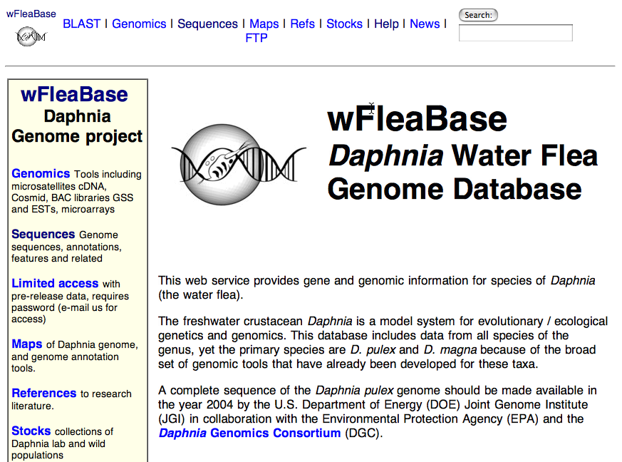
http://iubio.bio.indiana.edu/daphnia

Slide 12
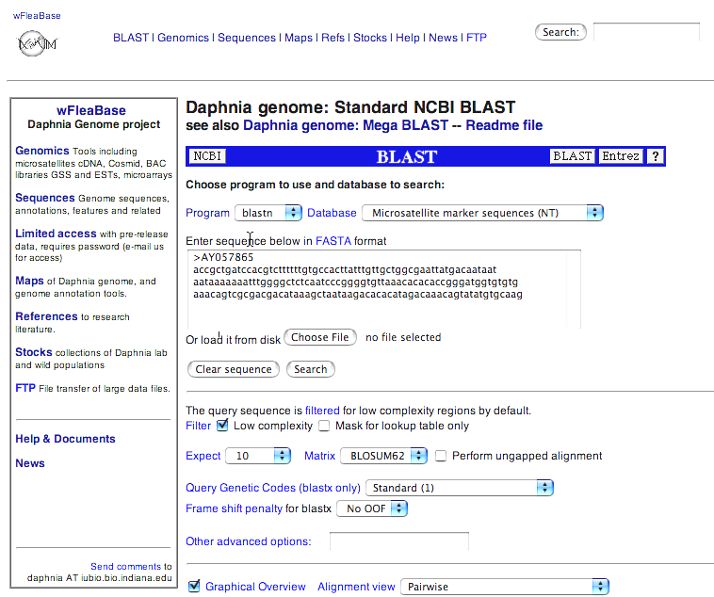
BLAST wFleaBase

Slide 13
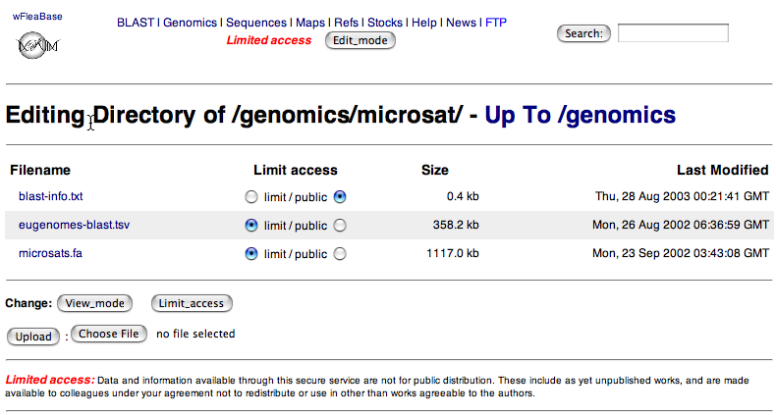
Edit wFleaBase

Slide 14
Lucegene (‘Lucy Jean’) for Genome Information Search and Retrieval

Slide 15
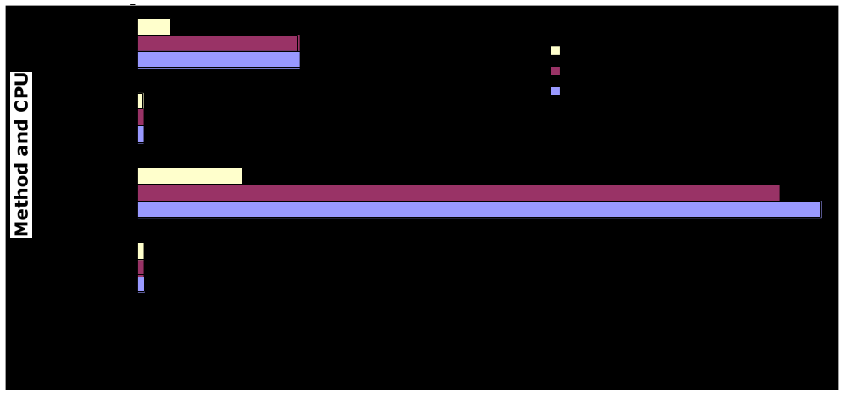
Info. Retrieval for Genomes
IR text search/retrieval tools tuned for data access, not management
Good for a wide range of semi-structured and complex structured data
Better functional match for textual data common in biology than numeric, table-oriented RDBMS
Easier to add new data (e.g. SRS parses 100s of existing bio-databanks)
Faster by orders of magnitude at search of complex data (no table joins; data is extremely non-normal)
Drosophila Genome Annotations
SRS or GaDB relational database

Slide 16
Lucene and LuceGene
Lucene open-source project at jakarta.apache.org/lucene
  Common text search features: booleans, phrases, word stemming, fuzzy and field range searches, relevance ranking
  Comparable to Glimpse, Excite, WAIS, ht/dig, Alta-vista, Google backends
  Author Doug Cutting wrote text search engines for Apple and Excite
LuceGene additions
  Data input adaptors for HTML; XML (e.g. MedLine); FlyBase flatfile; Biosequences (GenBank, EMBL, etc.)
  Basic output formats for XML, HTML via XSLT, Text, Spreadsheet
Tested with
  100,000s of FlyBase Genes, References, Game and Chado XML annotations
  euGenes gene summaries & Daphnia Medline, Sequences, HTML documents
LuceGene/Lucene needs
  Range search improvements (inefficient, dies w/ large range)
  Links/joins among databases
  Output adaptors and work? (or rely on data source formatting)

Slide 17
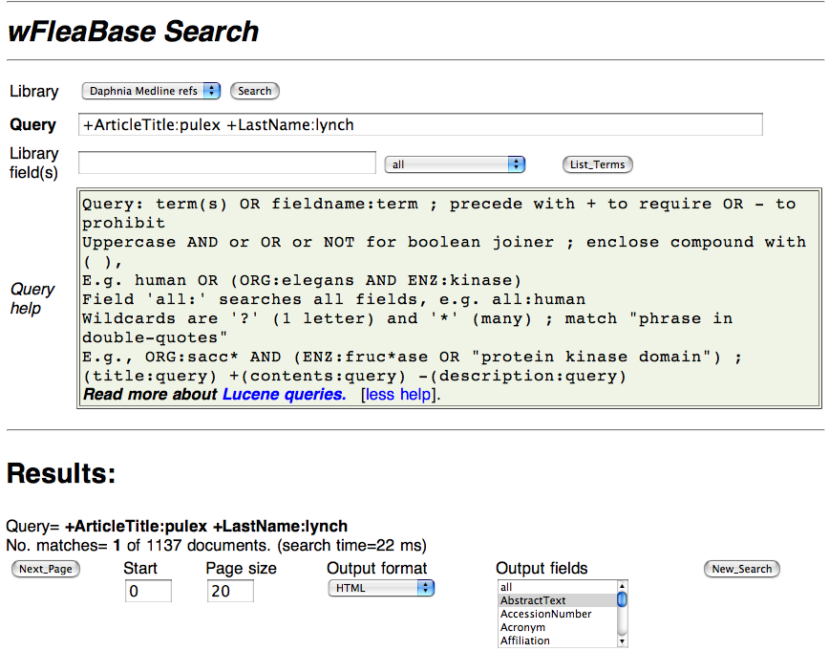
Search wFleaBase

Slide 18
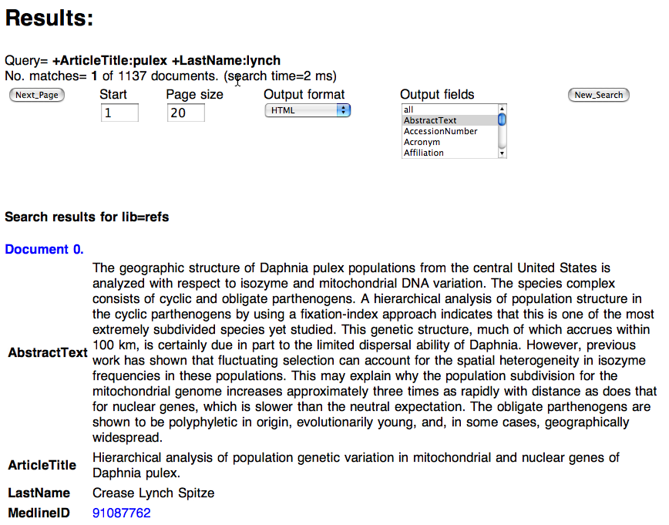
Search wFleaBase

Slide 19
Genome Data Directories for Data Grid and related Internet distributed search standards

Slide 20
Focus on Genome Data Access
Bioscientists are data-mining to study 1000s of genes rather than 1.
Web page scraping and bulk files not enough
Need Internet search & retrieval of genome objects distributed among many sources
Simple, flexible client program model
Efficient for high volumes (10⁵ objects; >1 GB sizes)

Slide 21
Directories of Genome Data
Directories are a necessary step for bio grids
  "broad and shallow" directories federate the "narrow and deep" databases
Bio-Data Access Tools
  SRS, Sequence Retrieval System; Entrez ; AceDB; Genome relational databases (Ensembl, FlyBase, WormBase) ; IBM DiscoveryLink; BioDAS ; BioMoby
Directory services for data access
  Layer onto access tools for common query/retrieval
  LDAP: mature, efficient for high volumes, query distributed directories ; works well with bio-access tools
  Web Services: XML messages over Web ; wide industry support , standards are in progress

Slide 22
Directory Aspects
Build on existing technology
Efficient for millions of objects
Queries distributed across directories
Support existing and new data access
Simple client program methods
Flexible, common schema for objects
Replicate directories among bioinformatics centers
Peer-to-peer directories for collaborations
Strong authentication and security

Slide 23
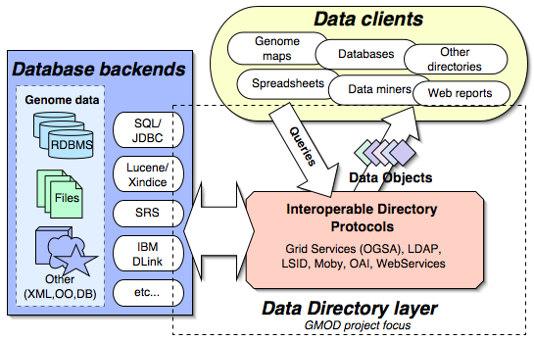
Directory Components

Slide 24
Directory Standards
Open Grid Services Architechture (OGSA)
  SOAP based; query support for XML-SQL, Xpath, Xquery.
  Data Access project: http://www.ogsa-dai.org.uk/
Lightweight Directory Access (LDAP)
  Robust system for distributed search and retrieval
  Object-centric, optimized for efficient read operations
  Hierarchical, distributed and replicated in nature
Life Sciences ID (LSID)
  new standard for bio-object naming, with LDAP and WebServices implementations
Moby project web services repository system

Slide 25
Directory Web Service
<?xml version="1.0" encoding="UTF-8"?>
<wsdl:definitions targetNamespace="http://eugenes.org/services" xmlns:impl="http://eugenes.org/services" xmlns:intf="http://eugenes.org/services" xmlns:apachesoap="http://xml.apache.org/xml-soap" xmlns:wsdlsoap="http://schemas.xmlsoap.org/wsdl/soap/" xmlns:soapenc="http://schemas.xmlsoap.org/soap/encoding/" xmlns:xsd="http://www.w3.org/2001/XMLSchema" xmlns:wsdl="http://schemas.xmlsoap.org/wsdl/" xmlns="http://schemas.xmlsoap.org/wsdl/">
<wsdl:types>
<schema xmlns="http://www.w3.org/2001/XMLSchema" targetNamespace="http://eugenes.org/services">
<import namespace="http://schemas.xmlsoap.org/soap/encoding/"/>
<complexType name="ArrayOf_xsd_string">
<complexContent>
<restriction base="soapenc:Array">
<attribute ref="soapenc:arrayType" wsdl:arrayType="xsd:string[]"/>
</restriction>
</complexContent>
</complexType>
</schema>
</wsdl:types>
<!-- ... -->
<wsdl:service name="DirectoryService">
<wsdl:port name="directory" binding="impl:directorySoapBinding">
<wsdlsoap:address location="http://eugenes.org/axis/services/directory"/>
</wsdl:port>
</wsdl:service>
<wsdl:portType name="Directory">
<wsdl:operation name="formats" parameterOrder="sid">
<wsdl:input name="formatsRequest" message="impl:formatsRequest"/>
<wsdl:output name="formatsResponse" message="impl:formatsResponse"/>
</wsdl:operation>
<wsdl:operation name="library" parameterOrder="name">
<wsdl:input name="libraryRequest" message="impl:libraryRequest"/>
<wsdl:output name="libraryResponse" message="impl:libraryResponse"/>
</wsdl:operation>
<wsdl:operation name="setpage" parameterOrder="sid start count">
<wsdl:input name="setpageRequest" message="impl:setpageRequest"/>
<wsdl:output name="setpageResponse" message="impl:setpageResponse"/>
</wsdl:operation>
<wsdl:operation name="nextpage" parameterOrder="sid">
<wsdl:input name="nextpageRequest" message="impl:nextpageRequest"/>
<wsdl:output name="nextpageResponse" message="impl:nextpageResponse"/>
</wsdl:operation>
<wsdl:operation name="attachpage" parameterOrder="sid">
<wsdl:input name="attachpageRequest" message="impl:attachpageRequest"/>
<wsdl:output name="attachpageResponse" message="impl:attachpageResponse"/>
</wsdl:operation>
<wsdl:operation name="setformat" parameterOrder="sid format">
<wsdl:input name="setformatRequest" message="impl:setformatRequest"/>
<wsdl:output name="setformatResponse" message="impl:setformatResponse"/>
</wsdl:operation>
<wsdl:operation name="count" parameterOrder="sid">
<wsdl:input name="countRequest" message="impl:countRequest"/>
<wsdl:output name="countResponse" message="impl:countResponse"/>
</wsdl:operation>
<wsdl:operation name="next" parameterOrder="sid">
<wsdl:input name="nextRequest" message="impl:nextRequest"/>
<wsdl:output name="nextResponse" message="impl:nextResponse"/>
</wsdl:operation>
<wsdl:operation name="search" parameterOrder="q">
<wsdl:input name="searchRequest" message="impl:searchRequest"/>
<wsdl:output name="searchResponse" message="impl:searchResponse"/>
</wsdl:operation>
<wsdl:operation name="search" parameterOrder="q format max">
<wsdl:input name="searchRequest1" message="impl:searchRequest1"/>
<wsdl:output name="searchResponse1" message="impl:searchResponse1"/>
</wsdl:operation>
<wsdl:operation name="lookup" parameterOrder="lib id">
<wsdl:input name="lookupRequest" message="impl:lookupRequest"/>
<wsdl:output name="lookupResponse" message="impl:lookupResponse"/>
</wsdl:operation>
<wsdl:operation name="lookup" parameterOrder="lib field val">
<wsdl:input name="lookupRequest1" message="impl:lookupRequest1"/>
<wsdl:output name="lookupResponse1" message="impl:lookupResponse1"/>
</wsdl:operation>
<wsdl:operation name="close" parameterOrder="sid">
<wsdl:input name="closeRequest" message="impl:closeRequest"/>
<wsdl:output name="closeResponse" message="impl:closeResponse"/>
</wsdl:operation>
<wsdl:operation name="directory">
<wsdl:input name="directoryRequest" message="impl:directoryRequest"/>
<wsdl:output name="directoryResponse" message="impl:directoryResponse"/>
</wsdl:operation>
</wsdl:portType>
<wsdl:binding name="directorySoapBinding" type="impl:Directory">
<wsdlsoap:binding style="rpc" transport="http://schemas.xmlsoap.org/soap/http"/>
<wsdl:operation name="formats">
<wsdlsoap:operation soapAction=""/>
<wsdl:input name="formatsRequest">
<wsdlsoap:body use="encoded" encodingStyle="http://schemas.xmlsoap.org/soap/encoding/" namespace="http://eugenes.org/services"/>
</wsdl:input>
<wsdl:output name="formatsResponse">
<wsdlsoap:body use="encoded" encodingStyle="http://schemas.xmlsoap.org/soap/encoding/" namespace="http://eugenes.org/services"/>
</wsdl:output>
</wsdl:operation>
<!-- ... -->
</wsdl:binding>
</wsdl:definitions>
/**
* Directory.java - SOAP service (Axis) for biology directory search/retrieval
*/
package iubio.net;
public interface Directory extends java.rmi.Remote {
public Object directory();
public Object library(String name);
public Object lookup(String lib, String id);
public Object lookup(String lib, String field, String val);
// search() returns qid = search/ query id
public String search(String q);
public String search(String q, String format, int max);
// return results of search
public int count(String qid);
public Object next(String qid);
public int setpage(String qid, int start, int page);
public Object nextpage(String qid);
public String attachpage(String qid);
// et cetera
public String[] formats(String qid);
public boolean setformat(String format);
public boolean setformat(String qid, String format);
public void close(Object qid);
}
Directory WSDL

Slide 26
Directory LDAP client
#!/usr/bin/perl
# basic Perl LDAP client and sample bio-data URLs
# 'ldap://eugenes.org/??one'
# 'ldap://eugenes.org:3895/srv=srs??sub?(&(lib=swissprot)(des=kinesin))’
# 'ldap://eugenes.org:3891/spp=worm,srv=srsgnomap??one'
# 'ldap://eugenes.org:3891/chr=2L,spp=fly,srv=srsgnomap??sub?(&(|(objectClass=Feature)
# (objectClass=NA-Sequence))(|(ft=gene)(ft=CDS)(ft=insertion))(start=>50000)(stop=<80000))'
use URI::URL; use LWP::UserAgent; use Net::LDAP;
foreach my $a (@ARGV) { ldapSearch($a) if ($a =~ m,^ldap://,); }
sub ldapSearch {
my $url = new URI::URL(shift);
if ($url->scheme ne 'ldap') { warn "not ldap: $url\n"; return; }
my $scope = $url->scope || "base";
my @opts = (scope => $scope);
push @opts, "base" => $url->dn if $url->dn;
push @opts, "filter" => $url->filter if $url->filter;
my @attrs = $url->attributes; push @opts, "attrs" => \@attrs if @attrs;
my @extn = $url->extensions; push @opts, @extn if (@extn);
$ldap = new Net::LDAP($url->host, port => $url->port) or die "$@";
$ldap->bind; # anonymous
my $mesg = $ldap->search(@opts);
if ($mesg->code) { warn $mesg->error,"\n"; }
else { foreach my $e ($mesg->all_entries) { $e->dump; } }
$ldap->unbind;
}

Slide 27
Directory Tests
Design and test distributed access with LDAP and Web Services
SRS backend for efficient search/retrieval from GenBank, SwissProt/TrEMBL, LocusLink, Medline, many others
Find & fetch 20,000 to 1.2 million objects
LDAP is ~10x faster than WebServices
Tests in progress for IUBio, FlyBase data

Slide 28
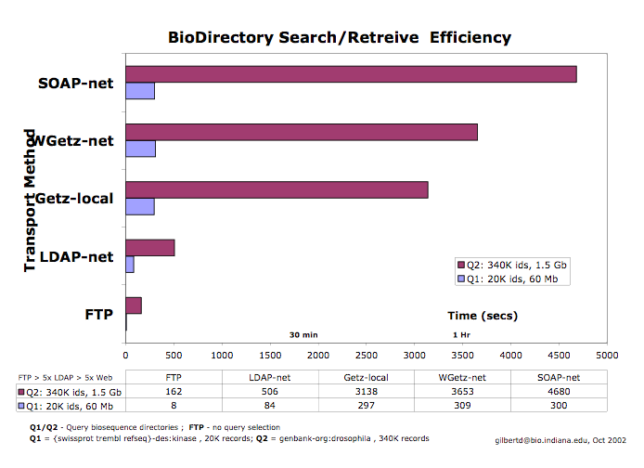
Directory Tests

Slide 29
Directory Issues
Basic Web-Services and LDAP access working in testing form; not stable nor finalized
Bio-Data categorization, schema, and meta-data for directories need work
Grid (OGSA), OAI, other interfaces to be developed
Directory tests at
http://iubio.bio.indiana.edu/biogrid/directories/

Slide 30
Thanks to these folks
Josh Goodman (gmod)
Paul Poole (gmod/iubio)
Nihar Sheth (flybase)
Victor Strelets (flybase)
And to many developers whose work we learn from and borrow from

