Slide 1

Genome Data Directories
Don Gilbert, gilbertd@indiana.edu
May 2003

Slide 2
Data Access Needs
Computable genome data access
-- Page scraping and bulk files not enough
-- Internet search & retrieval of all genome objects distributed among many sources
-- Simple, flexible client program model
-- Efficient for high volumes (10⁵ objects; >1 GB sizes)

Slide 3
Directories of Genome Data
Directories are a necessary step for bio grids
  "broad and shallow" directories federate the "narrow and deep" databases
Bio-Data Access Tools
  SRS, Sequence Retrieval System; Entrez ; AceDB; Genome relational databases (Ensembl, FlyBase, WormBase) ; IBM DiscoveryLink; BioDAS ; BioMoby
Directory services for data access
  Layer onto access tools for common query/retrieval
  LDAP: mature, efficient for high volumes, query distributed directories ; works well with bio-access tools
  Web Services: XML messages over Web ; wide industry support , standards are in progress

Slide 4
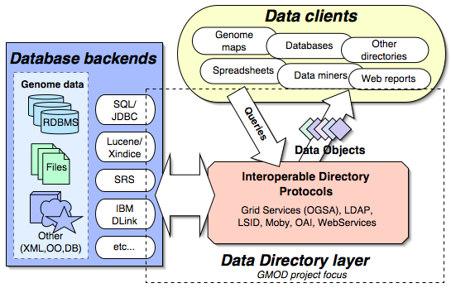
Directory components

Slide 5
Genome Directory Needs
Build on existing technology for finding distributed objects
Efficient for millions of objects, by the gigabyte and terabyte
Queries distributed across directories of collaborating services
Support existing and new bioinformatics data access (relational dbs, object and XML dbs, SRS, Entrez, AceDB)
Simple client program methods for computable use of directories
Flexible, common schema for describing objects
Replicate directories and objects among bioinformatics centers
Peer-to-peer directories for collaborative projects
Strong authentication and security for data access

Slide 6
Directory Standards
Open Grid Services Architechture (OGSA)
  SOAP based; query support for XML-SQL and Xquery.
  Data Access project: http://www.ogsa-dai.org.uk/
Lightweight Directory Access (LDAP)
  Robust system for distributed search and retrieval
  Object-centric, optimized for efficient read operations
  Hierarchical, distributed and replicated in nature
Life Sciences ID (LSID)
  new standard for bio-object naming, with LDAP and WebServices implementations
Moby project web services repository system

Slide 7
Directory Tests
Design and test distributed access with LDAP and Web Services
SRS backend for efficient search/retrieval from GenBank, SwissProt/TrEMBL, LocusLink, Medline, many others
Find & fetch 20,000 to 1.2 million objects
LDAP is ~10x faster than WebServices
Test in progress for FlyBase

Slide 8
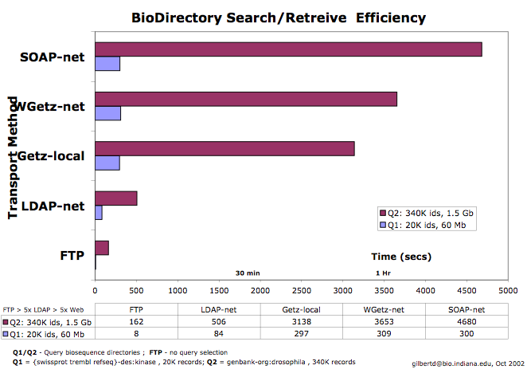
Directory Tests

Slide 9
Genome Directory Issues
Directory tests at
http://iubio.bio.indiana.edu/biogrid/directories/

