Slide 1

GBrowse: Generic Genome Browser
September 2003 Update
Lincoln Stein, CSHL

Slide 2
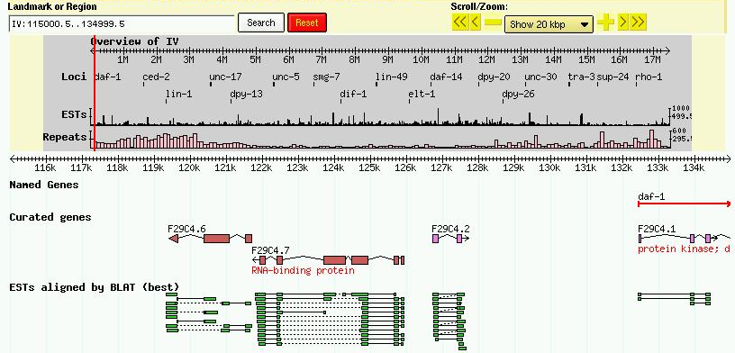
GBrowse

Slide 3
Documentation
PODified Documentation
  Man pages
  Text
  HTML
One-click web page
Illustrated tutorial
  No database needed

Slide 4
Installation Helpers
Genbank2GFF
UCSC2GFF
  Two versions
Gadfly2GFF
GFF3 Support

Slide 5
Schema Enhancements
Chado support improved
  Most (all?) performance issues resolved
Bio::DB::GFF improved
  Delete/update support
  Update plugin

Slide 6
Other Notable Happenings
“ISB GBrowse” released
  Multiple data sources
  DAS integration
“Don’s GBrowse”
MARC GBrowse
  Closed loop system

Slide 7

Credits
CSHL
Shuly Avraham
Scott Cain
ISI
Paul Edelfsen
Robert Hubley
BDGP
Chris Mungall
ShengQiang Shu
Elsewhere
Marc Colisimo
Marc Logghe
HGMP-RC Fugu
Shawn Hoon
http://www.gmod.org

