Slide 1
Turnkey
generate a web front end
for any database schema
Allen Day, Sept 2003

Slide 2
Turnkey Background
Previously known as “gmod-web”
Now an Open Source project
  http://www.sf.net/projects/turnkey
Active code generator produces DB⬄WWW mapping and display code

Slide 3
Goal: A Web-based front-end for GMOD
Minimally providing:
  Read-only access to Chado and/or GUS √
  Integration with other GMOD web-based projects (gbrowse, textpresso, et al) ~
Additionally:
  Provide a framework to “plug in” more functionality ~
    User preferences, history, shopping cart, forums
  Data(base) schema/model model agnostic √
    Tested with “All Music Guide” (www.allmusic.com) data
    Biopipe (www.biopipe.org) process tracker in progress

Slide 4



How it works
Translator
Directed Graph
--SQL
CREATE TABLE(…)
Apache / mod_perl
Turnkey Framework
Templates
templates
<XML/>
DB
Code Generator

Slide 5
Schema Patterns
G
H
A
A_B
B
J
E
C_E
C
reference / inherits
trivial traversal
multipath traversal
feedforward traversal
F
D
ontology
directed graph
another non-trivial traversal

Slide 6
SQL not Ideal for Modeling
A
A
A
A
B
B
B
B
C
C
C
C
Key export =
Has A ?
Is A ?
Combo ?

Slide 7
Credits
Brian O’Connor (presenting later)
Ken Clark

Slide 8
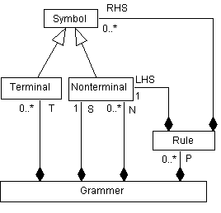
Model (vs SQL) Driven Generation
= template
MySQL
SQL Model
= production
PostgreSQL
O/R Map +
Controller
Java
Perl
UML
templates
View
XML / HTML
SVG / PNG / Flash
Increasing platform specificity

Slide 9
References
SQL::Translator (sqlfairy.sf.net)

