Slide 1
Curation Editor
Flexible web based editor for non gene model data.
FlyBase – Harvard University
Frank Smutniak

Slide 2
Non Gene Data Curation
FlyBase curates many types of non gene model data which is integrated with genetic data in the Chado Database.
This data is culled from published literature and described by curators with simple text fields, text descriptions, CV terms, and tree representations.
This data is currently represented in flat text files and batch processed into the database.

Slide 3
TI and Contra forms
Some common proformae are for Transposons and in vitro Constructs (Contra), and Transposable Element Insertion Sites (TI).
Contras are composed of what FlyBase call Mosegs and Juncsegs, which are characterized segments of nucleotides. Mosegs are often in turn composed of component Moseg and Juncseg nucleotide segments.
Curation Editor can be generalized for other types of data to be rendered in ChadoXML.

Slide 4
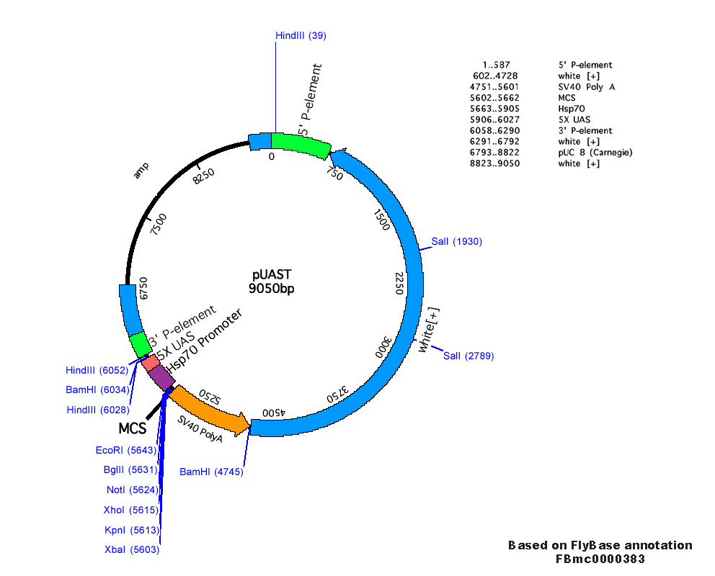
DGRC representation of a plasmid (from http://dgrc.cgp.indiana.edu)

Slide 5
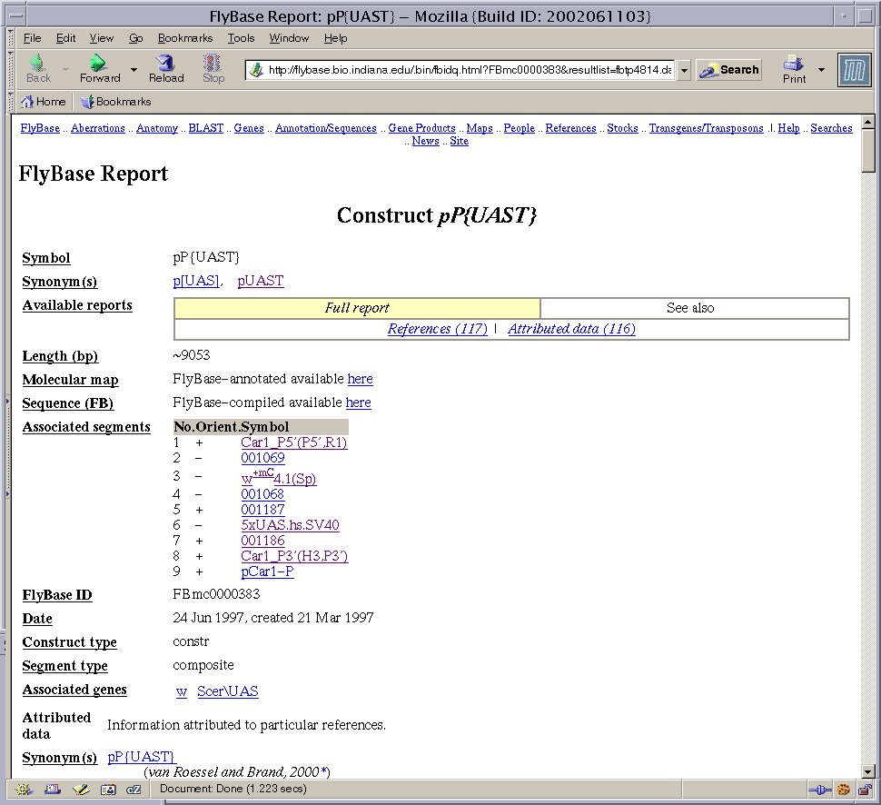

Slide 6
Data Paths
Text
Editor
Text File
Perl processing
into database
Representation
in web pages
Curation
Editor
ChadoXML
ChadoDB via
Standard Loader

Slide 7
Editor Requirements
Lightweight and easy to deploy.
Read and Write ChadoXML.
Easy to upgrade with new form types.
Easy to maintain and add/remove form fields.
Read and automatically upgrade old file versions.
Able to link to data in a database.
Ready to make use of future ChadoXML pipelines.

Slide 8
Editing Process
ChadoXML
Internal XML
representation
Webpage
presentation
ChadoXML
Internal XML
representation
PDF
Text
Other

Slide 9
Software
Server side processing.
Built entirely with XML, XSL and java running in a Cocoon servlet.
Performs all operations in memory, no need for direct database support.
Easily upgraded to point to live databases for CV terms or IDs.

Slide 10
Cocoon
Cocoon manages xml data pipelines.
Sitemap.xmap file maps pipelines to specific URLs.
Generators start a pipeline. A generator can be written in java, or be sourced from an xml file.
XSLT programs transform one xml schema to another. Consecutive XSLT transformations are possible.
Serializers perform well known or custom translations of xml into other forms. (pdf, xhtml, wml, svg, custom).
Actions can perform an action and select among multiple pipelines. Can be written in java.
Cocoon is a servlet that runs in a servlet container.
More information at http://cocoon.apache.org

Slide 11
Architecture
XML
static definitions
CSS
JavaScript
CV Terms
XSLT
XHTML
Browser
Data File
In Memory
Representation
Actions

Slide 12
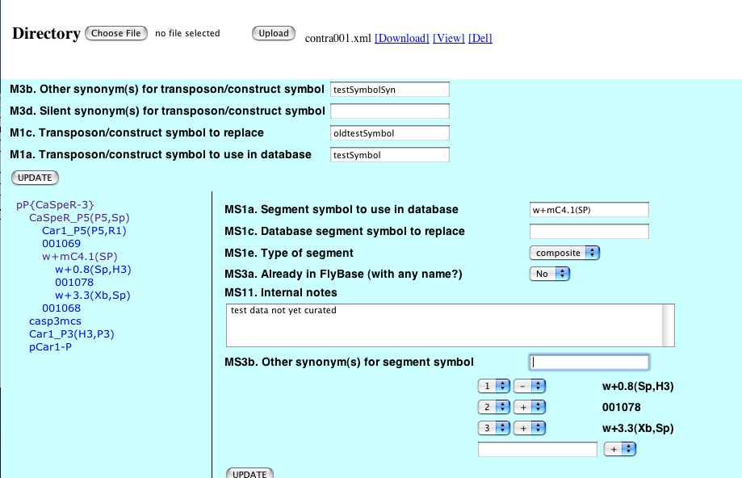

Slide 13
Acknowledgements
William Gelbart, PhD
Lynn Crosby
David Emmert

