Slide 1

GDR in Drupal
facilitating community building and efficient maintenance

Slide 2

GDR (Genome Database for Rosaceae)
  is a web-based community database of Rosaceae genetics and genomics data and analysis tools facilitating utilization of the data among member species
www.rosaceae.org

Slide 3
Topics
  GDR News
  Major objectives for the next grant period
    Content
    Infrastructure using Chado/Drupal (Demo)
  Data/tools currently available from GDR
  How to access the data and tools (Demo)

Slide 4
GDR News
GDR receives funding from Sept 2009 to Aug 2013
from the USDA Specialty Crop Research Initiative program ☺
Tree fruit Genome Database Resources (tfGDR) will expand GDR to include Citrus.
Whole genome sequence of peach in GBrowse (will go public in Apr 1)
  apple and strawberry data to follow
GDR is implemented in Drupal.
Project site developed for RosBreed.

Slide 5
Major goals for the next 4 years
To integrate whole genome sequences, large-scale phenotyping/genotyping data, and breeding data with the current GDR data
To develop an infrastructure using chado and drupal (tripal) that is easy to develop, implement and maintain

Slide 6
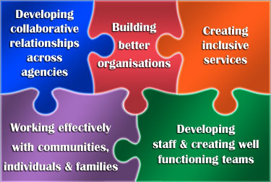
Data to be integrated..
  GENOMICS
  Nucleotide sequences
  (ESTs, Unigenes
  ,WGS)
  Physical maps
  Transcriptome maps
  Pathway
  Functional &
  Sequence
  alleles
  Phenotype Genotype
  Diversity Data
  Ontology
  GERMPLASM
  Cultivar
  Pedigree
  GENETICS
  Locus
  (Gene /MTL/QTL
  Marker Loci)
  Genetic Maps
  BREEDING
  PERFORMANCE

Slide 7


Plan for Building an Efficient Database
Content Management System
Demo by Stephen Ficklin
Jan 13th (Tue) 2:30 pm
Drupal modules as web front-end for Chado
Chado
Generic Database schema

Slide 8

Advantages of using Drupal
For Database Developers
  Easy to use and update
    Provides functionality for community building – forums, calendars, project pages etc
  Open Source, popular, robust, secure and modular
  Users/Roles/Access Control
For Users – control your own page/site!
  You can create/edit pages and upload data
    for meetings/conference/employment
    for project/lab sites
    as editors for gene, QTL, breeding data, etc
    access private data securely before publication

Slide 9
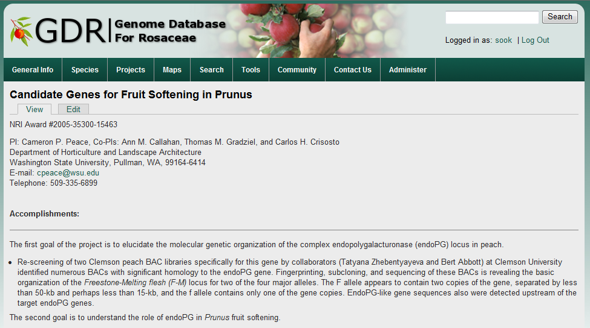
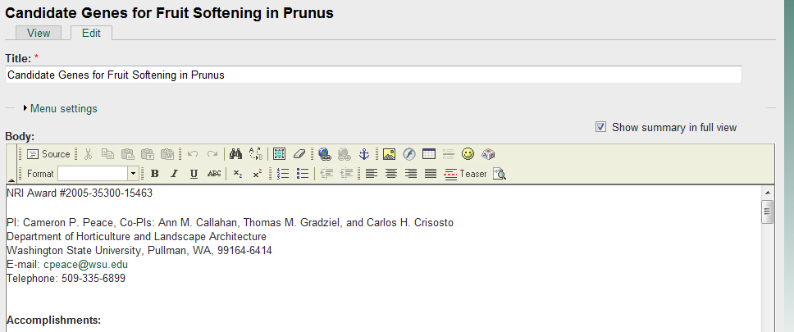
Editing a project page

Slide 10
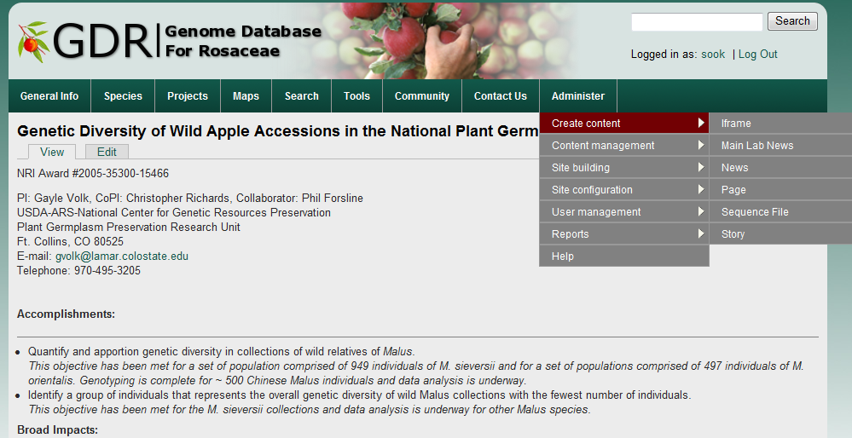
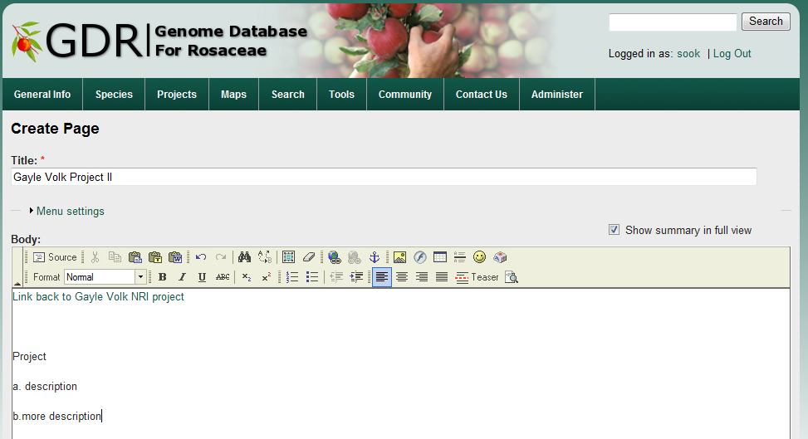
Creating a new page

Slide 11
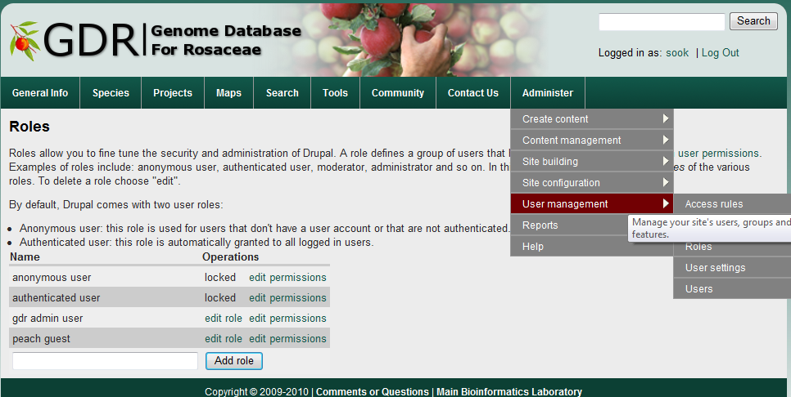
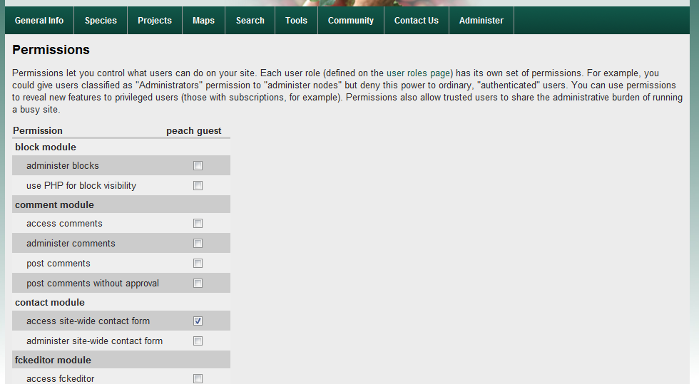
User Management

Slide 12
Genomics Data
  Unigene for family Rosaceae and for genus of malus, prunus, fragaria, pyrus and rosa ESTs.
  EST annotation includes unigene set, homology, SSRs, ORF, SNPs, unique oligo sets for unigene microarray
  NCBI/Swiss-Prot/TremBL Rosaceae protein data
Coming Soon – Whole Genome Sequence of Peach, Strawberry and Apple ☺

Slide 13
Genetics Data
  Locus (marker loci and MTL)
    Over 1400 locus data available from marker/trait search site
Maps and Genetic Diversity Data
    39 Rosaceae genetic maps in CMap
    polymorphism/diversity search site
    Genetically anchored peach physical and transcriptome map
    Hybridization data between probes (ESTs and genetic markers) and peach BACs
Publications
    relevant to Rosaceae genetics and genomics

Slide 14
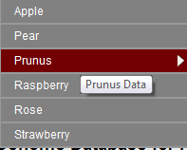
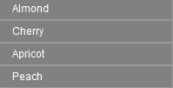
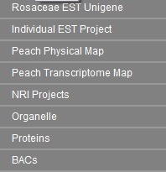
Access the data from
species page
or
projects page

Slide 15
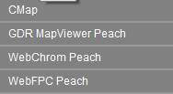
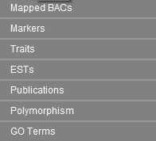
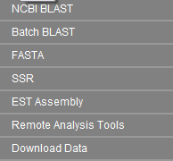

Or go directly to
maps
Tools
to blast against
or download
search

Slide 16
Maps

Slide 17
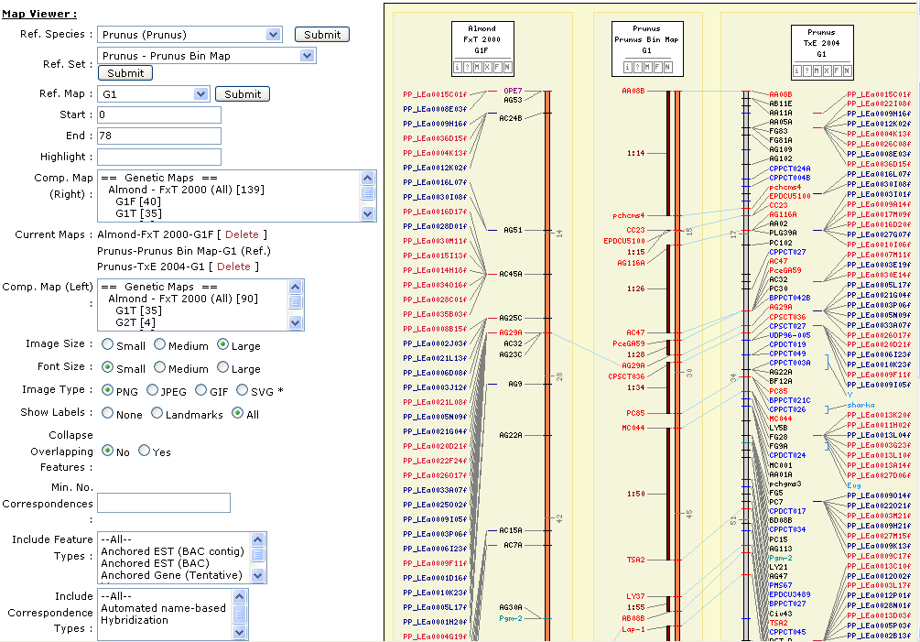
CMap (comparative map viewer)

Slide 18
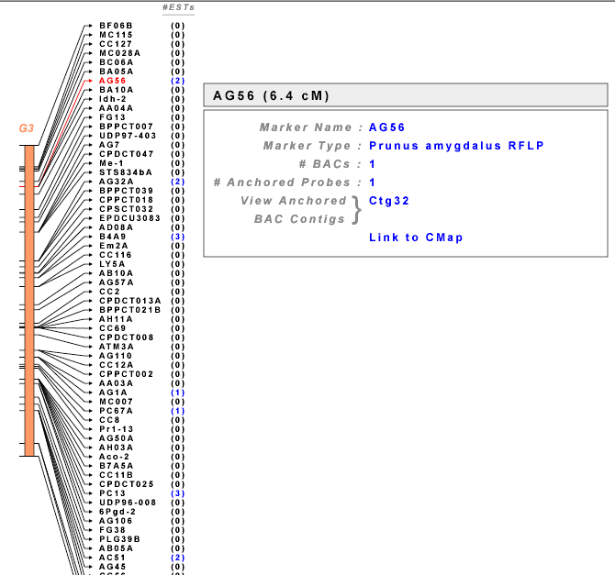
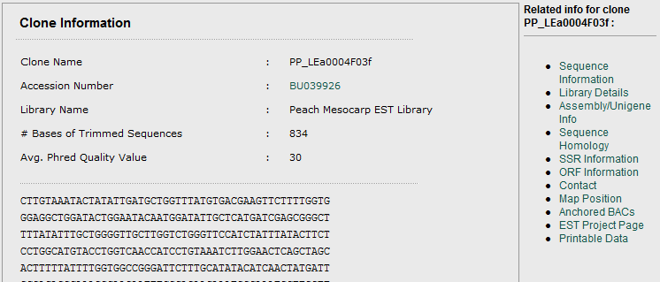
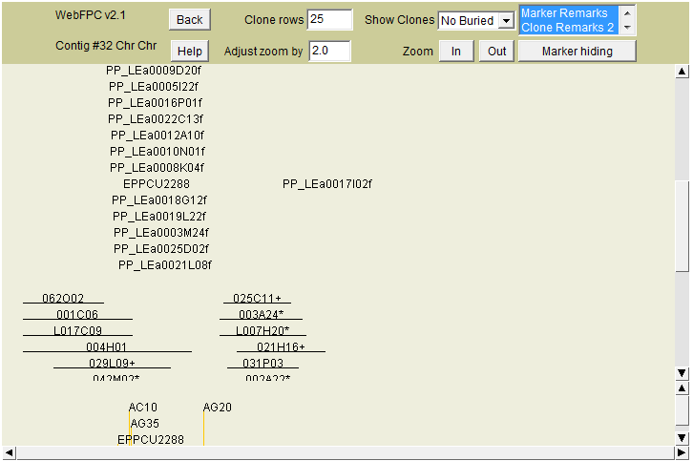
Genetic, Physical, and Transcriptome Map

Slide 19
search engine

Slide 20
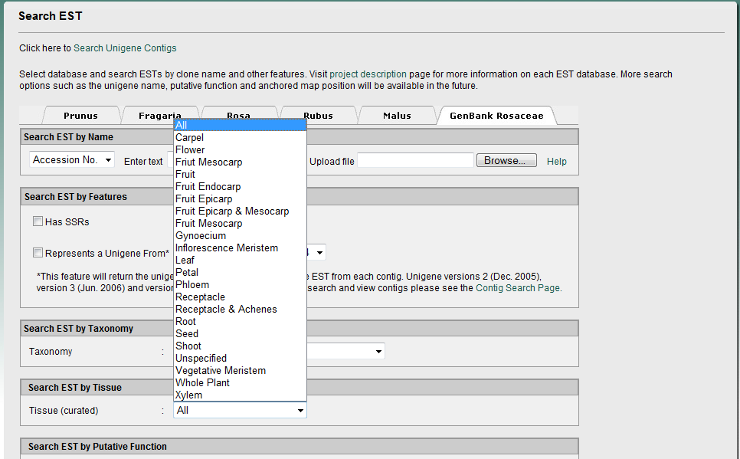
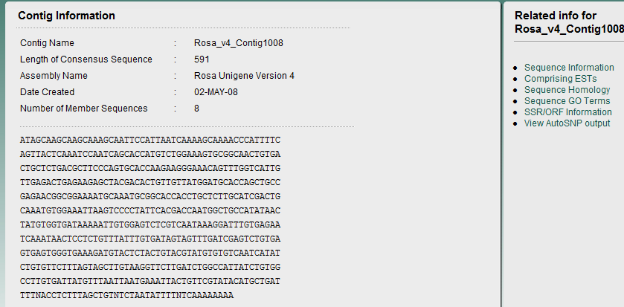
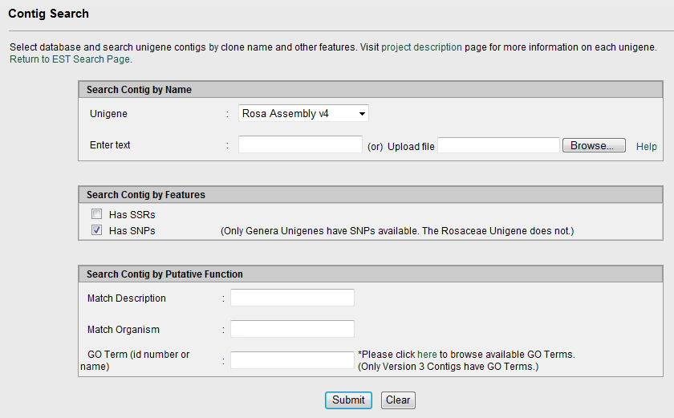

Slide 21
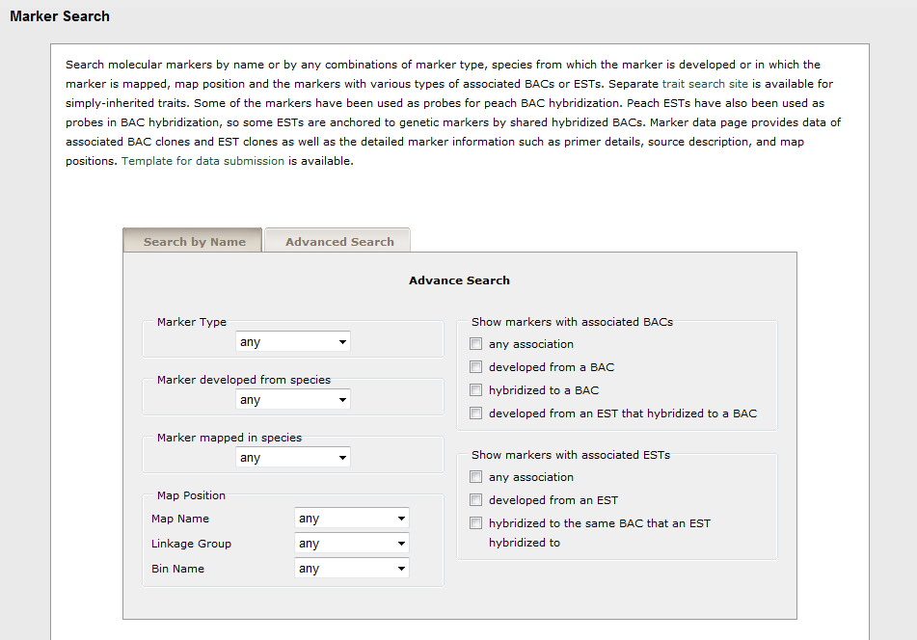
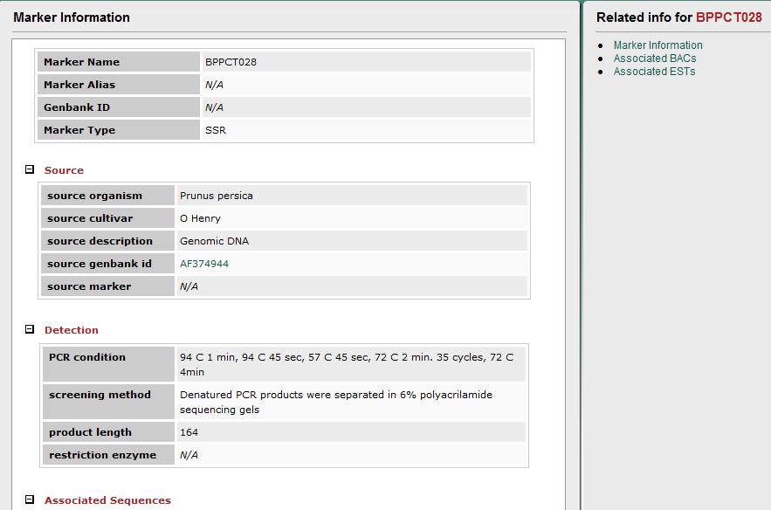
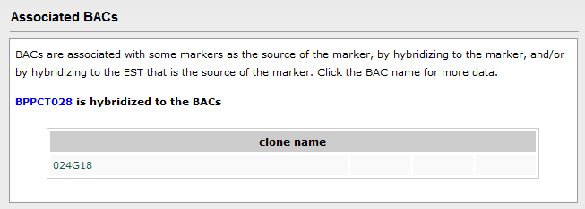
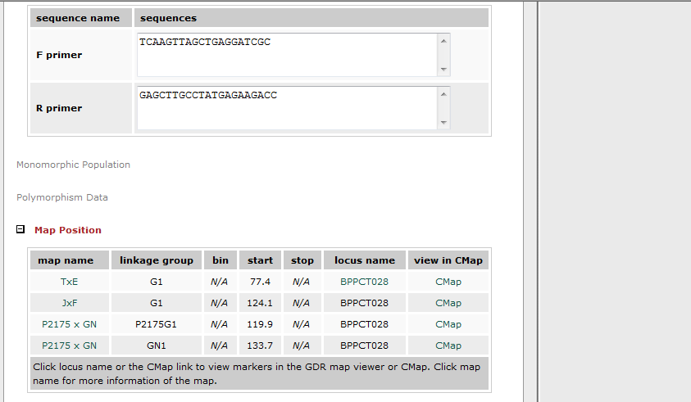

Slide 22
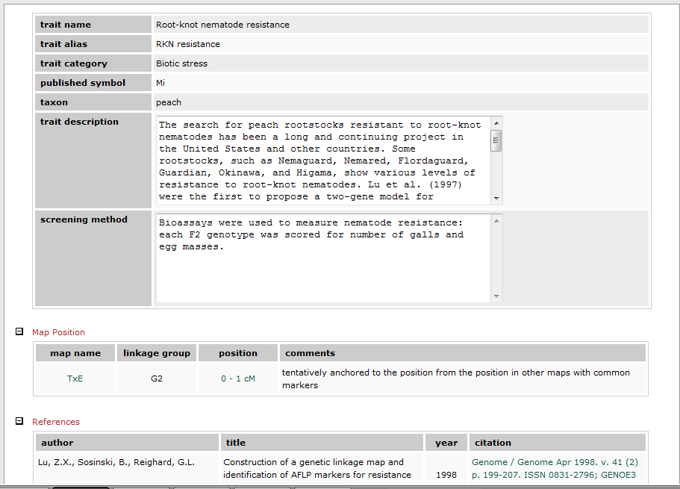
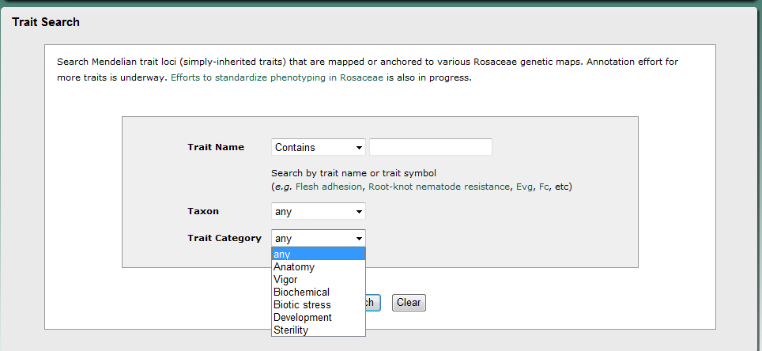

Slide 23
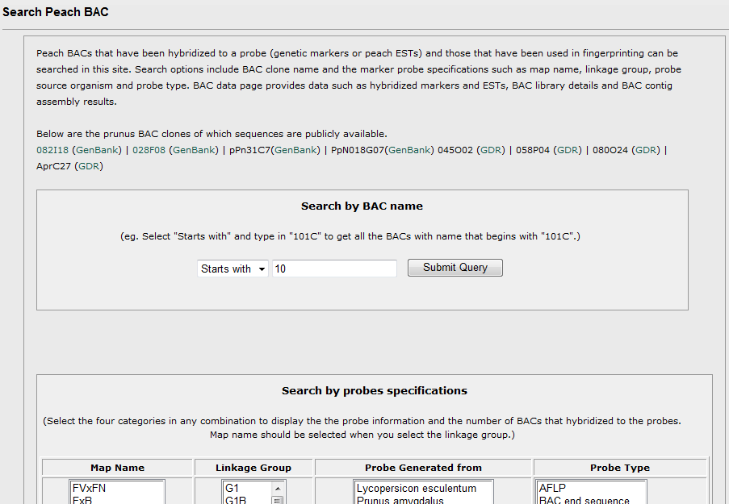
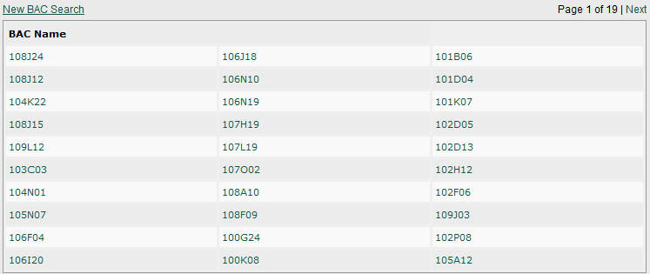

Slide 24
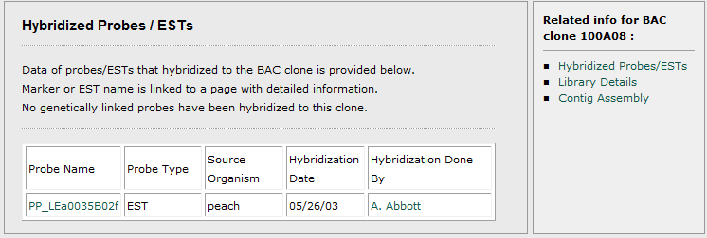
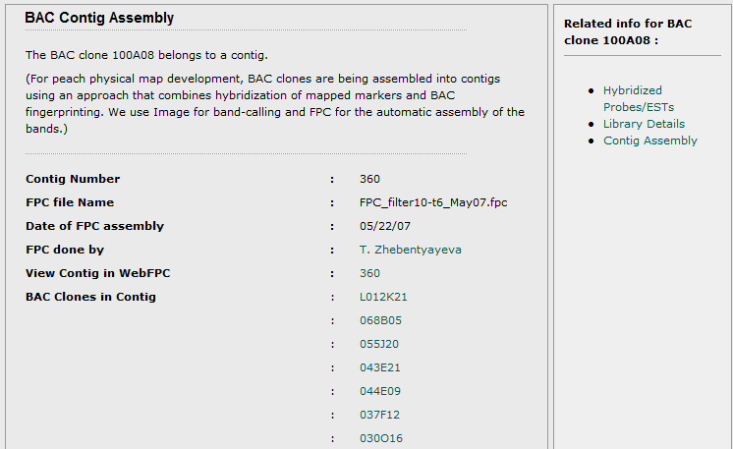
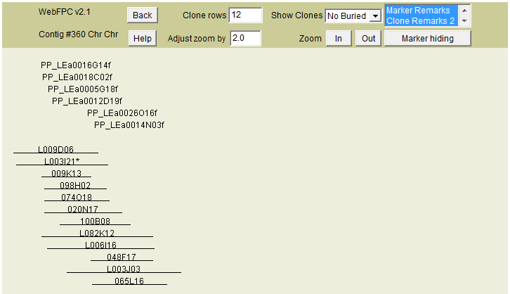

Slide 25
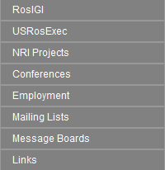
Rosaceae Community Resources

Slide 26
Acknowledgements
GDR Team – Dorrie Main, Sook Jung, Meg Staton, Randall Svancara, Taein Lee, Ping Zheng, Albert Abbott
Previous members: Anna Blenda, Stephen Ficklin, Christopher Jesudurai
Rosaceae Community
NSF Plant Genome Program
USDA Specialty Crop Research Initiative

Slide 27
Thank you!
Visit us at
Plant Database Booth
  Sunday 8-8:30 pm
  Monday 10-10:30 am, 4-4:30 pm
Poster C915
  Monday 10 -11:30

