Slide 1
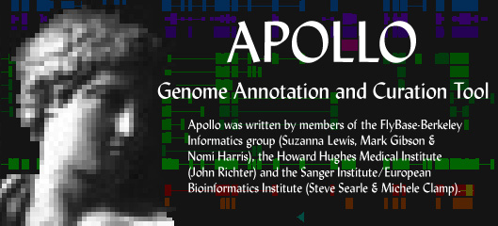
Apollo Progress Report
GMOD Meeting, Berkeley
September 15, 2003

Slide 2
May 2003: Coming soon
Upgrade to JDK 1.4
Handle non-gene annotations better
Improve Jalview
  Complete gapped alignments for GAME (cigars)
  Match/mismatch coloring scheme
  Get alignment sequences for Ensembl data
    (Have sequences, don’t have cigars)
  Improve memory usage
Improve synteny view
Layer raw BLAST results over current region
Highlight matches to new sequences
Notes:
Can mention that Suzi is working on that last item.

Slide 3
Highlighting new sequences
New sequences (since last pipeline run) boxed
“New” date for each type can be specified in tiers file
  Different pipeline databases might have different update dates
    type "Fly Sequence", "Community GB” … "31-JAN-2003”
    type "BLASTX Similarity to Fly", "BLASTX Similarity to Fly” … "31-MAY-2002"

Slide 4
Alignments for Jalview
Need full alignment of results (including gaps)
Cigars are a compact way to represent gapped alignments
  ATATAGGGATAT-----ATAGGG
  ATATA---ATATCCCCCATAGGG
  M 5 I 3 M 4 D 5 M 6
No need to represent mismatches in cigars, just gaps
Notes:
Quickly go over some of the main features. Next slide has screenshots.

Slide 5
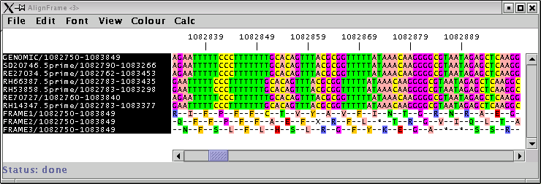
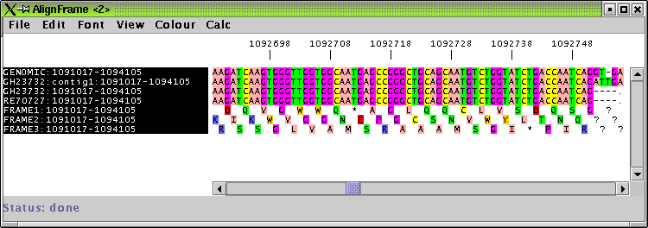
Alignment display before and after cigars

Slide 6
BOP/Apollo
BOP now integrated with Apollo
  Run as standalone application or launch from Apollo
Load/layer raw analysis results:
  BLAST (all flavors)
  sim4
  GENSCAN
  FgenesH
  Coming soon: BLAT (Josh Kaminker)

Slide 7
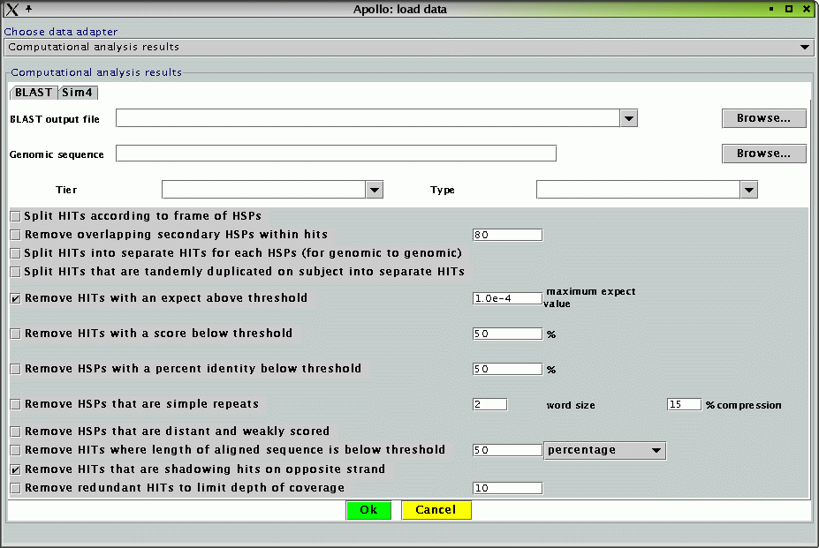
BOP/Apollo GUI for BLAST

Slide 8
Apollo use/reuse
1448 downloads YTD
  993 Windows
  22 Solaris
  212 Mac OS X
  173 Linux
  48 Generic Unix
Many groups are adapting Apollo to their needs (e.g. writing new data adapters)

Slide 9
The Apollo Team
Berkeley:
  Suzanna Lewis, Nomi Harris, Mark Gibson, Sima Misra, (John Richter), (Colin Wiel)
  (All the FlyBase curators)
Sanger Institute:
  Vivek Iyer, (Steve Searle), (Michele Clamp)
JGI:
  David Goodstein (adding regexps)

Slide 10
Code available at SourceForge: http://sourceforge.net/projects/gmod/
Installer available at http://ww.fruitfly.org/annot/apollo/install.html
Notes:
Leave this slide up while you answer any questions (or until next speaker starts his/her talk) so people can copy down the URLs.

