Slide 1

GBrowse: Generic Genome Browser
May 2003 Update
Lincoln Stein, CSHL

Slide 2
New Features

Slide 3
Database Adaptors
Bio::DB::GFF Schema
  MySQL
  PostgreSQL
  Oracle
  Text file
Chado Schema
  PostgreSQL
BioSQL Schema
  MySQL
EMBL Proxy

Slide 4
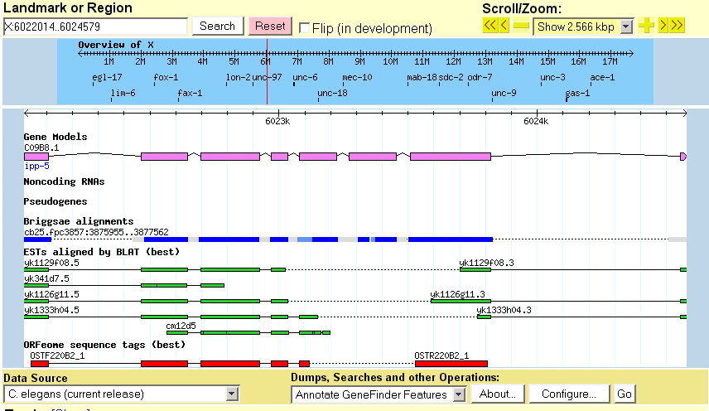
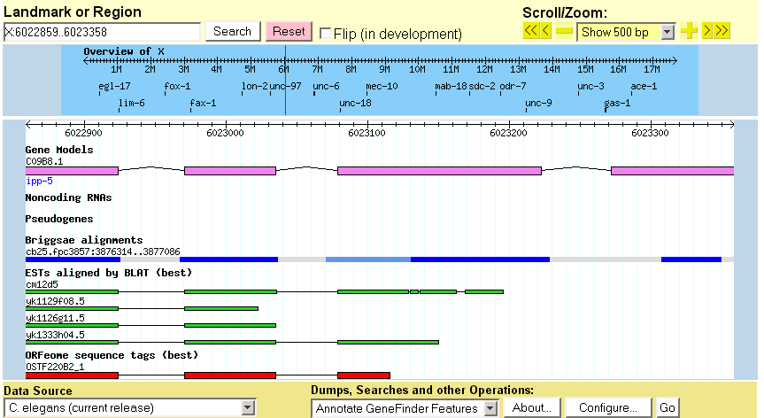
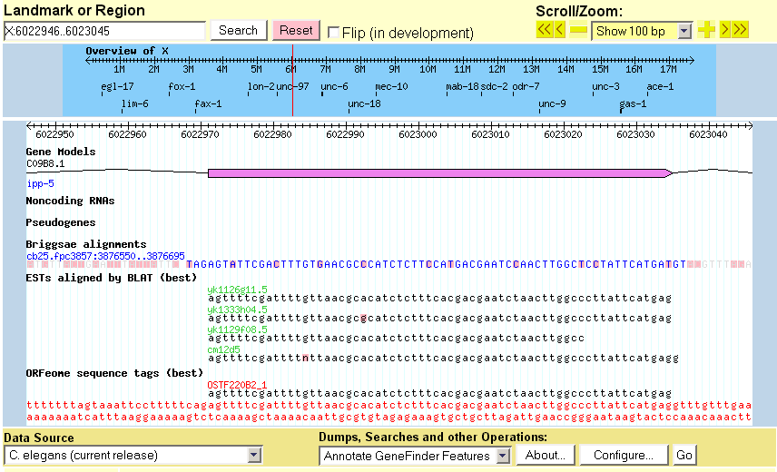
Multiple Alignment Display

Slide 5
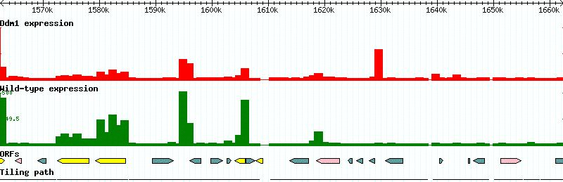
Histograms & XY Plots

Slide 6
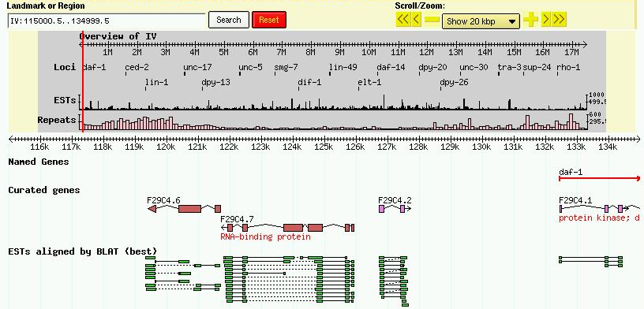
Configurable Overview

Slide 7
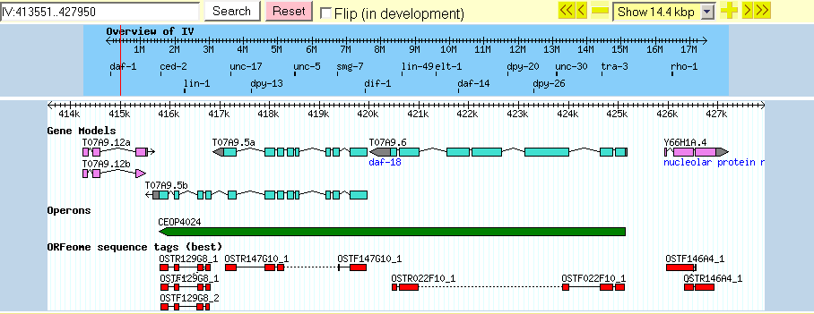
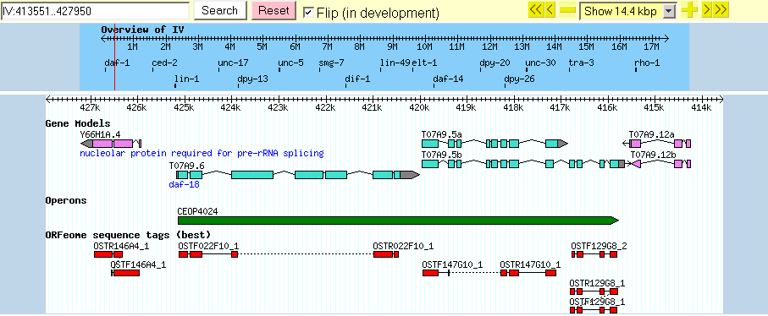
Flip Coordinates

Slide 8
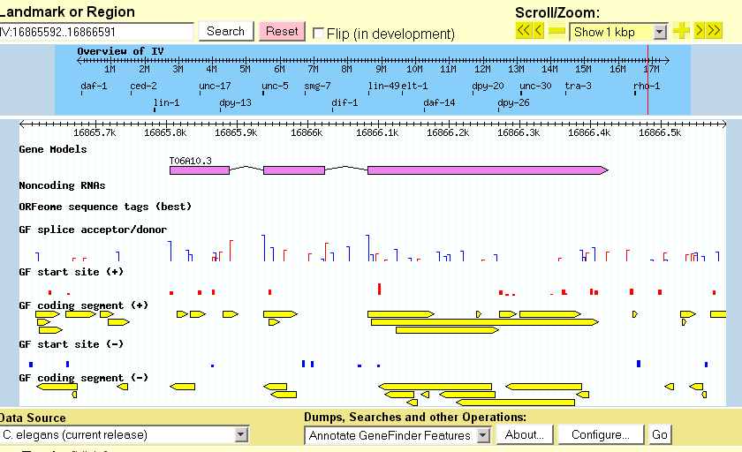
Plugin Layer for Gene Predictors

Slide 9
Lots of New Glyphs
Splice acceptor/donor glyph
Microarray red/green box glyph
Cytogenetic band glyph
X/Y graph glyph

Slide 10
Coming real soon now

Slide 11
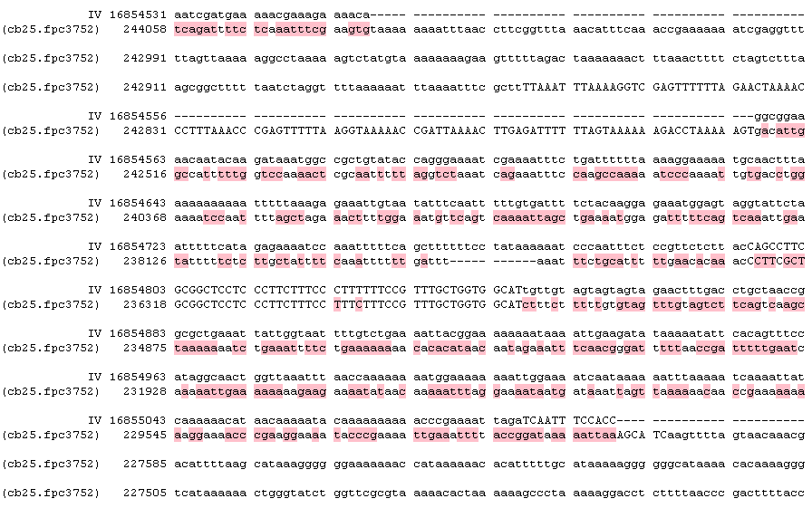
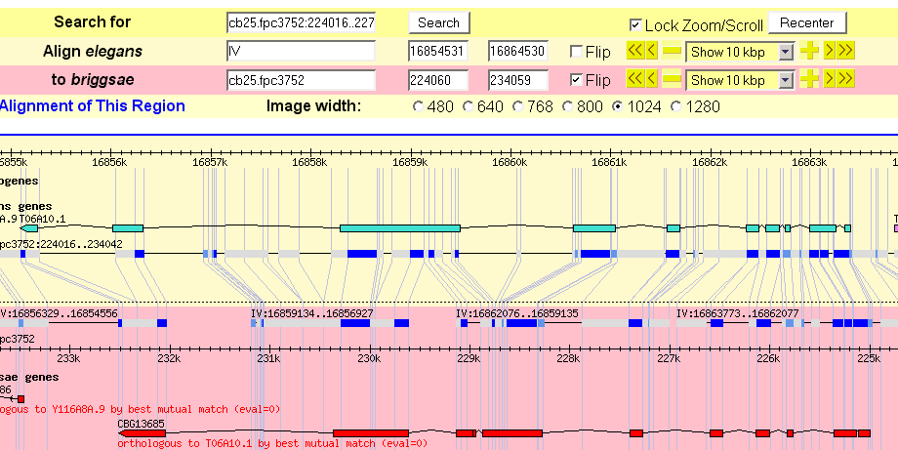
Synteny Browser

Slide 12
Feature Filtering & Coloring
Filtering
  Limit feature displays to those matching selected attributes.
Coloring
  Color background of features matching selected attributes.

Slide 13
Remote Annotation
Full DAS Support
Multiple databases merged into one display
Multiple database types merged onto display
  Local
  Remote
  Flat file
  Relational

Slide 14

Credits
CSHL
Shuly Avraham
Scott Cain
ISI
Paul Edelfsen
Robert Hubley
BDGP
Chris Mungall
ShengQiang Shu
Elsewhere
Marc Colisimo
Marc Logghe
HGMP-RC Fugu
Shawn Hoon
http://www.gmod.org

