Slide 1
IMDB: A Generic Insertional Mutagenesis Database
Xiaokang Pan and Lincoln Stein
Cold Spring Harbor Laboratory

Slide 2
Objectives
Store sequenced insertion sites for model organisms
Provide users with useful tools to search for insertions in gene of interest and to track progress of the multinational effort to find insertions in each gene.
Facilitate the study of insertion site distributions

Slide 3
Insertion Mapping
Flanking sequence
WU-BLAST
TIGR pseudo-chromosomes
If the top hit with score > 90
TIGR genome annotations
An insertion site on the
genome
Assigned it to a clone & gene

Slide 4
Database Design (Core Schema)
Chromosomes
Exon
Clone
Gene
Seq
_
Chr
Seq
_clone
FlankingSeq
Seq
_gene
Line

Slide 5
Programming and Database Implementation
Data parsing, insertion mapping and data loading scripts coded in Perl
Web interfaces use Perl-CGI scripts
Database implemented using MySQL, a relational DBMS

Slide 6
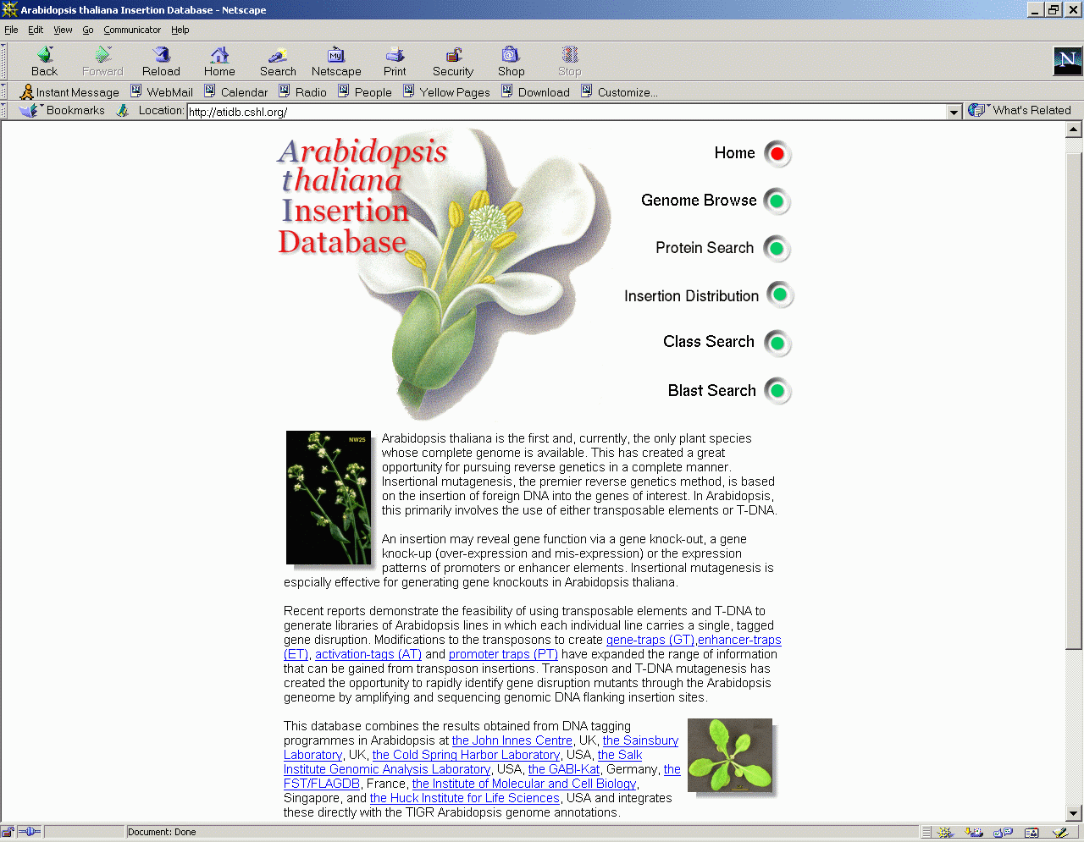

Slide 7
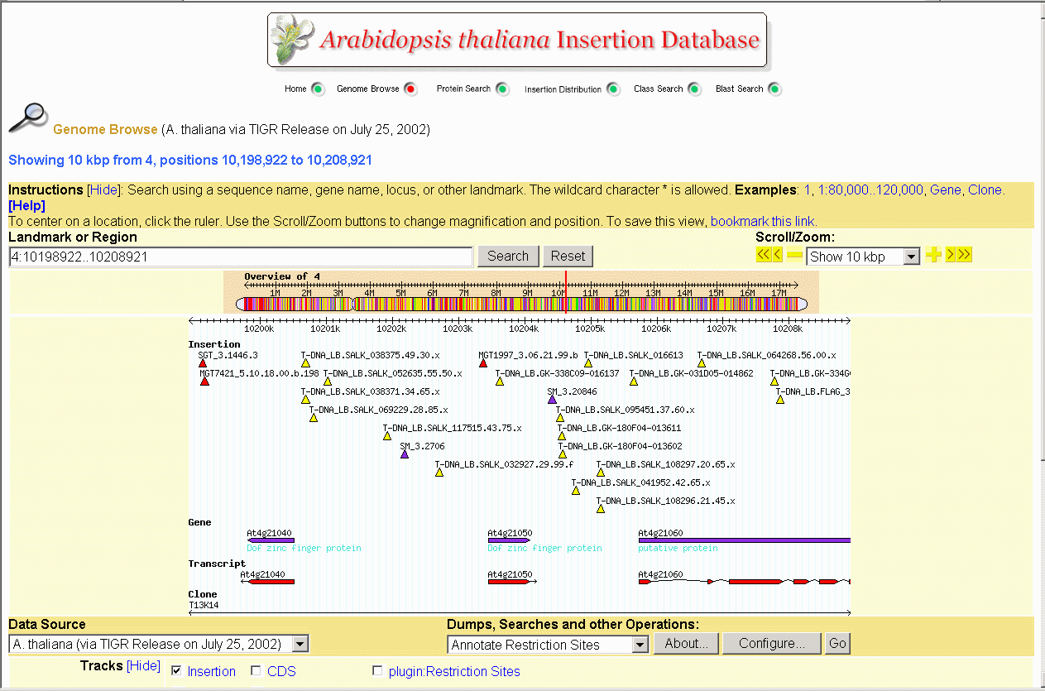

Slide 8
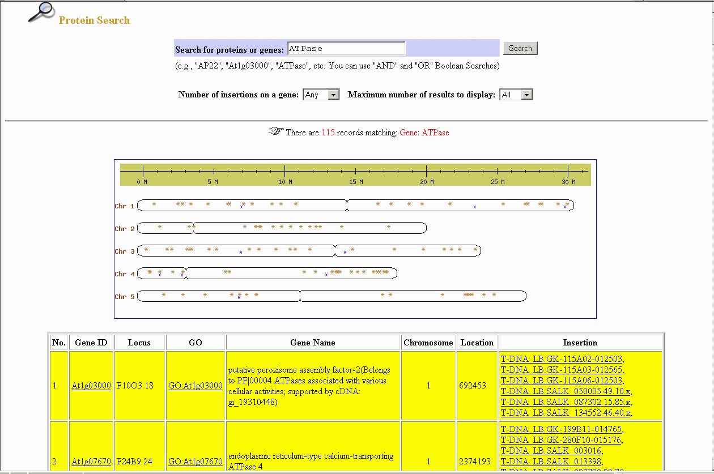

Slide 9
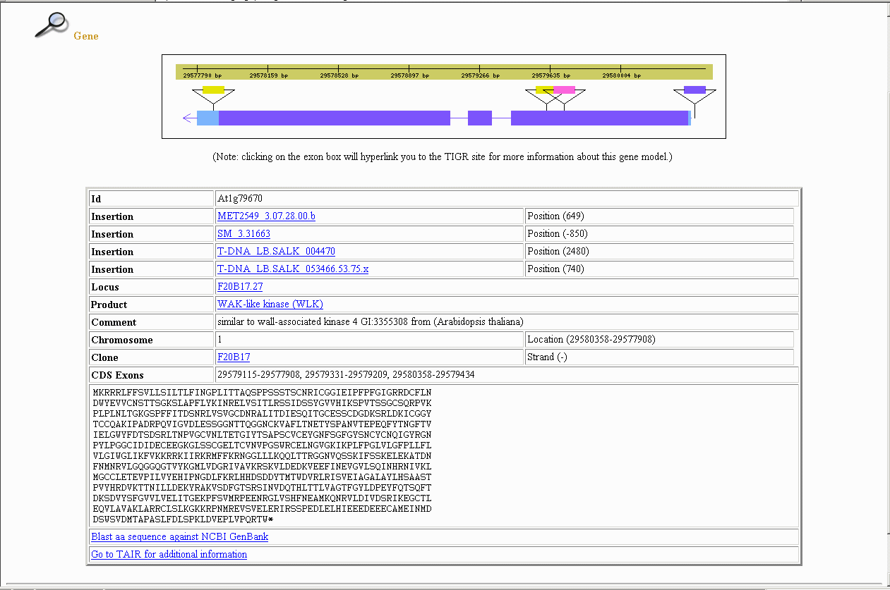
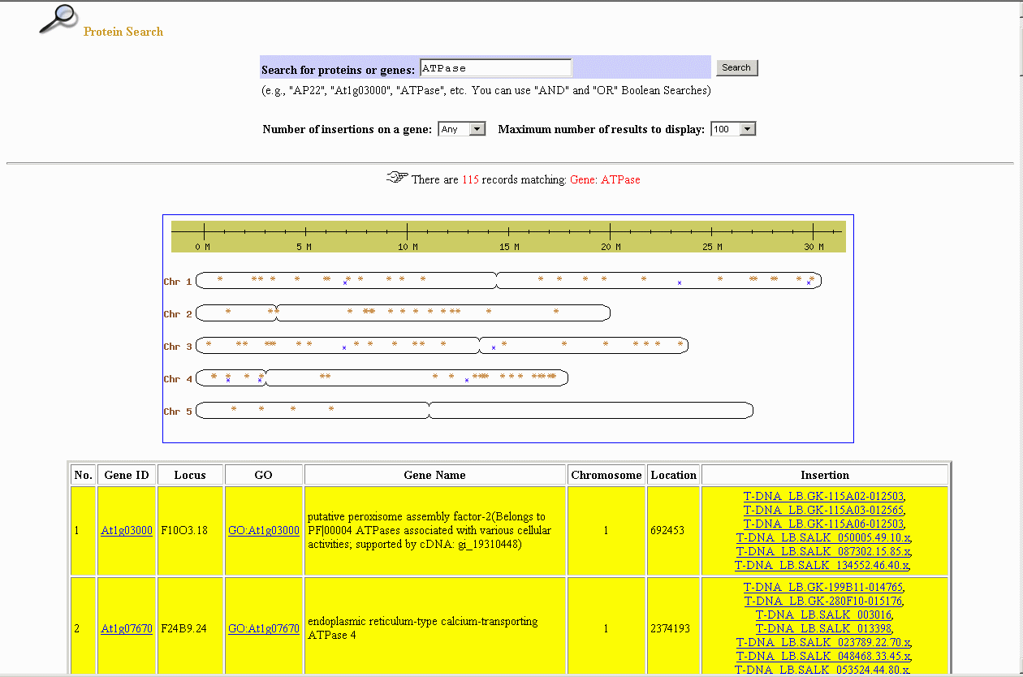

Slide 10
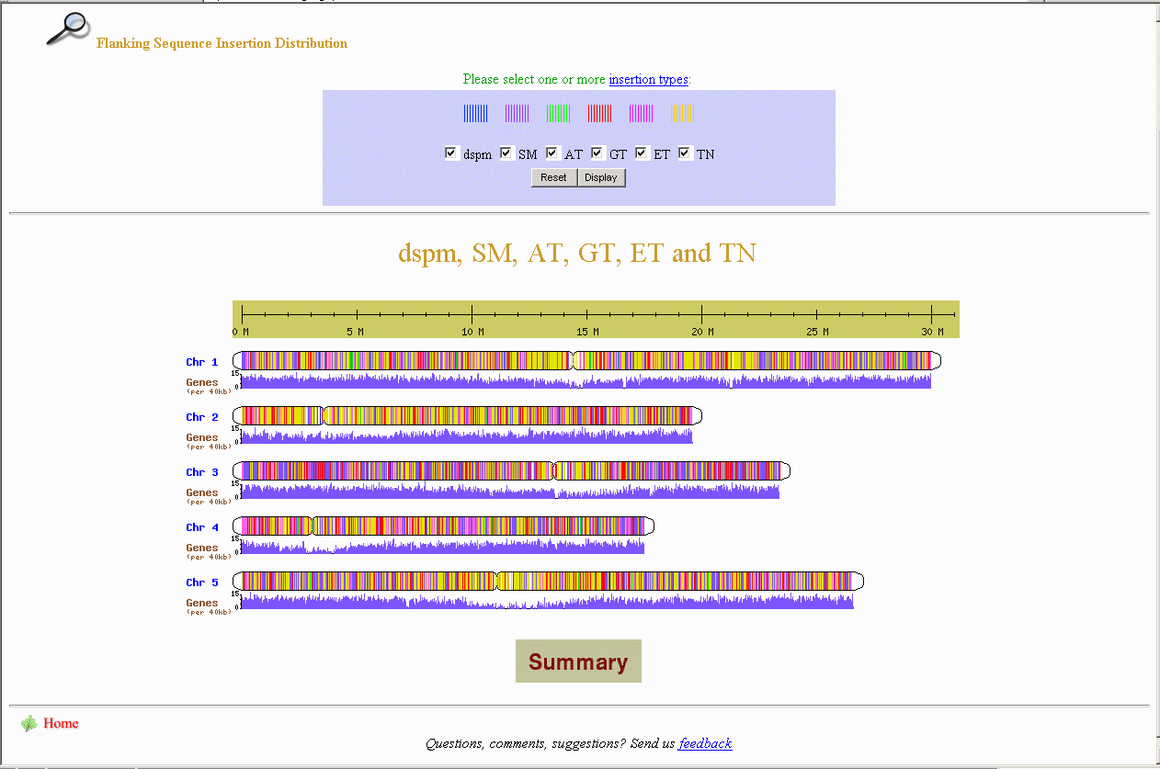

Slide 11
ATIDB Future Enhancements
Modules for phenotype and gene expression
Integrate with gene ontology, plant ontology, trait ontology, etc.

Slide 12
Database Design
(Schema for Phenotype and Gene Expression)
Line
ATIDB
core schema
Gene
Allele
CVTerm
Ontology
Schema
Phenotype
Expression
Environment
Publication
Image

Slide 13
Acknowledgement
Cold Spring Harbor Laboratory
Dr. Hong Liu (former postdoc in Stein Lab)
Steven Schmidt
Dr. Scott Cain
Other colleagues
John Innes Centre, UK
Dr. Mike Bevan
Dr. Jonathan Clarke
Other technical staff

