Slide 1
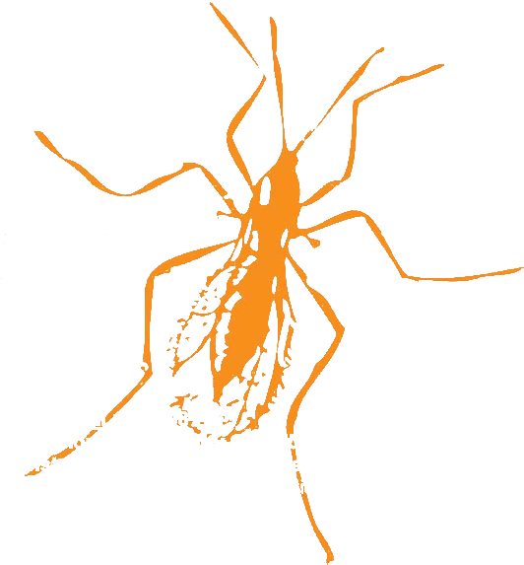

GMOD @ Arthropod Genomics Symposium
GMOD Users
wFleaBase
BeetleBase
FlyBase
AphidBase
ButterflyBase
VectorBase
BeeBase
HeliconiusBase
GnpAnnot-Lep
+ hundreds more
GMOD Tools
Chado
Apollo
GBrowse
CMap
Table Editor
GMODWeb
Ergatis
Textpresso
Sybil
BioMart
LuceGene
SynBrowse
Galaxy
InterMine
…
Thursday 7-9pm
Community Contributions to Genome Annotation
Christine Elsik, Christopher Childers, Darren Hagen
Workshops
Friday 7:30-9:30pm
Chado Databases and Integration with GMOD Tools
Scott Cain, Dave Clements
Friday 11:25-11:45am
Unlocated arthropod genes and ways to find them
Don Gilbert
Talks
Friday 5-6:30pm
A comparative annotation of Drosophilid dicistronic genes
Saturday 10-11:30am
A Complete System For Community Genome Annotation
GMOD: Database Resources for Emerging Model Organisms
Comparative genomics and database construction for Lepidoptera
Unlocated Arthropod genes, and ways to find them
VectorBase: A genome resource for arthropod vectors of human pathogens
The VectorBase Manual and Community Annotation Submission pipeline
ButterflyBase: A framework for comparative genomics in butterflies and moths
Posters
http://gmod.org
Got data?

