Slide 1
MGI/GMOD Update 9/03
Joel Richardson

Slide 2
seqdb_engine
A framework for building and maintaining customized blastable databases
  Used by MGI to build the MouseBLAST set of databases (19 external, 25 internal)
  Java class framework for filtering and routing sequence records
  Build processing based on make
Recent work:
  handle change in GenBank release proceedures
  rebundling for external use
Status: released

Slide 3
Example
filter
route
pressdb
mouse
mRNA
ROD
mouse
mRNA
mouse
mRNA
hum
mRNA
hum
mRNA
PRI
hum
mRNA
mouse
mRNAs
mouse
mRNA
HTC
hum
mRNA
human
mRNAs
mouse
mRNA
NC
hum
mRNA
GenBank
files
intermediate
files
sequence
files
sequence.
databases

Slide 4
GEN: Gene Expression Notebook
A lab-notebook application for managing gene expression data
  assays, reagents, results
  electronic data submission to GXD
Implemented in Excel
Working on ports to Win 2000, Mac OS/X
  Excel ain’t so cross-platform!
Status: released

Slide 5
Ontology Browser/Annotation Viewer
Original proposal: reimplement MGI’s text-based browser in Java, then release
Better browsers already available
Recent prototyping work at MGI:
  graphical displays (using AT&T GraphViz)
  Python
  similar to SGD’s TermFinder
New plan: release the prototype!
Status: soon (core libraries ready to go)

Slide 6
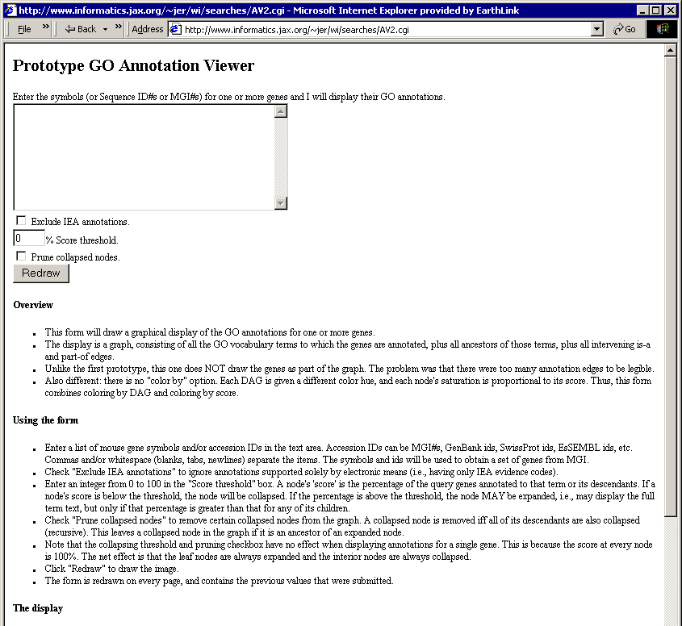
Prototype GO Annotation Viewer

Slide 7
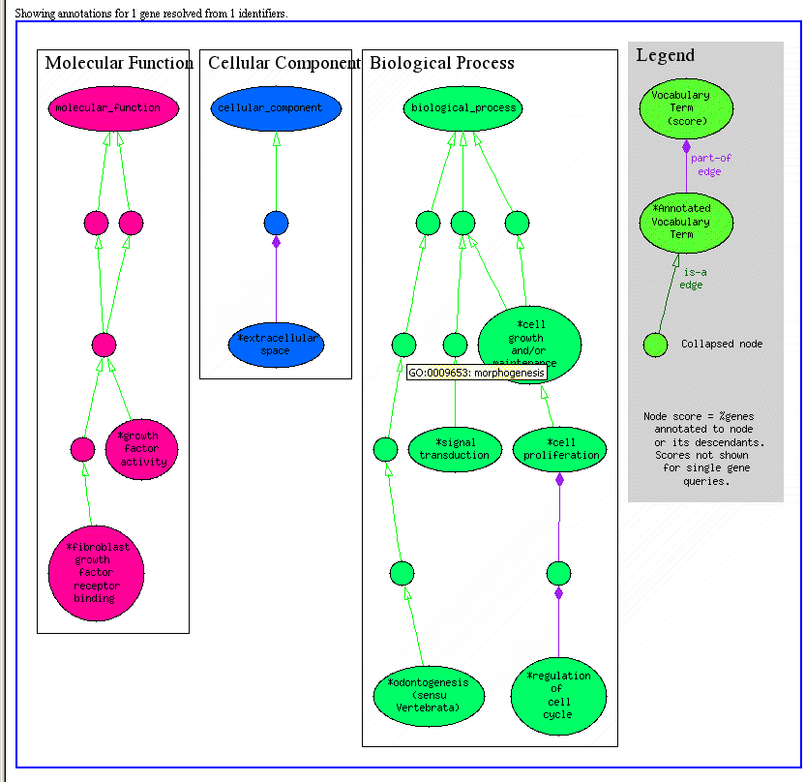
Fgf4

Slide 8
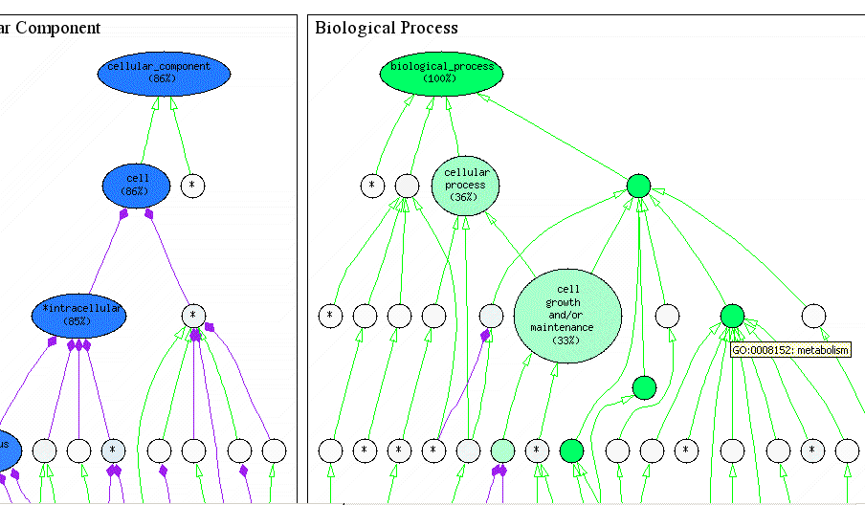
Test Set: 78 genes

Slide 9
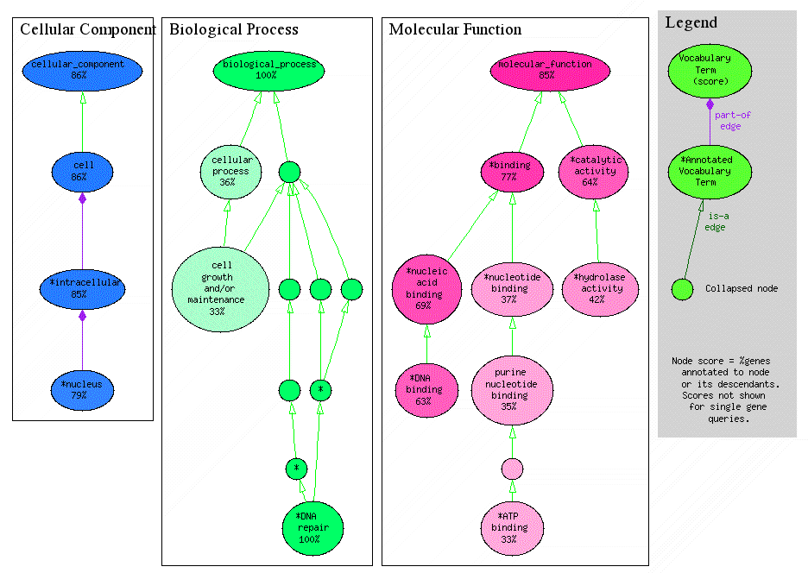
Pruned

Slide 10
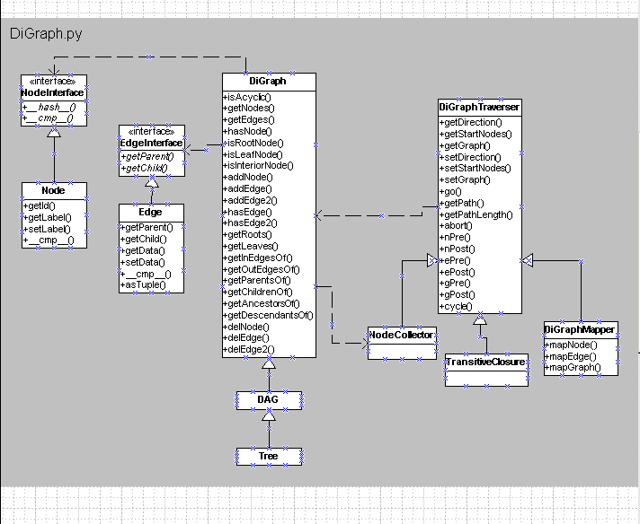
UML: digraph

Slide 11
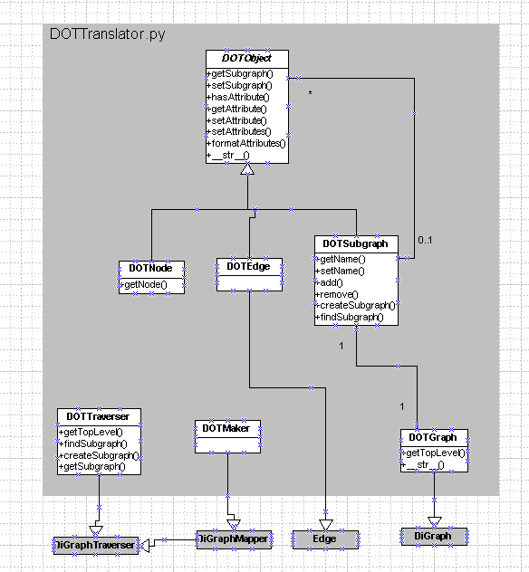
UML: trans

Slide 12
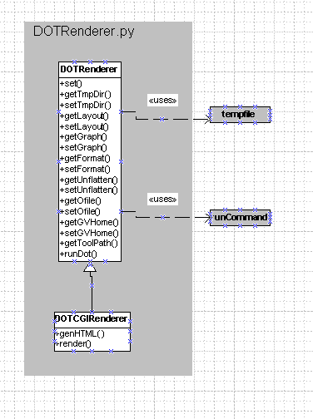
UML: render

Slide 13
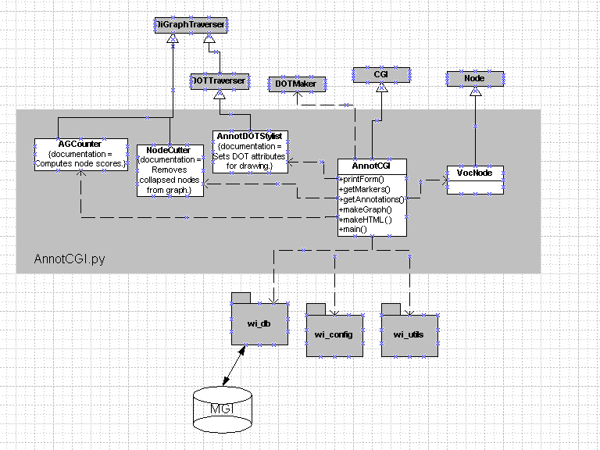
UML: app

