Slide 1
PubFetch / PubTrack
Simon Twigger
Vijay Narayanasamy

Slide 2
PubFetch
Interface between the literature curation tools and the online literature databases, such as PubMed, Agricola, Biosis.
Return data in PubMed MEDLINE Display Format (GMOD Standard)
Provides a generic way of searching and retrieving literature data from online literature data sources
  downstream applications don't have to deal with the idiosyncrasies of the individual literature databases

Slide 3

PubFetch Architecture
AGRICOLA
PubMed
LitDb
Adaptor
Adaptor
Adaptor
PubFetch Module
Query
Result

Slide 4

How PubFetch works?
Search LitDb for articles matching certain query criteria (eg. keywords, date, author, etc). and retrieve a set of accession numbers (eg. PMIDs) for matching references.
Retrieve the articles from the LitDb corresponding to the given accession numbers (eg. bring me the PubMed article for PMID 12345678)
The articles are returned in PubMed-MEDLINE Display Format

Slide 5
PubFetch as a BioMOBY Service
ID
Query
Service
1231333
2123133
4546623
Cancer, Rat
Search
Service
ID
_{PMID- 1231333}
UI – 76248581
OWN – NLM
STAT- completed
DA – 19760925
DCOM- 19760925
IS - 0070-4075
VI - 41
Get
Service
Document in MEDLINE Display Format
1231333
PubFetch core functionalities are available as webservices, following the BioMOBY service model.
Webservices model provide language-independence(XML data useable in Java, Perl, Python etc.)
MODs do not have to install PubFetch locally since it is available as a Service

Slide 6
BioMOBY
MOBY is a system through which a client will be able to interact with multiple sources of biological data regardless of the underlying format or schema. The system also allows for the dynamic identification of new relationships between data from different sources

Slide 7
PubFetch - BioMOBY
PubMed
AGRICOLA
Other
LitDb
PubFetch
PubFetch
PubFetch
MOBY Central
PubFetch –
PMID
PubFetch-
AGRICOLA ID
PubFetch
PubMed Docs
Cancer+AND+rat
PMIDs
Documents

Slide 8
Query
<?xml version="1.0" encoding="UTF-8"?>
<SOAP-ENV:Envelope…>
<namesp3:SearchPubmed xmlns:namesp3="http://biomoby.org/">
<body>
<![CDATA[<?xml version='1.0' encoding='UTF-8'?>
<moby:MOBY xmlns:moby='http://www.biomoby.org/moby-s'>
<moby:Query>
<moby:queryInput moby:articleName=''>
<moby:Simple>
<Object namespace='Global_Keyword' id='rat'/>
</moby:Simple>
</moby:queryInput>
</moby:Query>
</moby:MOBY>]]></body></namesp3:SearchPubmed>
</SOAP-ENV:Envelope>

Slide 9
Services
<Services>
<Service authURI='http://prometheus.brc.mcw.edu/MOBY/Central' serviceName='SearchPubmed'>
<serviceType>Retrieval</serviceType>
<authoritative>0</authoritative>
<Category>moby</Category>
<Description> Search PubMed for given query and get PMIDs </Description>
<URL>http://prometheus.brc.mcw.edu:8082/pubfetch-bin/PubFetchService.pl</URL>
<Input>
<Simple articleName='abc'>
<objectType>urn:lsid:biomoby.org:objectclass:object</objectType>
<Namespace>urn:lsid:biomoby.org:namespacetype:global_keyword</Namespace>
</Simple>
</Input>
<Output>
<Simple articleName='abcd'>
<objectType>urn:lsid:biomoby.org:objectclass:object</objectType>
<Namespace>urn:lsid:biomoby.org:namespacetype:pmid</Namespace>
</Simple>
</Output>
</Service>
<Service> ………...</Service>
</Services>

Slide 10
Response
<?xml version='1.0' encoding='UTF-8'?>
<moby:MOBY xmlns:moby='http://www.biomoby.org/moby'>
<moby:Response moby:authority='http://www.illuminae.com'>
<moby:queryResponse>
<Simple>
<moby:Object namespace='PMID' id="12964904"></moby:Object>
</Simple>
</moby:queryResponse>
<moby:queryResponse>
<Simple>
<moby:Object namespace='PMID' id="12964806"></moby:Object>
</Simple>
</moby:queryResponse>
</moby:Response>
</moby:MOBY>
The response will be a query for the next service(s) and so on. Thus copying and pasting from one tool to another is avoided.

Slide 11
RGD BioMOBY Services
SearchPubmed – Search PubMed for given query and get PMIDs
GetPubmed – Retrieve PubMed articles in MEDLINE display format for given PMIDs
SearchAGRI – Search AGRICOLA for given query and get IDs
GetAGRI – Retrieve AGRICOLA records in MEDLINE Display Format for given AGRICOLA ID

Slide 12
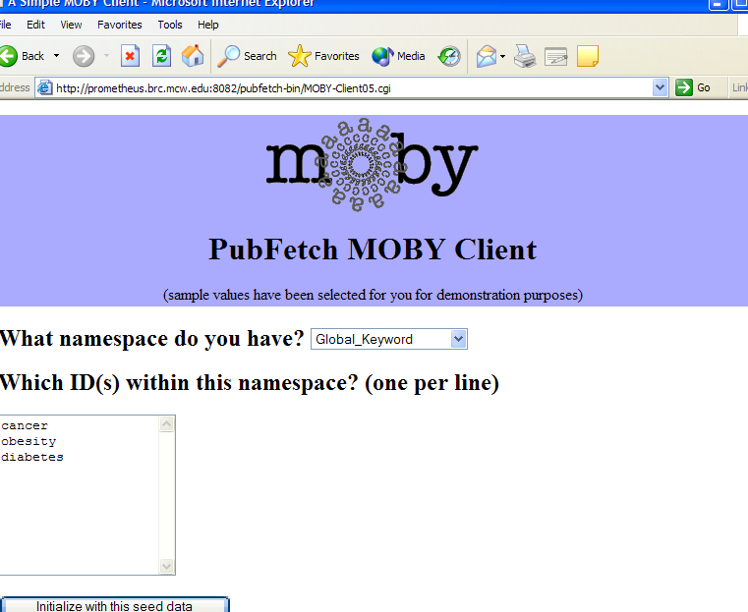

Slide 13
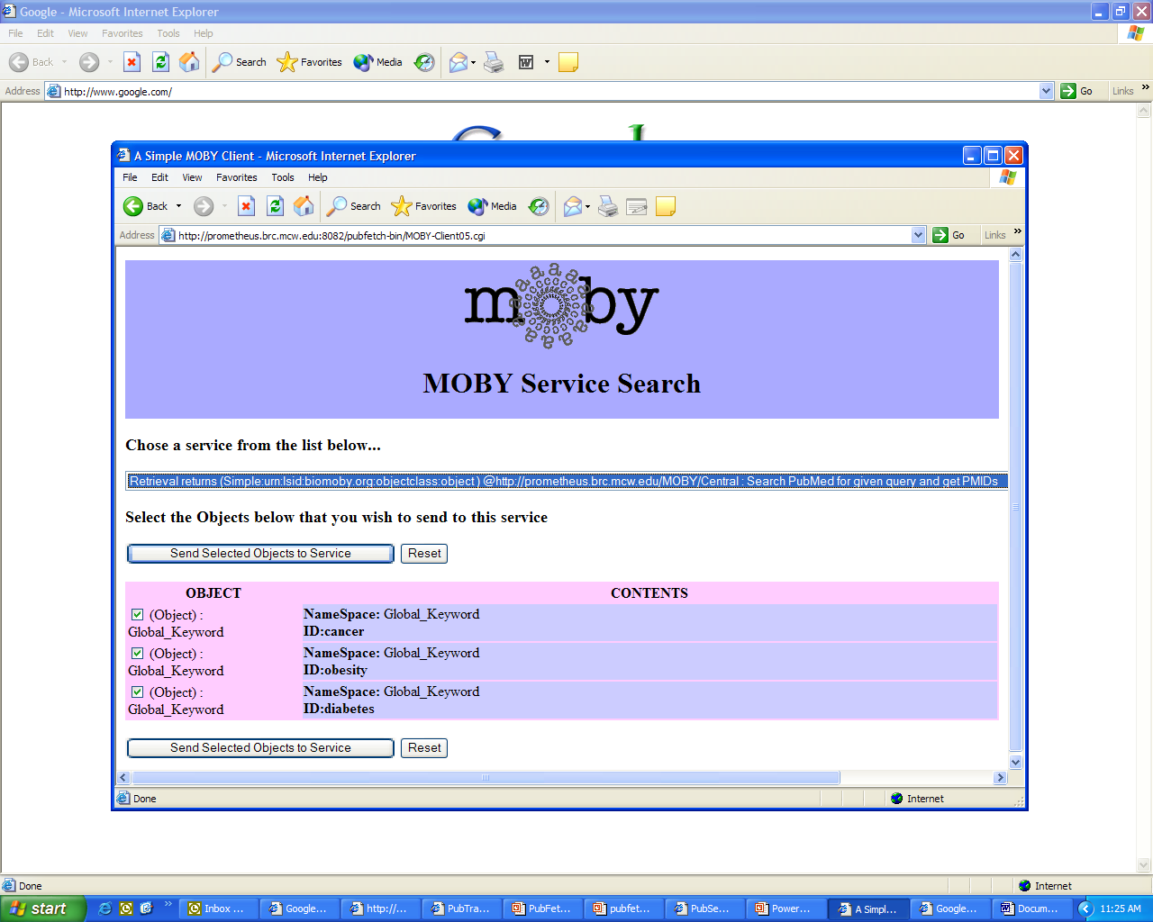

Slide 14
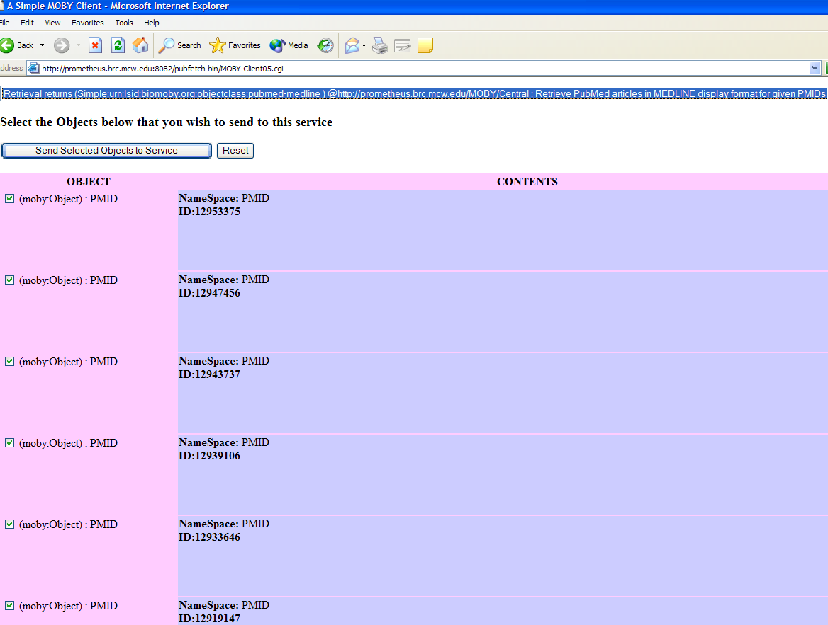

Slide 15
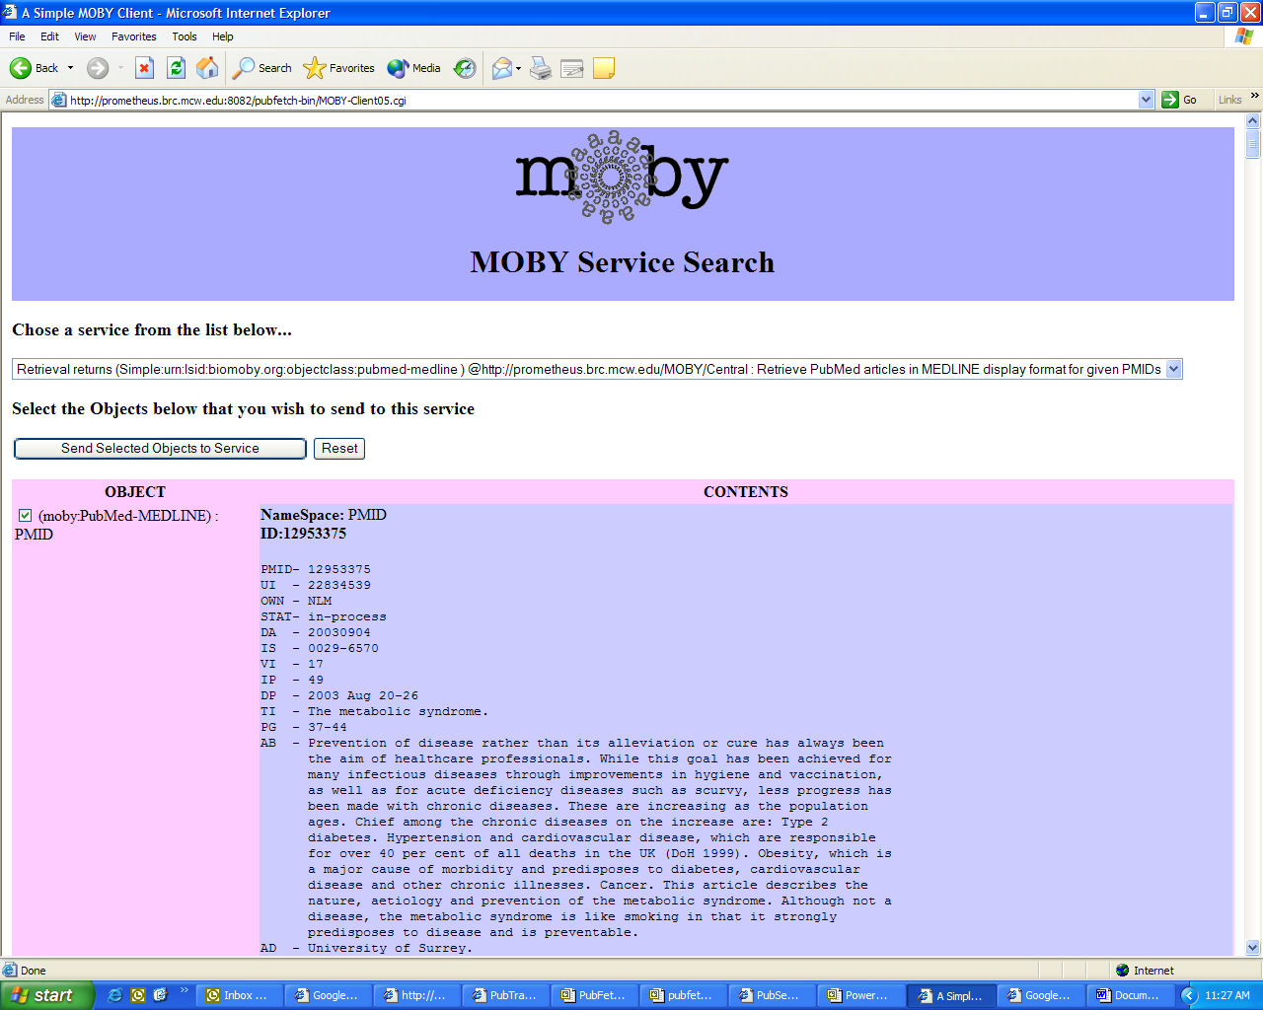

Slide 16
PubTrack
PubTrack is a software to monitor and visualize the current state and ongoing operations of a MOD
Tool for tracking literature objects (papers) through the curation process
Monitor work-in-process items and perform corrective actions by reassigning, re-prioritizing, or suspending them
Maximized use of software and human resources
Provides big-picture views of MOD
PubTrack can answer questions like
  Where in the world is Article X?
  How many articles did we curate?
  How long are the steps taking?
  Who? When? What? Why? …

Slide 17
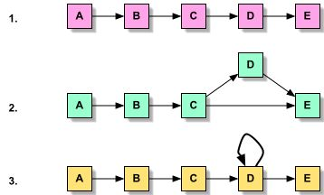
PubTrack Mechanism
Register the units of curation process in form of a Graph
Register the object (Literature)
Gather events from each unit
  Unit A has successfully processed Object 321425.
  Object 45635 format is not compatible for Unit B
  12 objects are in input queue for Unit C
  Unit D (Mr. David) is currently processing Object 564324
  Also other statistics (number of active Units, Number of Objects in the system, Percentage completed …)
Process the events
Display / Visualize events

Slide 18
PubTrack Progress
Looking into currently existing tools like BioPipe, GUS, Kaleidaseq and commercial business systems that have similar functionalities.
Develop in Java (JSP/Servlets)
db in MySQL, port to PostGres & Oracle, access via JDBC
Could be used to track any ‘thing’ through a series of user-definable steps
May provide more general tracking capabilities to GMOD projects

Slide 19



Acknowledgements
Simon Twigger
Susan Bromberg
Norie dela Cruz
Victor Ruotti
Jing Li
Sue Rhee
Lukas Mueller
Iris Xu
Danny Yoo
Behzad Mahini
Mark Wilkinson

