Slide 1
GBrowse Population Display and
CMap
SMBE 2009
Ben Faga

Slide 2
Population Data in GBrowse
Goal: Overlay population data from GBrowse on a Google Map
PhyloGeoViz is a mash up to display poplation data on a Google Map
PhyloGeoViz was a 2007 Google Summer of Code project by Yi-Hsin Erica Tsai at NESCent
Interface between GBrowse and PhyloGeoViz
Available in GBrowse 2 development code

Slide 3
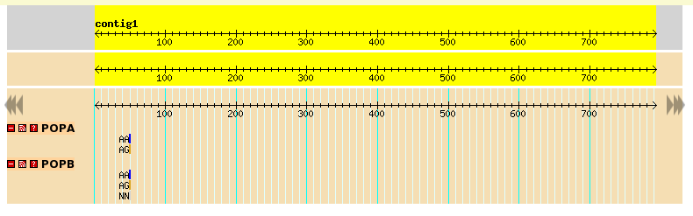
Population Demo
http://localhost/cgi-bin/gb2/gbrowse/pop_demo/
Each population is a track with latitude and longitude values

Slide 4
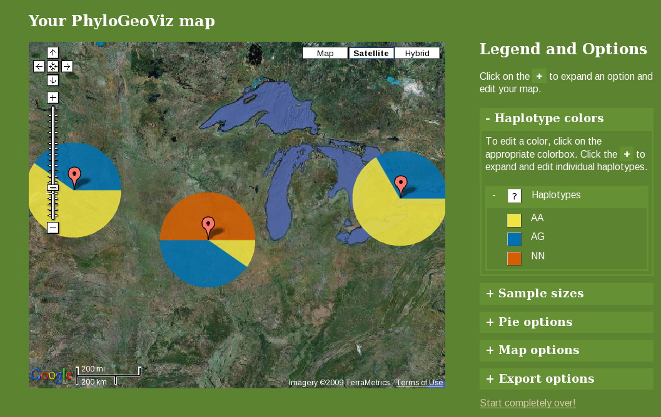
GBrowse data in PhyloGeoViz

Slide 5
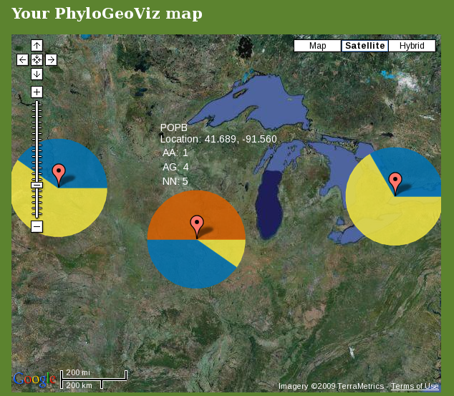
Click Marker to Get Population Data

Slide 6
PhyloGeoViz in a Pop-up Balloon

Slide 7
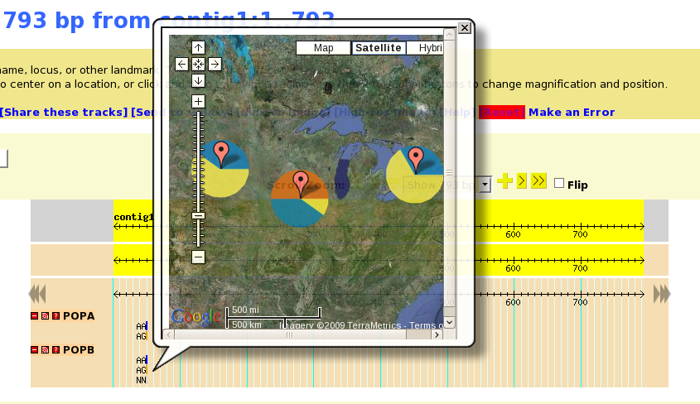
PhyloGeoViz in a Pop-up Balloon

Slide 8
Installation Requirements
GBrowse 2 (in development)
PhyloGeoViz (Optional but highly recommended)
  PHP
  Google Maps API Key

Slide 9
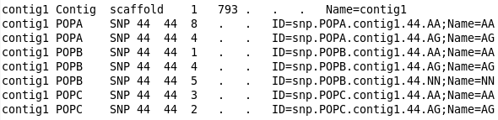
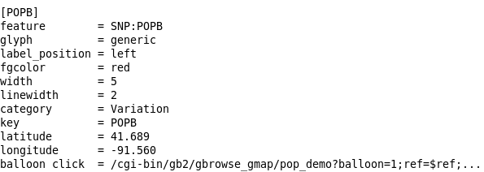
GBrowse Data and Configuration

Slide 10
Gbrowse/PhyloGeoViz Questions?

Slide 11
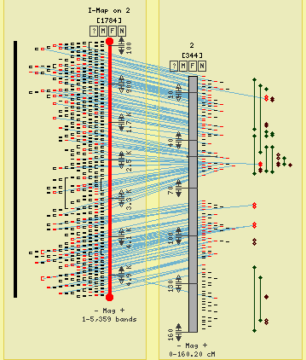
What is CMap?
CMap is a web-based, comparative map viewer
Data provided by the Gramene project (www.gramene.org)

Slide 12
About CMap
CMap is a web application that can be used to display data to anyone with a web browser
CMap is a component of the GMOD project which was originally developed for Gramene
CMap runs on a web server using Perl and is compatible most database management systems
CMap is freely available, under the GPL or the Artistic License 2.0.

Slide 13
Advantages of CMap
(Why Use CMap?)
CMap is data type agnostic and can display comparisons of sequence data, physical data, genetic data, etc with each other.
CMap can be used to compare chromosomes of different species.
CMap can be used to display comparisons of different types of data to look for inconsistencies.
CMap is web based which makes sharing information as easy as sending a bookmark.

Slide 14
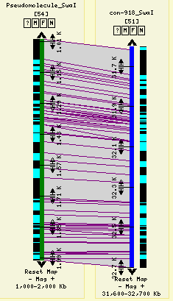
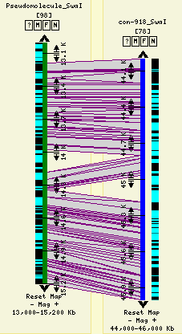
Comparing Sequence Assembly Against Optical Map

Slide 15
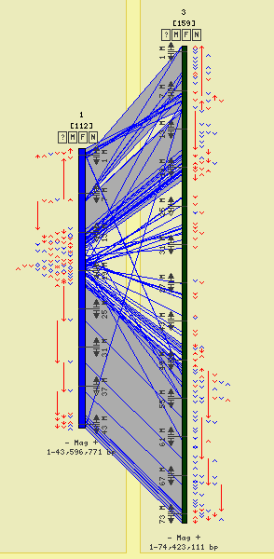
  CMap Displaying Synteny
Data provided by the Gramene project (www.gramene.org)

Slide 16
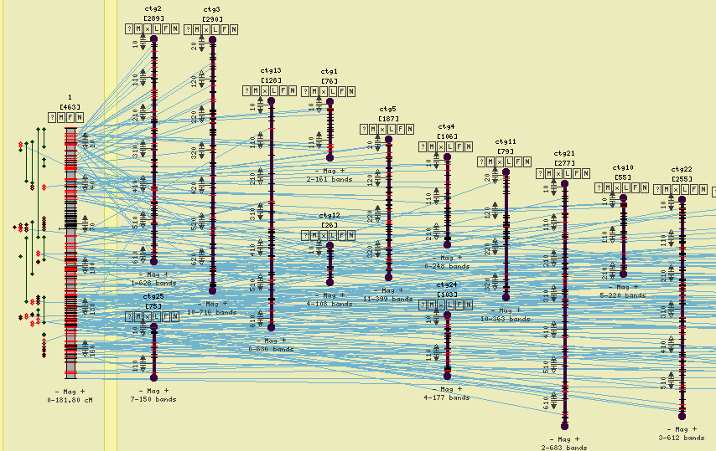
CMap Displaying a Sequence Assembly vs a FPC Maps
Data provided by the Gramene project (www.gramene.org)

Slide 17
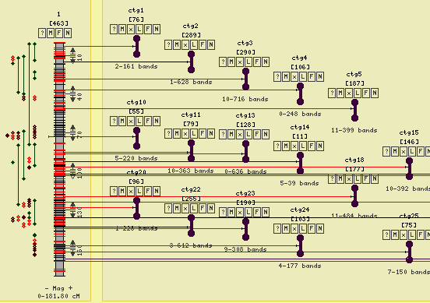
CMap Displaying a Sequence Assembly vs a FPC Maps
Data provided by the Gramene project (www.gramene.org)

Slide 18
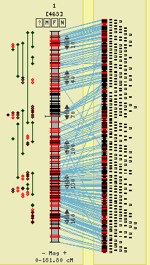
CMap Displaying a Sequence Assembly vs a FPC Maps
Data provided by the Gramene project (www.gramene.org)

Slide 19
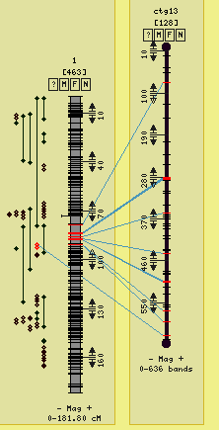
CMap Displaying a Sequence Assembly vs a FPC Maps
Data provided by the Gramene project (www.gramene.org)

Slide 20
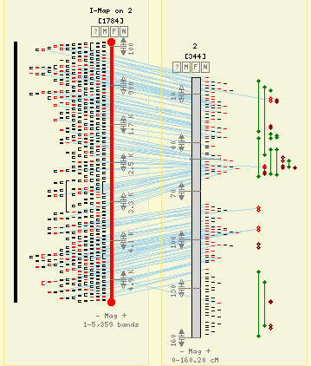
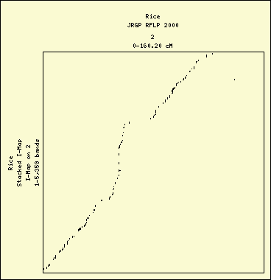
Dot Plot

Slide 21
What CMap is Not:
GBrowse
A sequence viewer (no sequence is imported)
A tool for creating data (although it has a tool for creating correspondences between features of the same name)
Easily googled for (use “GMOD CMap”)

Slide 22
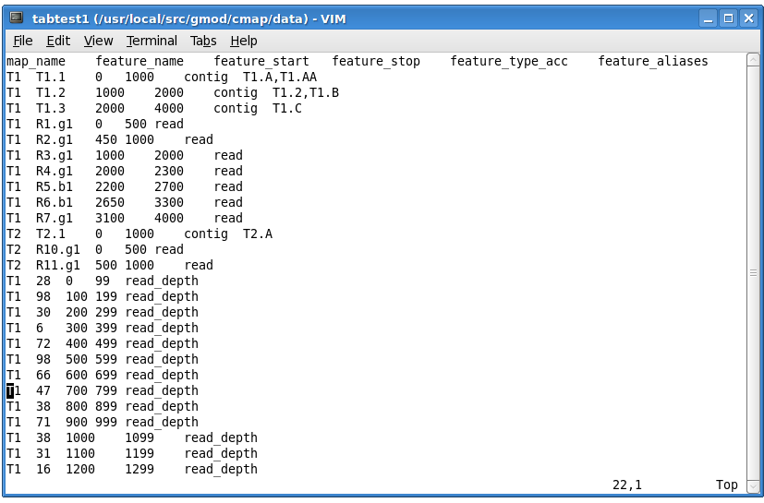
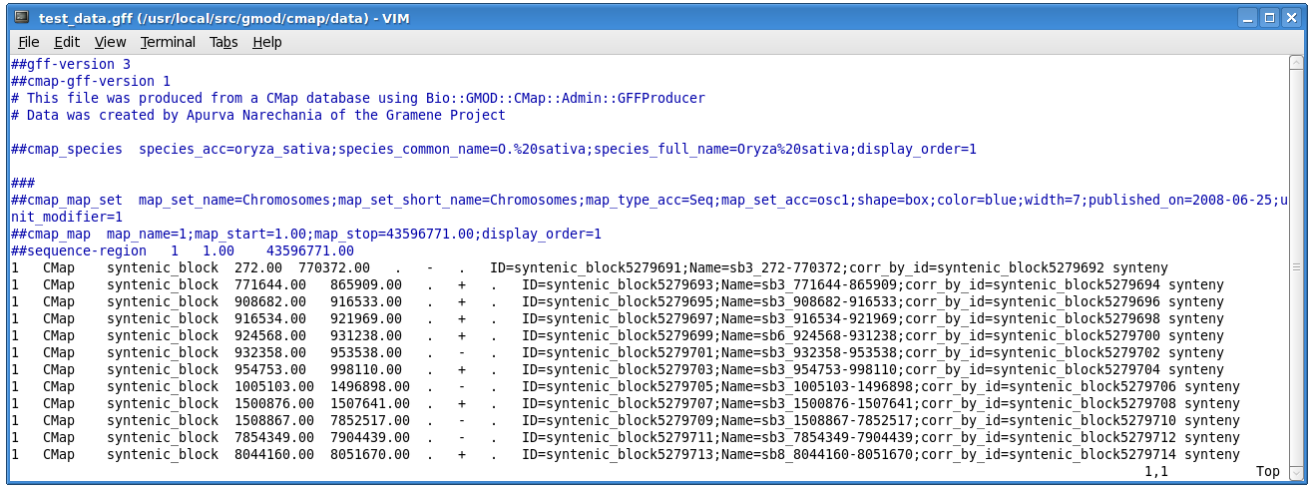
Importing Data
Tab Delimited
CMap GFF3

Slide 23
Acknowledgments
Doreen Ware and the Ware Lab
Lincoln Stein and the Stein Lab
Gramene (www.gramene.org)
GMOD (www.gmod.org)
NESCent (www.nescent.org)
Google (www.google.com)
Yi-Hsin Erica Tsai (original author of PhyloGeoViz)
Ken Clark (original author of CMap)
www.gmod.org/CMap

Slide 24
Live Demo
(Time and Technology Permitting)

Slide 25
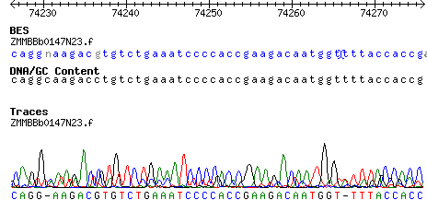
GBrowse Alignment and Trace
Note: base differences are gray and insertions are represented by “)(“

Slide 26
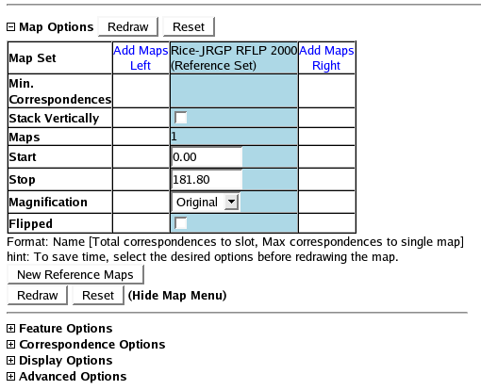
Menu System

Slide 27
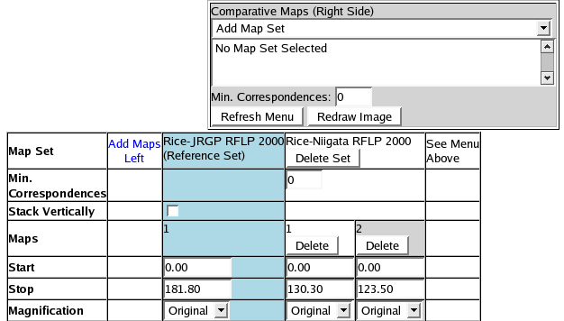
Asynchronous
Comparative Maps Menu

Slide 28
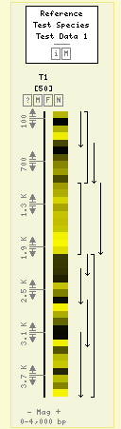
Heat Map Feature Glyph

