Slide 1

Chado on Rails
a framework to simplify development on the Chado schema
Justin Reese / Chris Childers

Slide 2
Some links:
These slides:
http://tinyurl.com/chadoonrails
Source code, have a look:
svn co http://chadoonrails.rubyforge.org/svn/trunk

Slide 3
The Big Idea
Chado database
(de facto standard in bioinformatics)
|
|
|
\ /
Chado on Rails
|
|
|
\ /
Your application
(gene pages, GFF loader, anything that needs to talk to Chado)

Slide 4
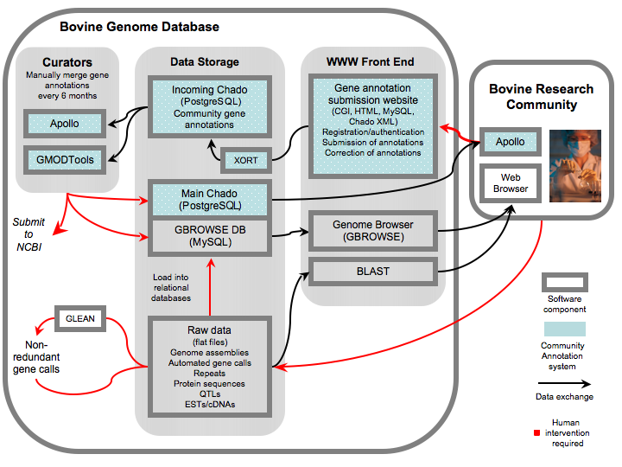
This time last year...
Bovine Genome Database status talk:
no gene pages!

Slide 5
How to implement gene pages?
- couldn't find existing tool that fit our needs
- why not roll our own?
- why not use Ruby on Rails?

Slide 6
The case for Ruby on Rails
- implement object-relational mapping for Chado database schema as legacy schema
- what we then get for free:
Mature MVC framework for fast web development on top of Chado
Rake tasks (a powerful tool for automating tasks)
Capistrano (another powerful tool for deployment, automating tasks)
Powerful debugging (stop request in stack wherever you want)
Sophisticated testing suite
Much more...
- BGD, Beebase, HymenopteraBase, other groups can build on this

Slide 7
Ruby
- "Perl's younger prettier sister"
- syntactic sugar, easy metaprogramming, pure object-oriented language, other sundry awesomeness
- A great 15 minute tutorial:
http://tryruby.org/
- A funny, longer tutorial:
http://mislav.uniqpath.com/poignant-guide/

Slide 8
Rails legacy database support
- Rails paradigm: "convention over configuration"
e.g. Model name "Feature" == table name "features"
- Chado doesn't follow Rails convention
e.g. Feature model == Chado table name "feature"
- Legacy support for Chado means overriding these conventions, explaining to Rails how to talk to Chado

Slide 9
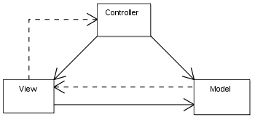
MVC paradigm
Model - the representation of your data (doesn't change much after development)
Controller - "business logic", i.e. the logic to retrieve and process information coming and going from view (changes more seldom)
View - presentation of information to user (changes every 3 seconds)

Slide 10
Quick rails anatomy lesson
Model files live in:
trunk/app/models/[model_name].rb
Controller files live in:
trunk/app/controllers/[model_name]_controller.rb
View files live in:
trunk/app/views/[model_name]/
One important config file:
trunk/config/database.yml - describes db conn.

Slide 11
Legacy Chado support - things to change
"Feature" model as an example:
in trunk/app/models/feature.rb :
This line tells Chado to look for features in table "feature", not table "features":
set_table_name "feature" #default is "features"
This line tells Chado to use "feature_id" not "id" as primary key:
set_primary_key "feature_id" # default is "id"
Repeat for each Chado tables we will support

Slide 12
Hooking up tables to each other ("associations")
Feature -- belongs to --> Cvterm
Cvterm <-- has many -- features
Easy:
in trunk/app/models/feature.rb, add this:
belongs_to :cvterm
in trunk/app/models/cvterm.rb, add this:
has_many :features, :foreign_key => "type_id"

Slide 13
We now have a powerful Chado console
Example: show me the name of the CV for the last thing loaded into Chado feature table
(try out by starting up trunk/script/console)
Before, using SQL:
SELECT cv.name FROM cv, cvterm, feature WHERE cv.cv_id = cvterm.cv_id AND cvterm.cvterm_id = feature.type_id ORDER BY feature_id DESC LIMIT 1;
After, using Rails:
Feature.find(:last).cvterm.cv.name

Slide 14
Example app: 5 min. Chado gene pages
model: done already
controller: make controller, write method to load up gene of interest into variable:
[~/chado_on_rails/trunk] jtr4v$ ./script/generate controller gene
exists app/controllers/
exists app/helpers/
create app/views/gene
exists test/functional/
exists test/unit/helpers/
create app/controllers/gene_controller.rb
create test/functional/gene_controller_test.rb
create app/helpers/gene_helper.rb
create test/unit/helpers/gene_helper_test.rb
then add this to trunk/app/controllers/gene_controller.rb:
def show
@gene = Feature.find(params[:id])
end
view: add trunk/app/views/gene/show.html.erb, present some gene info to user (next slide)

Slide 15
Simple view for gene page
<%= render :partial => 'header' %>
<% if @gene.nil? %>
There is no record for feature id <%= params[:id] %>
<% else %>
<ul>
<li>Name: <%= @gene.name %></li>
<li>Uniquename: <%= @gene.uniquename %></li>
<li>Feature id: <%= @gene.feature_id %></li>
<li>Cvterm: <%= @gene.cvterm.name %></li>
<li>Organism: <%= "#{@gene.organism.genus} #{@gene.organism.species}" %></li>
<li>Time last modified: <%= @gene.timelastmodified %></li>
</ul>
<% end %>
<br/>
<%= render :partial => 'footer' %>

Slide 16
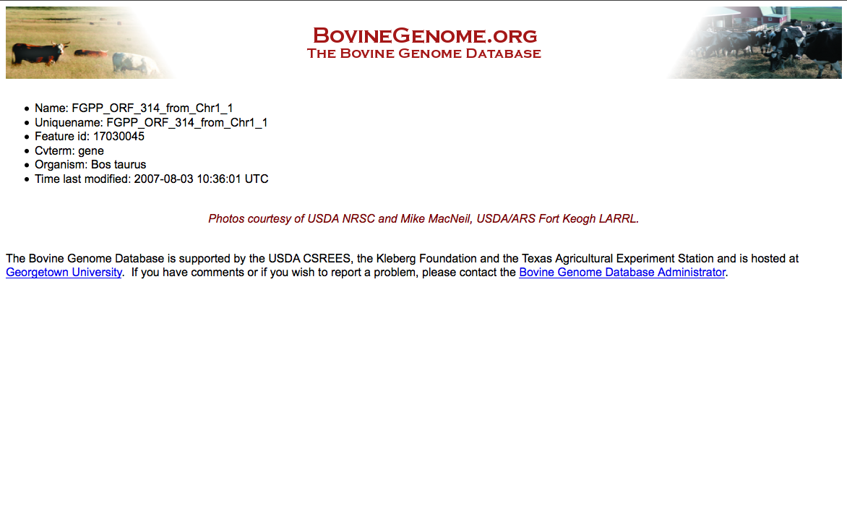
Chado on Rails + Chado db + 19 lines of code = gene pages!
http://0.0.0.0:3000/gene/show/17030045

Slide 17
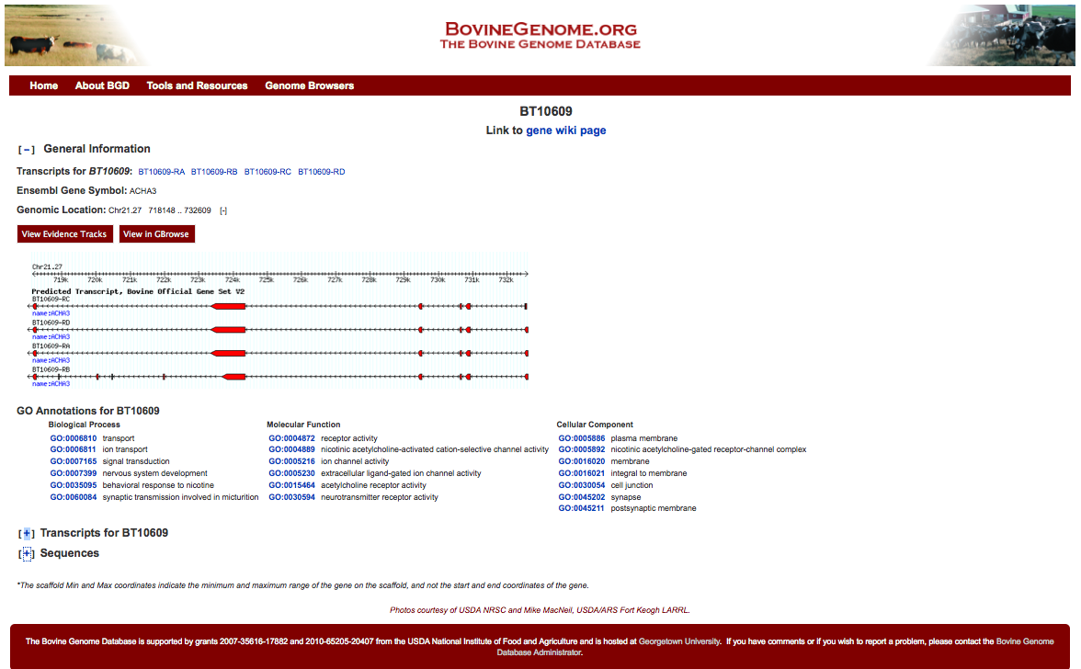
Mature BGD genes pages
http://genomes.arc.georgetown.edu/bovine/genepages/genes/BT10609

Slide 18
Testing
- Rails ships with sophisticated testing suite (a whole other talk)
- Chado on Rails contains unit tests for associations, other reality checks
- Easy to add more sophisticated tests (functional, etc.)
- rake test
Caching
- Add one line in controller to cache gene pages:
caches_page :show
- More sophisticated caching (expire cache after x days, caching expensive queries, etc.)

Slide 19
Deployment - a non-issue
- Used to be a major weakness of Rails
- Passenger Phusion + Capistrano provide dead-easy deployment, plays nicely with Apache and Nginx
- Fairly easy to set up staging environments to try out new releases

Slide 20
Other applications
- Powerful framework for the development of applications on top of Chado
- Ideas for possible applications?
- Help available from me, Chris, Rails community
- http://rubyforge.org/projects/chadoonrails/
(there's another dead project by the same name)
- Justin Reese:
justaddcoffee@gmail.com
- Chris Childers:
genetics.guy@gmail.com

Slide 21
Thanks
Chris Childers
Chris Elsik
Jay Sundaram
Darren Hagen
Monica Muñoz-Torres
Steve Shen
Anna Bennett
Shu Tao
Don Vile

