Slide 1

IoT-Honeypot on esp32
Stefan Aistleitner, Matthäus Förster, Marlin Ortner

Slide 2
Motivation
Elective lecture IoT project
Option to use esp32 and explore functionalities with platformio
Expand experience with esp32

Slide 3

Related work
Project built on existing GitHub Project NanoC6-ESP32-Honeypot from 7h30th3r0n3
ESP32 Honeypot configuration ready to use

Slide 4
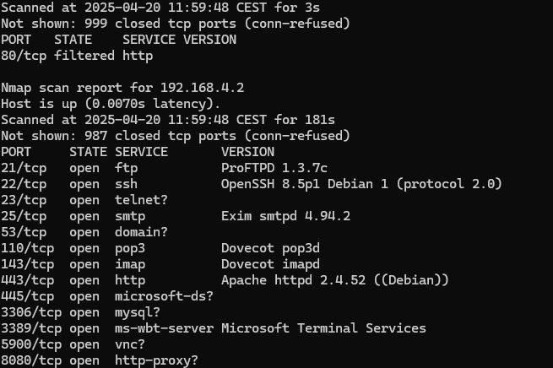
Results & showcasing
Honeypot running on ESP32
Discord webhook
Web GUI for WiFi-setup
NTP-synchronized logging
LED blinking color feedback when accessing honeypot port
RAW HTTP WebService

Slide 5
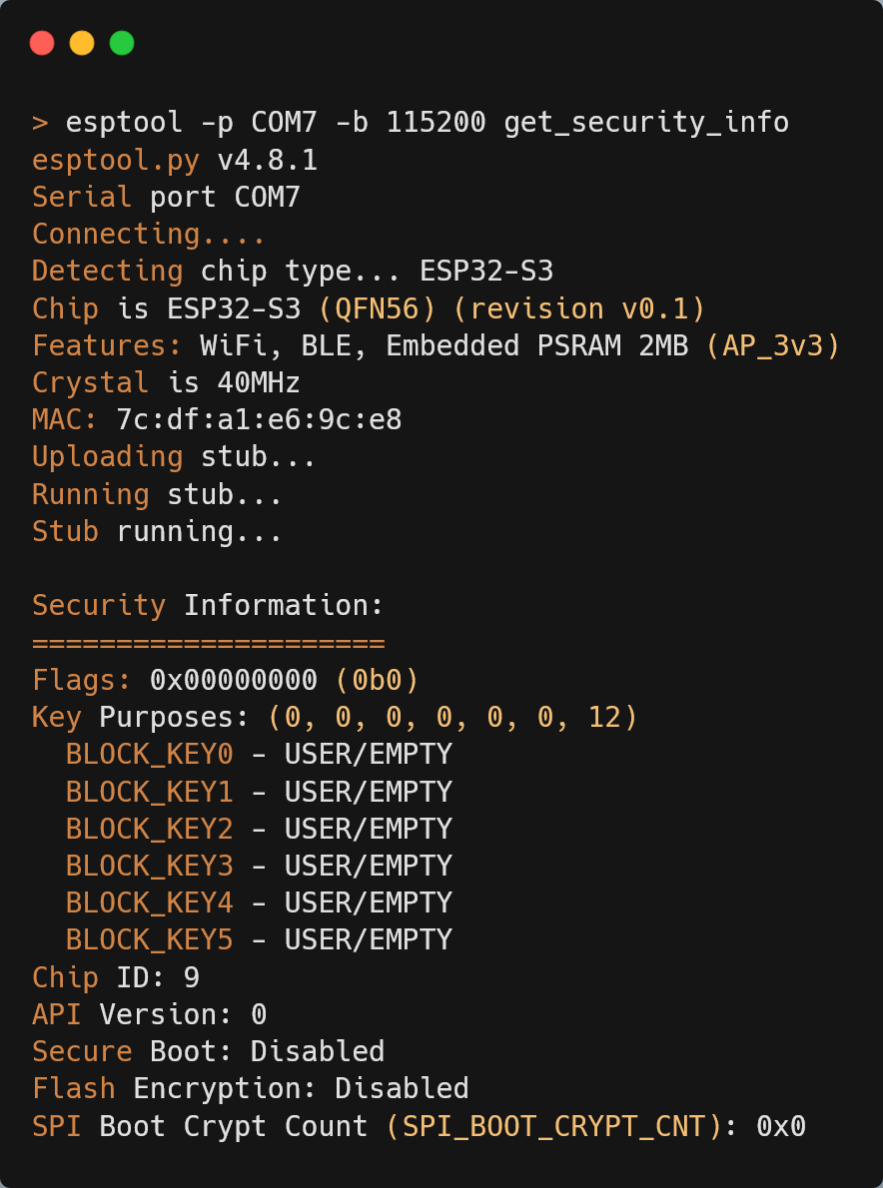
Reverse Engineering: esptool.py - securityinfo

Slide 6
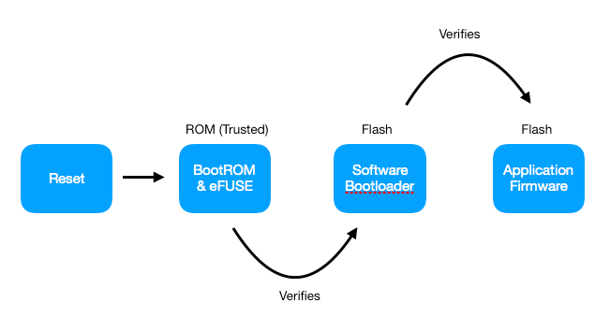
Reverse Engineering: esptool.py - securityinfo

Slide 7
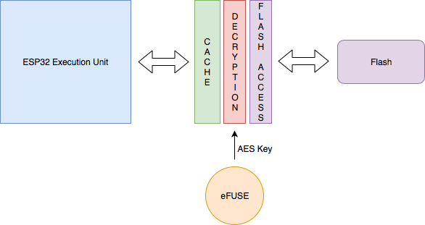
Reverse Engineering: esptool.py - securityinfo

Slide 8
Reverse Engineering: esptool.py - securityinfo

Slide 9
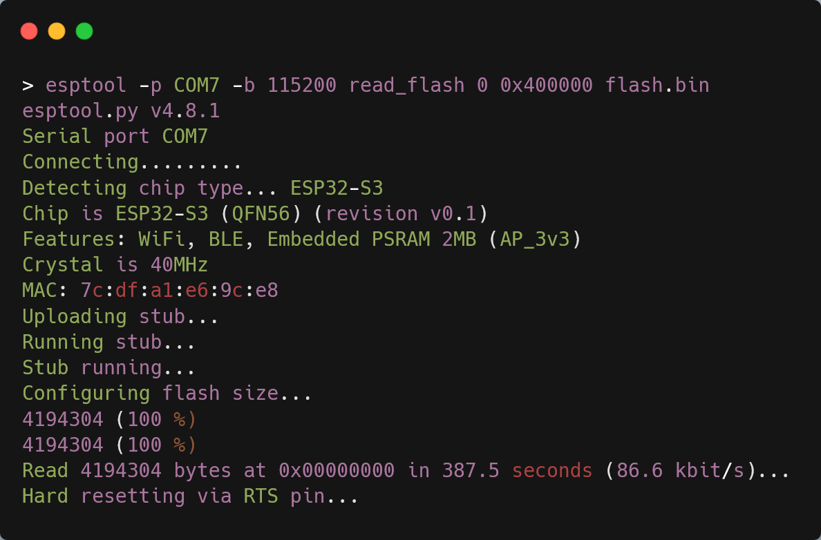
Reverse Engineering: esptool.py - dumping

Slide 10
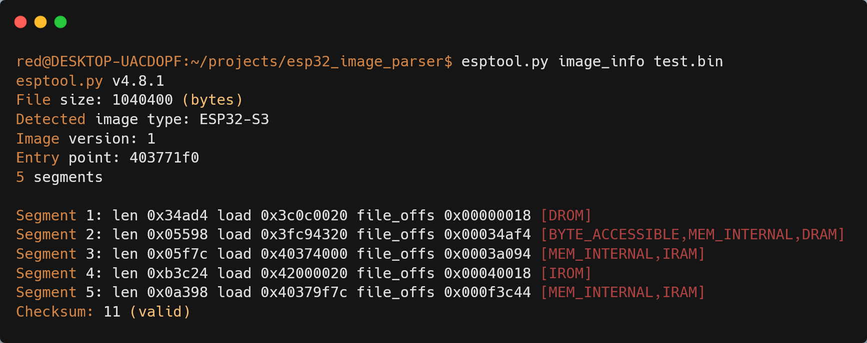
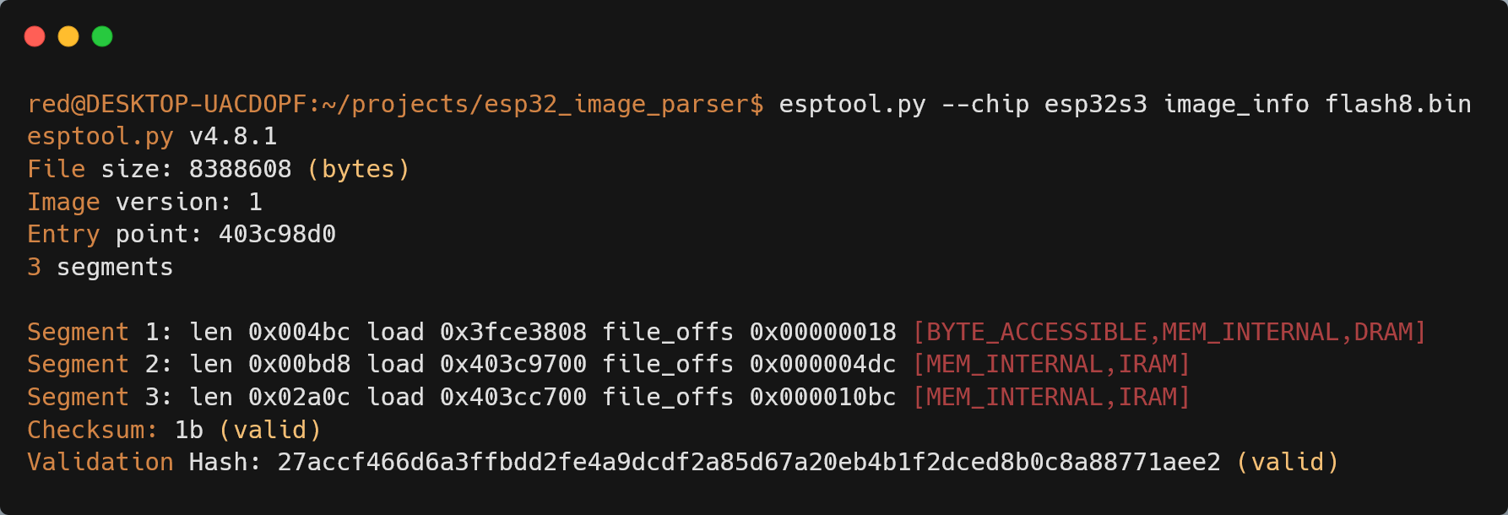
ESPTool.py image_info
With PIO generated ELF => .bin via esptool elf2image
firmware.elf
Partitiontable
Dumped data via esptool

Slide 11
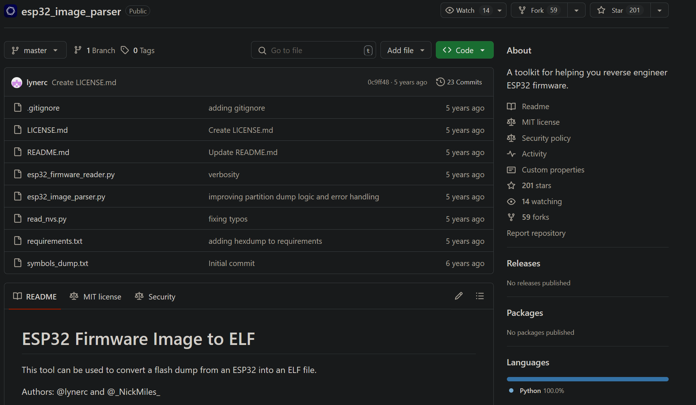
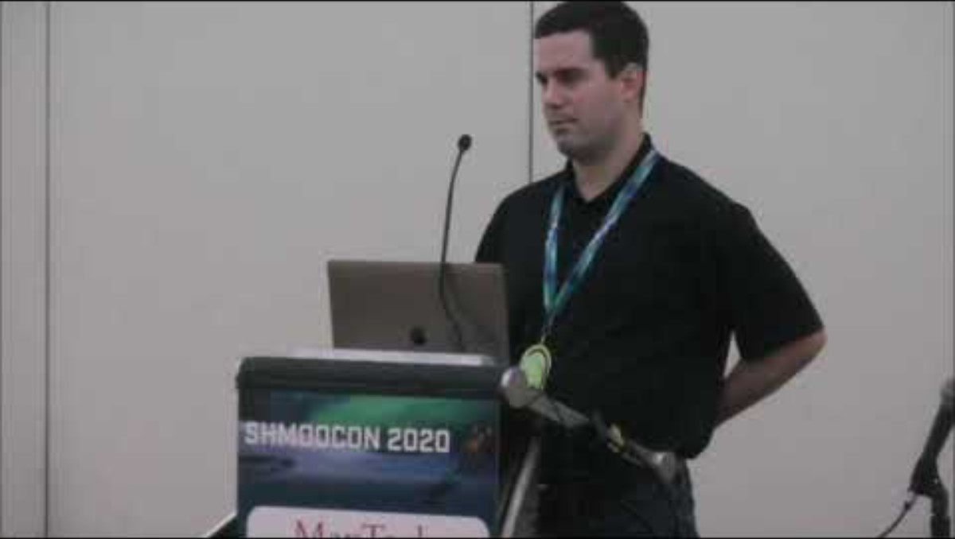
Extracting an ELF From an ESP32 - Chris Lyne and Nick Miles (Shmoocon 2020) [42:39]
https://github.com/tenable/esp32_image_parser
https://www.youtube.com/watch?v=w4_3vwN_2dI

Slide 12


Nothing worked
Could not map the affirmentioned segments and dump a ELF file to reverse engineer ​
Github Issues​
Overwriting Python Script​
Maybe it’s the flash download? Do it again​
Change segment mapping

Slide 13
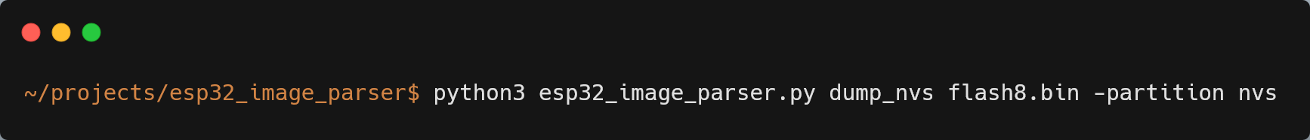
New approach: NVS
Non-Volatile Storage Library
designed to store key-value pairs in flash

Slide 14
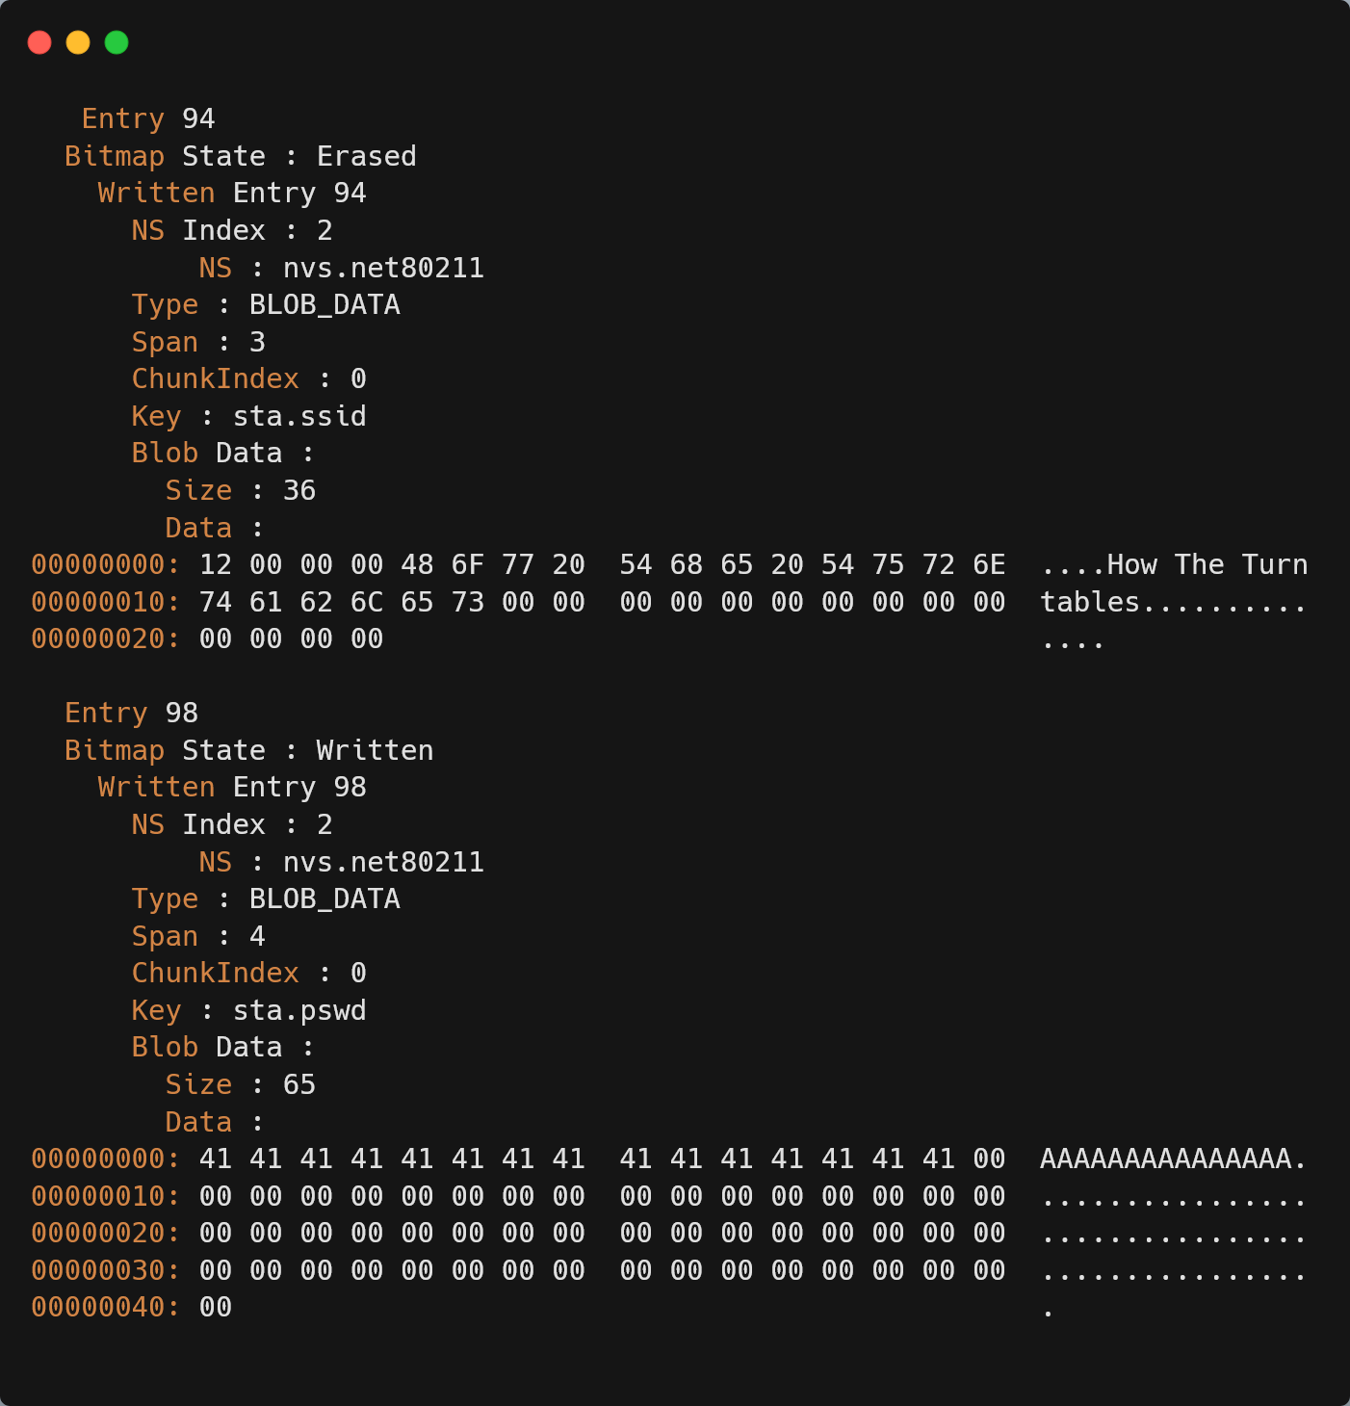
AP SSID + Password in Non-Volatile Storage (dumped flash)

Slide 15
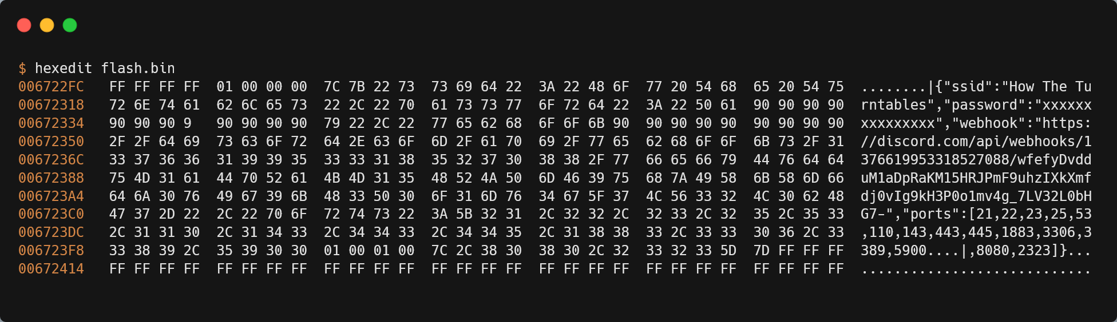
Also in hexedit (dumped flash)

Slide 16
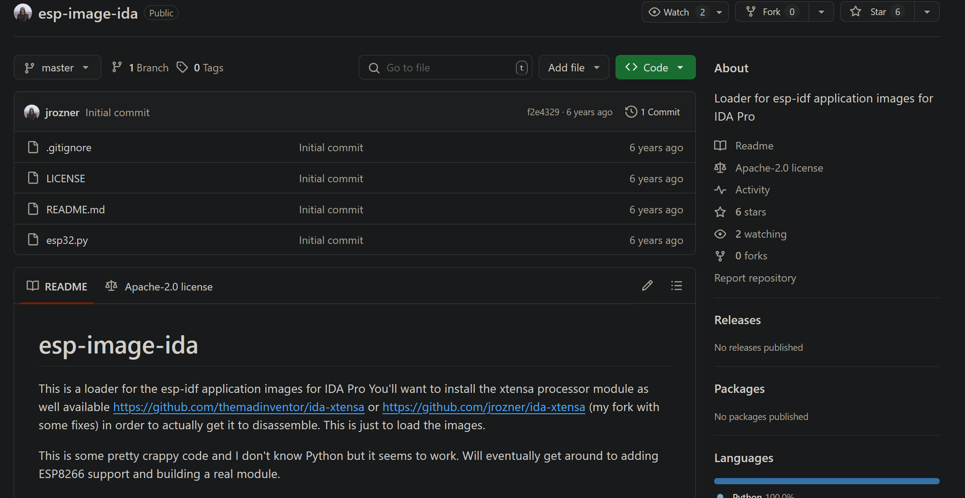
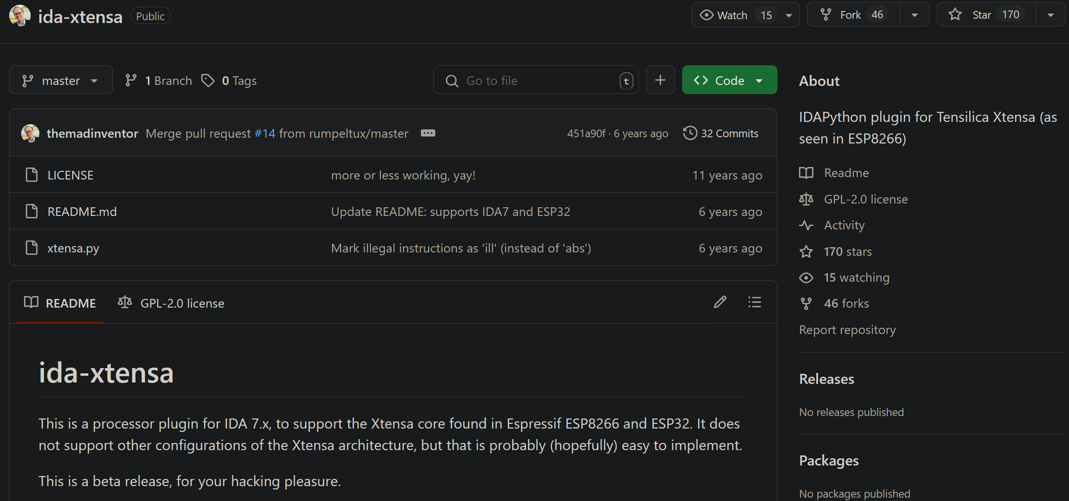
Reverse Engineering: IDA
https://github.com/jrozner/esp-image-ida
https://github.com/themadinventor/ida-xtensa

Slide 17
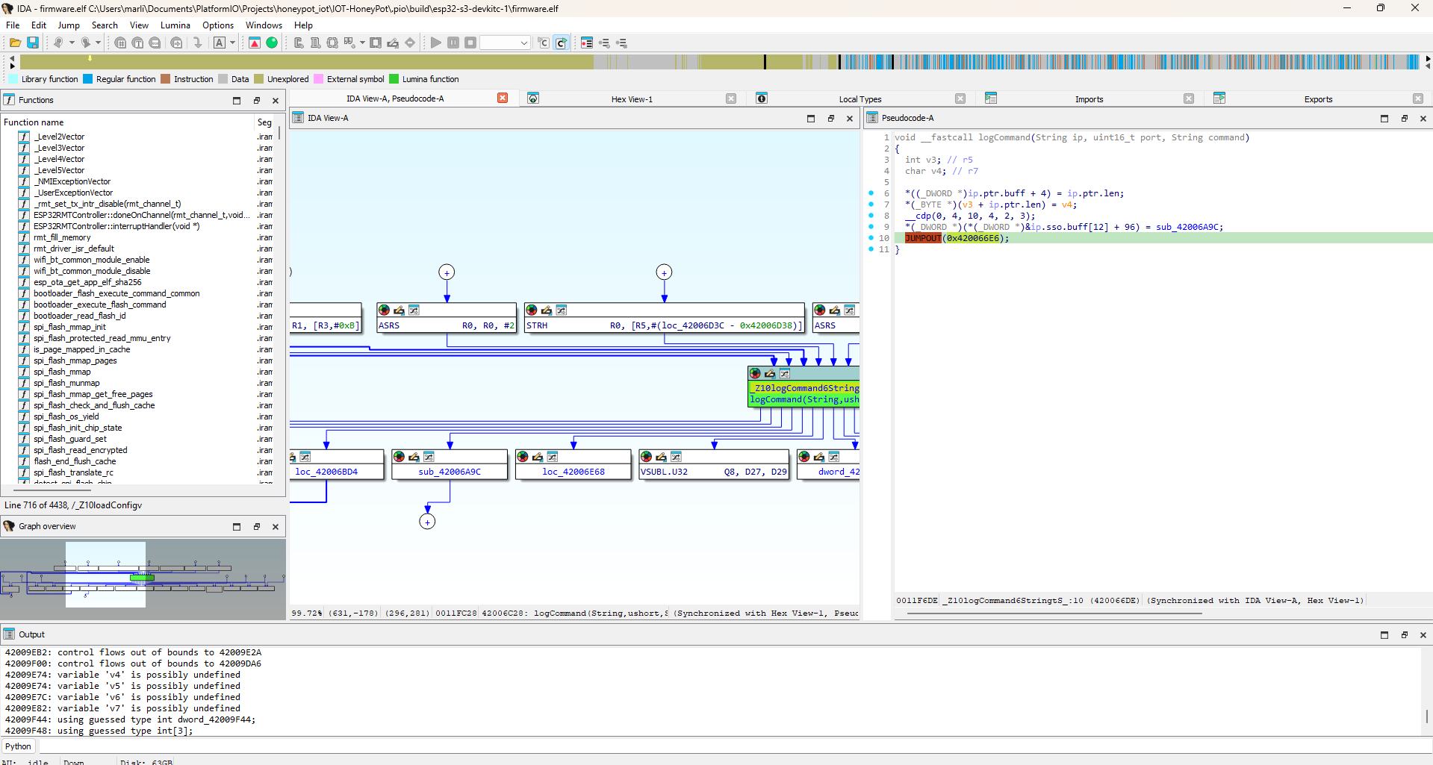
Reverse Engineering: IDA

Slide 18
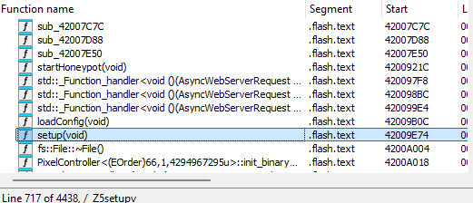
Image analysis in IDA
A lot of function (4438)
From a ctf perspective: either GUI application or a lot of libaries have been used

Slide 19

Future Work
Add more honeypot features
Extend implemented shell usage
Implement more logging features
User-friendly extraction of logs on the Filesystem
Practical setup and collect logs

Slide 20
Thank you for your attention!

Slide 21
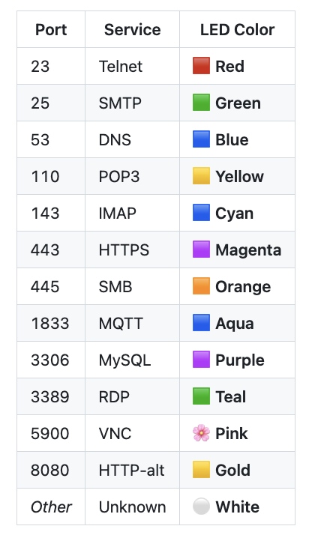
DEMO
SSID: Wifi
Passwort: pleaseEnter
IP: 192.168.137.193

