Slide 1
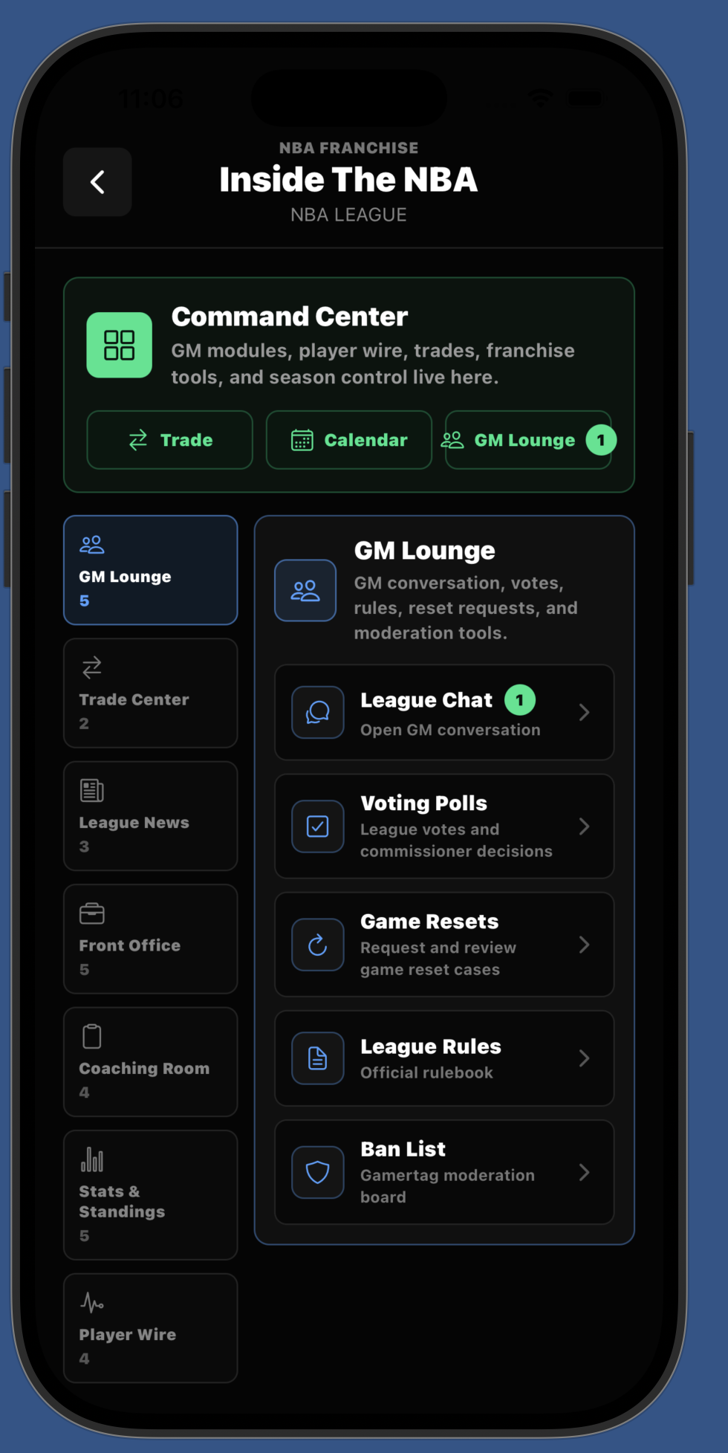
FRANCHISE MOBILE x NBA 2K
Keep the league alive
after the console turns off.
A persistent mobile community and front-office companion for MyNBA and MyGM.
WORKING PROTOTYPE
PROPOSED 2K INTEGRATION
Private strategic discussion
Notes:
Open with one sentence: Franchise Mobile extends a MyNBA or MyGM league into the hours when players are away from console or PC. Clarify immediately that NBA 2K remains the authoritative gameplay experience.
[Sources]
- Internal Franchise Mobile prototype screenshot, captured 2026-07-06.
[/Sources]

Slide 2
THE GAP
The game ends. The league should not.
Franchise communities lose momentum when essential activity moves into disconnected tools.
01
Coordination fragments
Schedules, rules, trades, and availability move into third-party chats and spreadsheets.
02
Vacancies stall the league
A missing GM can block matchups, negotiations, and season progression.
03
Management waits for console time
Routine front-office decisions compete with the time required to launch and play the full game.
PRIVATE STRATEGIC DISCUSSION
02
Notes:
Frame the problem as league continuity, not as a complaint about NBA 2K. The opportunity is to consolidate activity that already occurs outside the game and route it back toward scheduled NBA 2K play.

Slide 3
PRODUCT THESIS
One league. Two surfaces. Continuous engagement.
Mobile handles asynchronous management and community; NBA 2K owns the playable basketball experience.
PREPARE
PLAY
SYNC
REACT
Roster, trades, scouting, strategy
›
Authoritative game on console or PC
›
Results, box scores, standings, injuries
›
News, chat, votes, next decisions
The next console session begins before the previous league conversation ends.
PRIVATE STRATEGIC DISCUSSION
03
Notes:
Walk left to right. This is a proposed product loop, not a claim that a public NBA 2K integration API exists. The exact account linking, synchronization contract, and server authority would be determined with 2K and Visual Concepts.

Slide 4
WORKING PROOF
The league operating layer already exists.
The pitch demo is isolated, seeded, and designed to show a complete franchise-management loop.
30
530
1,230
12
CPU-READY FRANCHISES
ROSTERED PLAYERS
GAME SCHEDULE
SEEDED SHOWCASE GAMES
Prototype systems demonstrated
Commissioner tools
CPU vacancies
Trade rooms
Player intelligence
League stats
Social moderation
Schedules + standings
Game results
Coaching prep
Offseason flow
Alerts + news
Viewer-safe demo
PRIVATE STRATEGIC DISCUSSION
04
Notes:
These figures describe the current isolated pitch-demo dataset, not market traction. State plainly that the prototype demonstrates product depth and workflow feasibility; it does not yet represent a live NBA 2K integration.
[Sources]
- Internal pitch-demo verification and seeded Firestore dataset, verified 2026-08-04.
[/Sources]

Slide 5
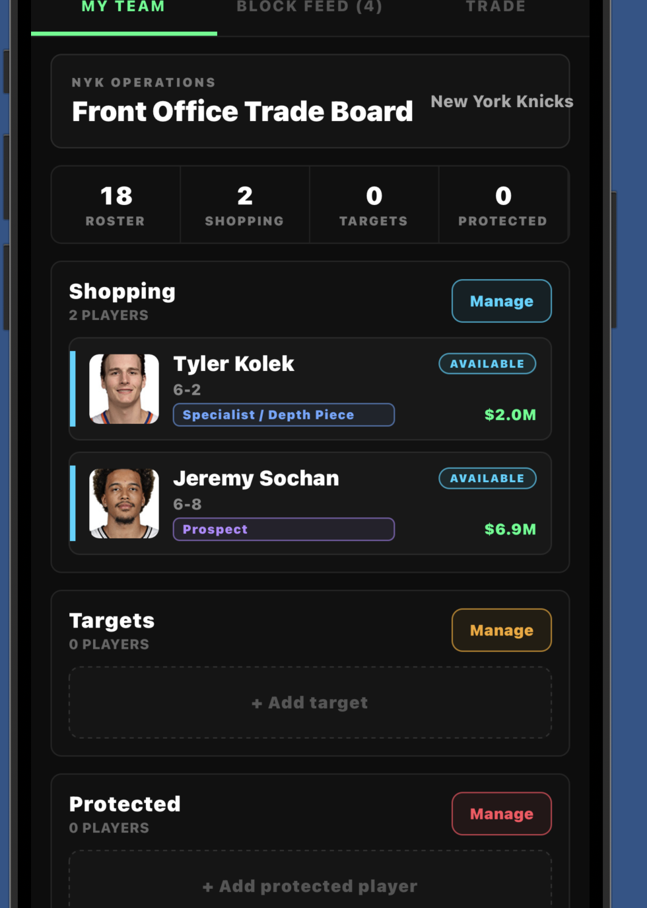
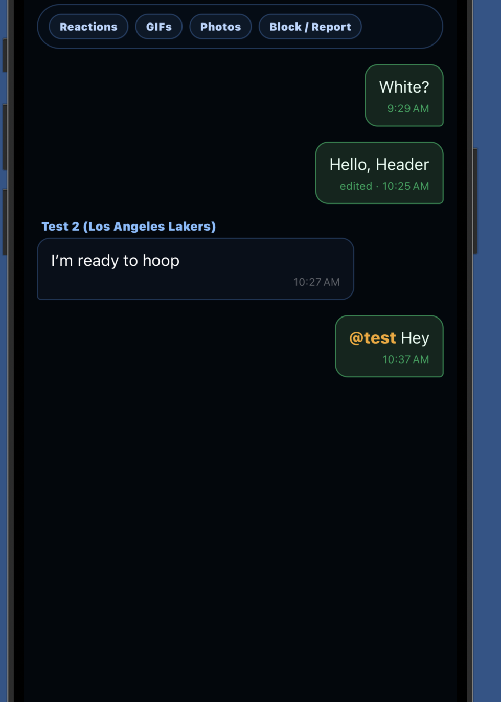
MOBILE GM EXPERIENCE
A front office that travels with the player.
Designed for quick decisions, sustained league activity, and a direct return path to NBA 2K.
NEGOTIATE
OPERATE
CONNECT
PRIVATE STRATEGIC DISCUSSION
05
Notes:
Show that the product is not only a stat viewer. It combines front-office operations, commissioner control, social coordination, moderation, and league-wide continuity in one mobile workflow.
[Sources]
- Internal Franchise Mobile prototype screenshots, captured 2026-07-06.
[/Sources]

Slide 6
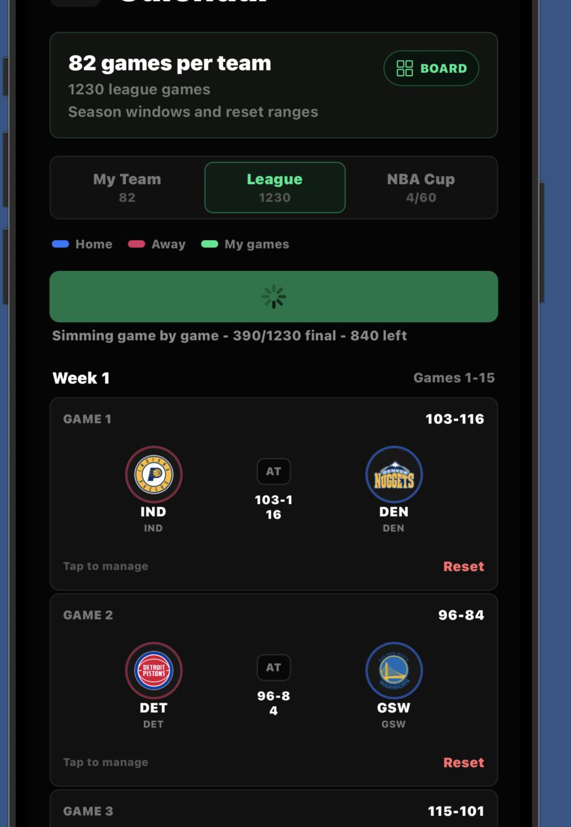
THE HANDOFF
Mobile decisions create reasons to return to NBA 2K.
The console or PC game remains the moment of truth; the companion makes that moment easier to reach.
AWAY FROM CONSOLE
ON NBA 2K
Review schedule and standings
Play the scheduled matchup
→
Prepare matchup strategy
NBA 2K remains authoritative for gameplay outcomes, licensed content, player data, anti-cheat, and platform services.
Coordinate availability
Resolve league business
RESULTS RETURN TO THE LEAGUE
PRIVATE STRATEGIC DISCUSSION
06
Notes:
This slide protects the product boundary. Franchise Mobile contributes the mobile operating layer; NBA 2K remains responsible for licensed presentation, playable basketball, authoritative outcomes, identity, entitlements, anti-cheat, and final synchronization contracts.
[Sources]
- Internal Franchise Mobile season screenshot, captured 2026-07-13.
[/Sources]

Slide 7
STRATEGIC VALUE
More league life. More reasons to return.
The opportunity is not more screen time for its own sake; it is healthier, more persistent communities around NBA 2K.
ENGAGEMENT
RETENTION
COMMUNITY
DIFFERENTIATION
Create useful daily touchpoints between full game sessions.
Reduce league drop-off by keeping schedules, vacancies, and decisions moving.
Bring coordination and conversation into a first-party connected ecosystem.
Give MyNBA and MyGM a persistent identity beyond the console session.
Precedent exists for connected console/mobile progression. Franchise Mobile applies that direction to franchise and community continuity.
PRIVATE STRATEGIC DISCUSSION
07
Notes:
Present these as strategic hypotheses for evaluation, not guaranteed business outcomes. 2K already supports shared progress between MyTEAM Mobile and supported console accounts, and recent NBA 2K releases have continued investing in MyNBA and MyGM. Franchise Mobile's fit is an inference from those published directions.
[Sources]
- https://support.2k.com/hc/en-us/articles/26105260862867-NBA-2K-General-Info-MyTEAM-Mobile-FAQ
- https://newsroom.2k.com/news/endless-possibilities-await-as-mynba-levels-up-in-nbar-2k26
- https://newsroom.2k.com/news/nbar-2k25-showcases-all-new-stephen-curry-mynba-era-and-introduces-mygm-on-playstationr5-xbox-series-xs-and-pc
[/Sources]

Slide 8
EXPANSION ROADMAP
Start with franchise. Grow into the broader community.
MyNBA and MyGM provide the focused first integration; MyCAREER community is the strategic upside.
01
CONNECTED FRANCHISE
MyNBA / MyGM league management, commissioner tools, schedules, trades, results, and social activity.
02
ORGANIZED PLAY
Creator leagues, community events, availability, matchup scheduling, groups, and persistent rivalry history.
03
MyCAREER COMMUNITY
Teammate discovery, squads, player identity, scheduled sessions, and community coordination outside console.
Roadmap only — not represented as current functionality.
PRIVATE STRATEGIC DISCUSSION
08
Notes:
Keep this section brief. The focused ask is MyNBA and MyGM. MyCAREER community should be presented as a later expansion after the connected franchise loop proves product and technical fit.
[Sources]
- Strategic roadmap developed from the Franchise Mobile product concept; no claim of announced 2K functionality.
[/Sources]

Slide 9
FOCUSED PILOT
Prove the connected loop before scaling it.
A narrow evaluation can answer product, technical, security, and community questions without exposing proprietary implementation.
1
2
3
4
PRODUCT WORKSHOP
TECHNICAL DISCOVERY
SANDBOX PROTOTYPE
EVALUATION
Align on one target league workflow and success criteria.
Define account linking, permissions, event sync, and server authority.
Connect a limited test league with controlled data and participants.
Measure league activity, reliability, return-to-game behavior, and user value.
NO SOURCE-CODE ACCESS REQUIRED FOR INITIAL EVALUATION
PRIVATE STRATEGIC DISCUSSION
09
Notes:
The objective is a product and technical evaluation, not an immediate commercial demand. Source code, simulation formulas, raw player-rating datasets, credentials, private security architecture, and unreleased roadmap details remain reserved for a separately protected diligence stage.

Slide 10
THE INITIAL ASK
Evaluate a connected
MyNBA / MyGM prototype.
DESIRED OUTCOME
Agreement on whether to explore a sandbox pilot, licensing path, strategic partnership, acquisition discussion, or another mutually appropriate structure.
Bring the right product and technical owners into one focused conversation.
NBA 2K PRODUCT
VISUAL CONCEPTS
Roadmap and player value
MyNBA / MyGM workflow and feasibility
Franchise Mobile keeps the league connected. NBA 2K remains where basketball is played.
2K ONLINE + MOBILE
TAKE-TWO STRATEGY
Identity, services, permissions, synchronization
Partnership and commercial structure
Non-confidential overview • No affiliation with Take-Two, 2K, Visual Concepts, NBA, NBPA, NFL, or MLB is claimed.
Notes:
Close with the product and technical evaluation request. Do not negotiate detailed commercial terms in the first meeting. Capture requested follow-up and move sensitive material into a separate diligence process only after scope and recipients are confirmed.

