Slide 1
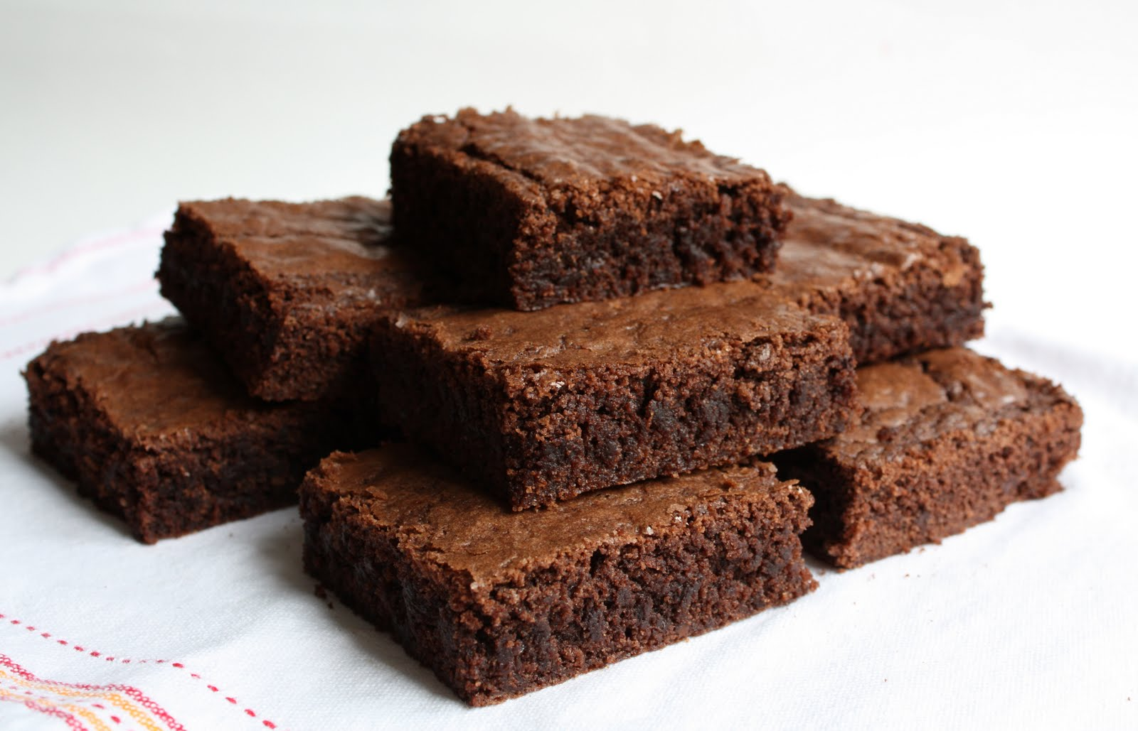
Brownies
Von Nikja, Jessica, Marlon & Marvin

Slide 2
