Slide 1


Building a mobile robot with Ros for education
Major Project BEng Design Engineering 2017/2018
Student : Marlon Gwira
Supervisor : Dr Zhijun Yang

Slide 2
Content
Notes:
About robotics(history of robot manipulators and mobile robots)
The ROS frameworks
Why mobile robots
Robots for educational purposes-the need for mobile robots in schools_ to showcase robotics and inspire young people(talk also about personal reasons for choosing such a project)
2
Current state of the Project
Design of the mobile robot
Design of the robot manipulator
Talk about circuit
Programming
Interface of the app
Add motive
Add pictures
Less text in slides
Security access- case for relay
What to do next

Slide 3
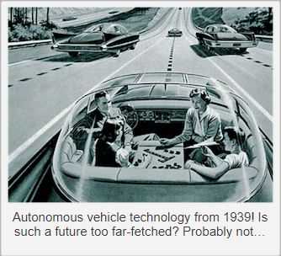
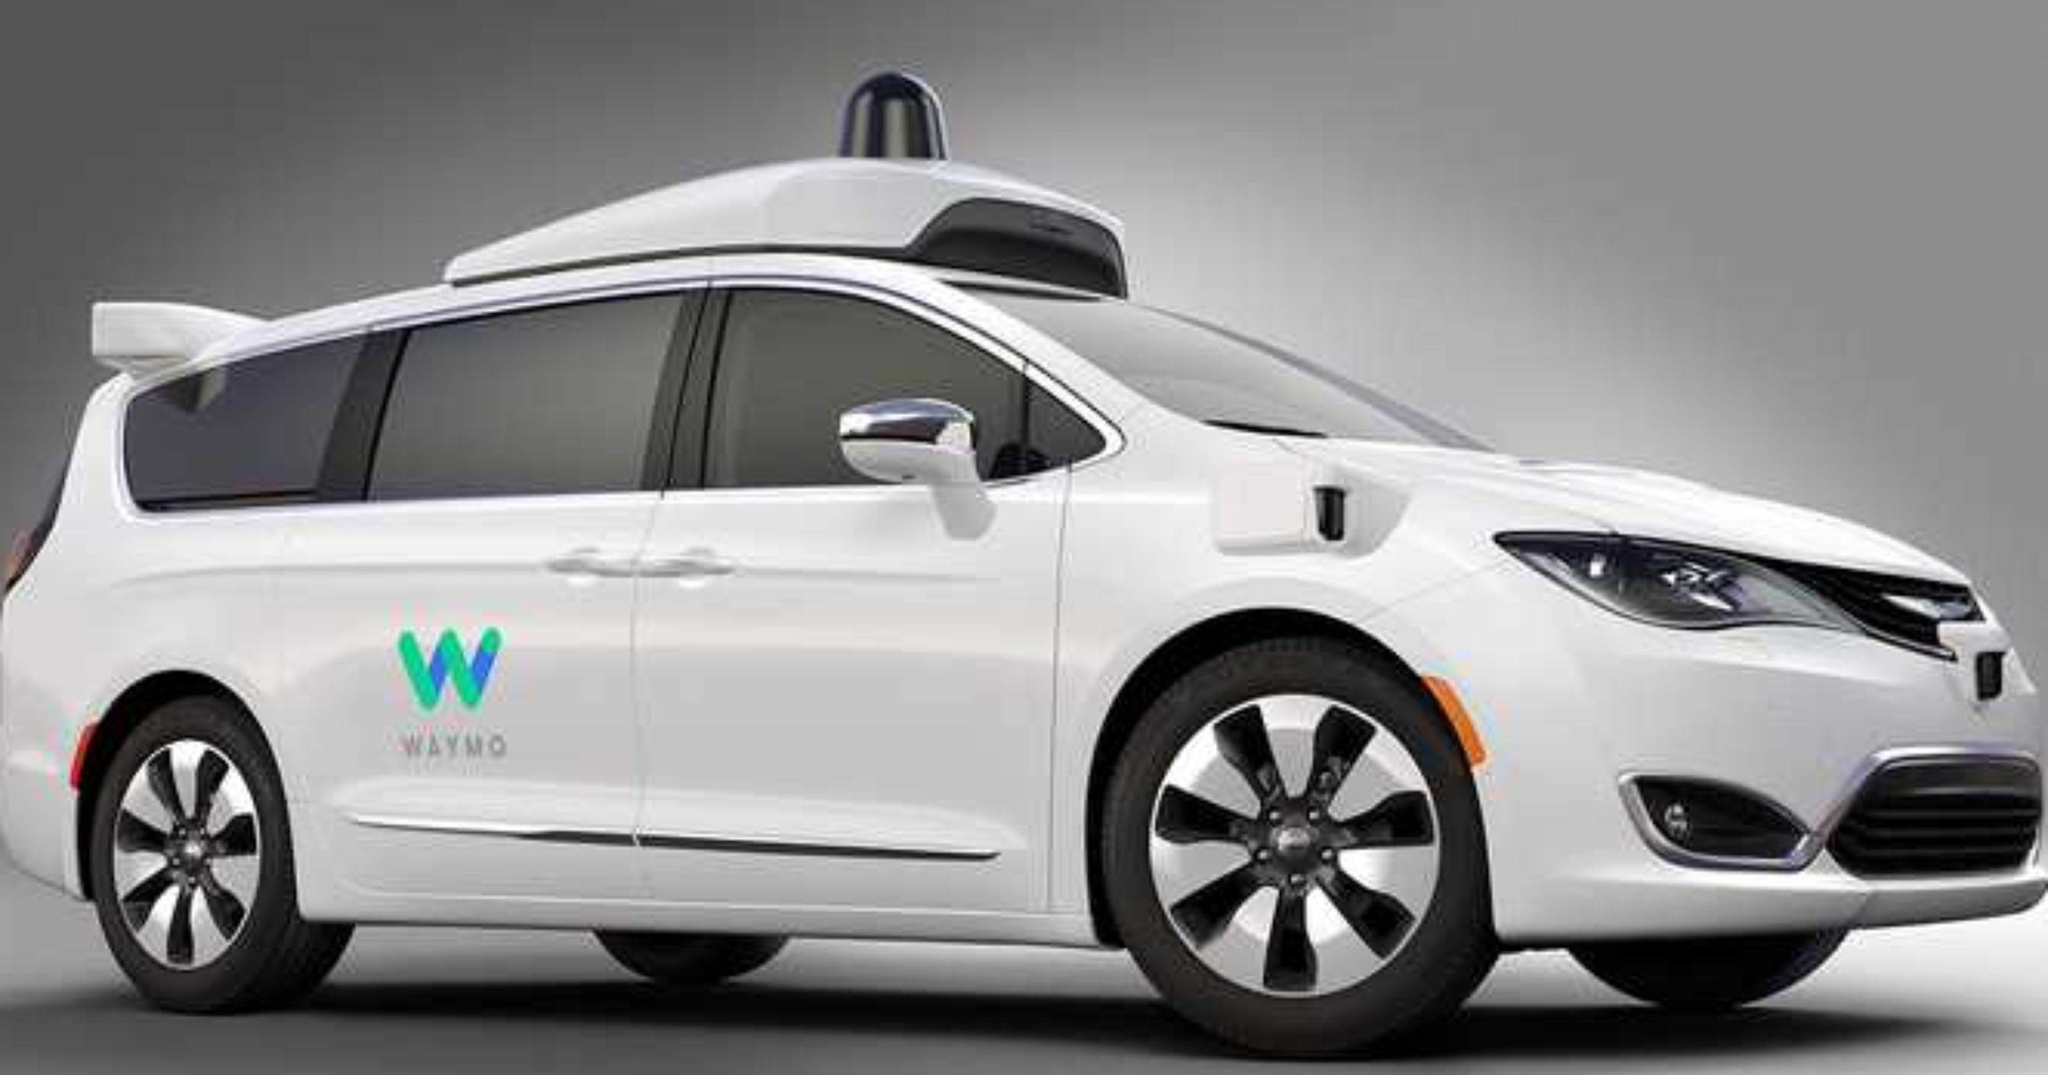
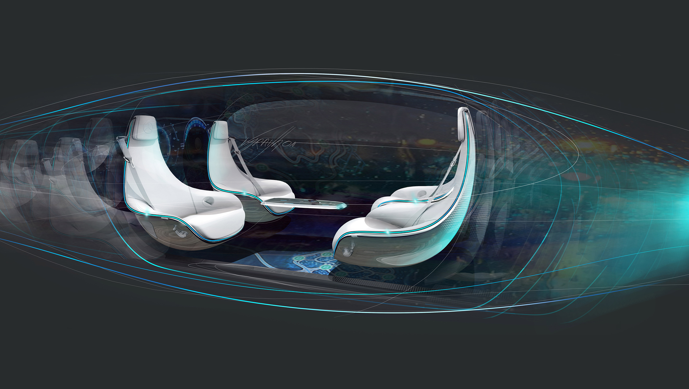
Why I chose this project
Mobile robots represent the future
There is and they’ll be a lot of demand for people which such expertise
To inspire younger generation as I was inspired
Notes:
In the first point remember to highlight how the tv series inspired you

Slide 4
Projects main goals
Building a mobile robot with Ros
Making a user interface to allow understanding of the basic functions of the robot
Interface mobile robot with a robot manipulator
Notes:
Reason for interfacing a manipulator with a mobile robot is to showcase how a pick and place with teleoperation where one of the degree of freedom of the manipulator is the robot itself hence have a more rounder view of the world of robotics.

Slide 5
State of the art
What are mobile robots?
About ROS
Teaching Robotics
Notes:
-define what mobile robots are
-talk through the ROS framework
-Highlight the need of teaching robotics

Slide 6
Background information
Where did the project start form..?

Slide 8
Current system
(put video of b4 and after design of the robot and if possible of the working webserver)

Slide 9
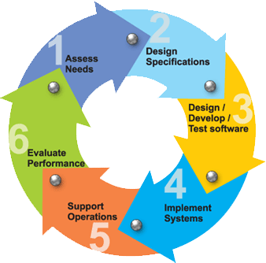
Project development
Design of mobile robot
Design of manipulator
3d printing
Laser cutting

Slide 10
Testing and validation

Slide 11
Summary and future work
Mobile robot
User interface (Local webserver) with tutorial and introduction to ROS
Mobile application
Notes:
( remind the audience where the current status of the project and then talk about what to expect within the time limit

