Slide 1
Volumetric Rendering
By Logan Laughery

Slide 2
Project Goals
Implement marching cubes in Three.js
Render functions and 3D objects
Parse and display medical images

Slide 3
Marching Cubes Algorithm
Extracts mesh from an isosurface
Created at GE in 1987
Popular algorithm in computer graphics

Slide 4
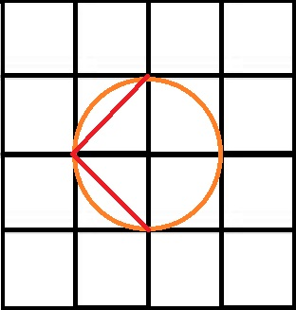
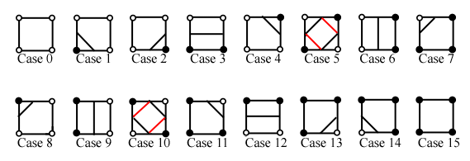
Marching Cubes Algorithm
2D example (marching squares algorithm)
http://users.polytech.unice.fr/~lingrand/MarchingCubes/algo.html

Slide 5
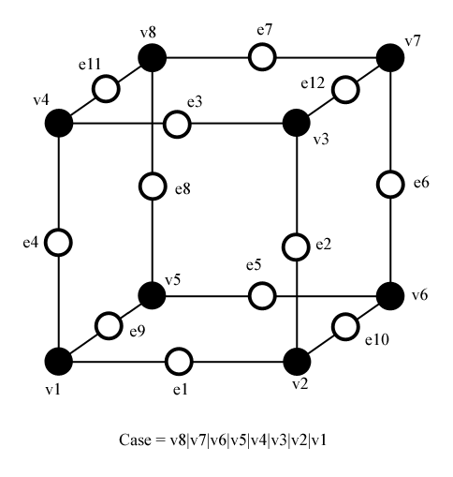
Marching Cubes Algorithm
Expand previous example to 3D
256 possible cases for triangles in a cube
Create an index to find cube case in an edge table
http://users.polytech.unice.fr/~lingrand/MarchingCubes/algo.html

Slide 6
Marching Cubes Algorithm
Find values at all points of a cube
Use these values to find the cube case
Apply linear interpolation to estimate positions
Use another table to form appropriate triangles

Slide 7
Implementation
Much of the algorithm is defined in an article: “Polygonising a Scalar Field” by Paul Bourke
Interpolation and computing normals is handled by Three.js
Faces can easily be added to a Three.Geometry object to be rendered later

Slide 8
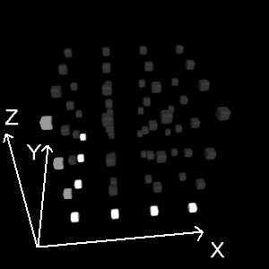
Raw 3D File Format
Used for CT and MRI images
Stores layers of 2D images
Each byte holds a monochromatic color value
Simply store these bytes in an array
http://www.3dleds.com/bitmap.html

Slide 9
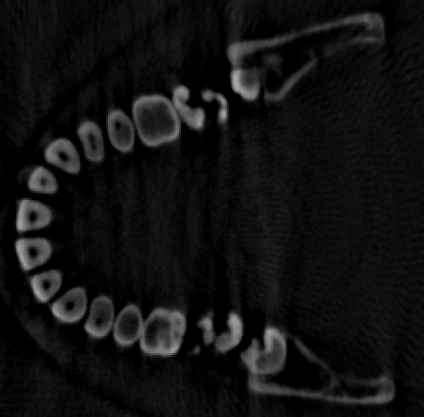
Rendering Raw 3D Files
Set surface (color) value
Find color values at each point on a cube from the byte array
Apply marching cubes as usual

Slide 10
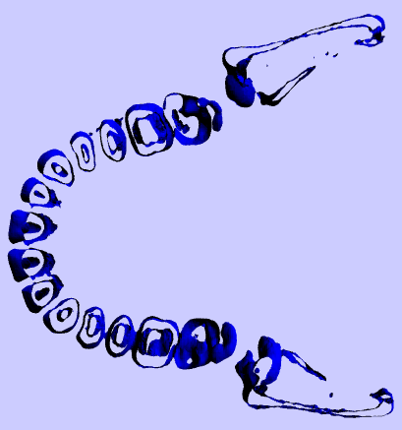
Rendering Raw 3D Files
Set surface (color) value
Find color values at each point on a cube from the byte array
Apply marching cubes as usual

Slide 11
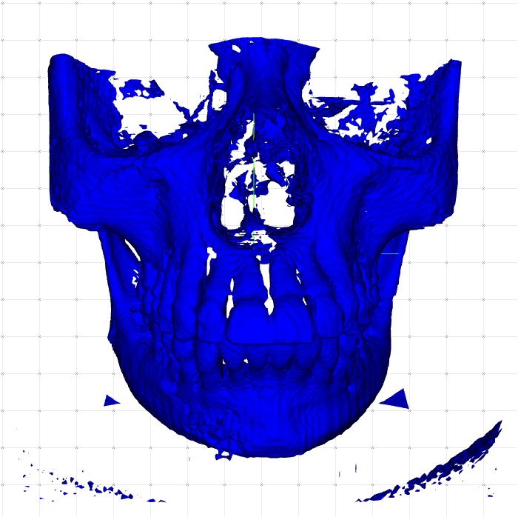
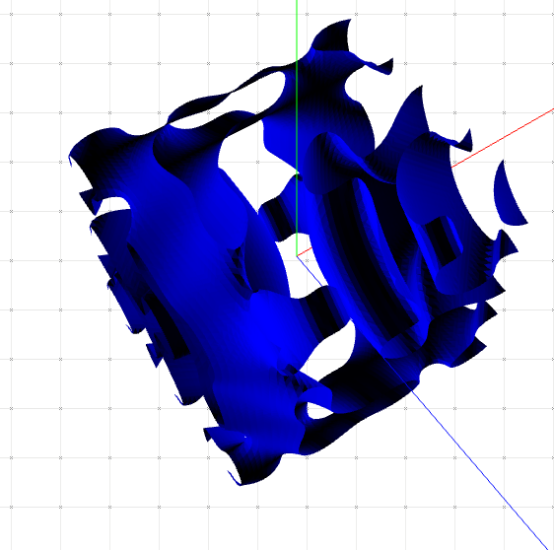
Results

Slide 12
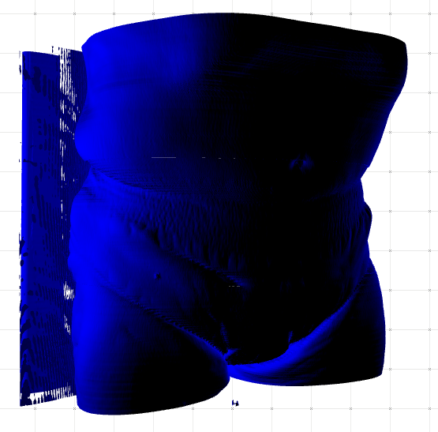
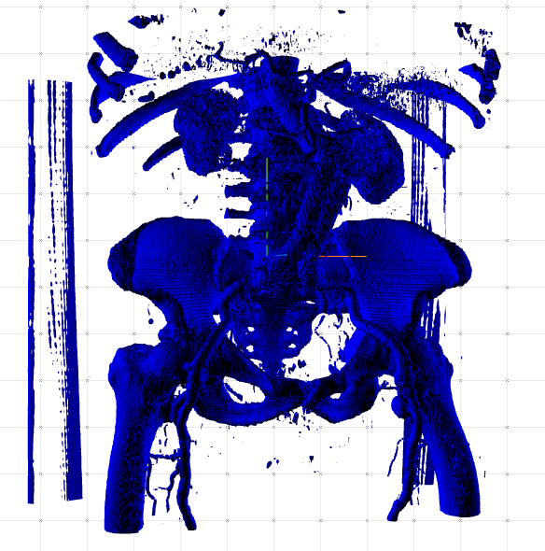
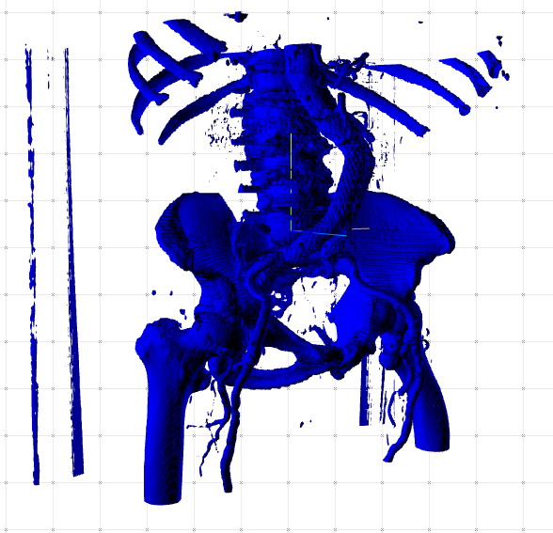
Adjusting Surface Values

Slide 13
Demonstration
Website
http://softwarego.no-ip.biz/FinalProject/Volumetic%20Rendering/MarchingCubesAlgorithm.html
GitHub
https://github.com/lockre35/Volume-Rendering

Slide 14
Questions

