Slide 1
my_pres
mm

Slide 2
Quarto
Quarto enables you to weave together content and executable code into a finished presentation. To learn more about Quarto presentations see https://quarto.org/docs/presentations/.

Slide 3
Bullets
When you click the Render button a document will be generated that includes:
Content authored with markdown
Output from executable code

Slide 4
Code
When you click the Render button a presentation will be generated that includes both content and the output of embedded code. You can embed code like this:
1 + 1
[1] 2

Slide 5
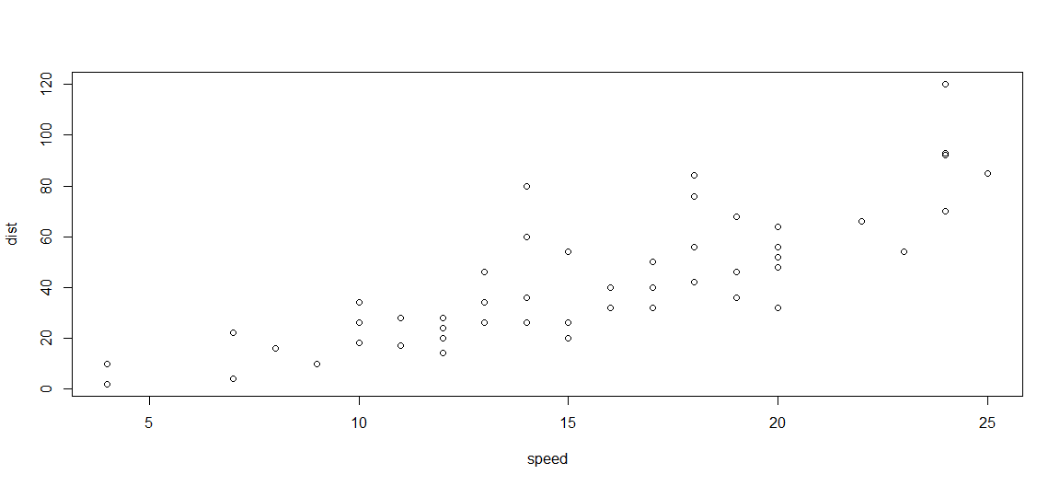
Plot
Slik lager vi plot
plot(cars)
Figur 1: Flott plot av bilers bremselengde

Slide 6
I Figur 1 er det et flott plot av fart og bremselengde..

