Slide 1
Scientific Reading
Research Practice
Prof. Dr. Uranchimeg Tudevdagva
Dr. Ariane Heller

Slide 2
Contents
Scientific Reading
References and Citation

Slide 3
Scientific Reading

Slide 4
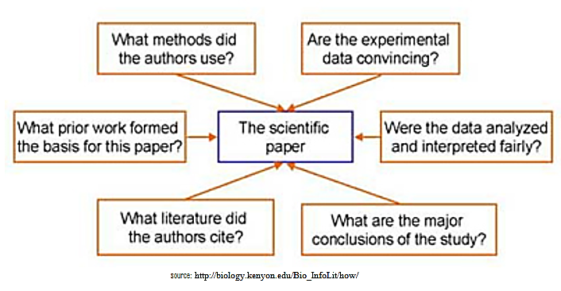
The scientific paper

Slide 5
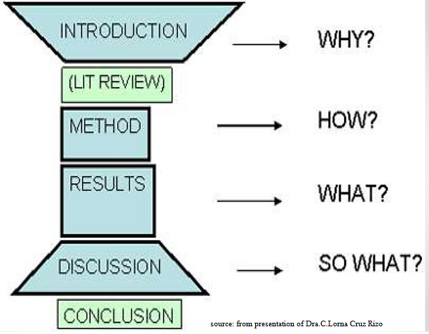
Structure of Scientific Paper

Slide 6
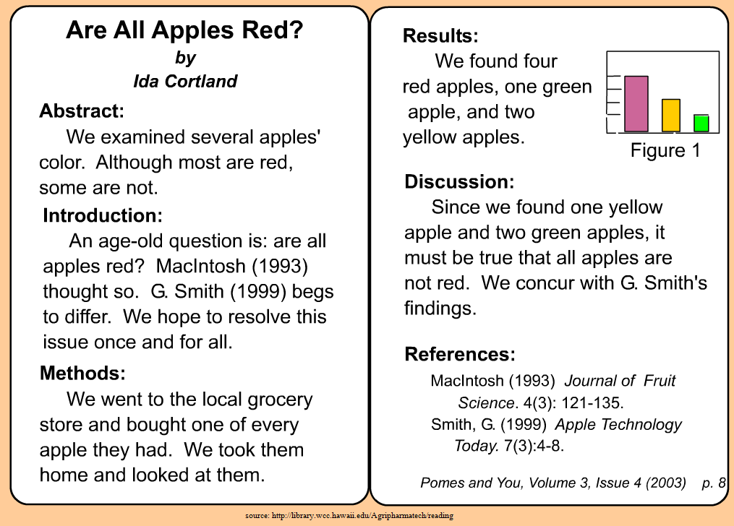
Anatomy of Scientific Paper

Slide 7
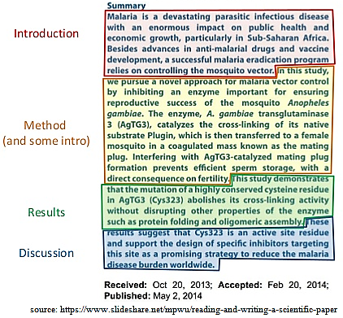
Abstract of Scientific Paper

Slide 8
References and Citation

Slide 9
References
No web pages
Exception: photos or artwork
Possible references
Academic journals
Academic book
Academic conferences
Thesis and technical reports
Web sites
Style
IEEE (Institute of Electrical and Electronic Engineers)
Many other styles

Slide 10
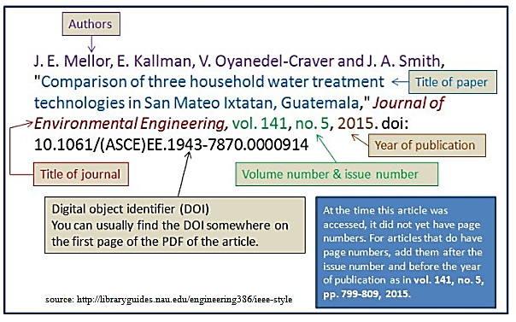
IEEE format: Journal article citation

Slide 11
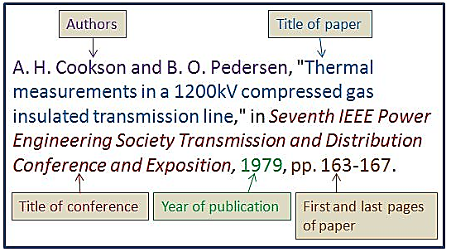
IEEE format: Conference paper citation

Slide 12
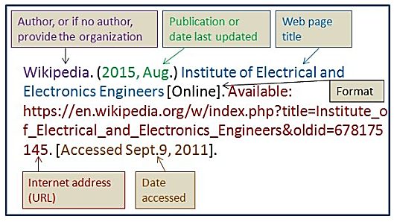
IEEE format: Website citation

Slide 13
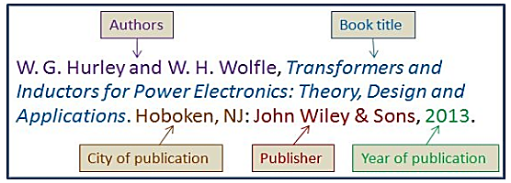
IEEE format: Book citation

Slide 14
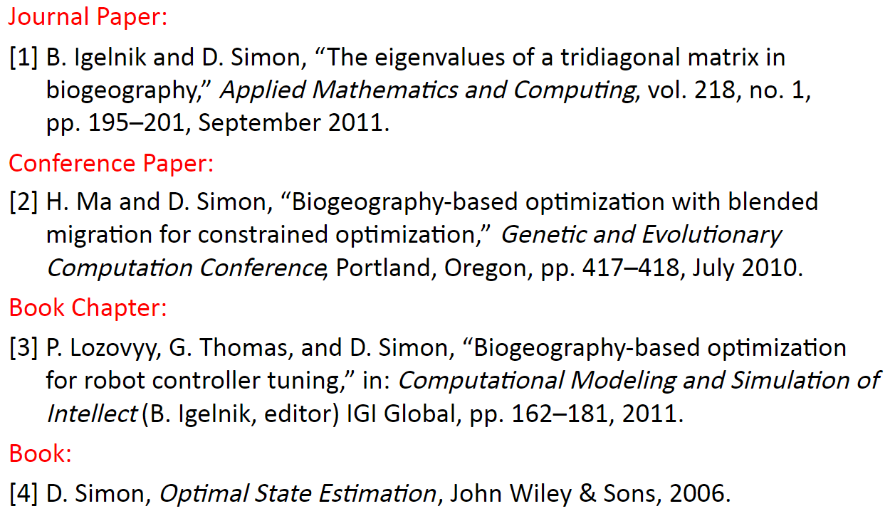
Example in paper

Slide 15

Q&A: Homework
Read about IEEE format
https://www.ieee.org/conferences_events/conferences/publishing/templates.html
Start to prepare Your Reference following by IEEE format
Make notes in your report from 5 up to 10 scientific papers relating to your topic!
Prepare 10 talk with slides about your project progress

Slide 16
Acknowledgements
These slides contain material developed and copyright by:
Vadim Karpusenko, Colfax International
and many other materials from MOOC and online free courses
Thanks to authors who published their valuable materials in internet for educational resources.

